Slide 1

Alfred State Training Flash Cards
Web Applications Capstone Team

Slide 2
Table of Contents
Intro
Design Process
Technical Details
Live Demo

Slide 3
Introduction
Our mission is to facilitate curriculum understanding though progression data, study environments, and topic analyst.

Slide 4
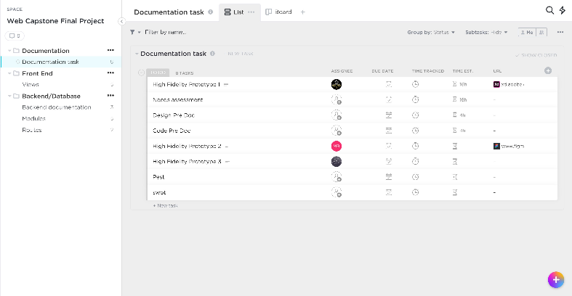
Design Process
ClickUp Project Manager
Brainstorm Ideas
Develop Individual Prototypes
Review Prototypes
Integrate Prototypes
Review Integrated Prototype
Finalize Prototype
Delegate Development
Review Development
Make Necessary Changes
Finalize Design Development

Slide 5
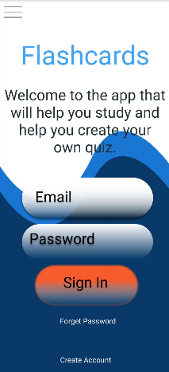
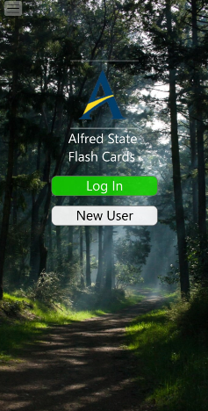
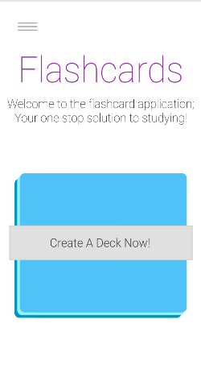
Individual Prototype Index
Reviewed what we liked:
Justin’s use of story telling & appropriate design
Sam’s simple interface design
Meissa’s line of thinking
Reviews what we didn’t like:
Color combinations
Cluttered image
Hard to read text
Meissa Justin Sam

Slide 6
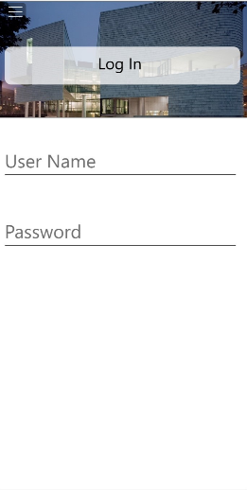
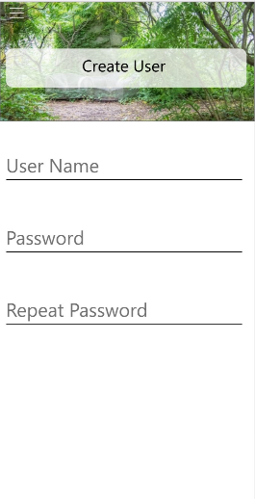
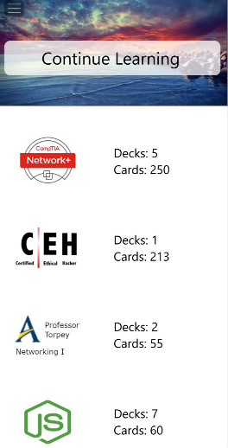
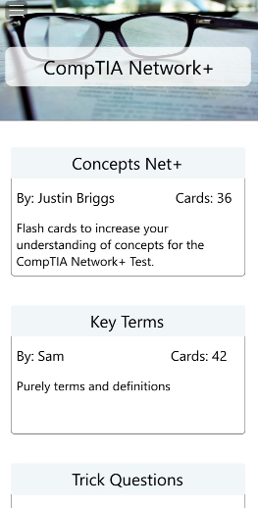
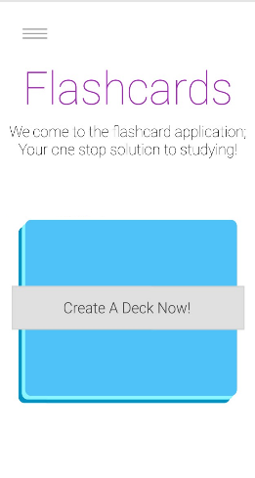
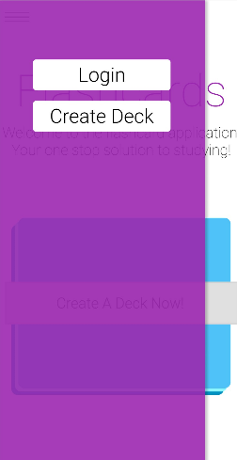
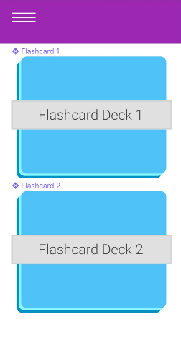
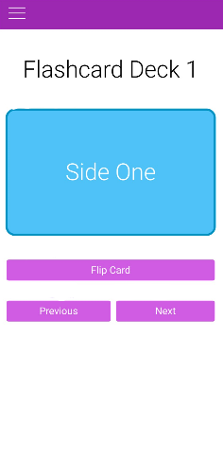
Individual Prototype Continued
Justin
Reviewed what we liked:
Justin’s continue learning section
Justin’s deck interface
Sam’s flashcard interface
Reviewed what we didn’t like:
Inconsistent design and feel
Visual separation between elements
Inconsistent order of operations
Sam

Slide 7
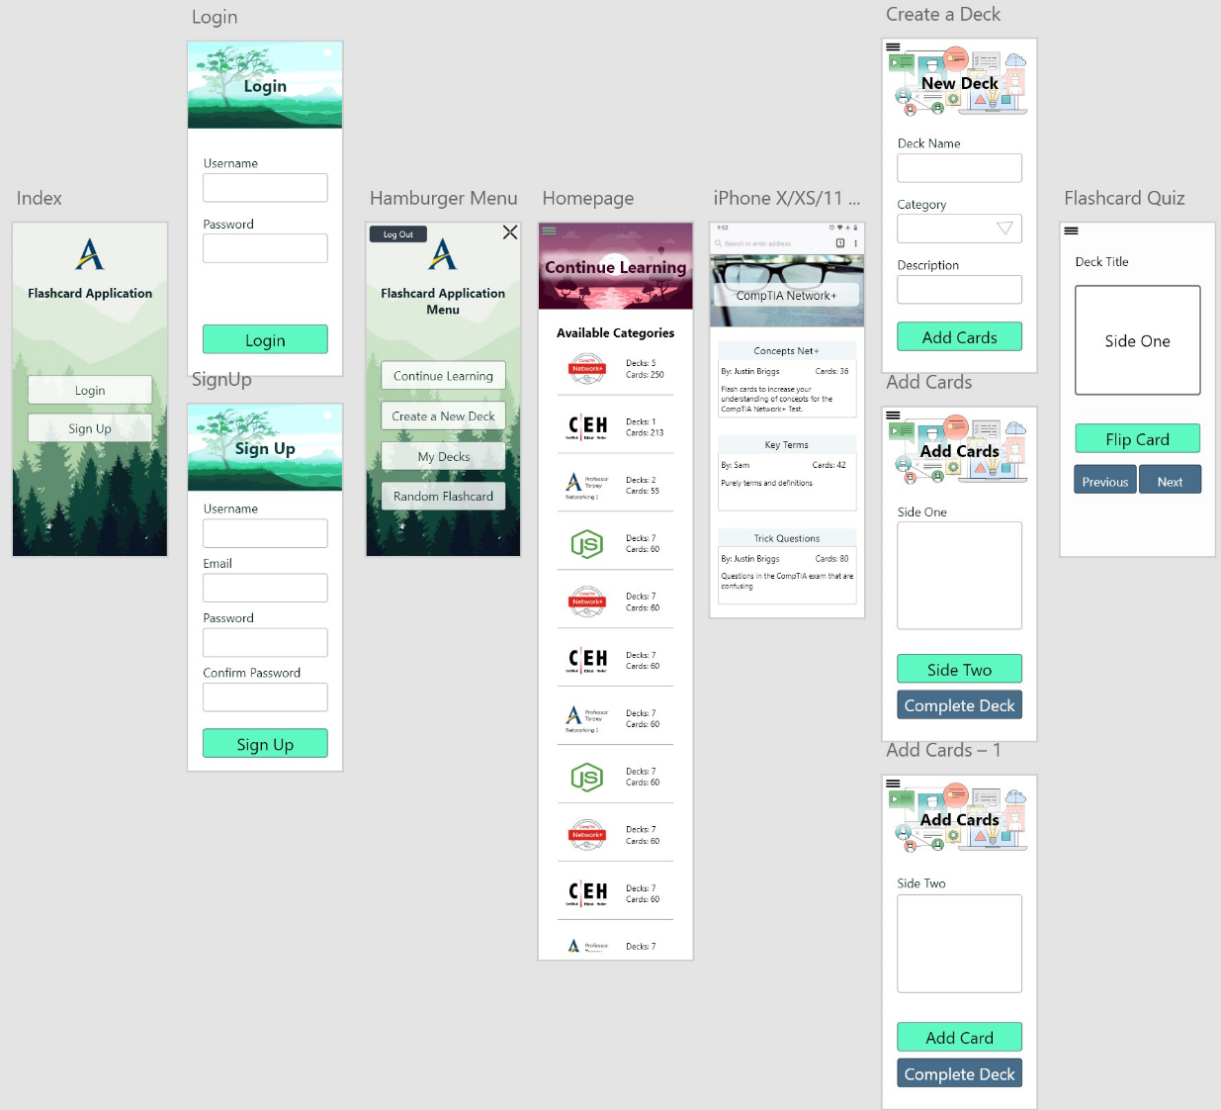
Integrated & Final Prototype
Take the culmination of elements we liked and make a single prototype:
Storytelling through imagery
Consistent color scheme and design
Logical order of operations
Useful navigational menu
Minimum viable product in mind

Slide 8
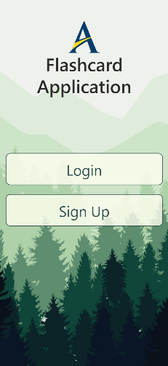
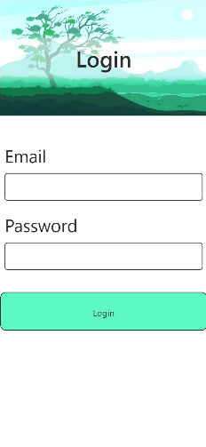
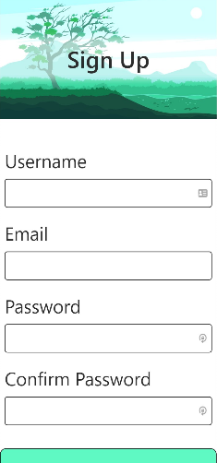
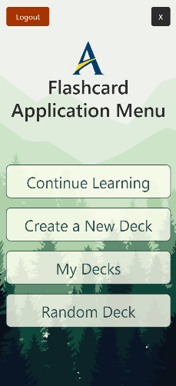
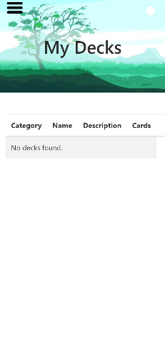
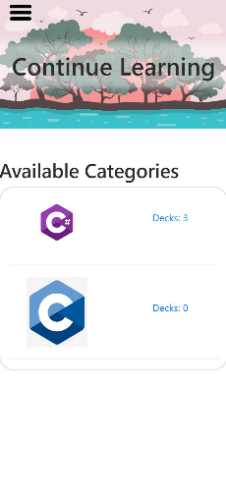
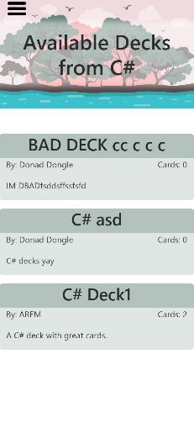
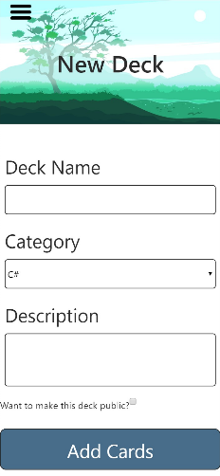
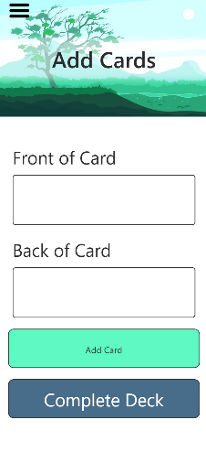
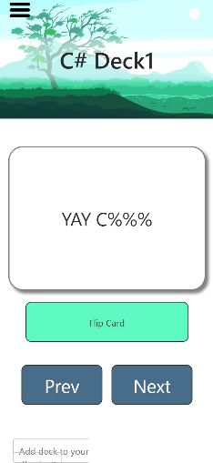
Finalized Design & Development
Some elements changes as we developed to benefit user experience:
Images changed
Adding cards is a single page
Navigation buttons altered
Added ability to make private decks public

Slide 9
Lessons Learned
Prototyping saved us time
Reduced scope creep
Created tangible elements
Improved communication
Faster development
Back-End group benefited as well
Visualized content

Slide 10
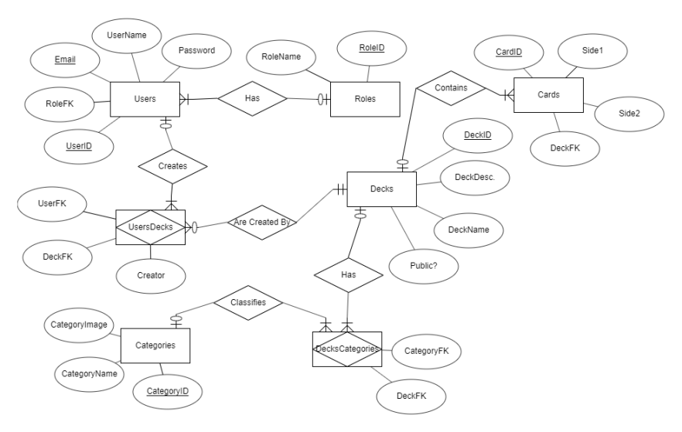
Entity Relationship Diagram
Users
Be able to be authenticated and authorized
Decks
Be public or private
Have an associated User as a creator
Have Cards
Have a Category
Cards
Front and back
Categories
Identify the topic of a deck

Slide 11
Technical Requirements
Ability to alter created content
Application needs to be hosted on campus
Application must be accessible both on and off campus
Application must support a minimum of 500 concurrent clients

Slide 12
Technical Requirements
Documentation of features and intent must be clear for future interns to understand
Application must be maintainable with high employee turn over
Card display algorithm that optimizes time spent learning material
Tracking script for student progression

Slide 13
Technical Requirements
Tracking script for class progression
Ability to admins/teachers to create mini test
Ability for class to answer questions in real time
Ability to see class results in real time

Slide 14
Technical Requirements
Ability to view student trends over time
Ability to change status of decks from private to public
Ability to alter created content

Slide 15
Planned Features Backlog
IR Remote Support
Multiple Choice Support
Real Time Class Results for MC
User Deck Review
Flash Card Grading
Flash Card Grade Tracking
Flash Card Display Algorithm
Trend Analysis

Slide 16
Live Demo

