Slide 1

SMART INDIA HACKATHON 2026
TITLE PAGE
Problem Statement ID – 26177
Problem Statement Title – A deployable AI-powered autonomous drone that aids search-and-rescue operations by detecting people and hazards, thereby improving responder safety and reducing victim discovery time.
Theme – Robotics and Drones
PS Category – Hardware
Team ID –
Team Name (Registered on portal) – ARES
Live site ares.paralux.in Source github.com/ARES-UAV/ARES
Engineering handbook github.com/ARES-UAV/ARES/docs/handbook

Slide 2
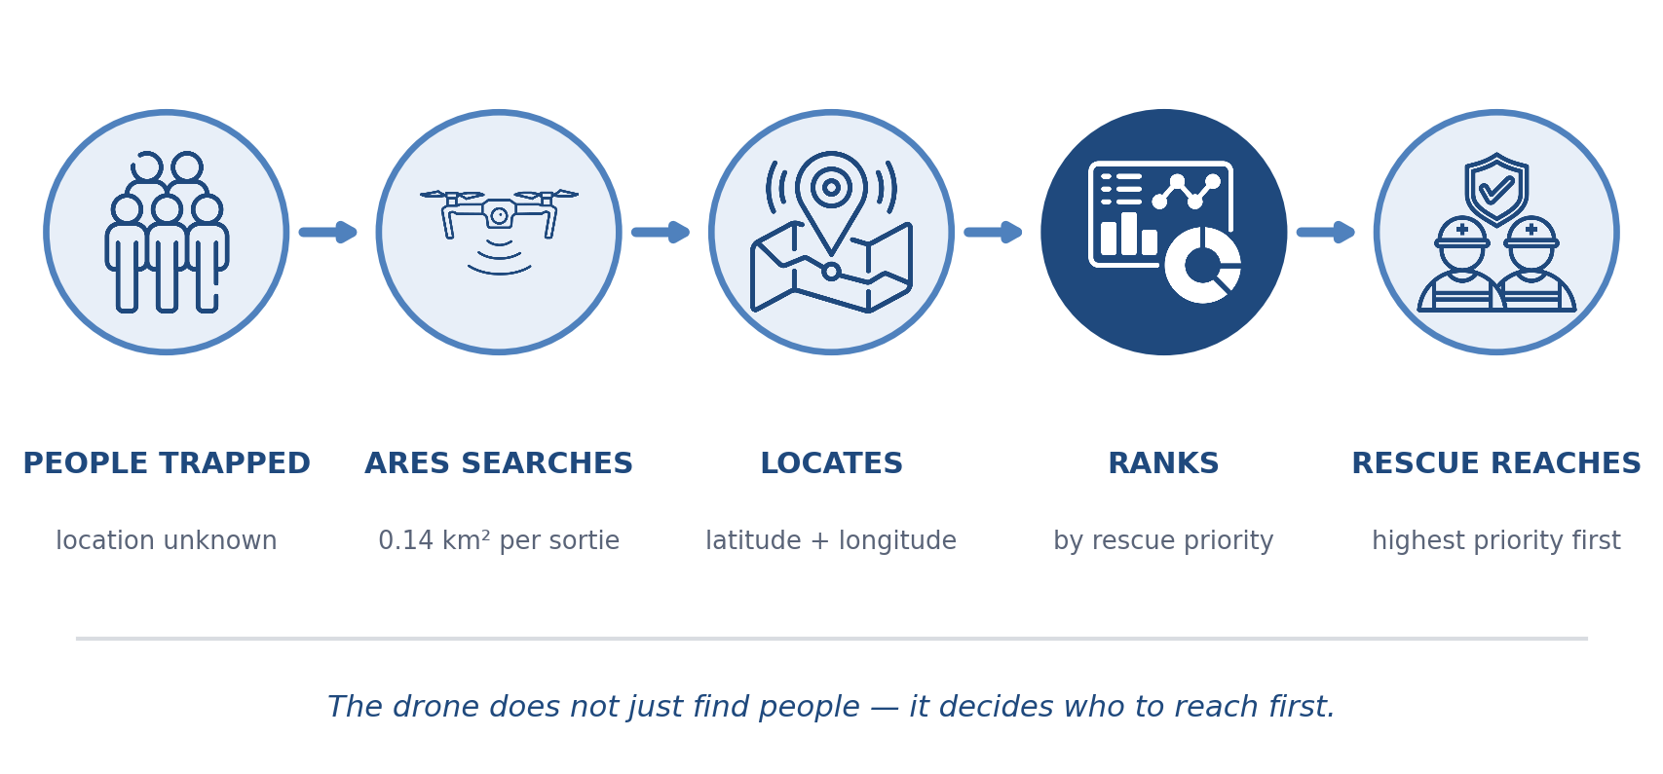
A DRONE THAT DECIDES WHERE TO LOOK NEXT
ARES
▶ Watch: the full pitch
IDEA/SOLUTION:
Problem Resolution:
The problem: After an earthquake or flood, the first hours decide who survives. Search teams fly fixed patterns a lawnmower grid that treats every square metre as equally likely to hold someone. It is not.
Why it matters: Survival odds fall sharply with every hour under rubble. Time over empty ground is time taken from ground that holds someone.
Our idea: A UAV that treats search as a decision, not coverage. Onboard AI finds survivors, ranks them, and re-plans its own path in the air with the radio switched off.
A UAV that decides where to look next, instead of covering ground in a fixed order.
Onboard AI detects survivors in RGB and thermal, counts each person once, places them on a map and ranks them by rescue priority.
A belief map of where people are likely to be is updated every time the drone looks somewhere — and the planner flies to whichever cell is worth the most per second of flight.
It re-plans its own path in the air, with the radio switched off.
Unique Value Propositions:
Search as a decision, not coverage. Priority changes the order of the search, not just the report at the end.
Nothing waits on a radio. Every decision is made on the aircraft; the link carries information out, not commands in.
Explainable ranking. A transparent weighted formula an officer can read — not a black box.
Honest scope. We label what is measured, what is simulated, and what is only described.

Slide 3
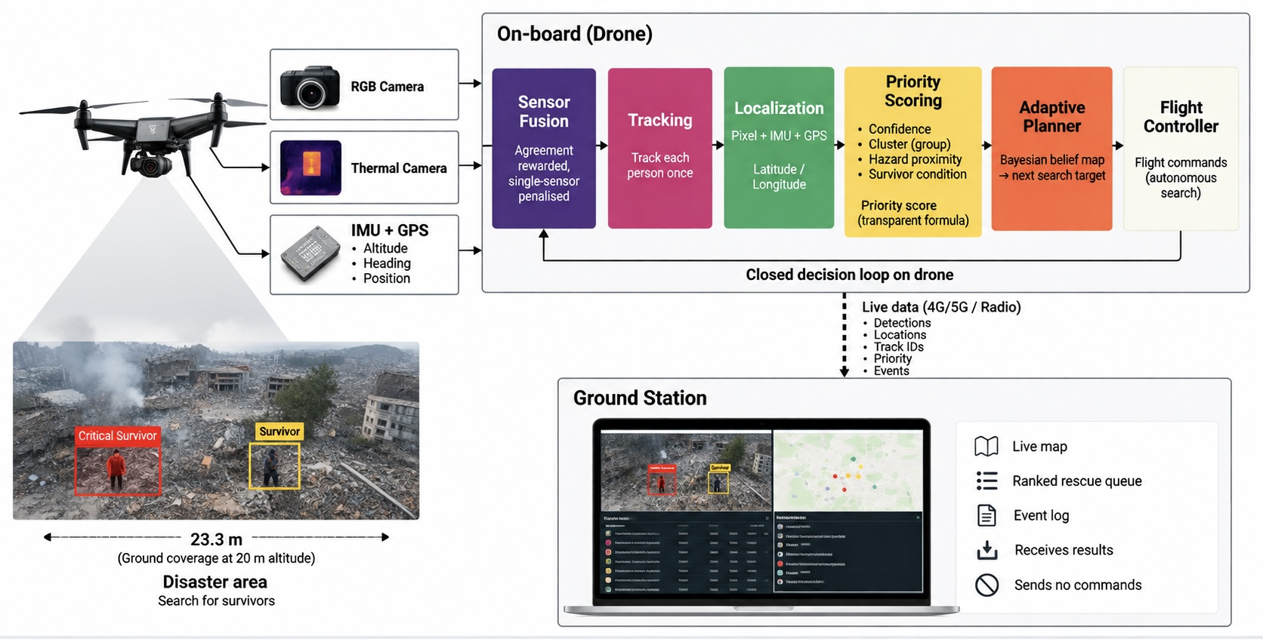
TECHNICAL APPROACH
ARES
▶ Watch: detection → tracking → GPS
NOT IN THE DIAGRAM
The models. YOLO, one person class — C2A + VisDrone for RGB, HIT-UAV for thermal.
The silicon. Qualcomm RB3 Gen 2, INT8 on the NPU: 209.5 ms a frame, 4.8 FPS measured.
Why it fits. Detection is the whole cost. Localization, priority and the planner together are 0.87% of the frame; the planner runs once per 20 s in 0.28 ms.
Why onboard. 60 decisions a sortie. On the ground each one is a radio round trip — 60 single points of failure.
Why the link is cheap. Records, not video: ~22 kbps against ~3,000. The whole mission is 2.7 KB.
Why 4.8 FPS is enough. At 20 m the footprint is 23 m and takes 7.7 s to cross — the same ground appears in roughly 37 frames.
Counted once. 7,081 raw detections become 333 confirmed tracks and 23 people.
What is simulated. Everything up to priority is measured. The planner has flown 30 simulated missions and no real ones.
Detection
Thermal
Tracking
Adaptive planner
YOLO · C2A + VisDrone · recall 0.824
YOLOv8s · recall 0.883 · night and smoke
ByteTrack · 7,081 detections → 23 people
Bayesian belief map · 0.28 ms per decision
Edge compute
Flight stack
Backend / Frontend
Downlink
Qualcomm RB3 Gen 2 · INT8 · 4.8 FPS
Pixhawk-class · ArduPilot · MAVLink
FastAPI · React · Leaflet
865–868 MHz · licence-exempt in India

Slide 4
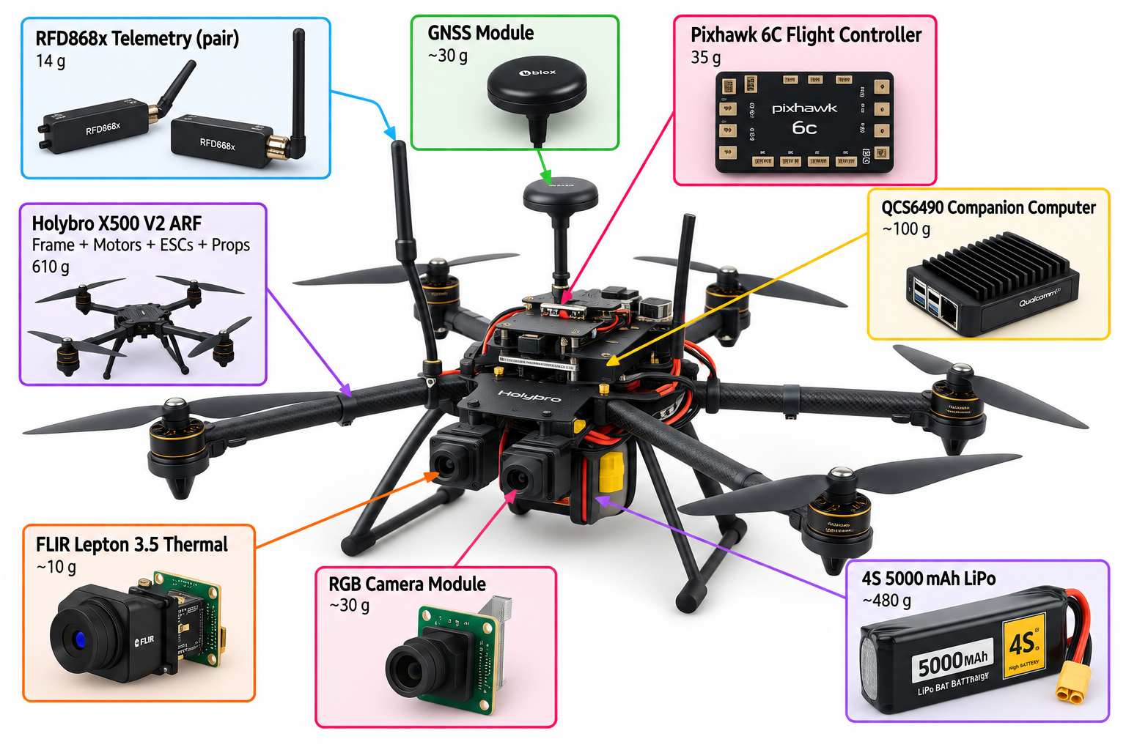
FEASIBILITY AND VIABILITY
ARES
SOFTWARE STACK
IS IT VIABLE IN THE FIELD?
Detection · tracking
0.14 km² per sortie. A 23.3 m swath at 20 m altitude, 5 m/s, twenty minutes. Two sorties cover a village block.
DGCA Micro class. At ~1.4 kg it stays under the 2 kg ceiling: registration and a remote pilot certificate, no type certification.
No infrastructure. No tower, no internet, no ground station needed to fly. The link is optional by design.
One operator, one backpack. Under 2 kg all-up, assembled in minutes, launched from any clear ground.
Endurance is the real constraint. Holybro rates this airframe at ~18 min hover unloaded on 5 Ah; our payload cuts into that. A larger battery buys time but pushes takeoff weight past 2 kg into DGCA Small.
Ultralytics YOLO + ByteTrack
AGPL-3.0
Flight stack
ArduPilot over MAVLink
GPL-3.0
Backend
FastAPI (Python)
MIT
Dashboard
React · Tailwind · Leaflet
MIT / BSD
Maps
OpenStreetMap tiles
no API key
Quantisation
Qualcomm AI Hub · INT8
free tier
Licence cost: zero.
ONE FRAME BECOMES ONE DECISION
frames
▶ Watch: the live dashboard
~1.4 kg
all-up takeoff weight — inside DGCA's Micro class, under the 2 kg ceiling. Registration and a remote pilot certificate; no type certification.
7,081
333
23
1
WHAT THIS DOES NOT YET PROVE
No aircraft has been built — this is a specified bill of materials, not a flown platform. The 209.5 ms benchmark ran on the RB3 dev kit on a bench supply. RGB and thermal together measured 2.4 FPS, not 4.8. In-flight power draw and thermal behaviour are unmeasured.
raw video
detections
confirmed
people
target
The narrowing is the argument: each person is counted once.
@SIH Idea submission- Template
4

Slide 5
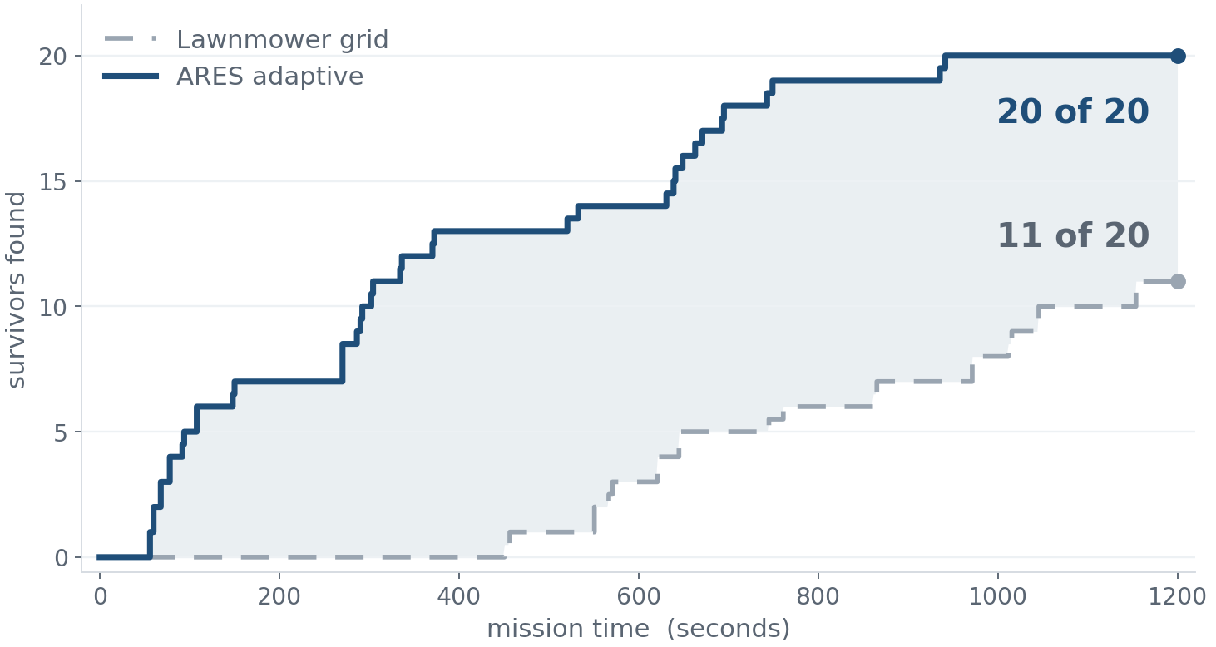
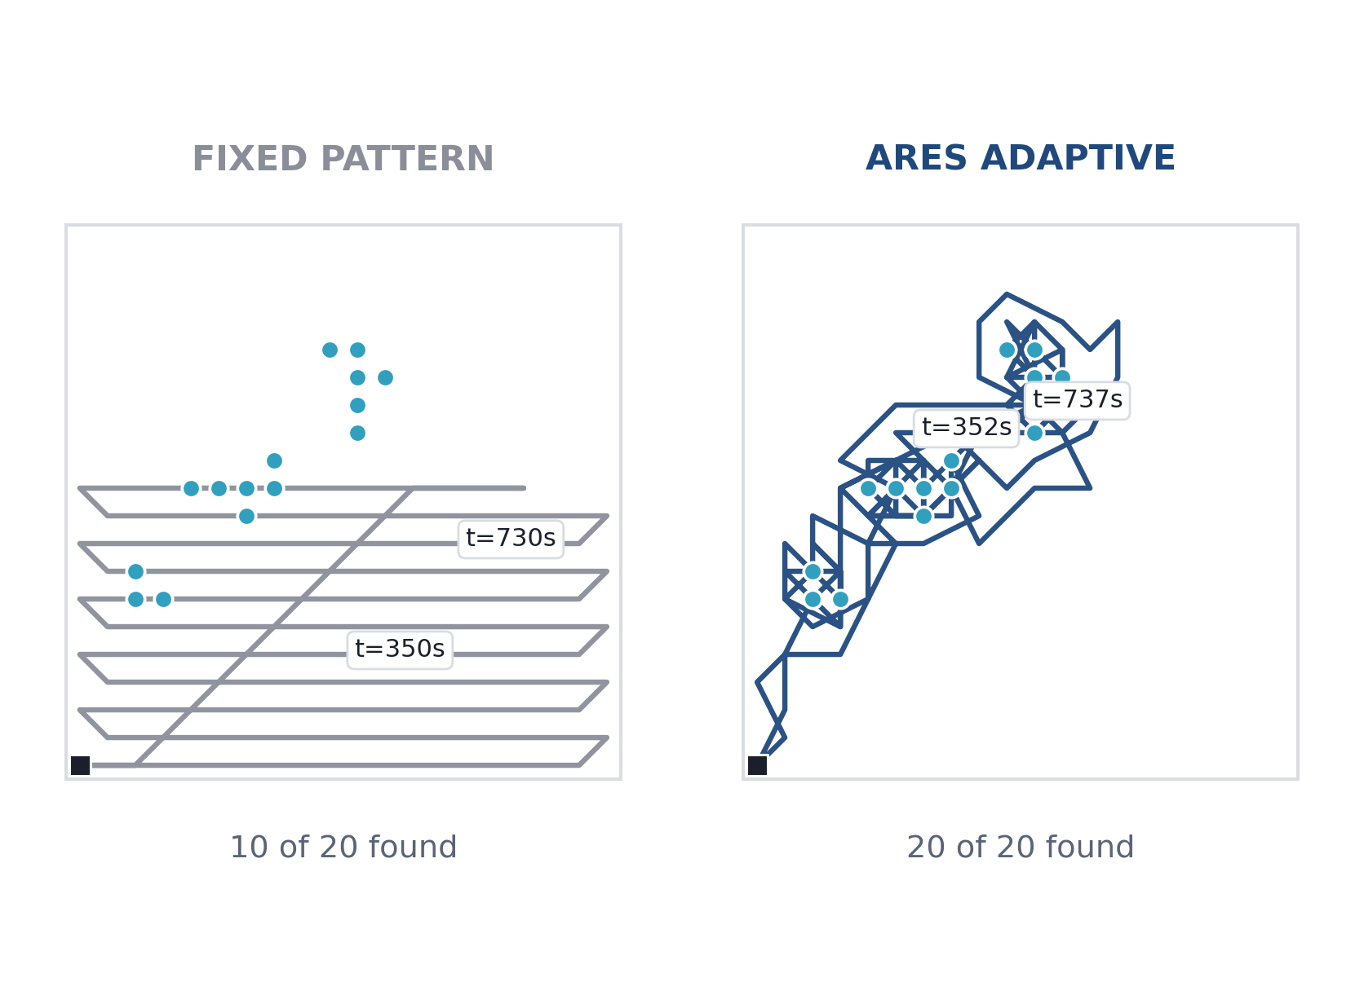
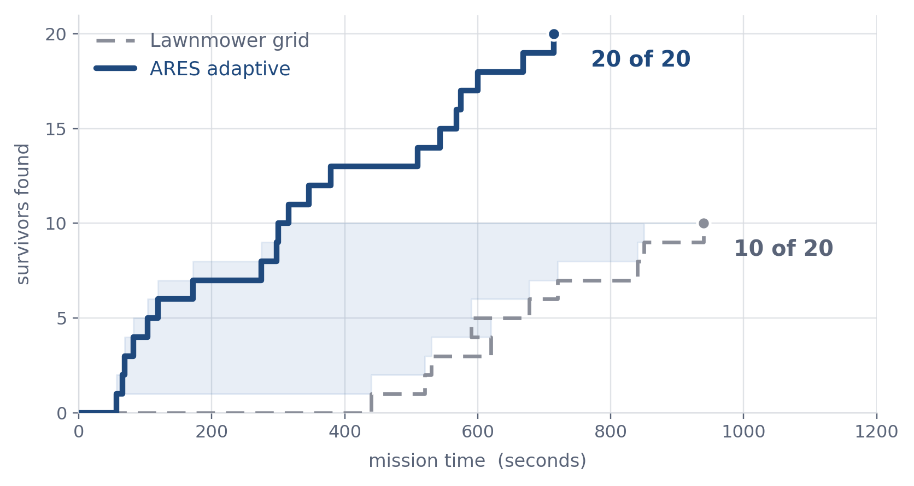
IMPACT AND BENEFITS
ARES
Finds more people
20 of 20 survivors against a lawnmower grid's 11.
Finds them sooner
Half the survivors reached 3.1× faster.
Works with no network
The full mission report is 2.7 KB.
Ranks who to reach first
Confidence, cluster size, hazard proximity.
▶ Watch: adaptive planner, 100 seeds
D4 · TWO FLIGHT PATHS
DRAW THIS — the brief is below
Same map twice, identical survivor dots. Left: the grid sweeping mechanically. Right: the adaptive track bending toward clusters. Put timestamps along both — without them it is two squiggles; with them it is evidence.
Survivors found over time — median of 100 simulated missions, good prior.
Simulated flight with the detector at our measured 0.824 recall. Adaptive covers 32% of the area against the grid's 56% — more people, sooner, over less ground. Never flown on hardware.

Slide 6
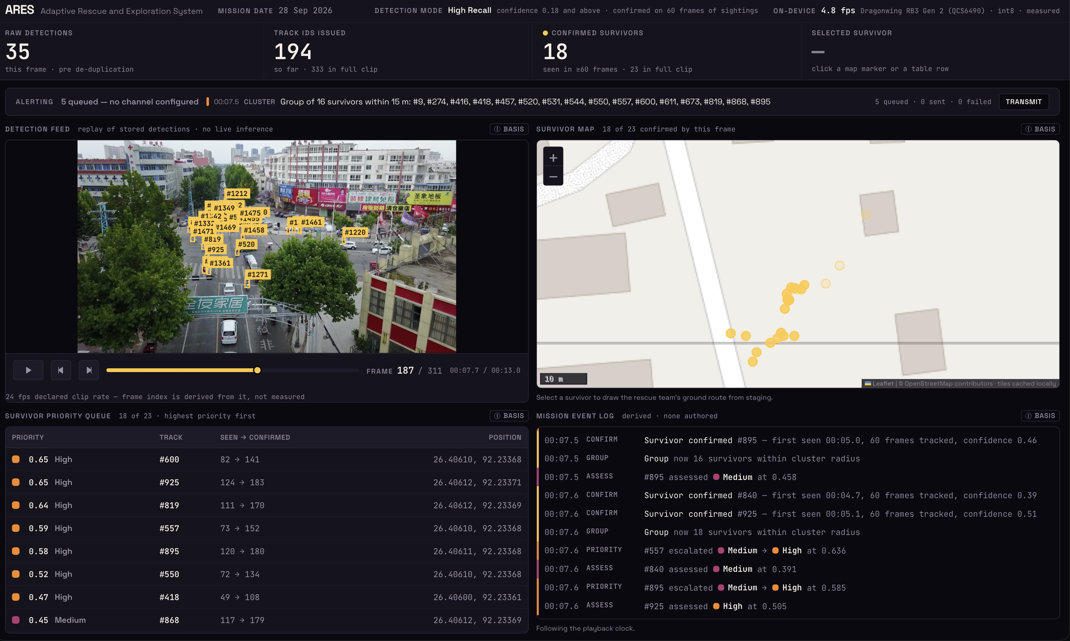
RESEARCH AND REFERENCES
ARES
LIVE SITE ares.paralux.in SOURCE CODE github.com/ARES-UAV/ARES ENGINEERING HANDBOOK 13 chapters
C2A
VisDrone
AIDER
Ultralytics
ByteTrack
Qualcomm AI Hub
WPC 865–868
disaster-scene humans
real aerial capture
UAV hazard imagery
detection + export
stops double-counting
INT8 benchmarking
India licence-exempt band
LINK
LINK
LINK
LINK
LINK
LINK
LINK
THE DASHBOARD, RUNNING
VIDEO EVIDENCE
WHAT IS BUILT
Every claim here has a recording behind it.
Detection, tracking, localization
BUILT
01 · The case for ARES
Priority scoring
BUILT
the system, and what we did not build
Command dashboard
BUILT
02 · Adaptive planner
On-device benchmark
MEASURED
100 missions, plus the no-information control
03 · Detection to GPS
RGB + thermal fusion
PARTIAL
7,081 boxes become 23 people
Hazard classification
PARTIAL
04 · Command dashboard
Adaptive planner
SIMULATED
18 of 23 confirmed at frame 187. Counts reconcile across every panel.
live map, ranked queue, alerts held offline
GPS-denied SLAM
DESCRIBED

