Slide 1

SMART INDIA HACKATHON 2026
ARES
Autonomous Rescue & Environmental Intelligence System
The drone that decides where to look next.
PROBLEM STATEMENT ID
26177
PROBLEM STATEMENT TITLE
A deployable AI-powered autonomous drone that aids search-and-rescue operations by detecting people and hazards, thereby improving responder safety and reducing victim discovery time.
P1 · IMAGE
Aerial disaster scene.
Darken 55%.
No caption.
THEME
Robotics and Drones
PS CATEGORY
Hardware
TEAM ID
[ from portal ]
TEAM NAME
ARES
@SIH Idea submission- Template
1

Slide 2
PROPOSED SOLUTION
ARES
THE IDEA
TODAY → ARES
THE IDEA
ON THE AIRCRAFT
The problem: After an earthquake or flood, the first hours decide who survives. Search teams fly fixed patterns — a lawnmower grid that treats every square metre as equally likely to hold someone. It is not.
Why it matters: [ insert one sourced survival-rate figure ]. Time over empty ground is time taken from ground that holds someone.
Our idea: A UAV that treats search as a decision, not coverage. Onboard AI finds survivors, ranks them, and re-plans its own path in the air — with the radio switched off.
Fixed grid — every metre treated alike
CAMERA
PLANNER
DETECTION
Search ordered by where survivors are likely to be
20 s
decision cycle
The same person counted many times
PRIORITY
TRACKING
LOCALIZE
Persistent IDs — 7,081 detections become 23 people
Needs a network the disaster destroyed
Search is a decision problem,
not a coverage problem.
GROUND STATION
survivor records · a few hundred bytes
Every decision onboard — 2.7 KB replaces 3 Mbps
@SIH Idea submission- Template
2

Slide 3
TECHNICAL APPROACH
ARES
HOW IT IS BUILT
ONE FRAME BECOMES ONE DECISION
TWO COMPUTERS, ONE AIRFRAME
TECHNOLOGIES USED
FLIGHT CONTROLLER
COMPANION (RB3)
Detection
frames
raw video
YOLO · single person class · C2A + VisDrone
ArduPilot
stabilise · failsafe · RTH
◄ MAVLink ►
perception + planner
fails safe
Thermal
7,081
detections
YOLOv8s · recall 0.883 · night and smoke
If the companion board fails, the aircraft still flies home.
Tracking
333
confirmed
ByteTrack — persistent IDs
Edge compute
23
people
Qualcomm RB3 Gen 2 · INT8 on NPU
P2 · DASHBOARD
Full screen capture — map,
priority queue and counts visible.
Backend / Frontend
1
target
FastAPI · React · Leaflet
The shape is the argument: we do not double-count.
Downlink
865–868 MHz — licence-exempt in India
COMPUTE BUDGET · ONE FRAME
detection 209.5 ms
Everything that makes ARES adaptive — localization, priority, the planner — costs 0.87% of the frame.
@SIH Idea submission- Template
3

Slide 4
FEASIBILITY AND VIABILITY
ARES
WHAT WE CAN DEFEND
FEASIBILITY
VIABILITY
RISKS WE NAME
Public data: C2A and VisDrone for survivors, AIDER for hazards.
Commodity hardware: a Qualcomm dev board and an off-the-shelf airframe.
Measured, not assumed: benchmarked on the board, not a datasheet.
No paid services: open tiles, no API keys, nothing that expires.
Works where infrastructure is gone: towers fall in exactly these conditions.
Cheap to carry: records instead of video — 136× less data.
Airframe-independent: the contribution is software.
Explainable: a transparent weighted formula, not a black box.
Planner is simulated: never flown. 30 simulated missions, labelled.
Accuracy is FP32, device is INT8: quantisation cost unmeasured.
Power and heat unmeasured: a benchmark is not a 20-minute sortie.
Footage borrowed: detections are our model's real output.
0.824
0.883
4.8 FPS
2.7 KB
RGB recall at conf 0.18
thermal recall, night and smoke
measured on device, INT8
entire mission downlink
@SIH Idea submission- Template
4

Slide 5
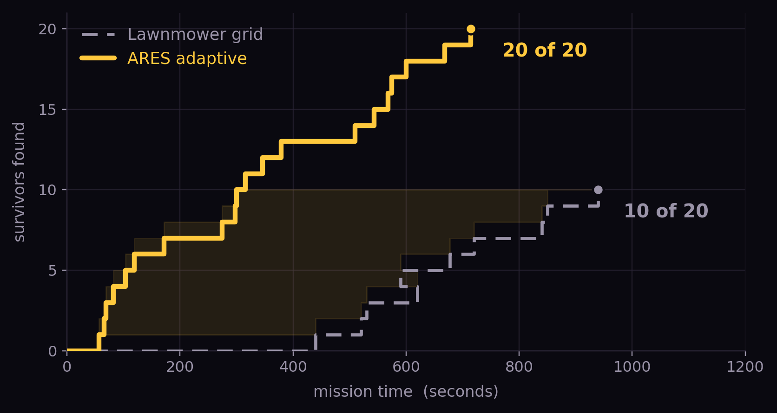
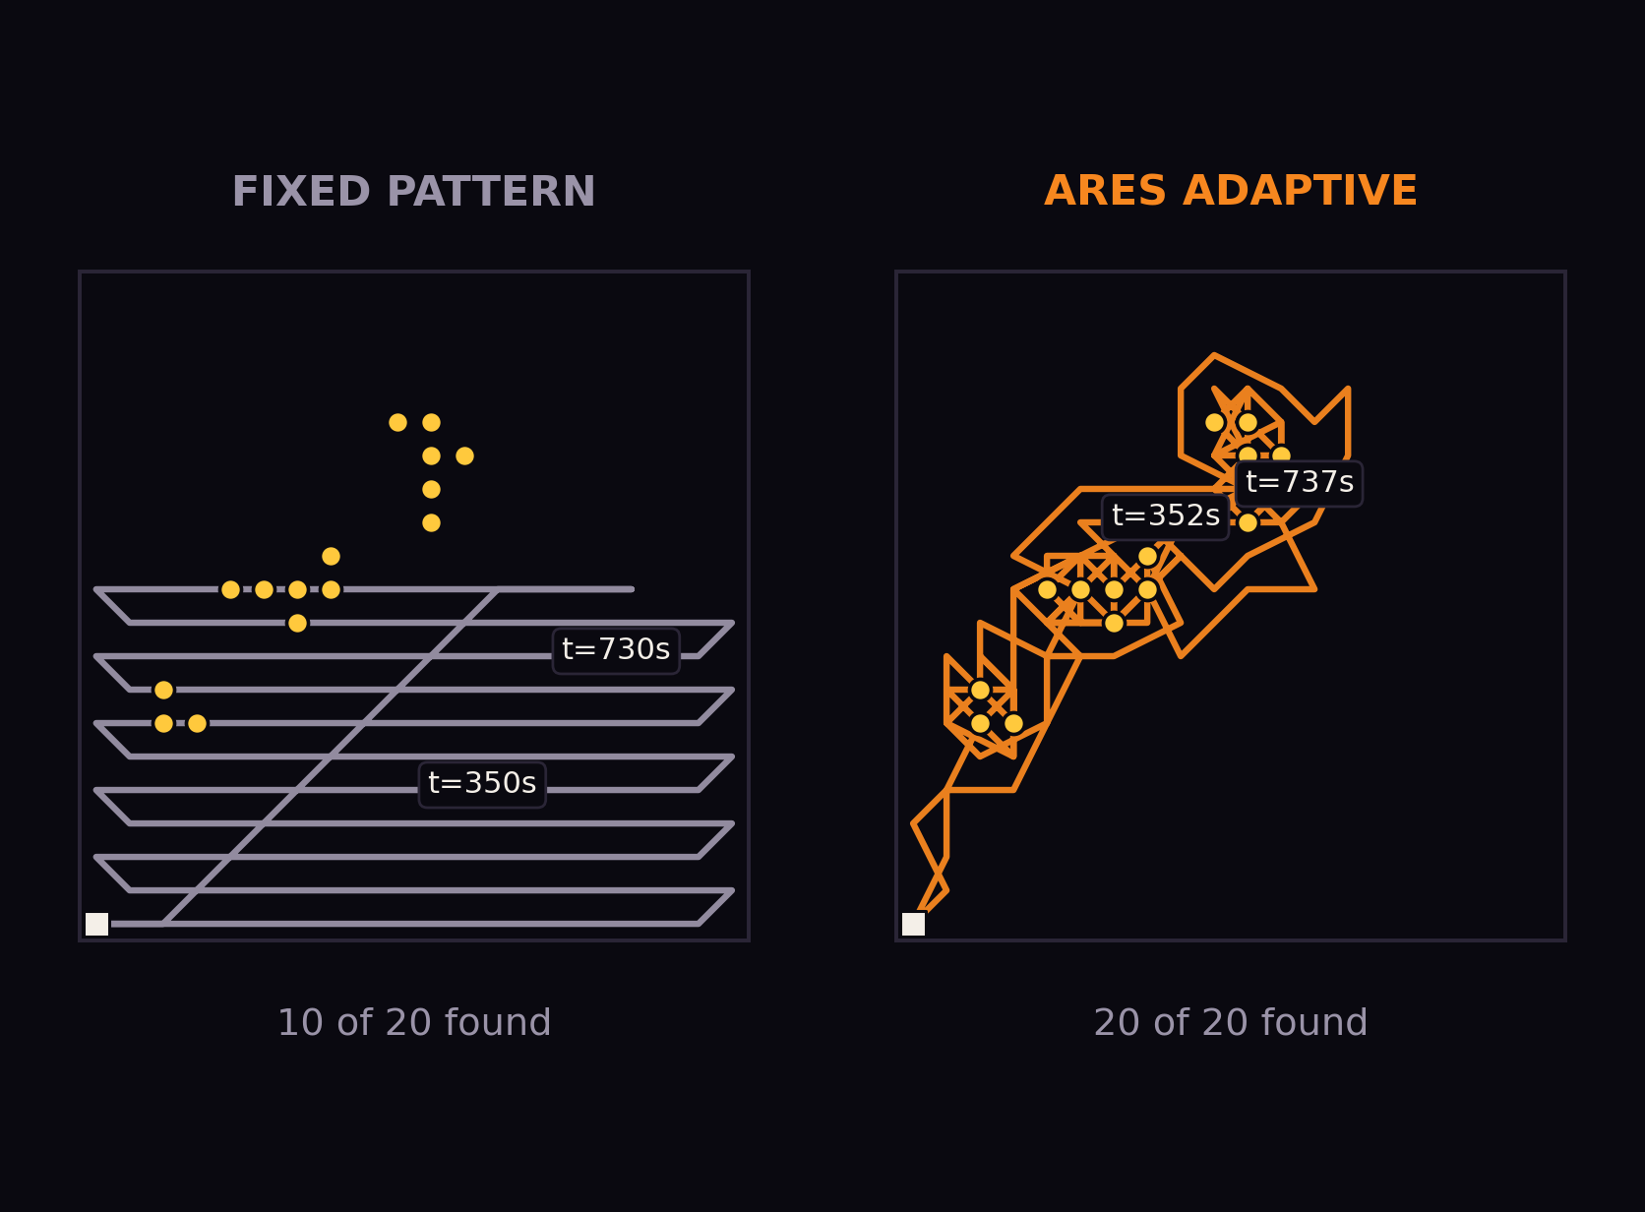
IMPACT AND BENEFITS
ARES
MEASURED, IN SIMULATION
Finds more people
20 of 20 survivors against a lawnmower grid's 10.
Finds them sooner
Half the survivors reached 3.1× faster.
Works with no network
The full mission report is 2.7 KB.
Ranks who to reach first
Confidence, cluster size, hazard proximity.
Survivors found over time — median of 30 simulated missions, good prior.
Simulated flight with the detector at our measured 0.824 recall. Adaptive covers 32% of the area against the grid's 56% — it finds more people, sooner, over less ground. Never flown on hardware.
@SIH Idea submission- Template
5

Slide 6
RESEARCH AND REFERENCES
ARES
WHAT WE BUILT ON
C2A
VisDrone
AIDER
HIT-UAV
Ultralytics
ByteTrack
Qualcomm AI Hub
disaster-scene humans
real aerial capture
UAV hazard imagery
thermal survivors
detection + export
stops double-counting
INT8 benchmarking
LINK
LINK
LINK
LINK
LINK
LINK
LINK
WHAT IS BUILT
Detection, tracking, localization
BUILT
Priority scoring
BUILT
Command dashboard
BUILT
P4 · INTERFACE
On-device benchmark
MEASURED
Three overlapping screenshots — dashboard, detections close-up, map.
Thermal detection
TRAINED
RGB + thermal fusion
PARTIAL
Hazard classification
PARTIAL
Adaptive planner
SIMULATED
GPS-denied SLAM
DESCRIBED
@SIH Idea submission- Template
6

