Slide 1

SMART INDIA HACKATHON 2026
ARES — Autonomous Rescue & Environmental Intelligence System
Problem Statement ID - 26177
Problem Statement Title - A deployable AI-powered autonomous drone that aids search-and-rescue operations by detecting people and hazards, thereby improving responder safety and reducing victim discovery time.
Theme - Robotics and Drones
PS Category - Hardware
Team ID -
Team Name - ARES
Notes:
Fill the six portal fields before exporting. Keep the SIH logo and title bar exactly as they are.

Slide 2
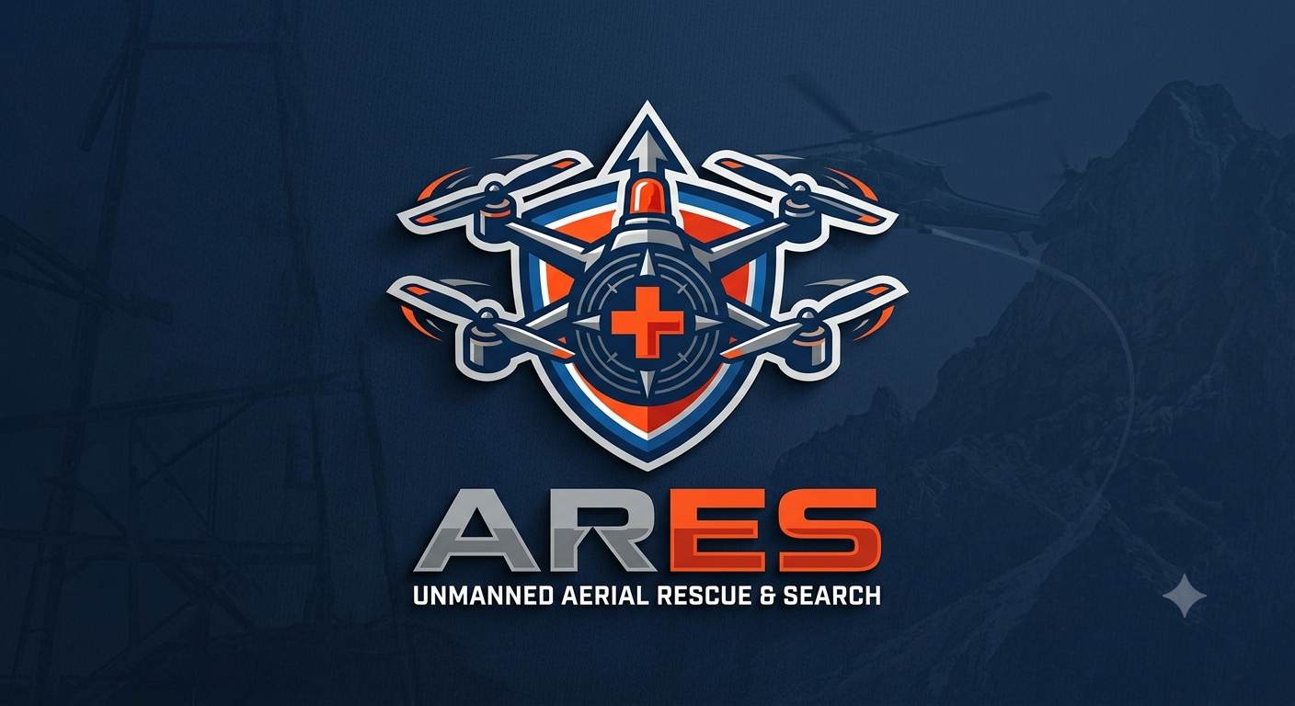
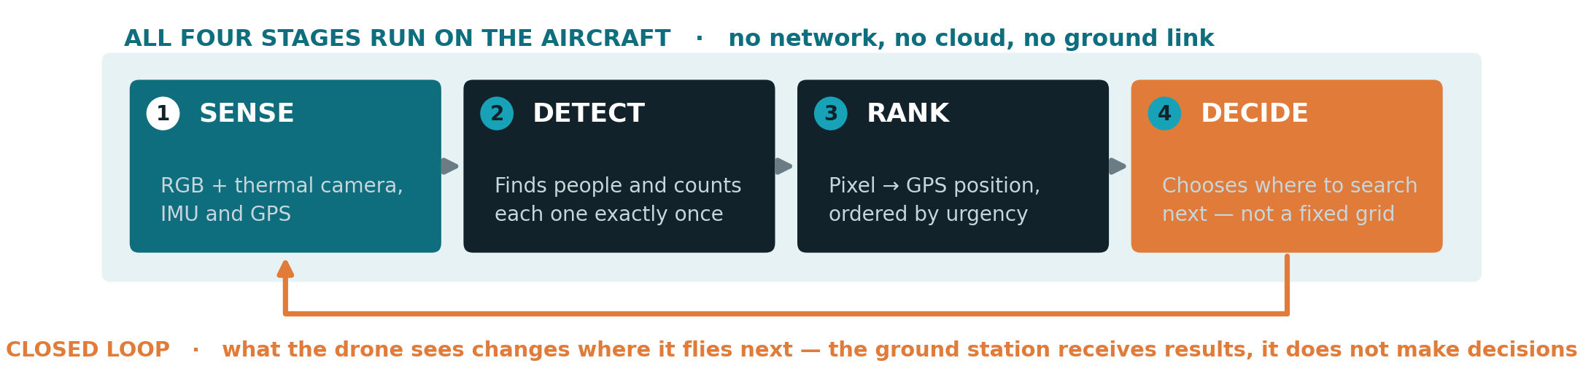
A DRONE THAT DECIDES WHERE TO LOOK NEXT
Your Team Name
THE PROBLEM
OUR SOLUTION
WHY IT IS DIFFERENT
• A fixed grid gives every square metre the same attention — including empty ground.
• The battery runs out before the area is covered, and the survivor list arrives with no order of urgency.
• While it flies, the drone builds a live probability map of where people are likely to be.
• It re-plans in the air and always flies to the best ground it has not yet searched.
• Priority-driven search that never performs worse than a fixed grid.
• Detection, tracking and localization all run on the drone itself — no cloud, no mobile tower.
20 / 20
survivors found vs 11 / 20 for a fixed grid
3.2×
faster to reach half the survivors
100 %
of model layers run on the drone's NPU
Notes:
Open with the problem in one line: after a disaster, drones fly a fixed grid and give every patch of ground equal time, including empty ground. Our drone reads the scene while flying and re-plans in the air. The three numbers at the bottom are all measured, not estimated: 20 of 20 survivors found against 11 for a grid, 3.2 times faster to reach half of them, and 100 percent of the model's layers running on the drone's own NPU chip.

Slide 3
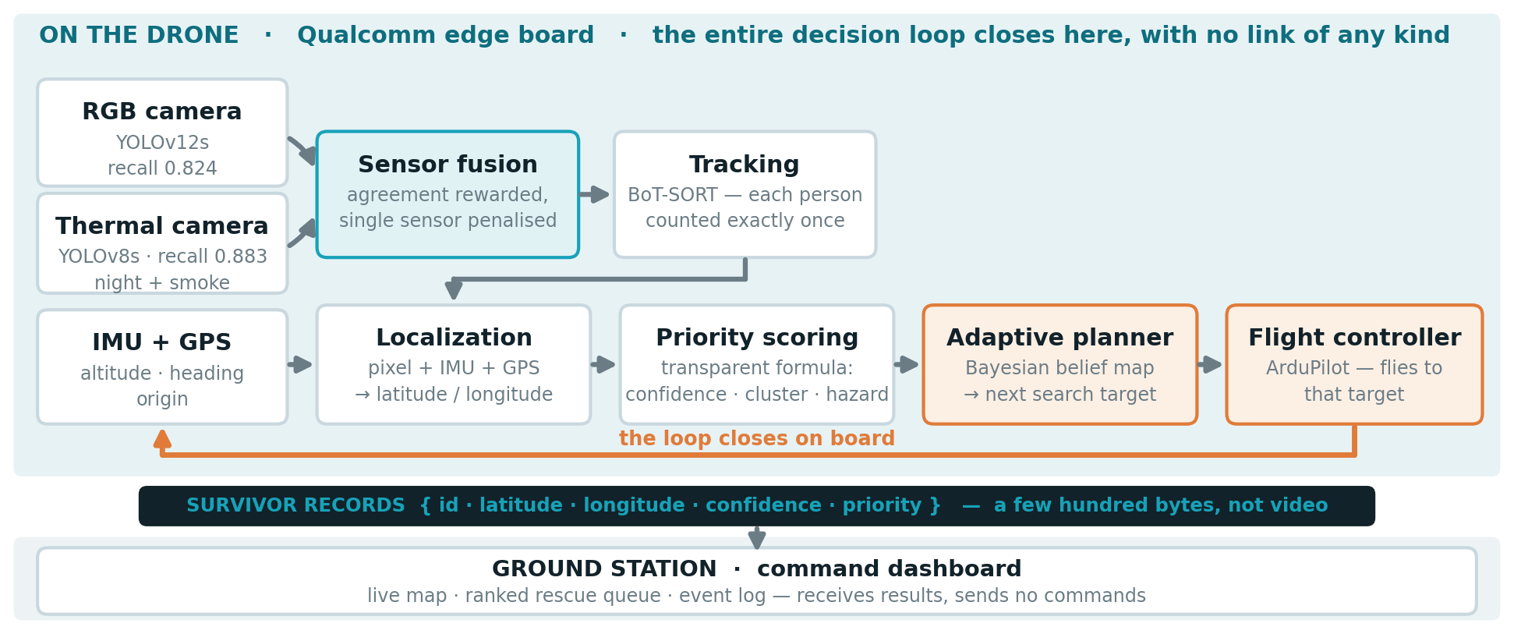
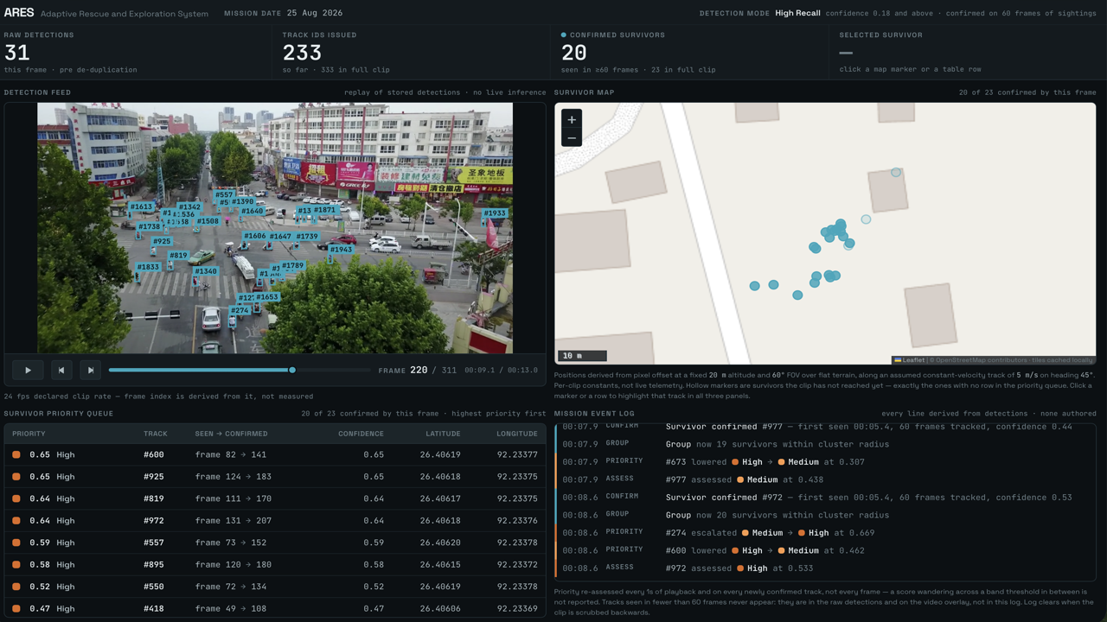
TECHNICAL APPROACH
YOLOv12s + YOLOv8s · BoT-SORT tracking · ONNX → INT8 on the Hexagon NPU · FastAPI + Pydantic · React + Leaflet · ArduPilot / MAVLink
THE COMMAND DASHBOARD — RUNNING, NOT A MOCKUP
• Every count reconciles across all four panels
• Keeps running with the backend switched off
Everything that decides anything runs on the aircraft.
The ground station is where people look — not where choices are made.
Notes:
Walk the diagram left to right along the top: two cameras feed a fusion step, then tracking makes sure each person is counted once. Every box in the shaded band is on the aircraft - sensing, detection, tracking, localization, priority and the planner itself. The dark bar is the one data format all three of our sub-teams agreed on. Below it is the ground station, which also runs with no internet. The orange line is the important one - the decision loop closes on the drone, so it needs no link at all. What crosses the radio is a few hundred bytes of survivor records, not video. The dashboard receives results and sends no commands.

Slide 4
FEASIBILITY AND VIABILITY
BUILT AND MEASURED TODAY
RISKS, AND HOW WE HANDLE THEM
Survivor detection
YOLOv12s · recall 0.824 over 86,092 labelled people
• Venue has no internet → map tiles cached locally; dashboard runs from a file
• Live inference could fail on stage → the demo replays genuine pre-computed model output
Thermal detection
YOLOv8s · recall 0.883 · works at night and in smoke
• No public dataset pairs aerial RGB with thermal → we measure fusion on the LLVIP benchmark and say so
Runs on real edge silicon
209 ms/frame · 489 of 489 layers on the Hexagon NPU
• Small edge compute budget → YOLOv8n fallback already trained and benchmarked
Counts each person once
7,081 detections → 333 tracks → 23 confirmed survivors
IN PROGRESS — NUMBERS TO ADD BEFORE SUBMISSION
Adaptive search
100 simulated missions · 20/20 found · 3.2× faster
• Hazard classifier (fire/smoke, flood, collapsed structure): [ per-class precision & recall — pending ]
• RGB + thermal fusion on LLVIP: [ false positives at equal recall — pending ]
• INT8 accuracy after quantisation: [ pending ] · Closed-loop flight sim: [ localization error — pending ]
Command dashboard
live map, ranked queue, event log · runs fully offline
SCOPE — WHAT IS BUILT AND WHAT IS DESCRIBED
Built · measured
On-device inference · Priority alerting · Command dashboard · Geo-tagged mapping · Offline resilience
Partial · honest
Multi-sensor fusion (RGB + thermal + IMU + GPS) · Hazard classification, 3 classes of 7
Simulated · not flown
Adaptive search planning · Autonomous navigation — flown on a simulated flight stack, never on hardware
We claim only what we measured. Nothing on this slide is estimated.
Notes:
Left column is what already works and is measured. Right column is honest about risk. The orange box is what we are still measuring - leave those brackets in only if the numbers are genuinely not ready on submission day; otherwise replace them. The dark strip is our scope table. Judges reward teams that say clearly what is built, what is partial and what is only simulated.

Slide 5
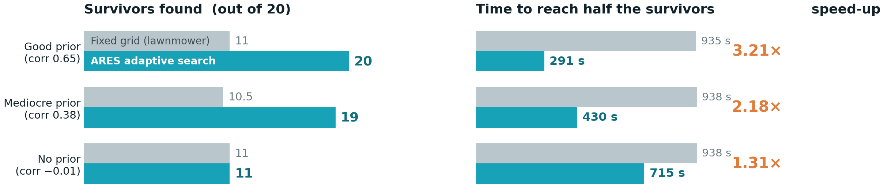
IMPACT AND BENEFITS
Median of 100 simulated missions · identical worlds, identical battery, identical detection probability (0.824, measured on 86,092 labelled people)
THE PRIOR — WHAT THE DRONE BELIEVES BEFORE IT FLIES
IMPACT
A map of where people are most likely to be — the drone's starting belief. The three rows above are three qualities of it: good, mediocre, and none at all.
• Survivors reached sooner inside the 72-hour window
• A ranked rescue queue, not an unsorted list of dots
• Works with no network, no cloud and no mobile tower
• A commodity drone plus one edge board — affordable for a state response force
IN THE FIELD IT IS ASSEMBLED FROM
• OpenStreetMap — buildings, shelters, schools
• Elevation model — high ground in a flood
• Sentinel-1 radar — flood extent, through cloud
• Emergency calls and last-known positions
Quality is reported as correlation with the truth — 0.65, 0.38 and −0.01 above — never as a number we chose. Today the prior is synthetic; sourcing it from live data is the next step.
Notes:
The left chart is survivors found, the right is how long it took to reach half of them. Note the bottom row deliberately: with no useful prior information our method simply matches the grid - it never does worse. Showing that we tested the case where our own method has no advantage is what makes the other two rows believable.

Slide 6
RESEARCH AND REFERENCES
DATASETS USED
MODELS, TOOLS, HARDWARE
METHOD AND BACKGROUND
• C2A — casualty detection in disaster scenes
• VisDrone — UAV person detection benchmark
• HIT-UAV — real UAV thermal infrared imagery
• AIResQ — aerial thermal rescue dataset (Sci Data, 2026)
• AIDER — UAV disaster-scene classification (hazards)
• LLVIP — registered visible/infrared pairs, for fusion
• COCO — pre-training baseline for both detectors
• OpenStreetMap — offline base map tiles for the dashboard
• Ultralytics YOLOv12s / YOLOv8s — detection + tracking
• BoT-SORT — multi-object tracking with re-identification
• Qualcomm AI Hub — Dragonwing RB3 Gen 2, IQ-9075 EVK
• ONNX + QNN — INT8 quantisation for the Hexagon NPU
• ArduPilot / MAVLink — flight stack and waypoints
• FastAPI · Pydantic · React · Leaflet · Vite
• PyTorch + ONNX Runtime — training and export
• Docker — reproducible flight-simulation environment
• Bayesian search theory — belief update over a grid
• Boustrophedon (lawnmower) coverage — our baseline
• Informative-path planning for UAV search and rescue
• NDRF / NDMA search-and-rescue operating guidance
• DGCA nano-category UAV rules (sub-250 g operation)
• Bayesian belief update with a staleness term — our
coverage guarantee: skipped cells resurface later
• Tracking metrics: ID switches and fragmentation
• [ add your faculty mentor's suggested references ]
HOW OUR NUMBERS WERE PRODUCED
Accuracy is measured on a held-out split of 2,591 images and 86,092 labelled people. Latency is measured on real Qualcomm silicon through AI Hub — medians of ~100 runs, not best-case.
Search results are medians of 100 simulated missions with identical worlds and identical battery. Demo footage is from public UAV datasets; every detection shown is genuine model output.
Demo video: [ paste the public link here before exporting to PDF ]
Notes:
Everything here is a public dataset, an open tool or standard practice. Nothing is proprietary and nothing is bought. The dark strip explains how the numbers were produced, which is the question a technical screener asks first.

