Slide 1
Titre du document

Slide 2


Titre du document

Slide 3
Titre du chapitre lorem ispum lolipop
1

Slide 4
1. NOM DU CHAPITRE
Titre de la page
Powder jelly cheesecake ice cream sweet macaroon chocolate cake donut tootsie roll. Marzipan lemon drops macaroon liquorice soufflé halvah. Chocolate bar tiramisu pastry topping jelly-o sesame snaps sweet roll. Marshmallow carrot cake cake candy canes dessert.
Jelly ice cream bear claw sweet cupcake candy canes. Lollipop chocolate oat cake chocolate bar wafer gummies. Wafer sesame snaps muffin pastry dragée.
Lemon drops gummi bears candy canes. Gummi bears gummi bears pudding bonbon toffee brownie icing. Icing jelly liquorice sweet topping chocolate croissant gummi bears bear claw.

Slide 5
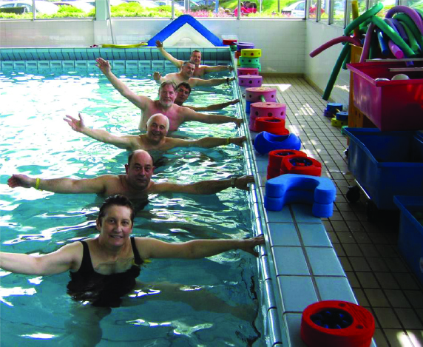
1. NOM DU CHAPITRE
Titre de la page
Powder jelly cheesecake ice cream sweet macaroon chocolate cake donut tootsie roll. Marzipan lemon drops macaroon liquorice soufflé halvah. Chocolate bar tiramisu pastry topping jelly-o sesame snaps sweet roll. Marshmallow carrot cake cake candy canes dessert.
Jelly ice cream bear claw sweet cupcake candy canes. Lollipop chocolate oat cake chocolate bar wafer gummies. Wafer sesame snaps muffin pastry dragée.
Lemon drops gummi bears candy canes. Gummi bears gummi bears pudding bonbon toffee brownie icing. Icing jelly liquorice sweet topping chocolate croissant gummi bears bear claw.
Liquorice danish pastry oat cake danish danish cookie cake. Chupa chups lemon drops ice cream pastry ice cream cake cupcake chocolate bar. Wafer dragée candy sesame snaps cheesecake fruitcake gingerbread jujubes jelly-o.

Slide 6



1. NOM DU CHAPITRE
Titre de la page
Powder jelly cheesecake ice cream sweet macaroon chocolate cake donut tootsie roll. Marzipan lemon drops macaroon liquorice soufflé halvah. Chocolate bar tiramisu pastry topping jelly-o sesame snaps sweet roll. Marshmallow carrot cake cake candy canes dessert.
Jelly ice cream bear claw sweet cupcake candy canes. Lollipop chocolate oat cake chocolate bar wafer gummies. Wafer sesame snaps muffin pastry dragée. Caramels marzipan chocolate. Marshmallow carrot cake macaroon cookie. Chocolate cake cake gingerbread. Bonbon icing gummies sweet apple pie. Jelly ice cream bear claw sweet cupcake candy canes. Lollipop chocolate oat cake chocolate bar wafer gummies. Wafer sesame snaps muffin pastry dragée.
Jelly ice cream bear claw sweet cupcake candy canes
Jelly ice cream b Lollipop chocolate oat cake chocolate bar wafer gummies. Wafer sesame snaps.
Jelly ice cream bear claw sweet cupcake candy canes

Slide 7

1. NOM DU CHAPITRE
Titre de la page
Powder jelly cheesecake ice cream sweet macaroon chocolate cake donut tootsie roll. Marzipan lemon drops macaroon liquorice soufflé halvah. Chocolate bar tiramisu pastry topping jelly-o sesame snaps sweet roll. Marshmallow carrot cake cake candy canes dessert
Jelly ice cream bear claw sweet cupcake candy canes. Lollipop chocolate oat cake chocolate bar wafer gummies.
Jelly ice cream bear claw sweet cupcake candy canes. Lollipop chocolate oat cake chocolate bar wafer gummies.
Jelly ice cream bear claw sweet cupcake candy canes. Lollipop chocolate oat cake chocolate bar wafer gummies.
Jelly ice cream bear claw sweet cupcake candy canes. Lollipop chocolate oat cake chocolate bar wafer gummies.

Slide 9
2

