Slide 1
INFINuS
TEAM MEMBERS:
NITISH SRIMAN K P
SRINIVASH V
SUGIRDAN V
VIGNESH ROSAN M

Slide 2
SMART MOVEMENT TRACKING SOLUTION OF PEOPLE/VEHICLES FROM POINT A TO POINT B

Slide 3
IDEA OVERVIEW
In our movement tracking system we combine the use of location tracking in the vehicle with GPS and microcontroller that collects these data for a comprehensive picture of vehicle locations and in case of any deviation from the intended path a warning message is sent to consented authorities by using GSM technology and through a web-page. Vehicle information can be viewed on map via the web page by the authorities.

Slide 4
TECHNOLOGIES USED:
GPS
MC60
GSM
IOT

Slide 5
GPS:
The Global Positioning System (GPS) is a navigation system using satellites, a receiver and algorithms to synchronize location, velocity and time data. The satellite system consists of a constellation of 24 satellites in six Earth-centered orbital planes, each with four satellites, orbiting at 13,000 miles (20,000 km) above Earth. While we only need three satellites to produce a location on earth’s surface, a fourth satellite is often used to validate the information from the other three. The fourth satellite also moves us into the third-dimension and allows us to calculate the altitude of a device.

Slide 6
MC60:
MC60 is a quad-band full-featured GSM/GPRS/GNSS module using LCC castellation package. With an extensive set of Internet protocols (TCP, UDP, PPP, FTP, HTTP, SSL, MQTT, etc.), it integrates the GNSS technology for satellite navigation. Based on the latest 2G chipset, it has the optimal performance in SMS & data transmission as well as audio service even in harsh environments.

Slide 7
GSM:
GSM (Global System for Mobile communication) is a digital mobile network that is widely used by mobile phone users in the world. GSM uses a variation of time division multiple access (TDMA) and is the most widely used of the three digital wireless telephony technologies: TDMA, GSM and code-division multiple access (CDMA). GSM digitizes and compresses data, then sends it down a channel with two other streams of user data, each in its own time slot. It operates at either the 900 megahertz (MHz) or 1,800 MHz frequency band.

Slide 8
IOT:
The Internet of Things essentially enables us to connect ‘things’ to the Internet (and to networks that use Internet technology). These things or items can exchange information between them and transmit data to other devices and systems. They can usually also received data. The information they share can be about objects to which they are attached and the environment they are in (through sensors that come in many shapes for different parameters). While GPS data transmitted to a host over a mobile data connection is enough to track the moment of a vehicle in real time, IoT essentially makes Vehicle Tracking solutions a lot more efficient, economical, automated, and reliable.

Slide 9
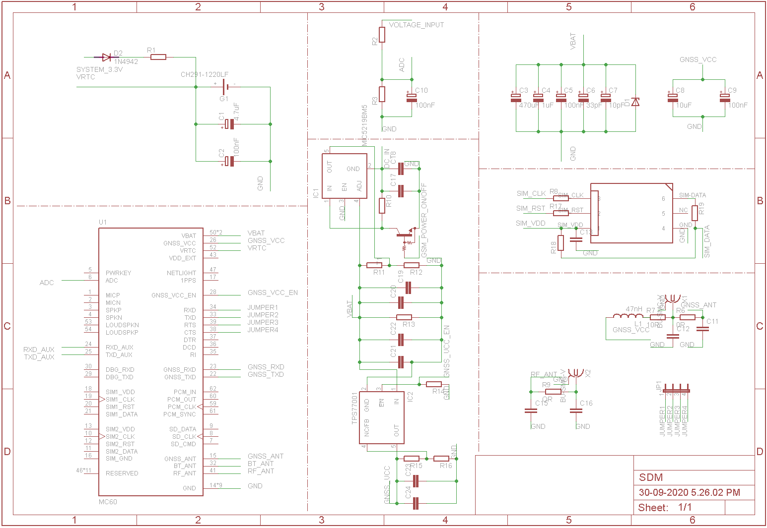
CIRCUIT DIAGRAM

Slide 10
INTENDED APPROACH:
The GPS module tracks the movement of the vehicle and the processor sends the data through TCP to the cloud server so the location, speed and path followed can be monitored. First the path to be followed is tracked and checkpoints are marked for reference. Now when the vehicle travels in the path it crosses the checkpoints. When a checkpoint is missed we can know that the vehicle has deviated and a warning message is sent to the authorities. From the data of GPS module we can calculate the speed by comparing the time from GPS data. We use the TCP protocol to transfer the data from the GPS module to the server from which our website can access the data to track the vehicle live. In case we need to send warning of over speed or deviation from the intended path, we can also use GSM to send message to concerned authorities.

