Slide 1



Hearing Aid Marketing Opportunities
United States Hearing Aid Market
(U.S.A Hearing Aid Market)
Hearing Central LLC
1390 Kathryn Lane
Lake Forest IL 60045
847-295-6946
phil@hearingcentral.com
Updated June 2008
Updated December 2007
Summer 2006
Source: Hearing Central LLC., 1390 Kathryn lane, Lake Forest IL 60045 www.hearingcentral.com

Slide 2
U.S.A Hearing Aid Market
Current And Future
Market Trends
Source: Hearing Central LLC., 1390 Kathryn lane, Lake Forest IL 60045 www.hearingcentral.com
Notes:
No Growth
Restricted access

Slide 3
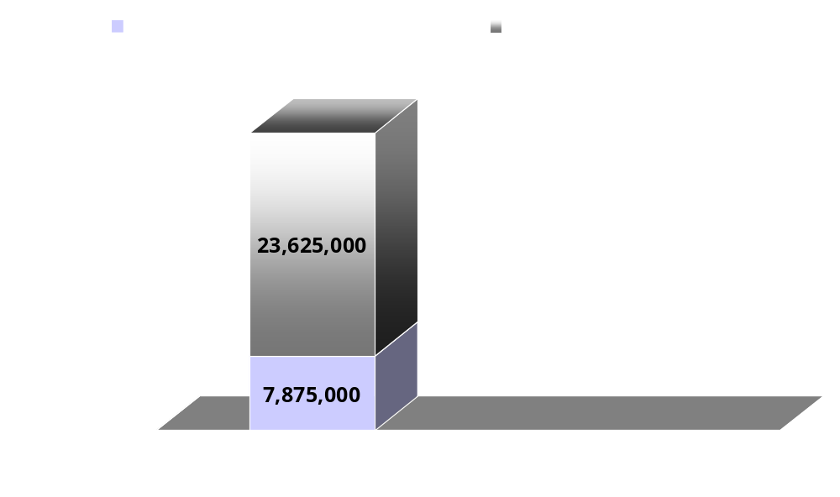
U.S.A Hearing Aid Market
Current Hearing Loss Population
Total Hearing Loss Population = 31,500,000
i.e. 75% of hearing impaired who could
wear a hearing aid do not.
Current hearing aid adoption rates - 25%
Source: Better Hearing Institute Marke Trak VII™ Semi-Annual Hearing Aid Market Survey/ Sergei Kotchkin Phd
Notes:
(2006) 10% percent of US population (31,500,000) suffer from some form of hearing loss that would be helped by a hearing aid
(2006) – Currently only 25% of that 10% population or about 7,875,000 people wear hearing aids
CONCLUSIONS: TODAY (2006) About 28,350,000 potential customers with a total need for about 48,195,000 hearing aids are not being served

Slide 4
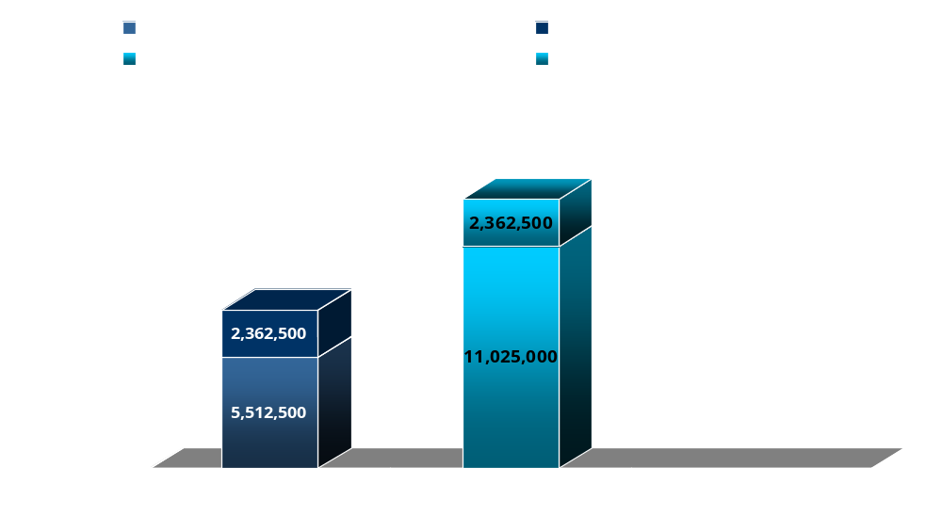
U.S.A Hearing Aid Market
Current Hearing Aid Usage (2006)
Includes All Hearing Aid Types (BTE, ITE, ITC)
# Units Worn
(13,387,500)
Single
Wearers
(7,875,000)
Binaural
Source: Better Hearing Institute Marke Trak VII™ Semi-Annual Hearing Aid Market Survey/ Sergei Kotchkin Phd
Notes:
(2006) – Currently 25% or about 7,875,000 people wear hearing aids
(70% of these wearers – 5,512,500 wear 2 hearing aids for a total of 11,025,000 units worn)
(30% of these wearers – 2,362,500 wear 1 hearing aid for a total of 2,362,000 worn)
Source: Better Hearing Institute Marke Trak VII™ Sem-Annual Hearing Aid Market Survey/ Sergei Kotchkin Phd

Slide 5
U.S.A Hearing Aid Market
Reasons for Slow Adoption
“Mom and Pop” distribution system
(9000+/- Audiologists, 3000+/- Dispensers)
Stigma of wearing a hearing aid
(will change as more people age and need a hearing aid)
High Cost ($1500 - $3000 ea.)
Most are not covered by private insurance
No Medicare/ Medicaid Coverage (VA does)
Barriers to entry
Source: Hearing Central LLC., 1390 Kathryn lane, Lake Forest IL 60045 www.hearingcentral.com
Notes:
Audiologists & Hearing Aid Stores combined aka “Dispensers”
USA - Only 12,000+ Hearing Aid Dispensers TOTAL (9000 Audiologists and 3,000 professionals at stores)
Avg. unit volume per dispenser is 16 units/mo. (Total for all dispensers is a little over 2,000,000 units/yr.)
Professional Dispensers retiring faster than new entrants
Current professional are not meeting today’s demand

Slide 6
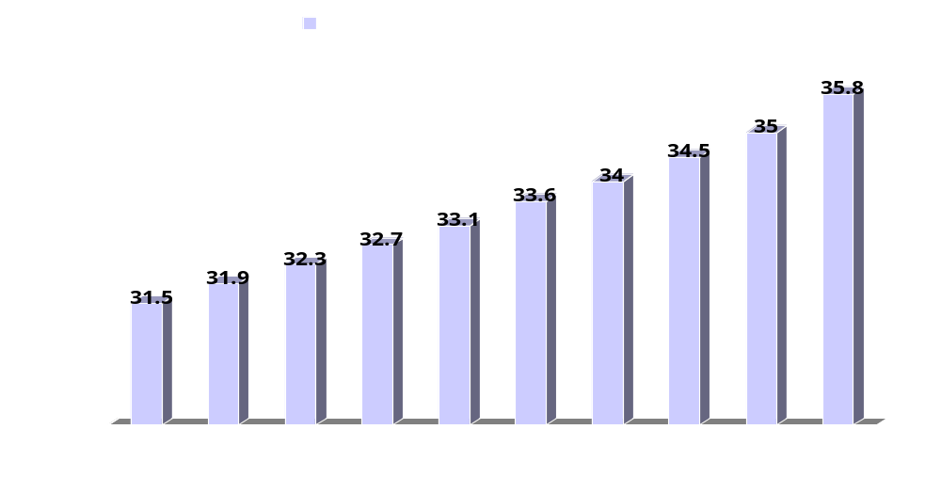
U.S.A Hearing Aid Market
Projected Hard-Of-Hearing Persons
Source: Better Hearing Institute Marke Trak VII™ Semi-Annual Hearing Aid Market Survey/ Sergei Kotchkin Phd
Notes:
No Growth in Dispenser entering the field
Penetration/adoption rates hold at about 25%
REPEAT: Market will be almost 36,000,000 Potential users by 2015
Future demand will definitely not be met by current distribution channels
i.e. New Distribution Channels must be created to meet demand
CONCLUSIONS
Market is ripe for disintermediation & high volume entrants

Slide 7
U.S.A Hearing Aid Market
Projected Hard-Of-Hearing Persons
Comments on Prior Graph
  There will be a steady increase
  in hard-of-hearing persons
  Boomers with prior loud listening habits
  and subsequent hearing loss will
  accelerate this market by 2010
Source: Better Hearing Institute Marke Trak VII™ Semi-Annual Hearing Aid Market Survey/ Sergei Kotchkin Phd
Hearing Central LLC., 1390 Kathryn lane, Lake Forest IL 60045 www.hearingcentral.com
Notes:
No Growth in Dispenser entering the field
Penetration/adoption rates hold at about 25%
REPEAT: Market will be almost 36,000,000 Potential users by 2015
Future demand will definitely not be met by current distribution channels
i.e. New Distribution Channels must be created to meet demand
CONCLUSIONS
Market is ripe for disintermediation & high volume entrants

Slide 8
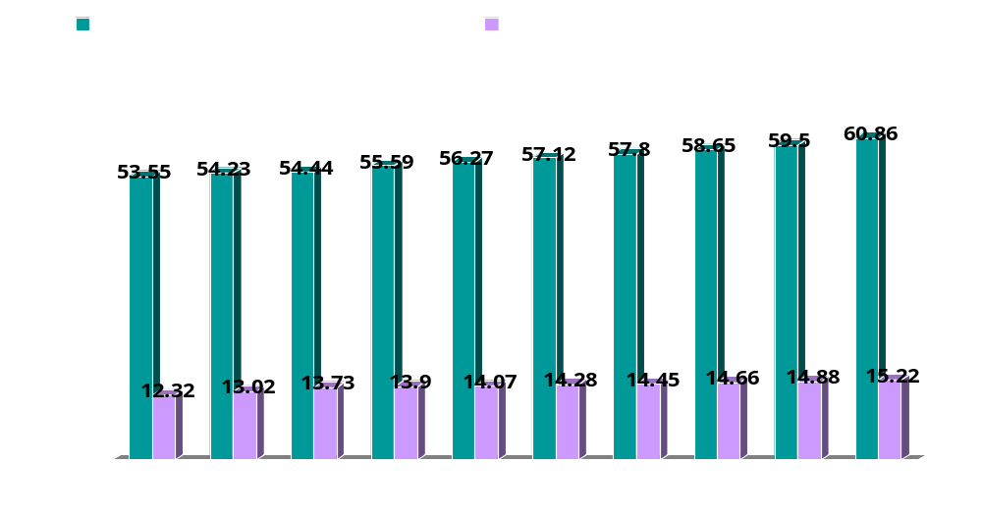
U.S.A Hearing Aid Market
Projected New Hearing Aids Sold
With No Channel Changes (Only Dispensers)
Assumes Current Adoption Rate holds at about 25%
Source: Better Hearing Institute Marke Trak VII™ Semi-Annual Hearing Aid Market Survey/ Sergei Kotchkin Phd
Notes:
No Growth in Dispensers
Penetration/adoption rates hold at about 25%
REPEAT: Market will be over 60 Million units by 2015
Future demand will definitely not be met by current distribution channels
i.e. New Distribution Channels must be created to meet demand
CONCLUSIONS
Market is ripe for disintermediation & high volume entrants

Slide 9
U.S.A Hearing Aid Market
Projected New Hearing Aids Sold
Comments on Prior Graph
Dispenser channel is not expected to grow – more people are retiring than entering the profession
No growth in dispensers causes adoption
rates to hold at 25% of hard-of-hearing population
CONCLUSIONS
  Future hearing aid demand will definitely
  not be met by current distribution channels
Source: Better Hearing Institute Marke Trak VII™ Semi-Annual Hearing Aid Market Survey/ Sergei Kotchkin Phd
Notes:
No Growth in Dispensers
Penetration/adoption rates hold at about 25%
REPEAT: Market will be over 60 Million units by 2015
Future demand will definitely not be met by current distribution channels
i.e. New Distribution Channels must be created to meet demand
CONCLUSIONS
Market is ripe for disintermediation & high volume entrants

Slide 10
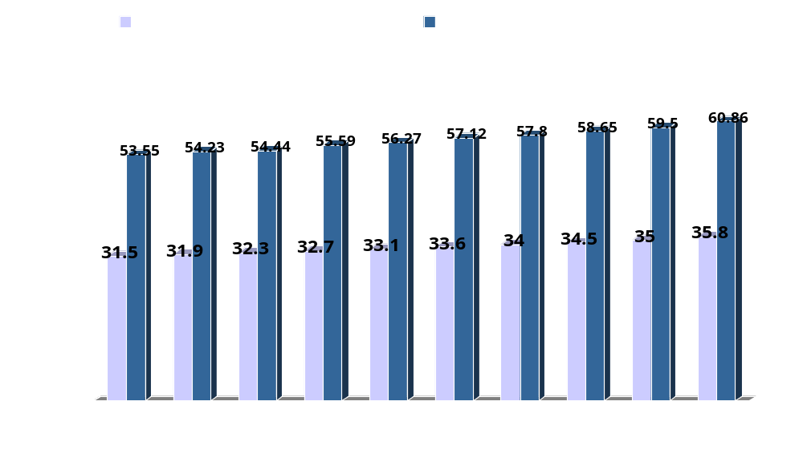
U.S.A Hearing Aid Market
Projected Total Demand for Hearing Aid Units
In Millions
Source: Better Hearing Institute Marke Trak VII™ Semi-Annual Hearing Aid Market Survey/ Sergei Kotchkin Phd
Notes:
Assumes 70% of users will opt for 2 hearing aids
Market will be almost 36,000,000 Potential users and 60+ million units by 2015

Slide 11
U.S.A Hearing Aid Market
Projected Total Demand for Hearing Aid Units
CONCLUSIONS
  Market potential of over 60 Million units by 2015
  New distribution channels must be created to meet demand
  Market is ripe for disintermediation &
  high volume entrants
Source: Hearing Central LLC., 1390 Kathryn lane, Lake Forest IL 60045 www.hearingcentral.com
Notes:
Assumes 70% of users will opt for 2 hearing aids
Market will be almost 36,000,000 Potential users and 60+ million units by 2015

Slide 12
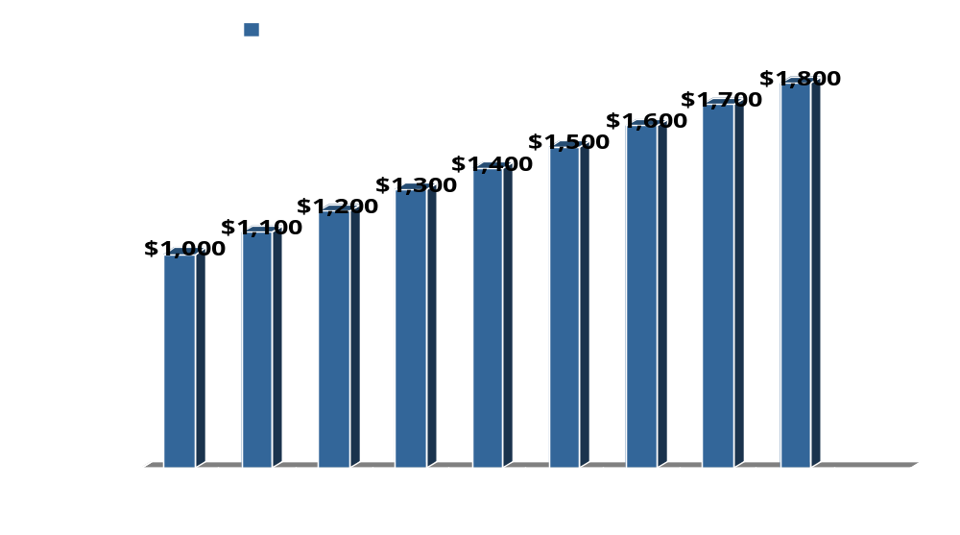
U.S.A Hearing Aid Market
Pricing Trends Through Current Channels w/ No Mass Market Entries
Source: Hearing Central LLC., 1390 Kathryn lane, Lake Forest IL 60045 www.hearingcentral.com
Notes:
Monopoly
Restricted distribution
No Competition
Prices rise over time

Slide 13
U.S.A Hearing Aid Market
Pricing Trends Through Current Channels w/ No Mass Market Entries
Comments on Prior Graph
If the current 12,000+/- Audiologists and
Dispensers remain as the only channels
for consumers to purchase hearing aids:
  Demand will rise as more people
  become hard-of-hearing
  Prices will rise due to the monopolistic
  nature of the distribution channel
Source: Hearing Central LLC., 1390 Kathryn lane, Lake Forest IL 60045 www.hearingcentral.com
Notes:
Monopoly
Restricted distribution
No Competition
Prices rise over time

Slide 14
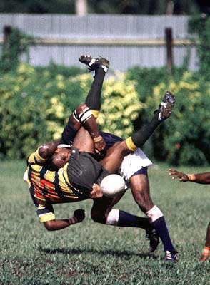
U.S.A Hearing Aid Market
The Future : 2006 - 2015
Upheaval!
Source: Hearing Central LLC., 1390 Kathryn lane, Lake Forest IL 60045 www.hearingcentral.com
Notes:
Dramatic upheaval in this sector
Shift to mass markets
Lower prices encourage higher adoption rates

Slide 15


U.S.A Hearing Aid Market
Expected Channel Changes
2006 - 2015
FROM:
Audiologists
Hearing Aid stores
TO:
Mass Markets i.e.
  Drug Stores
  Big Box Stores
  Internet
  Mail Order
Toll-Keepers
Open Markets
Source: Hearing Central LLC., 1390 Kathryn lane, Lake Forest IL 60045 www.hearingcentral.com
Notes:
Dramatic upheaval in this sector
Shift to mass markets
Lower prices encourage higher adoption rates

Slide 16
U.S.A Hearing Aid Market
Projected Distribution Channel Changes
2006
Audiologists 62%
H.A. Stores/Dispens. 19%
MDs/VA/ENTs 13%
Total 94%
MASS MARKETS
Mail Order 3.5%
Internet 2.5%
Super Stores >1%
Drug Stores >1%
Total 6%
2015 (Est.)**
Audiologists 15%
H.A. Dispensers 3%
MDs/VA/ENTs 15%
Total 33%
MASS MARKETS
Mail Order 9%
Internet 12%
Super Stores 12%
Drug Stores 32%
Total 67%
Source: Hearing Central LLC., 1390 Kathryn lane, Lake Forest IL 60045 www.hearingcentral.com
Notes:
Dramatic shift from dispensers to mass marketers
By 2015 Drug Stores could have a 40% market Share
Walgreen Co. could get a substantial piece of this market

Slide 17
U.S.A Hearing Aid Market
Projected Distribution Channel Changes
Comments on Prior Slide
In the US hearing aid markets, there will be a dramatic shift from dispensers to mass marketers
US hearing aid market will expand from 25% to 67% of the hard-of-hearing
Traditional channels will lose market share to mass market channels
Traditional channels will make money on custom molded hearing aids and hearing tests
**Source: Hearing Central LLC., 1390 Kathryn lane, Lake Forest IL 60045 www.hearingcentral.com
Notes:
Dramatic shift from dispensers to mass marketers
By 2015 Drug Stores could have a 40% market Share
Walgreen Co. could get a substantial piece of this market

Slide 18
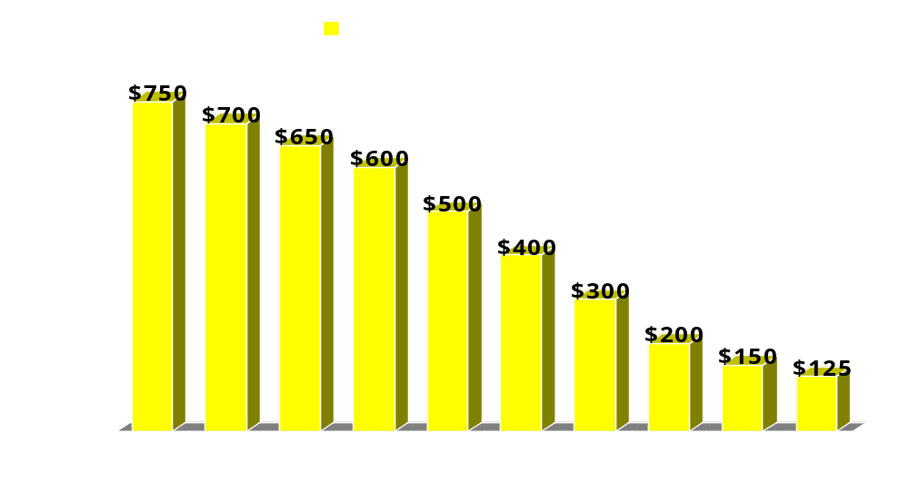
U.S.A Hearing Aid Market
Average Retail Pricing Trends
Through Mass Market Channels Alone
Source: Hearing Central LLC., 1390 Kathryn lane, Lake Forest IL 60045 www.hearingcentral.com
Notes:
Mass marketers will drive down prices

Slide 19
U.S.A Hearing Aid Market
Mass Market Channels Retail Pricing Trends
Comments on Prior Slide
Mass Market channels will drive down hearing aid
prices due to:
  Multiple competitors
  Supplier manufacturing economies
  Large ad budgets
Price erosion will accelerate beginning in 2010
RESULTS: Audiologists and dispensers will move to higher end custom hearing aids and to customers who want personal service
Source: Hearing Central LLC., 1390 Kathryn lane, Lake Forest IL 60045 www.hearingcentral.com
Notes:
Mass marketers will drive down prices

Slide 20
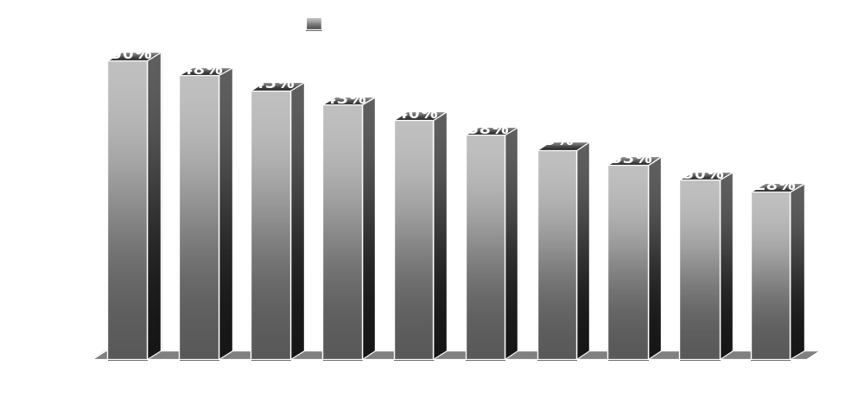
U.S.A Hearing Aid Market
Projected Distributor Profit Margin Deterioration
Due to Mass Market Competition
Source: Hearing Central LLC., 1390 Kathryn lane, Lake Forest IL 60045 www.hearingcentral.com
Notes:
Increased competition will decrease margins

Slide 21
U.S.A Hearing Aid Market
Projected Profit Margin Deterioration
Due to Mass Market Competition
Comments on Prior Graph
Mass Market competition will force down prices and margins will deteriorate accordingly
Margins will bottom out at around 25%
by 2015
Comments: This relentless price and margin deterioration could accelerate. If so, the projected timeline could be compressed to 2010 or 2012, depending on the aggressiveness of the mass marketers
Source: Hearing Central LLC., 1390 Kathryn lane, Lake Forest IL 60045 www.hearingcentral.com
Notes:
Increased competition will decrease margins

Slide 22
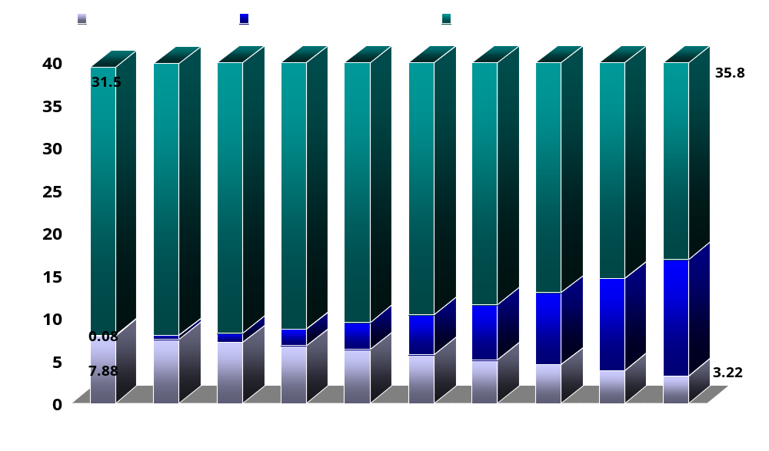
U.S.A Hearing Aid Market
Projected User Hearing Aid Adoption Rates
In Millions of users
Source: Better Hearing Institute Marke Trak VII™ Annual Hearing Aid Market Survey/ Sergei Kotchkin Phd
and Hearing Central LLC., 1390 Kathryn lane, Lake Forest IL 60045 www.hearingcentral.com
Notes:
More Mass Marketing outlets will cause adoption rate to rise from 25% to 57% by 2015
i.e. new mass marketer entries causing:
LOWER PRICES
CONVENIENCE
Will cause at least 38% of the hearing impaired to purchase at least one hearing aid by 2015

Slide 23
U.S.A Hearing Aid Market
Projected User Hearing Aid Adoption Rates
Comments on Prior Graph
More outlets
Lower hearing aid prices
  = Greater availability
  + More choices
Result:
More people who need hearing aids will make a purchase decision
Hearing Central LLC., 1390 Kathryn lane, Lake Forest IL 60045 www.hearingcentral.com
Notes:
More Mass Marketing outlets will cause adoption rate to rise from 25% to 57% by 2015
i.e. new mass marketer entries causing:
LOWER PRICES
CONVENIENCE
Will cause at least 38% of the hearing impaired to purchase at least one hearing aid by 2015

Slide 24
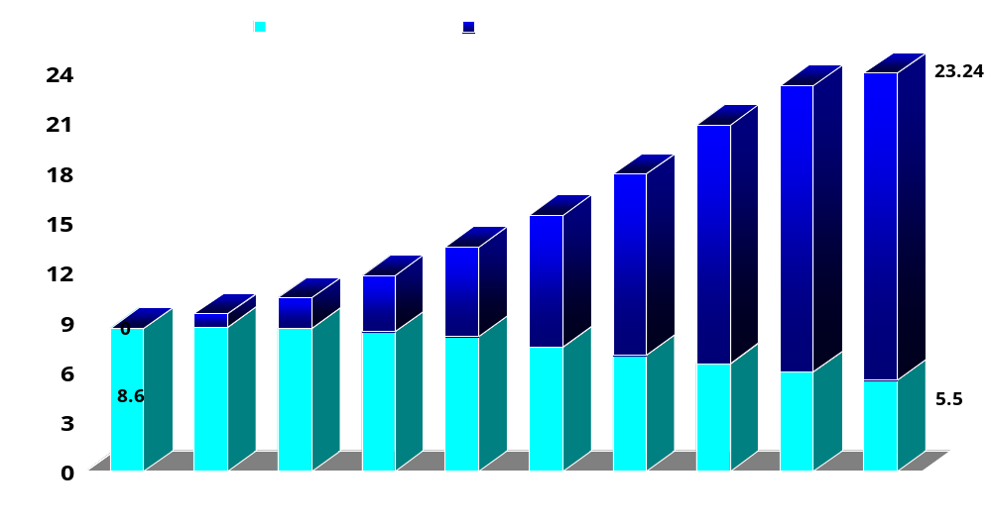
U.S.A Hearing Aid Market
Projected UNIT Forecast w/ Mass Market Channels
In Millions of units
Market Share of Dispensers is reduced over time
**Assumes 70% of users will purchase 2 hearing aids
Source: Hearing Central LLC., 1390 Kathryn lane, Lake Forest IL 60045 www.hearingcentral.com
Notes:
More outlets will cause adoption rate to rise from 25% to about 57% by 2015
This translates into about 23,240,000 units being sold by 2015
Lower prices and mass marketers will drive out inefficient dispensers

Slide 25
U.S.A Hearing Aid Market
Projected UNIT Forecast w/ Mass Market Channels
Comments on Prior Graph
Current trends will continue where 70% of purchasers choose 2 hearing aids (binaural)
67% market penetration rate by 2015 translates to over 23 million hearing aids
Market will split into:
  OTC (low cost/low maintenance) hearing aids sold through mass marketers/Internet/mail order
  Custom /programmable hearing aids (high cost) sold through traditional channels
Source: Hearing Central LLC., 1390 Kathryn lane, Lake Forest IL 60045 www.hearingcentral.com
Notes:
More outlets will cause adoption rate to rise from 25% to about 57% by 2015
This translates into about 23,240,000 units being sold by 2015
Lower prices and mass marketers will drive out inefficient dispensers

Slide 26
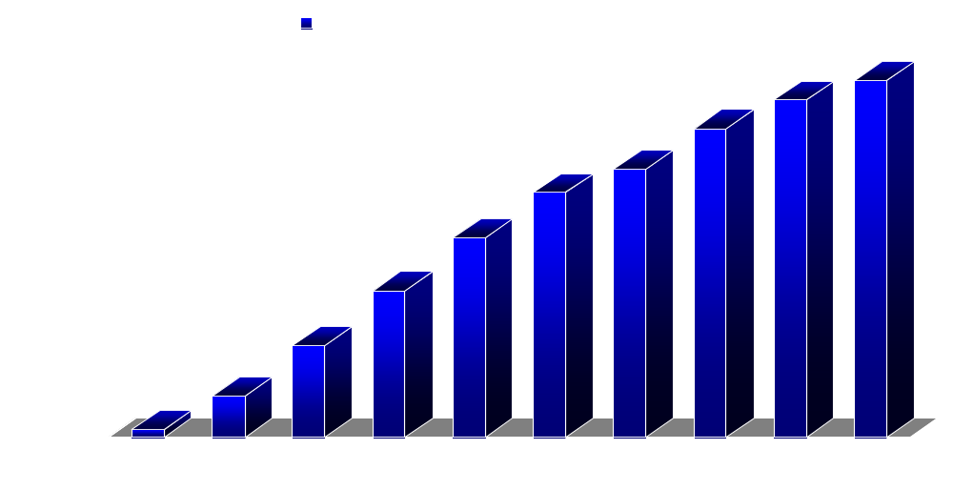
U.S.A Hearing Aid Market
Dollar Value of Mass Market Channels
(67% of Total Market in 2015)
23,240,000 units
X$125
In Millions of Dollars
**Assumes 70% of users will purchase 2 hearing aids
Source: Hearing Central LLC., 1390 Kathryn lane, Lake Forest IL 60045 www.hearingcentral.com
Notes:
More outlets will cause adoption rate to rise from 25% to about 57% by 2015
Lower prices and mass marketers will drive out inefficient dispensers

Slide 27
U.S.A Hearing Aid Market
Dollar Value of Mass Market Channels
Comments on Prior Graph
In the next 10 years, the growth rate in hearing aid sales will accelerate
Mass marketers and other efficient channels (Internet and mail order) can expect to participate in a 5 Billion dollar market by 2015
Source: Hearing Central LLC., 1390 Kathryn lane, Lake Forest IL 60045 www.hearingcentral.com
Notes:
More outlets will cause adoption rate to rise from 25% to about 57% by 2015
Lower prices and mass marketers will drive out inefficient dispensers

Slide 28
U.S.A Hearing Aid Market
Requirements for Entry
Customer Education
  They don’t need a prescription
  They don’t need to visit a dispenser or MD/ENT
  No Medicare or Medicaid reimbursement (except VA)
Hearing Aid Requirements
  Need sufficient display “shelf space” (website or store)
  Must be high quality (perceived value for the money)
  Must be relatively inexpensive i.e. must hit price points
    $299 - $899 in 2007
    $99? - $499? in 2015
  No custom molds i.e. no visit required to audiologist
  Self regulation – Easy to adjust (volume control)
  Self Maintain - Easy to clean
Source: Hearing Central LLC., 1390 Kathryn lane, Lake Forest IL 60045 www.hearingcentral.com

Slide 29
Mass Market Entry Options
U.S.A Hearing Aid Market
Option 1: Put Audiologists in Stores
  Lease space or hire audiologists
  Advantages
    Professional can dispense & answer questions
    Complies with most State regulations
  Disadvantages
    Customer must make appointment if
    audiologist is busy (impulse buy is dampened)
    Customer must meet with a professional
    i.e. Audiologist must “dispense”
    Hearing aids can probably be sold for under $1,000
    Depending on price, margins can be reasonable or
    relatively low
Source: Hearing Central LLC., 1390 Kathryn lane, Lake Forest IL 60045 www.hearingcentral.com

Slide 30
U.S.A Hearing Aid Market
Mass Market Entry Options
Option 2: Sell Directly Thru Web & Store
Phase I: Start selling on corporate website
  Lower startup costs
  Suppliers can fulfill orders
    No inventory carrying costs
    Requires Supply Chain integration
  Can see how hearing aids sell
Phase II: Start selling Direct in stores
  Pilot test in a city/ region
  Go nation-wide after kinks worked out
Source: Hearing Central LLC., 1390 Kathryn lane, Lake Forest IL 60045 www.hearingcentral.com

Slide 31
U.S.A Hearing Aid Market
Mass Market
Web/Store Product Strategies
Start selling just 2 models (will meet most
consumer requirements)
  Sell one OTE digital model (Over the Ear)
  w/ the new “open ear” technology
    Advantages
      No mold i.e. no audiologist fitting required
      Self fitting
      Lightweight and invisible
  Sell one ITE digital model (In The Ear)
    Find one that doesn’t require a mold
    Find one that will fit in either ear
Source: Hearing Central LLC., 1390 Kathryn lane, Lake Forest IL 60045 www.hearingcentral.com

Slide 32
U.S.A Hearing Aid Market
Web/Store Product Strategies
December 2007 Update
Costco is now selling hearing aids in their stores using audiologists:
  Name brand CICs, ITEs and OTEs. Price points are $1500 - $2,000 each – about a 30% discount from regular audiologists
Walmart is now selling hearing aids through their website:
  “Sport Ears” (ITE) ostensibly for the hunter market ($380)**Update Feb. 2008 – These are no longer on the Walmart website
  Walker (BTE) “Game Ear” ostensibly for the gamer market ($199)

Slide 33
U.S.A Hearing Aid Market
Web/Store Product Strategies (1 of 3)
December 2007 Update – Big Boxes
Target is selling on the hearing aid periphery thru their website
  “Listen up” – ear pieces and pocket amplifier for TV/theater listening ($14.95)
  “TV Ears” – for listening to TV ($69.99 - $99.99)
Costco is selling “TV assistants” on the hearing aid periphery thru their website
  “TV Ears” – ($59.99 - $89.99)

Slide 34
U.S.A Hearing Aid Market
Web/Store Product Strategies (1 of 3)
June 2008 Update –The March Continues
Target now is selling hearing aids thru their website
  “Nexear” – Selling for $429.99
Drugstore.com is selling hearing aids thru their website
  NexEar – selling for $499.99
Discount Drug Mart stores are selling NexEar –
  no other info
CVS website is selling 2 models of NexEar –
$389.99 and $489.99

Slide 35
U.S.A Hearing Aid Market
Web/Store Product Strategies (2 of 3)
June 2008 Update – Drug Store Chains
BJ’s – No Action
Walgreen – No Action
CVS – No action
Rite Aid – No Action
Longs Drugs – No Action
Jean Coutu – No Action
NOTE: Just because there is no action at this date, it does not mean these channels are not seriously looking at the hearing aid market. Some or all of these Drug Store Chains are already opening medical clinics in certain stores. If this trend becomes prevalent, there is no reason why these clinics could not also offer optometry and audiology products and services.

Slide 36
U.S.A Hearing Aid Market
Web/Store Product Strategies (3 of 3)
June 2008 Update- Grocery Chains
(A possible future 800 lb. gorilla)
Grocery stores get 8-10 times the foot traffic of most drug stores.
Many grocery chains now have a small pharmacy in an area of their store, usually a contractor arrangement with a local hospital or pharmacy chain.
  As with the Drug Store Chains, there is no reason why these in-Grocery Store drug dispensing centers could not also offer clinical services and optometry and audiology products at a future date.
  (We will have more details on this channel in future updates)

Slide 37
Marketing Issues
U.S.A Hearing Aid Market
Source: Hearing Central LLC., 1390 Kathryn lane, Lake Forest IL 60045 www.hearingcentral.com

Slide 38
U.S.A Hearing Aid Market
Barriers to Entry
Regulations Differ from State to State
  Some State require a licensed dispenser
  Some states have reciprocal dispenser recognition
  (Licensed dispenser can be in another state)
  Some States do not require a licensed dispenser
FDA Regulations
  Anyone who wants to purchase a hearing aid may do so without visiting a doctor but the customer “must be given the opportunity to sign a waiver”
  All states incorporate these FDA regulations into their statutes
  ALWAYS have customer sign the waiver and keep on file for State or FDA inspection (website click-thru’s are OK)
Source: Hearing Central LLC., 1390 Kathryn lane, Lake Forest IL 60045 www.hearingcentral.com

Slide 39
U.S.A Hearing Aid Market
Overcoming Legal Barriers
Hire/Train dispensers in each State (Dispensers are NOT required full-time in each store!) ***
  Initially 1 or 2 licensed dispensers per State
    They visit a store every week or two
    Visit times are posted for customers
    Customer can set up a time for consultation
IMPORTANT: To meet State regulations customer should
always be given the opportunity to set up a time to see a dispenser at the time of first interest or at the time of sale. Make sure FDA handout and waiver is signed by customer and kept on file
***As long as a dispenser is available at reasonable dates and times at a store,
it appears that this arrangement will meet most State requirements.
(Have your legal counsel review this strategy for compliance)
Source: Hearing Central LLC., 1390 Kathryn lane, Lake Forest IL 60045 www.hearingcentral.com

Slide 40
U.S.A Hearing Aid Market
Regulatory Strategy
For Chain Drug stores – Get the NACDS to petition/ lobby the FDA to make certain hearing aid models reclassified as OTC (Over The Counter i.e no professional intermediary)
  Arguments to use
    New hearing aids do not require canal molds
      New “Open Ear” OTEs have no occlusion
      Certain ITE models have soft tips instead
      of a canal mold
    Once the FDA gives their blessings, the States
    will defer to the FDA within 18 mos. and follow suit
  The potential market size of $5 Billion would justify
  the lobbying investment
Source: Hearing Central LLC., 1390 Kathryn lane, Lake Forest IL 60045 www.hearingcentral.com

Slide 41
U.S.A Hearing Aid Market
Store Strategy
Source: Hearing Central LLC., 1390 Kathryn lane, Lake Forest IL 60045 www.hearingcentral.com

Slide 42
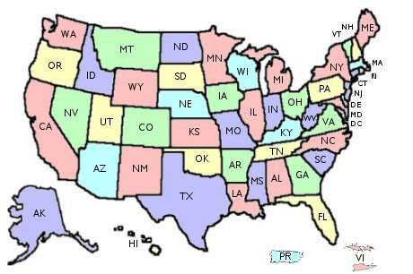

U.S.A Hearing Aid Market
Store Intro Strategy
Choose one State
Rollout to stores in all large metro
areas within designated state
within 3 months
Evaluate
Modify the strategy
Rollout to rest of state within 3 more months
Re-Evaluate
Re-Modify the strategy
Go nationwide after 6 months
Source: Hearing Central LLC., 1390 Kathryn lane, Lake Forest IL 60045 www.hearingcentral.com

Slide 43
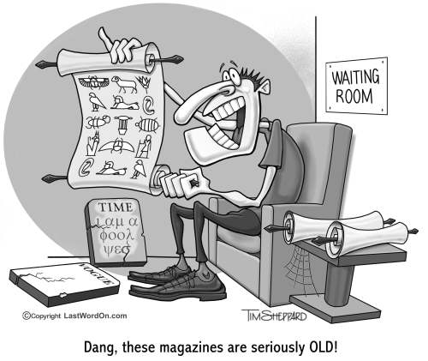
U.S.A Hearing Aid Market
Suggested Store Placement
Keep inventory behind pharma / vision counter
1 of each model on a secure display and 2 of each model in inventory
Have POP display at end-cap or in Pharma/ vision waiting area (4-6 sq.ft. ?)
Nice to have:
  TV on POP display with a 2 minute VCR/CD tape loop
  PC w/ hearing test for self hearing test

Slide 44
U.S.A Hearing Aid Market
Summary
The hearing aid market is too big to ignore
Current distribution channels (audiologists
and dispensers) cannot meet current and
future market needs
Reclassification of some hearing aids
as OTC (Over The Counter) by the FDA
will open up this market
Source: Hearing Central LLC., 1390 Kathryn lane, Lake Forest IL 60045 www.hearingcentral.com

Slide 45
U.S.A Hearing Aid Market
Author Information
For comments and feedback on
this presentation, please contact:
Phil Wyatt CEO
Hearing Central LLC Group
1390 Kathryn Lane
Lake Forest IL 60045
847-295-6946
phil@hearingcentral.com
The Hearing Central Group LLC manufactures and distributes hearing aids for resale to mass marketers such as drug store chains and other high volume discount big box stores. The group also market their hearing aids through their own websites directly to consumers (www.hearingcentral.com and www.hearingaidscentral.com).
Source: Hearing Central LLC., 1390 Kathryn lane, Lake Forest IL 60045 www.hearingcentral.com

