Slide 1
Opening
NexaMart Enterprise Data Warehouse
Source
Milestone 2 · Assignment 4 · Group Arif
12 slides + appendix
30-35 min + Q/A
Every member speaks
Pipeline
KPIs
Member Name
Roll No
Assigned Role
Completion %
Muhammad Arif Rubbani
L1F22BSDS0010
Lead — warehouse build
100%
Khallad Ahmad
L1F22BSDS0020
Identity & GMV model
100%
Business Answer
Sameen Fatima
L1F21BSDS0004
Product master
100%
Asad Ali
L1F22BSDS0030
Inventory
100%
Hamza Asim
L1F22BSDS0031
Sales & returns
100%
Azhar Sajjad
L1F22BSDS0021
Reviews & marketplace
100%
Every figure traces to a live NEXAMART_MARTS view; supporting screenshots in the evidence appendix.
NexaMart EDW · Milestone 2

Slide 2
Business Problem
1. Business Problem
Business
Explain why a data warehouse was needed before showing technical work.
Main Business Question
Department
What Looked Wrong
Student Explanation
Was the Back-to-School campaign actually successful, or were the numbers misleading?
Sales
Revenue looked high
A1 + A4: ₹0.41 Cr cancelled & ₹1.72 Cr seller-sold over-counted
Finance
Net revenue was lower
GSV ₹141.51 Cr → NCR ₹138.35 Cr after leakage
Inventory
Stock availability unreliable
A5/A6 fixed; inventory 99.47% accurate
Presenter Instruction
Ecommerce
Cart abandonment increased
Cart abandonment 41.5%; on-time delivery 54.2%
Do not start with code. Start with the business confusion and why different departments reported different answers.
NexaLocal
Sold listings not confirmed sales
A4 → ESTIMATED; B6 ₹1.26 Cr ±35%, never in NCR
Support
Complaint volume inflated
A16: 7 duplicate cases deduped
Expected Speaking Point
Our presentation will prove what we built, which anomalies we found, how we solved them, and what the BI dashboard says about the business.
NexaMart EDW · Milestone 2

Slide 3
Architecture
2. Overall Architecture
Pipeline
Show the end-to-end flow from source data to dashboard.
SQLite Source
Databricks
Snowflake Bronze
Snowflake Silver
Snowflake Gold
Snowflake Marts
Power BI/Tableau
Operational data
PySpark processing
Raw layer
Clean + flagged
Kimball model
KPI views
Business dashboard
Layer
Purpose
Group Evidence to Show
Bronze
Raw data loaded without transformation
Snowsight: 61 tables, 843,304 rows (E1)
Silver
Cleaning, standardization, anomaly flagging
05/06 notebooks; anomaly_flag counts (E2/E3)
Gold
13 dimensions + 14 facts using Kimball design
27 tables = 13 dims + 14 facts; grain check (E1/E4)
Marts
KPI views for stakeholder reporting
kpi_views.sql — 28 views (E5)
BI Dashboard
Business analysis and final decision
4 Power BI pages + funnel (E6)
Built on NEXAMART_DW (Snowflake) via Databricks PySpark; the dashboard reads MARTS views only.
NexaMart EDW · Milestone 2

Slide 4
Assignment 3
3. Assignment 3 / Milestone 1 Completion
Milestone 1
Summarize what was completed in Bronze, Silver, and Gold.
Required Work
Completed?
Evidence
Required Message
Loaded 61 Bronze tables
Yes
61 tables, 843,304 rows (E1)
Milestone 1 builds the warehouse and preserves anomalies in Silver. Do not claim anomalies were solved in Assignment 3.
Created Silver notebooks
Yes
02_silver_* (8 notebooks)
Standardized dates and statuses
Yes
date/status normalization
Strong Evidence
Generated surrogate keys
Yes
surrogate keys on dims/facts
Show row counts, notebook runs, Snowflake schemas, Bus Matrix, grain declarations, and anomaly flag counts.
Built 13 dimensions
Yes
13 dims in NEXAMART_GOLD (E1)
Built 14 fact tables
Yes
14 facts in NEXAMART_GOLD (E1)
Weak Evidence
Created Bus Matrix
Yes
docs/bus_matrix.md
Only saying "we completed it" without screenshots, files, or query outputs is not acceptable.
Declared fact grains
Yes
grain per fact (report S2)
Flagged anomalies in Silver
Yes
anomaly_flag on Silver (E2)
NexaMart EDW · Milestone 2

Slide 5
Assignment 4
4. Assignment 4 / Milestone 2 Completion
Milestone 2
Summarize anomaly resolution, validation, KPI views, and dashboard work.
Required Work
Completed?
Evidence
Mandatory Flow
SQL anomaly identification
Yes
anomaly_discovery.sql (E2)
Identify in Snowflake SQL -> Fix in Databricks PySpark -> Rebuild Gold -> Validate -> Analyze BI dashboard.
PySpark anomaly resolution
Yes
05_anomaly_resolution.ipynb (E3)
Corrected Silver tables
Yes
corrected Silver (E2/E3)
Rebuilt affected Gold tables
Yes
9 facts rebuilt, Δ0 (E4)
Student Must Say
Which anomalies were resolved, which tables changed, and which KPI values changed after the rebuild.
Ran validation suite
Yes
validation_suite.sql 9/10 (E4)
Created KPI views
Yes
kpi_views.sql — 28 views (E5)
Built BI dashboard
Yes
nexamart_dashboard.pbix + PNGs (E6)
Evidence Rule
Final campaign conclusion
Yes
report S5 + dashboard (E6)
Every claim must be linked to a screenshot, query result, notebook output, or dashboard page.
NexaMart EDW · Milestone 2

Slide 6
Anomalies
5. Anomalies Found
Anomaly List
List actual anomalies found by your group and their business impact.
Code
Anomaly Name
Category
System/Table
Business Impact
A1
Cancelled order counted in revenue
A
Ecommerce / revenue
₹0.41 Cr removed (94 orders) · M5
A3
Mixed tax bases (POS incl vs EC excl)
A
POS / ecommerce / marketplace
₹16.25 Cr on one basis · M5
A4
NexaLocal sold counted as confirmed revenue
A
NexaLocal
₹1.72 Cr → ESTIMATED (449) · M6
A6
Negative store inventory
A
Inventory
8 rows → 0; oversell flag · M4
A16
Duplicate complaint cases
A
Customer support
7 cases deduped · M6
B6
Estimated Classified GMV model
B
NexaLocal (vw_estimated_classified_gmv)
₹1.26 Cr ±35%, ESTIMATED · M2
24 anomalies total: 16 Category A (clear bugs) + 8 Category B (judgment calls, defended).
NexaMart EDW · Milestone 2

Slide 7
Detection
6. How We Detected the Anomalies
SQL Proof
Explain detection logic, not only anomaly names.
Anomaly
Detection Logic
Tool Used
Evidence to Show
Cancelled order in revenue
status='CANCELLED' AND subtotal_excl_tax>0 → 94
Snowflake SQL
sf_detect_A1 (E2)
Negative ATP
sellable_qty<0 OR physical_qty<0 → 8
SQL / PySpark
sf_detect_A6 (E2)
Duplicate complaints
is_duplicate_flag = TRUE → 7
PySpark
sf_detect_A16 / 05 notebook (E2/E3)
NexaLocal false revenue
event_type_code='SELLER_SOLD' → 449
Snowflake SQL
sf_detect_A4 (E2)
Category B anomaly
B6 GMV: weighted signals vs raw seller-sold value
SQL + PySpark
vw_estimated_classified_gmv (E5)
Must Show
Must Show
Must Show
At least one SQL query screenshot
At least one query output screenshot
Anomaly flag visible in Silver
NexaMart EDW · Milestone 2

Slide 8
Resolution
7. How We Solved the Anomalies
Fix Logic
Show before, fix logic, after, and validation evidence.
Anomaly
Before Fix
Fix Applied
After Fix
Validation
Cancelled revenue
Cancelled orders had revenue
ZEROED_CANCELLED_REVENUE
94 → 0
recheck PASS
Tax/shipping mismatch
Revenue bases differed
NORMALISED_TAX_EXCLUSIVE
₹16.25 Cr one basis
KPI PASS
Negative ATP
8 negative-qty rows
CORRECTED_ATP_TO_ZERO
8 → 0
check PASS
Duplicate complaints
7 duplicate cases
DEDUPED_CANONICAL_CASE
7 → deduped
dedup PASS
NexaLocal false revenue
449 SELLER_SOLD as revenue
RELABELLED_ESTIMATED_GMV
₹1.72 Cr → ESTIMATED
C9 segregation PASS
For Category B anomalies, explain why your chosen interpretation is better than alternatives and quantify the impact if possible.
NexaMart EDW · Milestone 2

Slide 9
Validation
8. Gold Rebuild and Validation
Validation
Prove what changed after fixing the data.
Question
Answer
Validation Check
Before Fix
After Fix
Status
Which Silver tables were corrected?
16 silver_* tables (with audit columns)
Cancelled revenue anomaly count
94
0
PASS
Which Gold tables were affected?
9 of 14 facts affected
Negative ATP rows
8
0
PASS
Which Gold tables were rebuilt?
Same 9 facts rebuilt (06 notebook)
Which validation checks passed?
9 of 10 (C8 documented)
Duplicate complaint count
7
0
PASS
What changed in final numbers?
GSV 141.51 / NCR 138.35 Cr; A1 −0.41; A4→EST
Metric certainty nulls
—
0
PASS
Referential integrity issues
—
0
PASS
Presenter Instruction
Grain violation check
—
0
PASS
Do not only say validation passed. Show before and after counts and mention which notebooks or SQL files produced them.
Required Evidence
validation_suite.sql output + affected Gold table row counts
NexaMart EDW · Milestone 2

Slide 10
BI Dashboard
9. BI Dashboard Analysis
Dashboard
Show dashboard screenshots and explain what the business learned.
Executive Summary
Sales by Channel
Inventory Health
GSV, NCR, margin, leakage
Store / Ecommerce / Marketplace
ATP, stockout, oversell
Customer Journey
NexaLocal & Seller Quality
Funnel, cart abandonment
Estimated GMV, risk tiers
Business Area
Dashboard Finding
Business Meaning
Revenue
GSV ₹141.51 Cr vs NCR ₹138.35 Cr
₹3.16 Cr gap = leakage + reclassification
Finance
Leakage ₹0.41 Cr cancel + ₹0.65 Cr refunds
Trusted top-line is NCR, not GSV
Inventory
99.47% accurate; stockout ≤1/195 SKU-days
Few campaign days; A5/A6 corrected
NexaLocal
Estimated GMV ₹1.26 Cr ±35% (ESTIMATED)
Never added to NCR; demand signal only
Margin is deferred (COGS unpopulated); the Executive-Summary waterfall page is in finalisation — figures shown are from live MARTS views.
NexaMart EDW · Milestone 2

Slide 11
Conclusion
10. Final Business Conclusion
CEO Answer
Our verdict: clearly positive on a certainty-segregated, anomaly-corrected basis.
KPI
Result
Certainty
Interpretation
Final Answer
Gross Sale Value
₹141.51 Cr
Confirmed
Gross, tax-exclusive, all channels
Successful — clearly positive (certainty-segregated, anomaly-corrected)
Net Confirmed Revenue
₹138.35 Cr
Confirmed
Trusted top-line after leakage
Net Margin
Deferred
Deferred
COGS unpopulated — not yet meaningful
Sample Wording
Campaign-window confirmed revenue ran +₹1.27 Cr above baseline. The legacy +34% headline was inflated by A1 (₹0.41 Cr cancelled) and A4 (₹1.72 Cr seller-sold), now corrected. The verdict follows from 24 resolved anomalies, not opinion.
Revenue Leakage
₹1.06 Cr
Confirmed
₹0.41 Cr cancel + ₹0.65 Cr refunds
Stockout Rate
≤1/195 SKU-days
Confirmed
Few campaign days; corrected
Cart Abandonment Rate
41.5%
Confirmed / Inferred
684/1,647 whole-period
Not Allowed
Estimated Classified GMV
₹1.26 Cr ±35%
Estimated
Demand signal; never in NCR
Do not conclude only: "sales increased, so campaign was successful."
NexaMart EDW · Milestone 2

Slide 12
Contribution
11. Member-Wise Contribution and Final Proof
Accountability
Every member must present the part they personally completed.
Member
Assigned Work
Output Produced
Completion %
Evidence
Arif Rubbani (Lead)
Bronze + lead build
Gold rebuild, validation, KPI views
100%
05/06, validation_suite.sql, report (E1–E5)
Khallad Ahmad
Customer identity & seller-trust
dim_customer, dim_seller_risk_tier
100%
A11, B5/B6/B8 (E2/E3)
Sameen Fatima
Product master
dim_product, dim_listing_condition
100%
A9, B4 (E2/E3)
Asad Ali
Inventory Silver
dim_store, fact_warehouse_inventory_snapshot
100%
A6, A10 (E2/E3)
Hamza Asim
Sales / payments / returns
fact_store_sale_line, dim_promotion
100%
A1, A2, A3 (E2/E3)
Azhar Sajjad
Reviews / support / marketplace
dim_seller, fact_customer_review
100%
A4, A13, A15, A16 (E2/E3)
Required Proof
Shown?
Required Proof
Shown?
Required Proof
Shown?
Snowflake schemas/tables
Yes
Silver anomaly flags
Yes
Validation suite result
Yes
Bronze row count validation
Yes
PySpark fix notebook
Yes
BI dashboard screenshots
Yes
Anomaly SQL output
Yes
Gold rebuild evidence
Yes
Member contribution table
Yes
No proof means no full marks for that part. Each member must answer questions about their own work.
NexaMart EDW · Milestone 2

Slide 13
Q/A
Appendix: Questions
Appendix
Prepare every member for individual questions. Do not include this slide in the 12-slide limit.
Anomaly Impact
Validation
Which anomaly had the biggest business impact and why?
What was the before vs. after count?
Detection Proof
Dashboard Meaning
What SQL query proved the anomaly?
What does your BI dashboard say about campaign success?
Fix Logic
Certainty
Which PySpark logic fixed it?
Why must Estimated Classified GMV not be mixed with Confirmed GMV?
Rebuild Scope
Member Work
Which Gold tables were rebuilt and why?
Which exact file, notebook, or query did you personally complete?
Final Reminder
Every group must prove: what was built, what anomalies were found, how they were solved, what changed, and what the dashboard means for business.
NexaMart EDW · Milestone 2

Slide 14
Members
Member-Wise Breakdown - discovery -> resolution -> impact per member (back-up)
Not part of the 12-slide presented deck. Each member presents their own 3 slides:
Discovery (detection, E2) -> Resolution (fix, E3) -> Impact (KPI / Rs, E5).
24 anomalies across 6 members: Lead 9 - Khallad 4 - Azhar 4 - Hamza 3 - Sameen 2 - Asad 2.
NexaMart EDW · Milestone 2
__MEMBER_SECTION__

Slide 15
Member - Lead
Arif Rubbani - Discovery
Lead - Infra & Reconciliation - Roll L1F22BSDS0010 - anomalies: A5, A7, A8, A12, A14, B1, B2, B3, B7
M1 built: 5 lookup dims + 8 facts (EC order line, fulfilment, inventory, web, complaint) | M2: 3 KPI views + validation C1/C2/C5/C7/C10 + orchestration + Dashboard P1
Anomaly | Detection logic | Tool | Evidence
A5 ATP positive, physical zero | atp_qty>0 AND physical_qty=0 (5) | Snowflake SQL | discovery.sql (E2)
A7 Restock before inspection | inspection_status='PENDING' AND restocked_qty>0 (10) | Snowflake SQL | discovery.sql (E2)
A8 Missing snapshot days | stores 3/7/12 x (1-7 Aug) absent from snapshots (~21) | Snowflake SQL | discovery.sql (E2)
A12 Relisted after sold | self-join image_hash+seller, prior SOLD/EXPIRED -> ACTIVE (3 pairs) | Snowflake SQL | discovery.sql (E2)
A14 Courier clock drift | delivered_ts < pickup_ts (strict) (18) | Snowflake SQL | discovery.sql (E2)
B1 Campaign attribution bridge | 126 promo-less in-window + prior BTS2024 UTM session | PySpark (05) | 05 nb (E3)
B2 Cross-period partial refund | Aug sale / Sep refund, 1 row | PySpark (05) | 05 nb (E3)
B3 Null-reference movements | 175 PCK movements with NULL reference_number | PySpark (05) | 05 nb (E3)
B7 BOPIS scan miss | 25 BOPIS DELIVERED with no BOPIS_COLLECTED scan | PySpark (05) | 05 nb (E3)
NexaMart EDW · Milestone 2
__MEMBER_SECTION__

Slide 16
Member - Lead
Arif Rubbani - Resolution
Lead - Infra & Reconciliation - Roll L1F22BSDS0010 - anomalies: A5, A7, A8, A12, A14, B1, B2, B3, B7
M1 built: 5 lookup dims + 8 facts (EC order line, fulfilment, inventory, web, complaint) | M2: 3 KPI views + validation C1/C2/C5/C7/C10 + orchestration + Dashboard P1
Anomaly | Before fix | Fix applied | After fix | Validation
A5 ATP positive, physical zero | 5 | CORRECTED_ATP_TO_ZERO | 5 -> 0 | recheck -> 0 (PASS)
A7 Restock before inspection | 10 | ZEROED_RESTOCK_PRE_INSPECTION | 10 -> 0 | recheck -> 0 (PASS)
A8 Missing snapshot days | ~21 missing | RECONSTRUCTED_SNAPSHOT | ~21 rebuilt | INFERRED, pre-campaign only
A12 Relisted after sold | 3 pairs | LINKED_RELISTING_EXCLUDED | excl. from GMV | reliability LOW
A14 Courier clock drift | 18 | CORRECTED_DELIVERY_TS / ESCALATED (>72h) | <=72h fixed | on-time rate corrected
B1 Campaign attribution bridge | 126 ambiguous | ATTRIBUTED 102 @ conf 0.85 | 102 attributed | certainty 0.85
B2 Cross-period partial refund | period ambiguity | RECOGNISE_IN_RETURN_PERIOD | both exposed | GAAP matching
B3 Null-reference movements | 175 | PROBABLE_MISSING_REF | INFERRED | back-fill lag, not shrinkage
B7 BOPIS scan miss | 25 | TREAT_AS_FULFILLED (+collection_unconfirmed) | excl. BOPIS SLA | ~13% scan-miss baseline
NexaMart EDW · Milestone 2
__MEMBER_SECTION__

Slide 17
Member - Lead
Arif Rubbani - Impact
Lead - Infra & Reconciliation - Roll L1F22BSDS0010 - anomalies: A5, A7, A8, A12, A14, B1, B2, B3, B7
M1 built: 5 lookup dims + 8 facts (EC order line, fulfilment, inventory, web, complaint) | M2: 3 KPI views + validation C1/C2/C5/C7/C10 + orchestration + Dashboard P1
Anomaly | Business impact | KPI / metric corrected | Certainty
A5 ATP positive, physical zero | oversell risk removed | vw_atp / stockout | CONFIRMED
A7 Restock before inspection | ATP inflation removed | vw_return_to_restock | CONFIRMED
A8 Missing snapshot days | allocation accuracy for 1-7 Aug ramp-up | inventory accuracy | INFERRED
A12 Relisted after sold | GMV double-count removed | vw_relisting_rate | INFERRED
A14 Courier clock drift | on-time delivery rate corrected | vw_on_time_delivery_rate | CONFIRMED
B1 Campaign attribution bridge | alt: not attributing understates ~Rs 0.94 Cr confirmed | vw_campaign_incremental_revenue | CONFIRMED
B2 Cross-period partial refund | alt: original period cuts Aug NCR ~Rs 2.16 L | NCR timing | CONFIRMED
B3 Null-reference movements | alt: shrinkage reading overstates loss | inventory movements | INFERRED
B7 BOPIS scan miss | alt: not-collected understates fulfilment | BOPIS readiness | INFERRED
NexaMart EDW · Milestone 2
__MEMBER_SECTION__

Slide 18
Member - M2
Khallad Ahmad - Discovery
Customer Identity & Seller Trust - Roll L1F22BSDS0020 - anomalies: A11, B5, B6, B8
M1 built: dim_customer (SCD2), dim_seller_risk_tier, fact_seller_performance_snapshot | M2: 8 NexaLocal/seller KPI views + validation C6/C9 (certainty) + Dashboard P5
Anomaly | Detection logic | Tool | Evidence
A11 Placeholder-ID collision | customer_id='9999' shared by guest + real loyalty (178) | Snowflake SQL | discovery.sql (E2)
B5 Cross-channel identity merge | 1 cross-channel pair @ 0.92 confidence | PySpark (05) | 05 nb (E3)
B6 Estimated Classified GMV model | weighting choice for NL signals | PySpark (05) | 05 nb (E3)
B8 Seller trust score model | weighting choice for 8 trust signals | PySpark (05) | 05 nb (E3)
NexaMart EDW · Milestone 2
__MEMBER_SECTION__

Slide 19
Member - M2
Khallad Ahmad - Resolution
Customer Identity & Seller Trust - Roll L1F22BSDS0020 - anomalies: A11, B5, B6, B8
M1 built: dim_customer (SCD2), dim_seller_risk_tier, fact_seller_performance_snapshot | M2: 8 NexaLocal/seller KPI views + validation C6/C9 (certainty) + Dashboard P5
Anomaly | Before fix | Fix applied | After fix | Validation
A11 Placeholder-ID collision | 178 | REKEYED_GUEST_BUCKET (GUEST-{session}) | 178 -> 0 | recheck -> 0 (PASS)
B5 Cross-channel identity merge | 1 pair @0.92 | MERGED (threshold >=0.90) | merged | 0.90 conservative
B6 Estimated Classified GMV model | weighting choice | weighted 0.60/0.15/0.08/0.30 + -/+35% band | ESTIMATED | C9: never in NCR
B8 Seller trust score model | weighting choice | weighted 8-signal -> 5 tiers | tier label | not equal-weight (brief)
NexaMart EDW · Milestone 2
__MEMBER_SECTION__

Slide 20
Member - M2
Khallad Ahmad - Impact
Customer Identity & Seller Trust - Roll L1F22BSDS0020 - anomalies: A11, B5, B6, B8
M1 built: dim_customer (SCD2), dim_seller_risk_tier, fact_seller_performance_snapshot | M2: 8 NexaLocal/seller KPI views + validation C6/C9 (certainty) + Dashboard P5
Anomaly | Business impact | KPI / metric corrected | Certainty
A11 Placeholder-ID collision | real customer profile de-collided | dim_customer integrity | CONFIRMED
B5 Cross-channel identity merge | alt: 0.70 over-merges distinct customers | dim_customer | CONFIRMED
B6 Estimated Classified GMV model | Rs 1.26 Cr point (band Rs 0.82-1.70 Cr) | vw_estimated_classified_gmv | ESTIMATED
B8 Seller trust score model | alt: equal-weight unacceptable; 348 sellers LOW band | vw_seller_risk_score_distribution | CONFIRMED
NexaMart EDW · Milestone 2
__MEMBER_SECTION__

Slide 21
Member - M3
Sameen Fatima - Discovery
Product Master & Matching - Roll L1F21BSDS0004 - anomalies: A9, B4
M1 built: dim_product (SCD2, most-shared), dim_listing_condition | M2: vw_open_box_conversion_rate + validation C3 (grain) + supports Dashboard P2/P3
Anomaly | Detection logic | Tool | Evidence
A9 SKU / product mismatch | silver_ts_seller_listings: listing 42 / NX-TECH-0001 (1) | Snowflake SQL | discovery.sql (E2)
B4 Catalogue fuzzy-match threshold | NexaLocal title -> catalogue (rapidfuzz) | PySpark (05) | 05 nb (E3)
NexaMart EDW · Milestone 2
__MEMBER_SECTION__

Slide 22
Member - M3
Sameen Fatima - Resolution
Product Master & Matching - Roll L1F21BSDS0004 - anomalies: A9, B4
M1 built: dim_product (SCD2, most-shared), dim_listing_condition | M2: vw_open_box_conversion_rate + validation C3 (grain) + supports Dashboard P2/P3
Anomaly | Before fix | Fix applied | After fix | Validation
A9 SKU / product mismatch | 1 | APPLIED_CANONICAL_PRODUCT | 1 -> 0 | recheck -> 0 (PASS)
B4 Catalogue fuzzy-match threshold | threshold call | MATCHED>=0.75 / REVIEW 0.65-0.75 / UNMATCHED<0.65 | per-threshold | avoids false matches
NexaMart EDW · Milestone 2
__MEMBER_SECTION__

Slide 23
Member - M3
Sameen Fatima - Impact
Product Master & Matching - Roll L1F21BSDS0004 - anomalies: A9, B4
M1 built: dim_product (SCD2, most-shared), dim_listing_condition | M2: vw_open_box_conversion_rate + validation C3 (grain) + supports Dashboard P2/P3
Anomaly | Business impact | KPI / metric corrected | Certainty
A9 SKU / product mismatch | category revenue corrected | product category | CONFIRMED
B4 Catalogue fuzzy-match threshold | alt: lower threshold injects mis-linked demand | demand signal | INFERRED
NexaMart EDW · Milestone 2
__MEMBER_SECTION__

Slide 24
Member - M4
Asad Ali - Discovery
Inventory Health - Roll L1F22BSDS0030 - anomalies: A6, A10
M1 built: dim_store, fact_warehouse_inventory_snapshot | M2: 6 inventory KPI views (ATP, stockout, accuracy) + validation C4/C8 + Dashboard P3
Anomaly | Detection logic | Tool | Evidence
A6 Negative store inventory | sellable_qty<0 OR physical_qty<0 (8) | Snowflake SQL | discovery.sql (E2)
A10 Open-box restocked as NEW | condition_on_receipt='OPENED' AND restocked_as_condition='NEW' (12) | Snowflake SQL | discovery.sql (E2)
NexaMart EDW · Milestone 2
__MEMBER_SECTION__

Slide 25
Member - M4
Asad Ali - Resolution
Inventory Health - Roll L1F22BSDS0030 - anomalies: A6, A10
M1 built: dim_store, fact_warehouse_inventory_snapshot | M2: 6 inventory KPI views (ATP, stockout, accuracy) + validation C4/C8 + Dashboard P3
Anomaly | Before fix | Fix applied | After fix | Validation
A6 Negative store inventory | 8 | CORRECTED_ATP_TO_ZERO (+oversell flag) | 8 -> 0 | recheck -> 0 (PASS)
A10 Open-box restocked as NEW | 12 | CORRECTED_CONDITION_OPEN_BOX | 12 -> 0 | recheck -> 0 (PASS)
NexaMart EDW · Milestone 2
__MEMBER_SECTION__

Slide 26
Member - M4
Asad Ali - Impact
Inventory Health - Roll L1F22BSDS0030 - anomalies: A6, A10
M1 built: dim_store, fact_warehouse_inventory_snapshot | M2: 6 inventory KPI views (ATP, stockout, accuracy) + validation C4/C8 + Dashboard P3
Anomaly | Business impact | KPI / metric corrected | Certainty
A6 Negative store inventory | stockout analysis fixed | vw_inventory_accuracy / oversell | CONFIRMED
A10 Open-box restocked as NEW | price premium quantified | vw_open_box_conversion | CONFIRMED
NexaMart EDW · Milestone 2
__MEMBER_SECTION__

Slide 27
Member - M5
Hamza Asim - Discovery
Sales, Payments & Returns - Roll L1F22BSDS0031 - anomalies: A1, A2, A3
M1 built: dim_promotion, fact_store_sale_line, fact_return_line (keystone EC fact rebuild) | M2: 6 Finance KPI views (GSV/NCR/leakage/payment-failure) + validation C4 + Dashboard P2
Anomaly | Detection logic | Tool | Evidence
A1 Cancelled order in revenue | order_status='CANCELLED' AND subtotal_excl_tax>0 (94) | Snowflake SQL | discovery.sql (E2)
A2 Payment captured after cancel | captured PG txn (captured_ts) after earliest CANCELLED (27) | Snowflake SQL | discovery.sql (E2)
A3 Mixed tax bases | POS incl-tax vs EC excl-tax basis differ (schema-wide) | PySpark | 05 nb (E3)
NexaMart EDW · Milestone 2
__MEMBER_SECTION__

Slide 28
Member - M5
Hamza Asim - Resolution
Sales, Payments & Returns - Roll L1F22BSDS0031 - anomalies: A1, A2, A3
M1 built: dim_promotion, fact_store_sale_line, fact_return_line (keystone EC fact rebuild) | M2: 6 Finance KPI views (GSV/NCR/leakage/payment-failure) + validation C4 + Dashboard P2
Anomaly | Before fix | Fix applied | After fix | Validation
A1 Cancelled order in revenue | 94 | ZEROED_CANCELLED_REVENUE | 94 -> 0 | recheck -> 0 (PASS)
A2 Payment captured after cancel | 27 | FLAGGED_REVERSAL_REQUIRED | 27 excl. NCR | held as liability, not revenue
A3 Mixed tax bases | mixed bases | NORMALISED_TAX_EXCLUSIVE | one basis | cross-channel KPI reconciles
NexaMart EDW · Milestone 2
__MEMBER_SECTION__

Slide 29
Member - M5
Hamza Asim - Impact
Sales, Payments & Returns - Roll L1F22BSDS0031 - anomalies: A1, A2, A3
M1 built: dim_promotion, fact_store_sale_line, fact_return_line (keystone EC fact rebuild) | M2: 6 Finance KPI views (GSV/NCR/leakage/payment-failure) + validation C4 + Dashboard P2
Anomaly | Business impact | KPI / metric corrected | Certainty
A1 Cancelled order in revenue | Rs 0.41 Cr (4.08M) over-count removed; deflated +34% claim | vw_revenue_leakage / NCR | CONFIRMED
A2 Payment captured after cancel | Rs 1.08 Cr reversal liability (excl. NCR) | NCR (excluded) | CONFIRMED
A3 Mixed tax bases | Rs 16.25 Cr put on a comparable basis | GSV/NCR cross-channel | CONFIRMED
NexaMart EDW · Milestone 2
__MEMBER_SECTION__

Slide 30
Member - M6
Azhar Sajjad - Discovery
Reviews, Support & Marketplace - Roll L1F22BSDS0021 - anomalies: A4, A13, A15, A16
M1 built: dim_seller, fact_customer_review, fact_classified_listing_event | M2: 4 customer-journey KPI views + assist C3/C9 + Dashboard P4
Anomaly | Detection logic | Tool | Evidence
A4 Seller-sold as confirmed rev | event_type_code='SELLER_SOLD' (449) | Snowflake SQL | discovery.sql (E2)
A13 Image-hash fraud ring | image_hash shared by >=2 seller accounts (3 rings, 18 listings) | Snowflake SQL | discovery.sql (E2)
A15 Review before delivery | days_post_delivery < 0 (25) | Snowflake SQL | discovery.sql (E2)
A16 Duplicate support cases | is_duplicate_flag=TRUE (7) | Snowflake SQL | discovery.sql (E2)
NexaMart EDW · Milestone 2
__MEMBER_SECTION__

Slide 31
Member - M6
Azhar Sajjad - Resolution
Reviews, Support & Marketplace - Roll L1F22BSDS0021 - anomalies: A4, A13, A15, A16
M1 built: dim_seller, fact_customer_review, fact_classified_listing_event | M2: 4 customer-journey KPI views + assist C3/C9 + Dashboard P4
Anomaly | Before fix | Fix applied | After fix | Validation
A4 Seller-sold as confirmed rev | 449 | RELABELLED_ESTIMATED_GMV | 449 -> 0 confirmed | feeds B6 at weight 0.60
A13 Image-hash fraud ring | 3 rings | FLAGGED_FRAUD_RING | rings flagged | trust & safety review
A15 Review before delivery | 25 | SET_VERIFIED_PURCHASE_FALSE | 25 -> unverified | recheck (PASS)
A16 Duplicate support cases | 7 | DEDUPED_CANONICAL_CASE | 7 -> deduped | distinct incidents only
NexaMart EDW · Milestone 2
__MEMBER_SECTION__

Slide 32
Member - M6
Azhar Sajjad - Impact
Reviews, Support & Marketplace - Roll L1F22BSDS0021 - anomalies: A4, A13, A15, A16
M1 built: dim_seller, fact_customer_review, fact_classified_listing_event | M2: 4 customer-journey KPI views + assist C3/C9 + Dashboard P4
Anomaly | Business impact | KPI / metric corrected | Certainty
A4 Seller-sold as confirmed rev | Rs 1.72 Cr moved out of Confirmed to ESTIMATED | Confirmed GMV -> ESTIMATED | ESTIMATED
A13 Image-hash fraud ring | coordinated listing ring surfaced | vw_validated_report_rate | CONFIRMED
A15 Review before delivery | review-score KPI corrected | review score | CONFIRMED
A16 Duplicate support cases | complaint volume corrected | complaint volume | CONFIRMED
NexaMart EDW · Milestone 2
__MEMBER_SECTION__

Slide 33
Appendix
Evidence Appendix — back-up proof (not part of the 12-slide deck)
Every figure on the main slides traces to a live NEXAMART_MARTS view.
SQL evidence below is run live as NEXAMART_ENGINEER on NEXAMART_DW (rhxendw-yb24678), 24 Jun 2026.
BI dashboard pages are exported from nexamart_dashboard.pbix (Power BI).
Evidence map: E1 schemas & layers · E2 detection · E3 resolution · E4 validation · E5 reconciled KPIs · E6 dashboard
NexaMart EDW · Milestone 2
__EVIDENCE_APPENDIX__

Slide 34
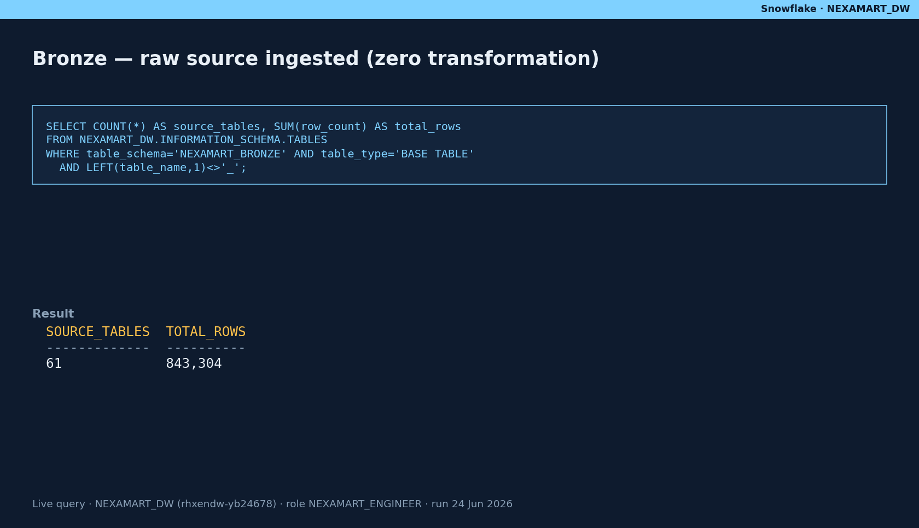
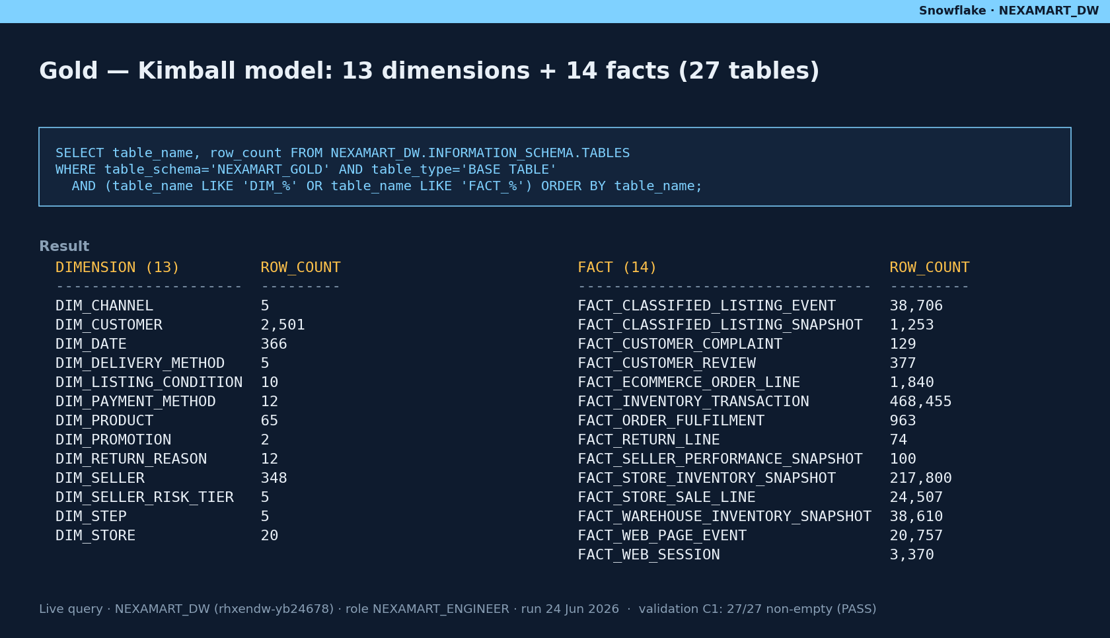
Evidence
Architecture evidence — Bronze ingestion & Gold Kimball model
E1
E1
NexaMart EDW · Milestone 2
__EVIDENCE_APPENDIX__

Slide 35
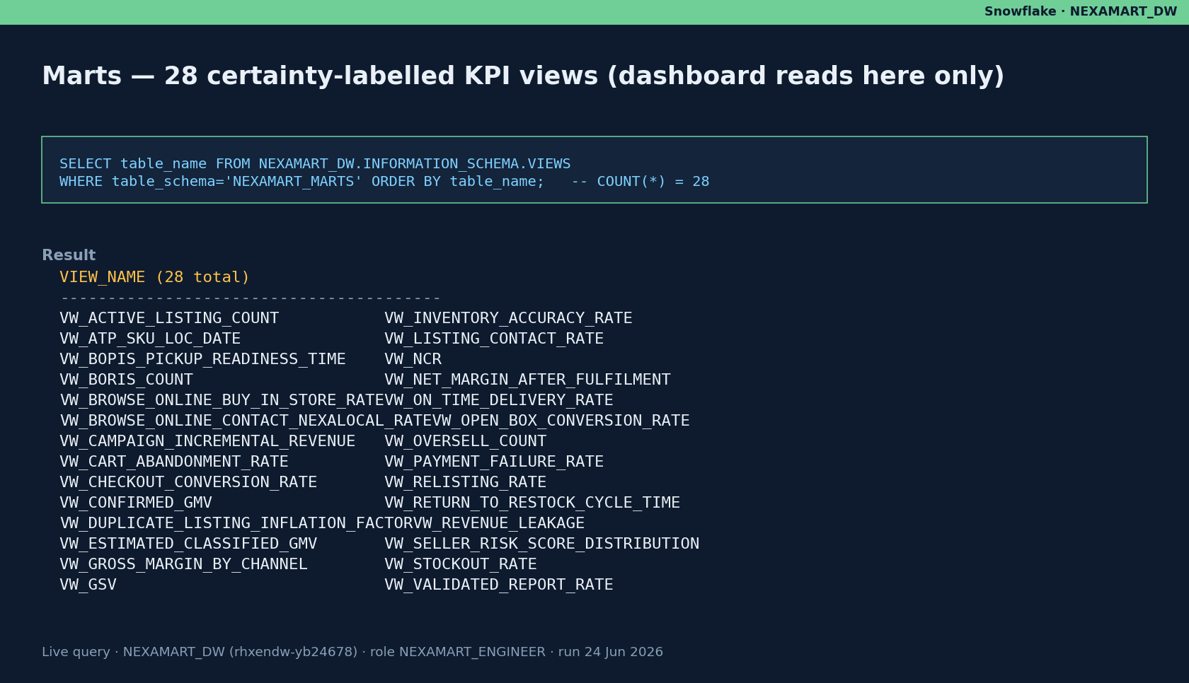
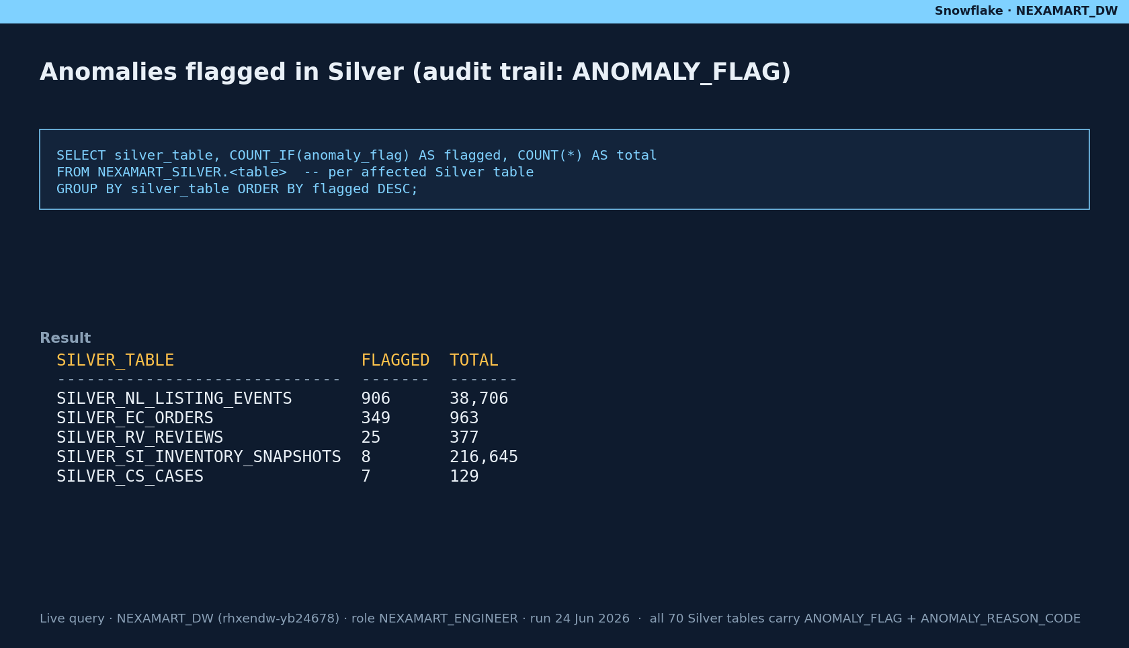
Evidence
Architecture evidence — Marts KPI views & Silver anomaly flags
E5
E2
NexaMart EDW · Milestone 2
__EVIDENCE_APPENDIX__

Slide 36
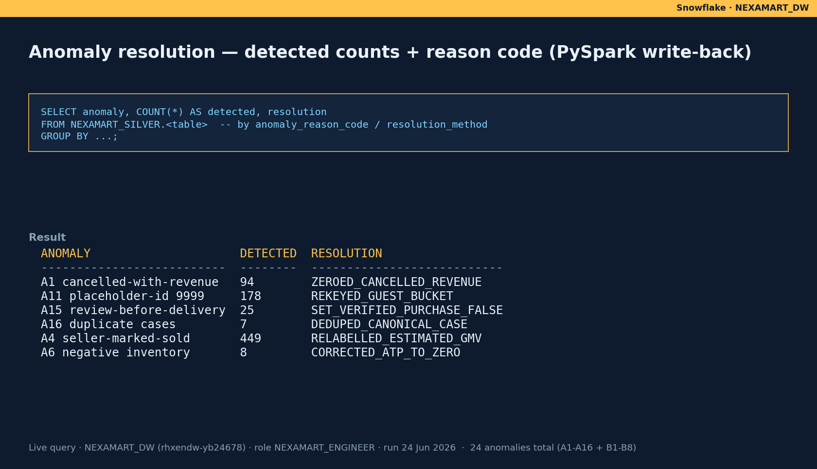
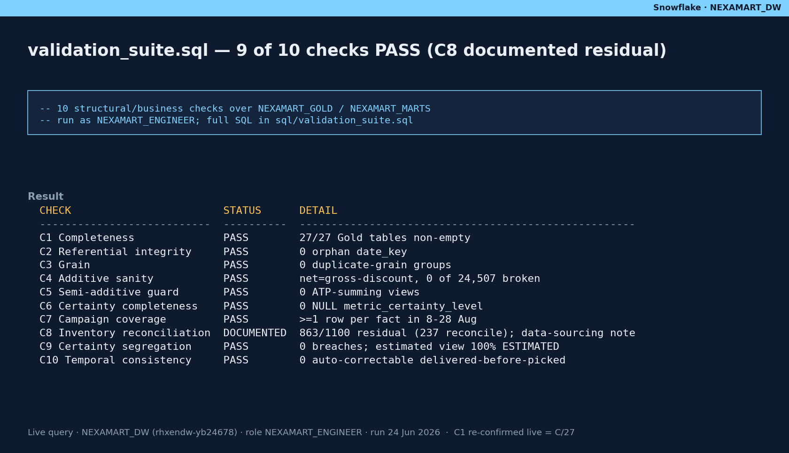
Evidence
Anomaly resolution & validation suite
E3
E4
NexaMart EDW · Milestone 2
__EVIDENCE_APPENDIX__

Slide 37
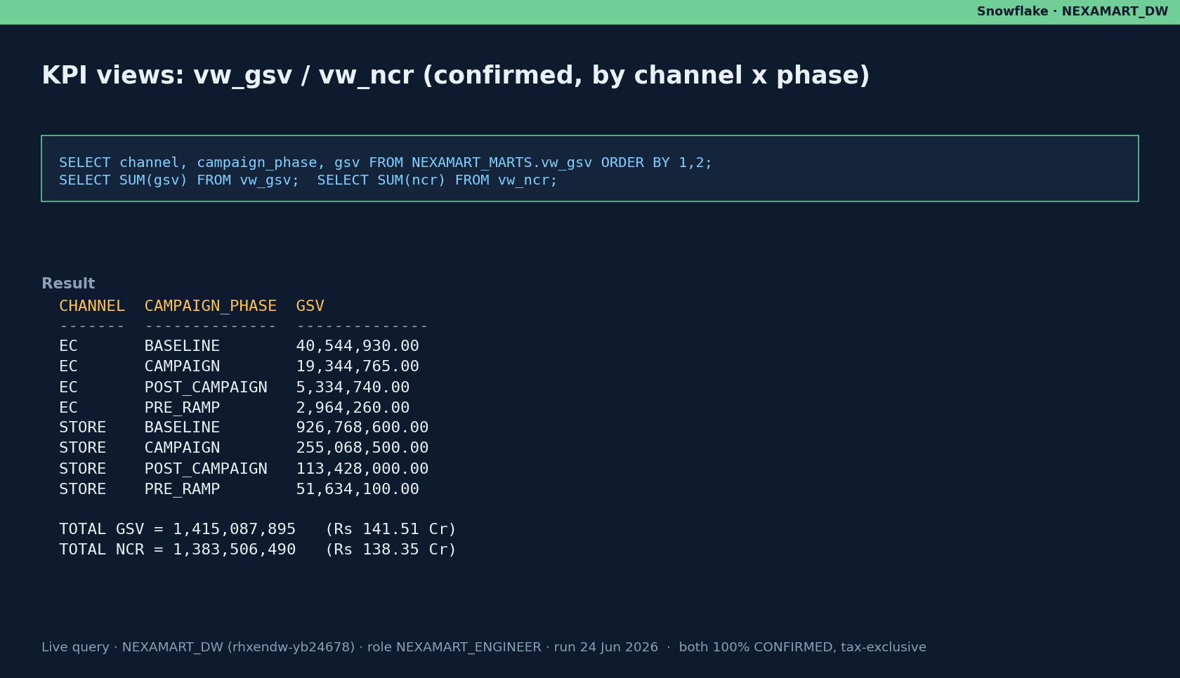
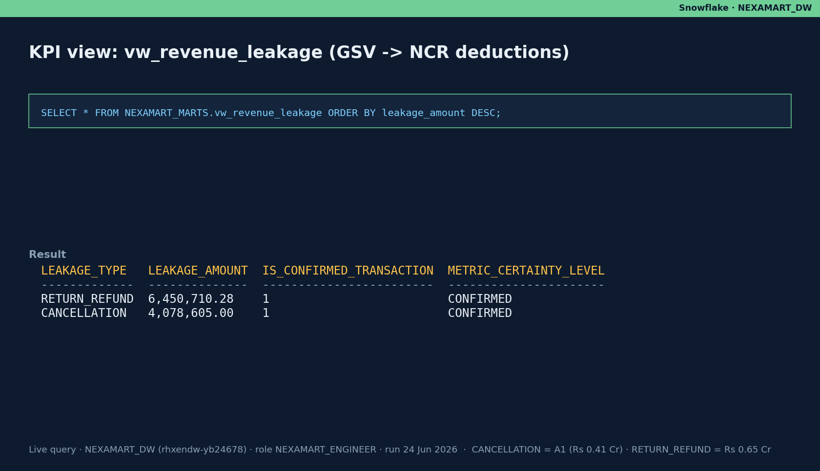
Evidence
Reconciled KPIs — GSV/NCR & revenue leakage
E5
E5
NexaMart EDW · Milestone 2
__EVIDENCE_APPENDIX__

Slide 38
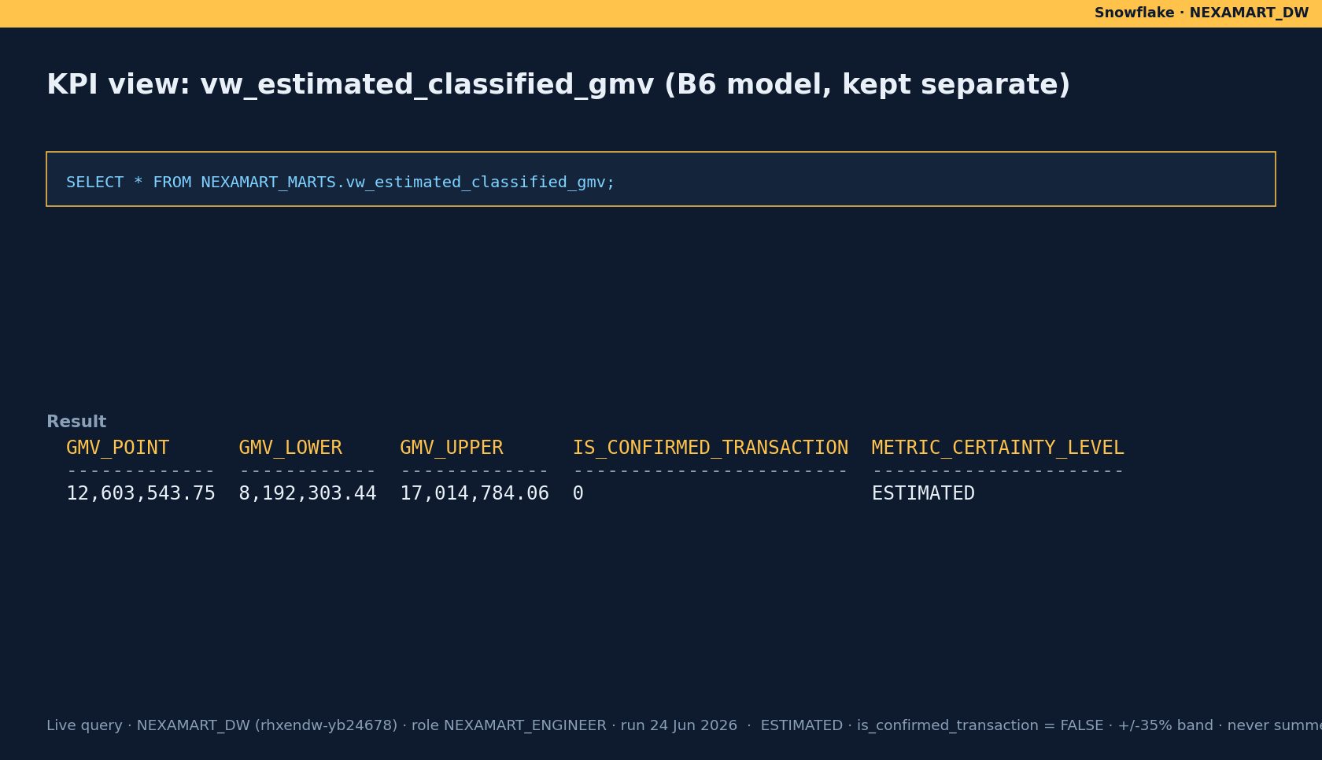
Evidence
Reconciled KPIs — Estimated Classified GMV (B6, kept separate)
E5
NexaMart EDW · Milestone 2
__EVIDENCE_APPENDIX__

Slide 39
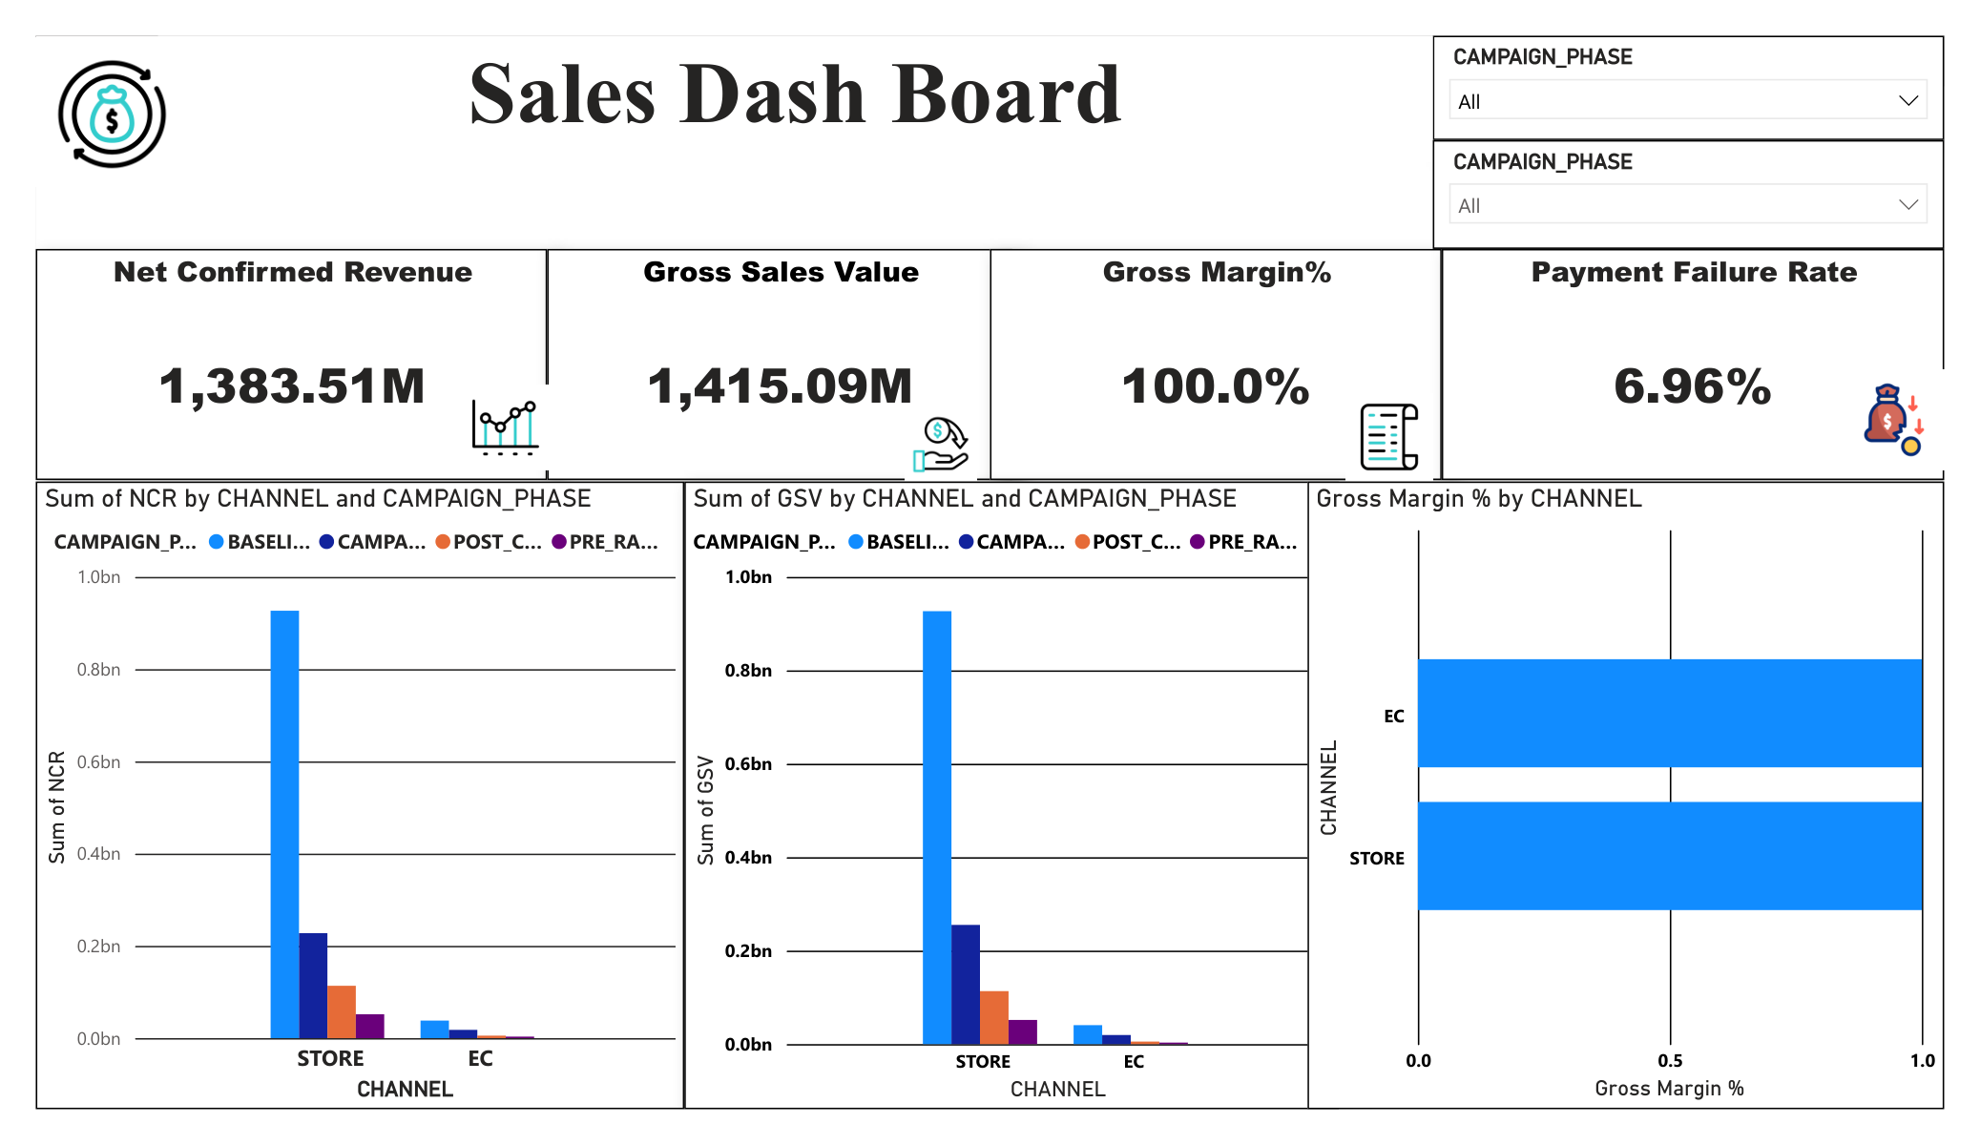
Dashboard
BI Dashboard — Sales by Channel (Executive KPIs: NCR, GSV, margin, payment-failure)
E6
NexaMart EDW · Milestone 2
__EVIDENCE_APPENDIX__

Slide 40
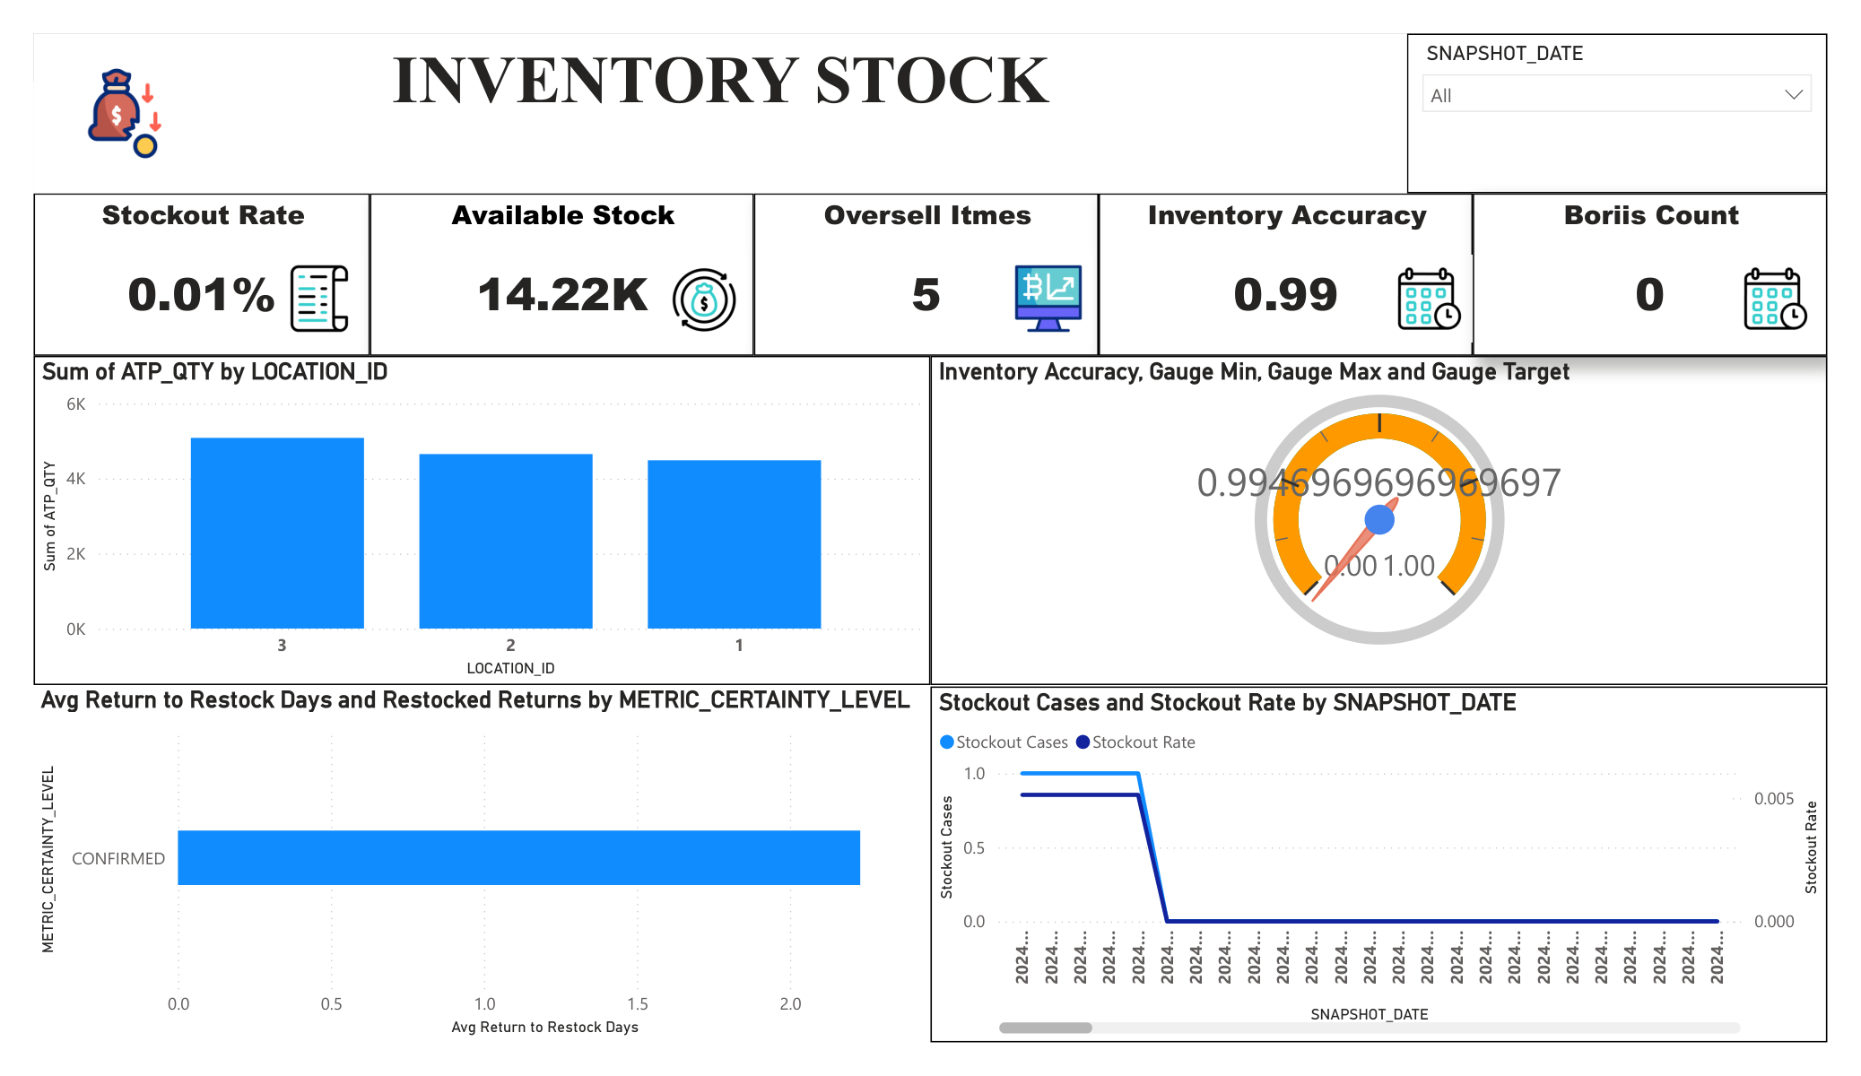
Dashboard
BI Dashboard — Inventory Health (ATP, stockout, oversell)
E6
NexaMart EDW · Milestone 2
__EVIDENCE_APPENDIX__

Slide 41
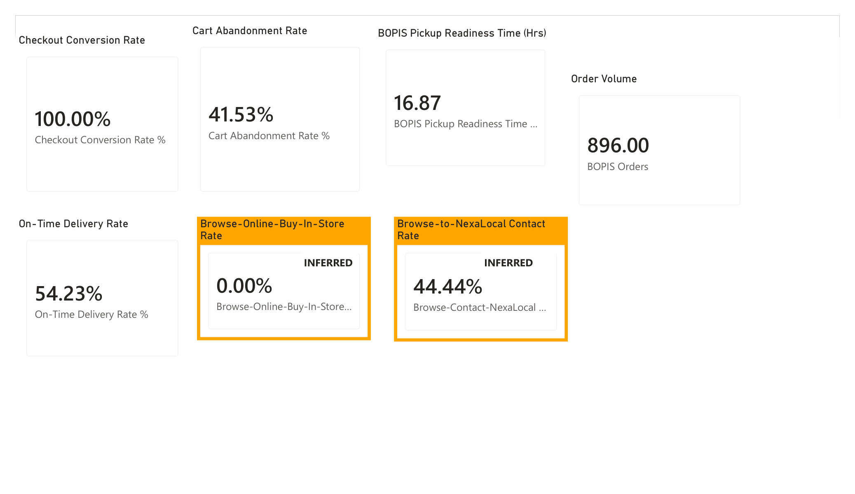
Dashboard
BI Dashboard — Customer Journey (funnel, cart abandonment)
E6
NexaMart EDW · Milestone 2
__EVIDENCE_APPENDIX__

Slide 42
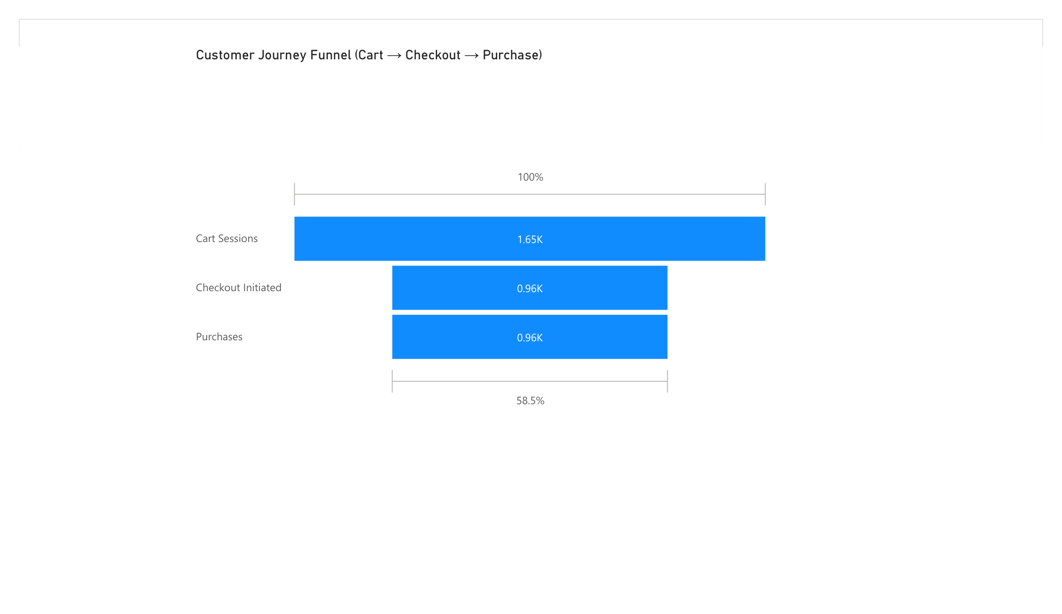
Dashboard
BI Dashboard — Customer Journey funnel (clickstream)
E6
NexaMart EDW · Milestone 2
__EVIDENCE_APPENDIX__

Slide 43
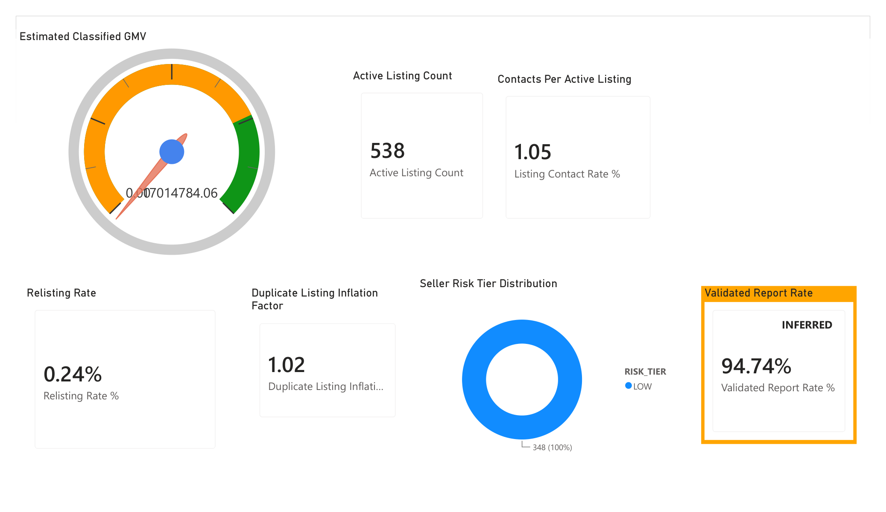
Dashboard
BI Dashboard — NexaLocal & Seller Quality (Estimated GMV, risk tiers)
E6
NexaMart EDW · Milestone 2
__EVIDENCE_APPENDIX__

