Slide 1
Product Performance Analysis Using MySQL
OBJECTIVE : To analyze product-level performance using SQL techniques such as window functions and CTEs, focusing on ranking, growth trends, and performance variability across products.
Tools Used:
MySQL — Data analysis, SQL queries, CTEs, and window functions
Microsoft Power BI — Data visualization and dashboard creation

Slide 2
Dataset Overview
The datasets used in this project were sourced from Kaggle and are publicly available for educational and analytica purposes
Calendar Dataset
Total Records: 731
Columns:
• Date
• Year
• Month
• Day
• Week
• Day of Week
Purpose:
• Time-based analysis
• Seasonal trend tracking
Products Dataset
Total Records : 200
Columns:
• Product ID
• Product Name
• Category
• Brand
• Price
Purpose:
• Product performance analysis
• Category-wise comparison
Customers Dataset
Total Records : 5000
Columns:
• Customer ID
• Age
• Gender
• Loyalty Member
• Join Date
Purpose:
• Customer segmentation
• Loyalty analysis
Sales Dataset
Total Records : 1000000
Columns:
• Sales ID
• Product ID
• Customer ID
• Store ID
• Quantity Sold
• Revenue
• Sales Date
Purpose:
• Revenue analysis
• Sales trend analysis
Stores Dataset
Total Records : 100
Columns:
• Store ID
• Store Name
• Location
• Region
• Store Type
Purpose:
• Store-wise performance analysis
• Regional comparison
Key Relationships:
• Customers → customer_id
• Products → product_id
• Stores → store_id
• Calendar → date
• Sales acts as the central fact table
Data Model

Slide 3
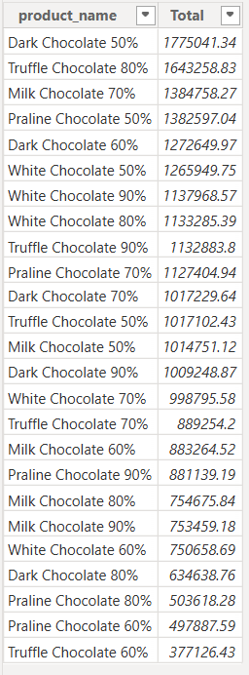
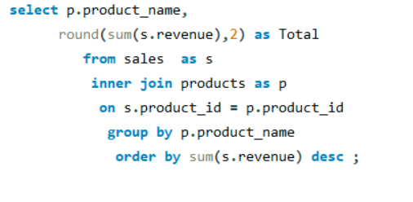
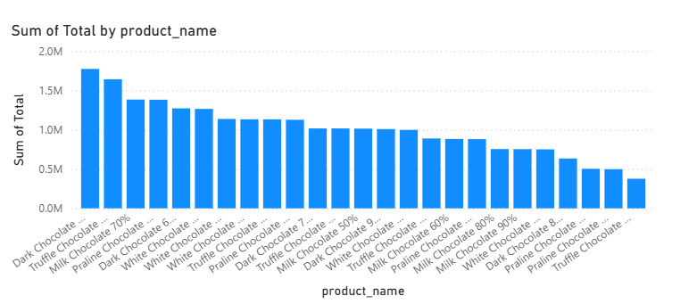
Q1. Calculate total revenue generated by each product.

Slide 4
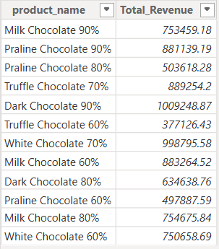
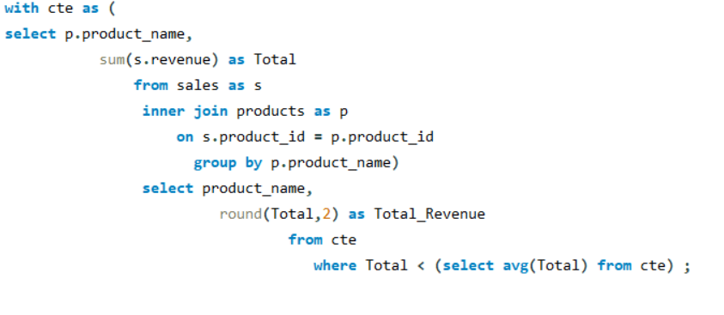
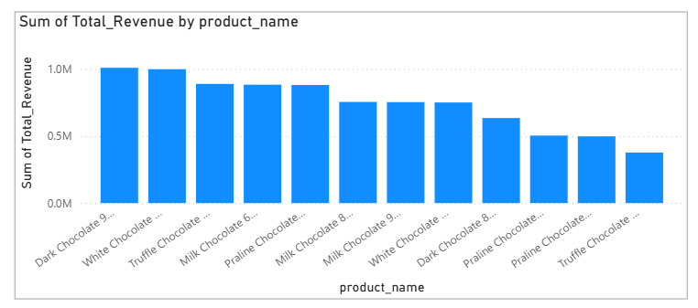
Q2. Identify products whose total revenue is below the overall average revenue across all products.

Slide 5
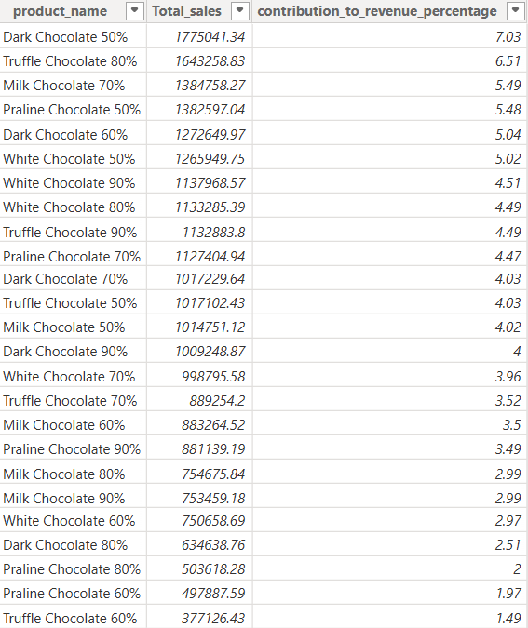
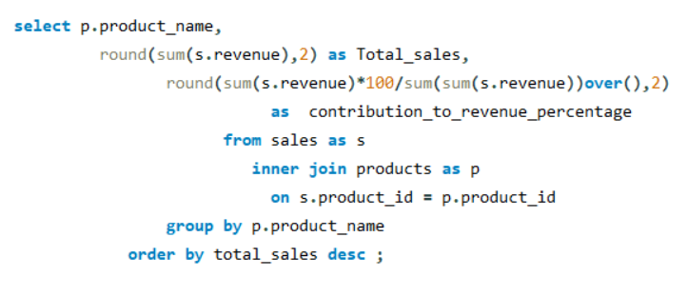
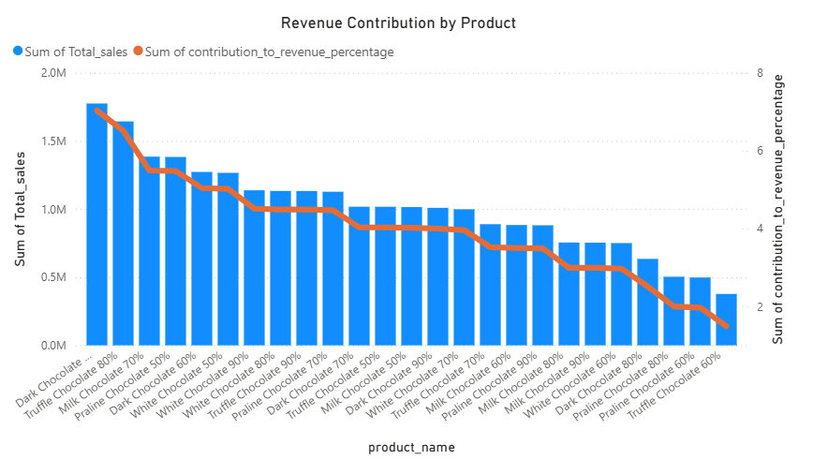
Q3 : Calculate the percentage contribution of each product to total revenue.

Slide 6
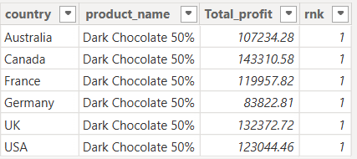
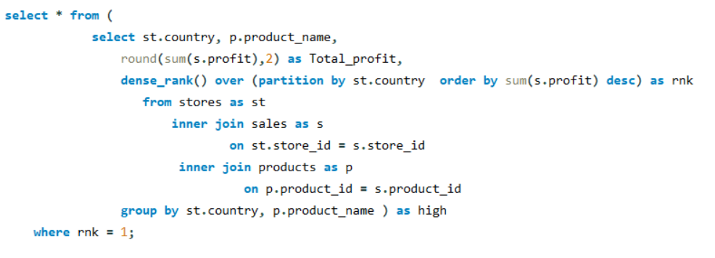
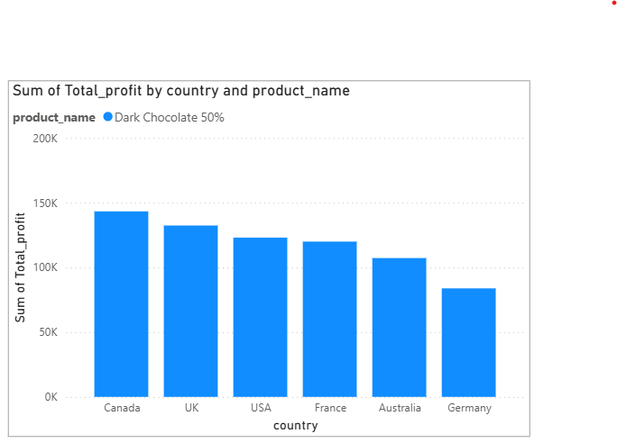
Q4 Which product earns the highest profit in each country?

Slide 7
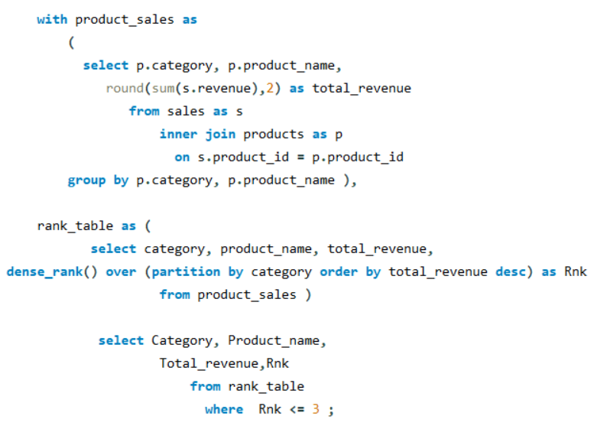
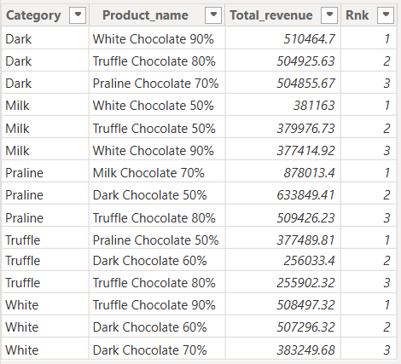
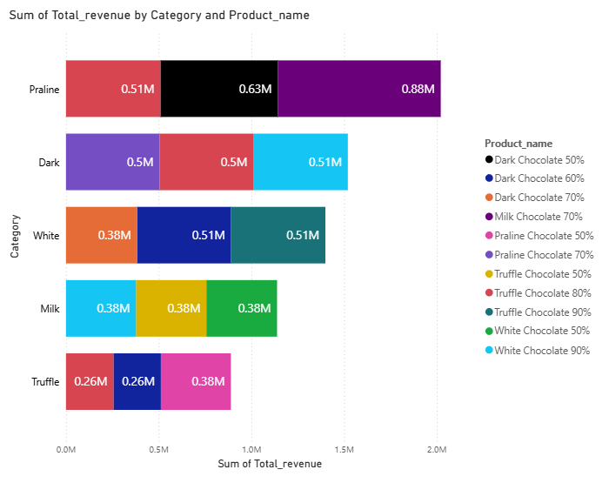
Q5 : Find the top 3 products within each category based on total revenue.

Slide 8
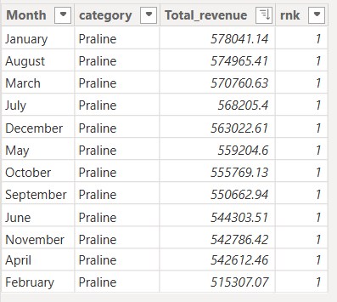
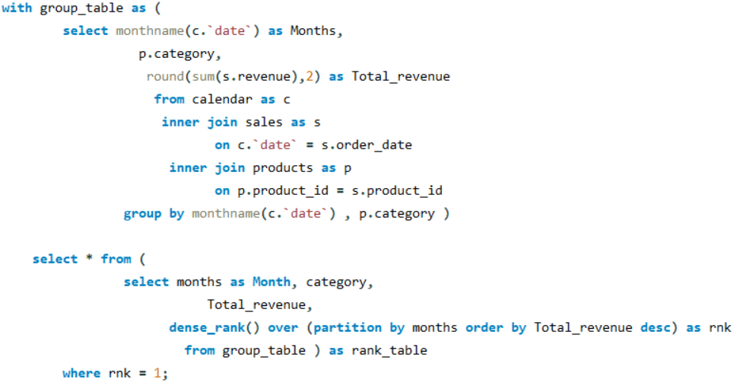
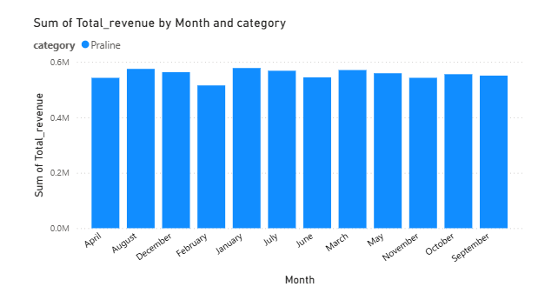
Q6 : Which product categories peak in which months?

Slide 9
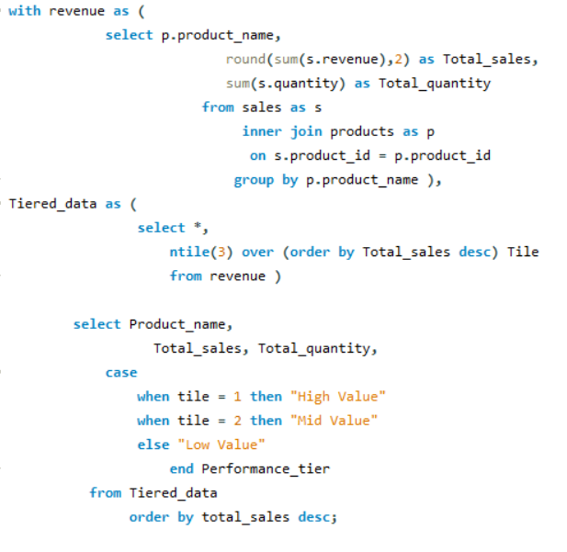
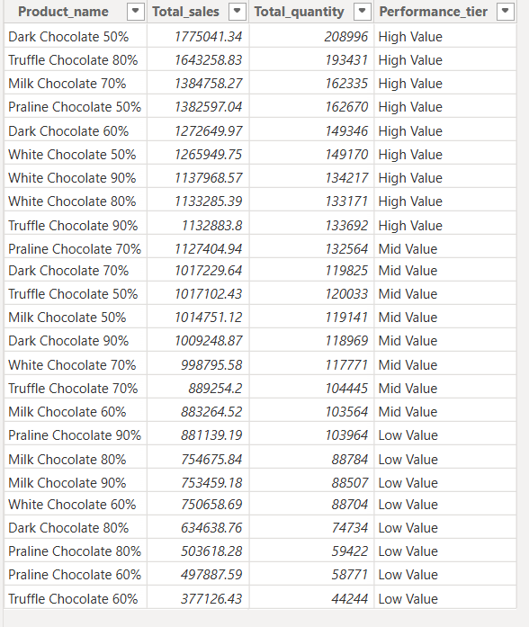
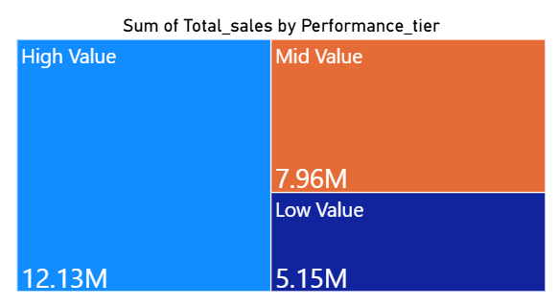
Q7 : Categorize products by revenue and analyze their quantity

Slide 10
Challenges Faced
Handling 1 Million Sales Records: Processing large datasets significantly increases query execution time and causes performance bottlenecks during heavy analytical tasks.
Managing Complex Table Joins: Linking multiple relational tables requires precise syntax to prevent duplicate records and ensure data integrity across dimensions.
Writing Advanced SQL Queries: Constructing deep analytical structures using window functions and Common Table Expressions (CTEs) increases the risk of logical errors.
Performing Time-Based Analysis: Tracking chronological data patterns requires complex sequential logic to accurately evaluate growth trends across specific months.

Slide 11
Recommendations
Track Growth Trends: Compare monthly sales patterns to see if top-performing items like Dark Chocolate 50%
maintain steady revenue momentum or experience sharp monthly drops.
Measure Performance Variability: Compute revenue variance across the 12 months to quantify which
items have stable demand versus fluctuating items like Praline.
Expand Ranking Insights: Cross-reference total quantity sold against total sales revenue to spotlight high-volume,
lower-margin items like Milk Chocolate 60%.
Evaluate Tier Transitions: Analyze monthly data to see if low-performing products like Truffle Chocolate 60%
shift into higher value tiers during your highest-revenue peak month of January.

