Slide 1




Heart Attack Prediction
Parth Maheshwari
Vaibhav Panse
Parvath Darshini
Arin Makwana

Slide 2

Project Objectives
Problem Statement
Project Overview – Introduction
End Users
Modelling/Block Diagram/Flow of Project
Result/outcomes
Conclusion

Slide 3
Problem Statement
In the present world, many people suffers from heart attack in the world. In India, about 32,457 people died from heart attacks in 2022, which is a 12% increase from 2021.
After the intervention of COVID-19, the heart attack rates are increased eventually.
To save an individual from a heart attack, there should an model developed which can predict the heart attack chances by taking the data which is associated with heart health.
Our dataset comprises of various attributes which are commonly associated with heart health such as chest pain type, resting blood pressure, cholesterol levels and many more.
The dataset's primary objective is to facilitate the prediction of the likelihood of a heart attack occurrence based on an individual's health and medical attributes.

Slide 4
Project overview - Introduction
Our ML model evaluates the patterns of attributes related to heart health and finds hidden patterns through taking important parameters which in turn predicts the early risks of heart attack.
The dataset used for evaluation is a balanced dataset which has a distribution of 54% to 46% of the targeted attribute.
The comprehensive nature of the dataset allows for the application of various machine learning and statistical techniques to analyse and predict the risk of heart attacks based on an individual's specific characteristics.
The model contains powerful and precise machine learning algorithms such as Logistic Regression, Random Forest, KNN, which provides optimal predictions.

Slide 5
End User
Doctors
Common people
Healthcare Companies
Insurance Companies

Slide 6
Modelling
Project Setup
Importing libs
Defining functions
Loading Data
EDA
Data Correlation
Histograms, Box plots, Donut, Heatmap, Dendrogram
Feature engineering
Predictive Modelling
Model Performance Comparison
Conclusions

Slide 7
Modelling
ML
Logistic Regression
Decision Tree
KNN
Random Forest
XGBOOST

Slide 8
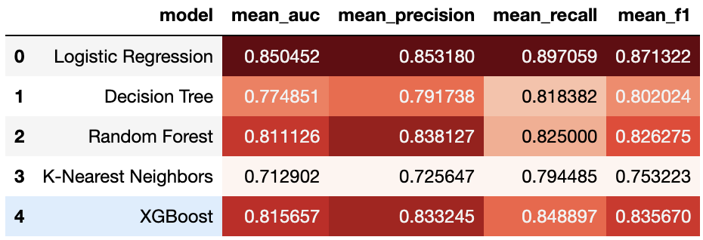
Result / Outcomes

Slide 9
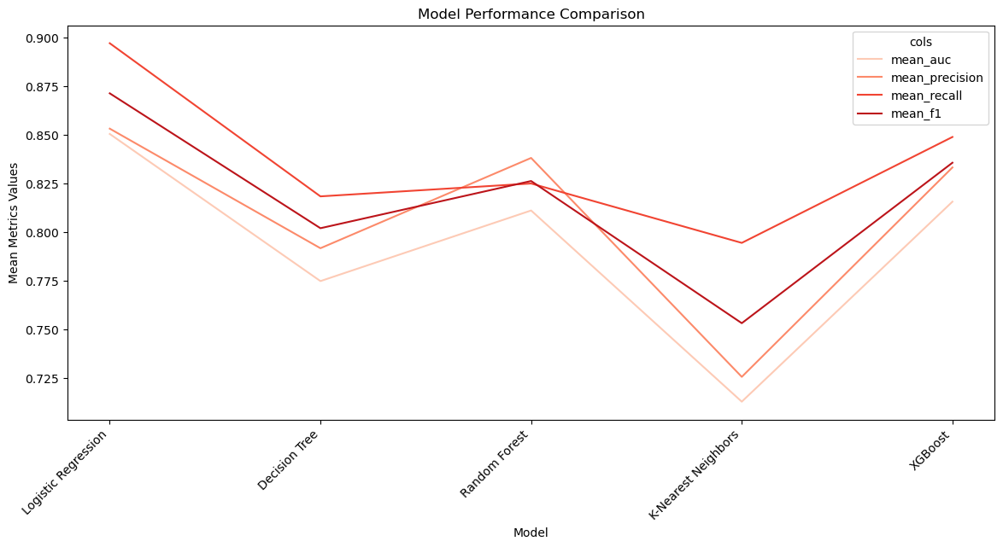
Result / Outcomes

Slide 10
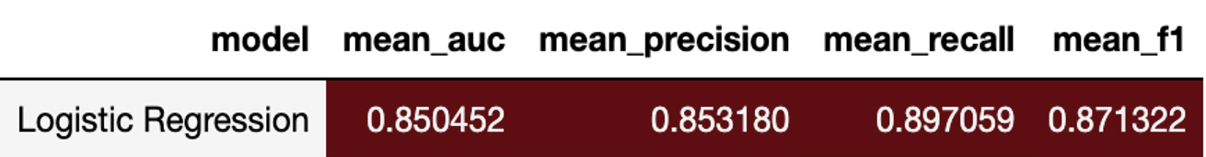
Conclusion
Logistic Regression has the has the highest mean AUC score but also has competitive mean precision, mean recall, and mean F1-score values.
Its balanced performance across all metrics suggests that Logistic Regression is the optimal choice for this dataset.
In conclusion, considering the balanced performance across all metrics, the Logistic Regression model is the recommended choice for its superior performance in terms of the mean AUC, mean precision, mean recall, and mean F1-score.

Slide 11
Thank you...!
Notes:
11

