Slide 1
Name of Trainer :- Prof. Digamber T. Bodake
Subject :- Computer Networks
Topic :- IP Addressing & Subnetting
Date :- 13/06/2017
Notes:
Chapter 2

Slide 2

Objectives
Students will be able to:
Understand IP Addressing & Subnetting
Identify different classes of IP addresses
Describe IP Subnet
Identify IP Masks
Solve Subnetting Examples
Prof. D. T. Bodake (SKNCOE)

Slide 3
IP Address
A Unique, 32-bit address used by computers to communicate over a computer network
Types of IP Address
Static
Dynamic
Prof. D. T. Bodake (SKNCOE)

Slide 4
Classes of Address
IP address structure consists of two addresses, Network and Host
IP address is divided into five classes
IP Address
Classes
Class A
Class B
Class C
Class D
Class E
Prof. D. T. Bodake (SKNCOE)

Slide 5
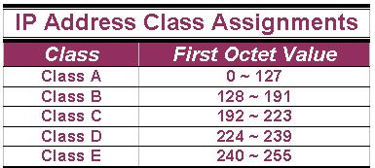
IP Address Classes
The 5 IP classes are split up based on the value in the 1st octet:
Prof. D. T. Bodake (SKNCOE)

Slide 6
IP Address Classes(Cont.)
Byte 1
Byte 2
Byte 3
Byte 4
Class A
Network ID
Host ID
Class B
Network ID
Host ID
Class C
Network ID
Host ID
Class D
Multicast Address
Class E
Reserved for future use
Prof. D. T. Bodake (SKNCOE)

Slide 7
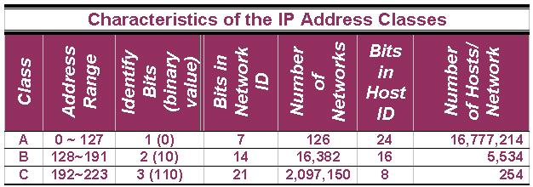
IP Addresses Classes (Cont.)
Prof. D. T. Bodake (SKNCOE)

Slide 8
Examples of IP Address
14.23.120.8 - The first byte of the address represents 14 which lies between 0 and 127, hence Class A address.
134.11.78.56 - The first byte of address is 134 which lies between 128 and 191 hence the address belongs to Class B.
193.14.56.22 - As first byte is 193 which is between 192 and 223, hence the address belongs to Class C.
Prof. D. T. Bodake (SKNCOE)

Slide 9
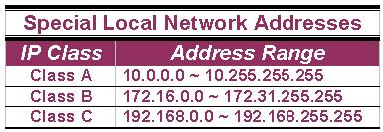
Special Addresses (Cont.)
A list of these addresses for each IP address class:
Prof. D. T. Bodake (SKNCOE)

Slide 10
Subnet Mask
An IP address has 2 parts:
  The Network identification.
  The Host identification.
Frequently, the Network & Host portions of the address need to be separately extracted.
In most cases, if you know the address class, it’s easy to separate the 2 portions.
Prof. D. T. Bodake (SKNCOE)

Slide 11
Subnet Mask
Specifies part of IP address used to identify a subnetwork.
Subnet mask when logically ANDed with IP address provides 32-bit network address
Subnet Mask
AND
Operation
IP Address
Network Address
Prof. D. T. Bodake (SKNCOE)

Slide 12
Default Mask
Has predetermined number of 1s
Class A, B and C contains 1s in network ID fields for default subnet mask
Address Class | Default Mask (in Binary)
Class A | 11111111.00000000.00000000.00000000
Class B | 11111111.11111111.00000000.00000000
Class C | 11111111.11111111.11111111.00000000
Prof. D. T. Bodake (SKNCOE)

Slide 13
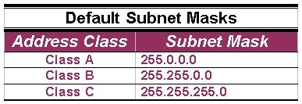
Default Standard Subnet Masks
There are default standard subnet masks for Class A, B and C addresses:
Prof. D. T. Bodake (SKNCOE)

Slide 14
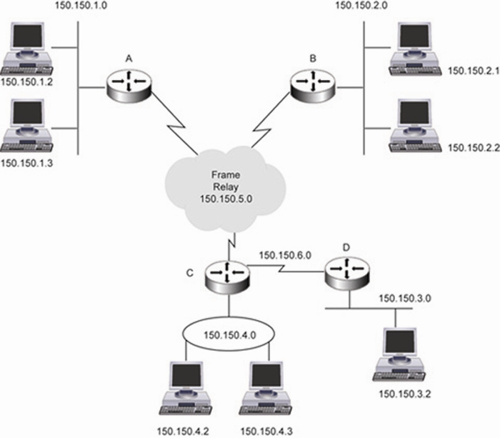
IP Subnetting
Allows you to divide a network into smaller sub-networks
Each subnet has its own sub-network address
Subnet can be created within Class A, B, or C based networks
Prof. D. T. Bodake (SKNCOE)

Slide 15
Subnetting
Division of a network into subnets
  For example, division of a Class B address into several Class C addresses
Some of the host IDs are used for creating subnet IDs
Prof. D. T. Bodake (SKNCOE)

Slide 16
Need for Subnetting
Classes A and B have a large number of hosts corresponding to each network ID
It may be desirable to subdivide the hosts in Class C subnets
Often, there is a limitation on the number of hosts that could be hosted on a single network segment
  The limitation may be imposed by concerns related to the management of hardware
Smaller broadcast domains are more efficient and easy to manage
Prof. D. T. Bodake (SKNCOE)

Slide 17
Subnetting Principle
Use parts of the host IDs for subnetting purpose
A subnet mask is used to facilitate the flow of traffic between the different subnets and the outside network (hops)
  A hop is the distance a data packet travels form one node to the other
Prof. D. T. Bodake (SKNCOE)

Slide 18
Using Host IDs to Subnet
140
15
1
0
Subnet 1
Class B Network
140
15
2
0
140
15
0
0
Subnet 2
140
15
3
0
Subnet 3
Third octet is now used for subnet IDs
Prof. D. T. Bodake (SKNCOE)

Slide 19
Knowing How to Calculate Subnets
To determine the number of subnets & hosts per subnet available for any of the available subnet masks, 2 simple formulas to calculate these numbers:
Number of Subnets=(2^{n})
Number of Host per Subnets=(2^{h-2})
Prof. D. T. Bodake (SKNCOE)

Slide 20
Knowing How to Calculate Subnets (Cont.)
Although the 2 formulas look identical, the key is to remember the number you’re trying to calculate, hosts or subnets.
Eg., suppose you are asked to determine the number of subnets available & the number of hosts available on each subnet on the network 192.168.1.0 ➔
Prof. D. T. Bodake (SKNCOE)

Slide 21
Knowing How to Calculate Subnets (Cont.)
Using the subnet & hosts formulas, the answers are easily calculated. Of course, you must know your powers of 2 to calculate the answers.
Prof. D. T. Bodake (SKNCOE)

Slide 22
Subnetting – Example
Host IP Address: 138.101.114.250
Network Mask: 255.255.0.0 (or /16)
Subnet Mask: 255.255.255.192 (or /26)
Given the following Host IP Address, Network Mask and Subnet mask find the following information:
Major Network Information
  Major Network Address
  Major Network Broadcast Address
  Range of Hosts if not subnetted
Subnet Information
  Subnet Address
  Range of Host Addresses (first host and last host)
  Broadcast Address
Other Subnet Information
  Total number of subnets
  Number of hosts per subnet
Prof. D. T. Bodake (SKNCOE)

Slide 23
Major Network Information
Host IP Address: 138.101.114.250
Network Mask: 255.255.0.0
Subnet Mask: 255.255.255.192
Major Network Address: 138.101.0.0
Major Network Broadcast Address: 138.101.255.255
Range of Hosts if not Subnetted: 138.101.0.1 to 138.101.255.254
Prof. D. T. Bodake (SKNCOE)

Slide 24
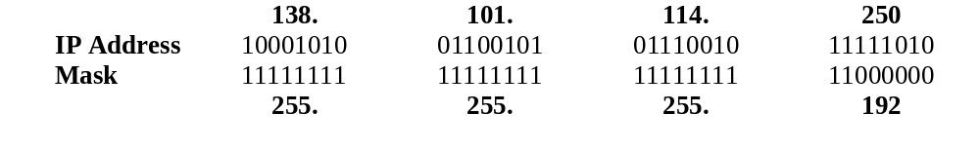
Step 1: Convert to Binary
128 64 32 16 8 4 2 1
Step 1:
Translate Host IP Address and Subnet Mask into binary notation
Prof. D. T. Bodake (SKNCOE)

Slide 25
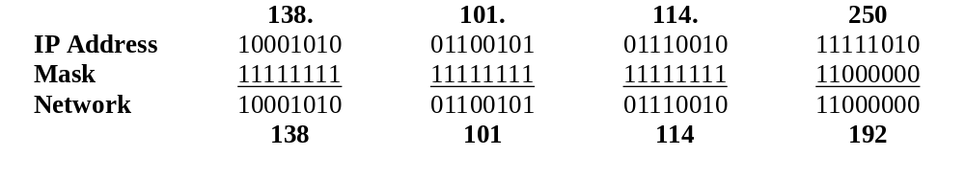
Step 2: Find the Subnet Address
Step 2:
Determine the Network (or Subnet) where this Host address lives:
1. Draw a line under the mask
2. Perform a bit-wise AND operation on the IP Address and the Subnet Mask
Note: 1 AND 1 results in a 1, 0 AND anything results in a 0
3. Express the result in Dotted Decimal Notation
4. The result is the Subnet Address of this Subnet or “Wire” which is 138.101.114.192
Prof. D. T. Bodake (SKNCOE)

Slide 26
Step 2: Find the Subnet Address
Step 2:
Determine the Network (or Subnet) where this Host address lives:
Quick method:
Find the last (right-most) 1 bit in the subnet mask.
Copy all of the bits in the IP address to the Network Address
Add 0’s for the rest of the bits in the Network Address
Prof. D. T. Bodake (SKNCOE)

Slide 27
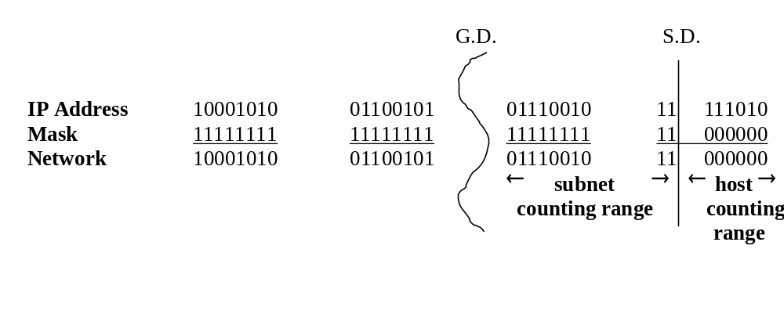
Step 3: Subnet Range / Host Range
Step 3:
Determine which bits in the address contain Network (subnet) information and which contain Host information:
Use the Network Mask: 255.255.0.0 and divide (Great Divide) the from the rest of the address.
Use Subnet Mask: 255.255.255.192 and divide (Small Divide) the subnet from the hosts between the last “1” and the first “0” in the subnet mask.
Prof. D. T. Bodake (SKNCOE)

Slide 28
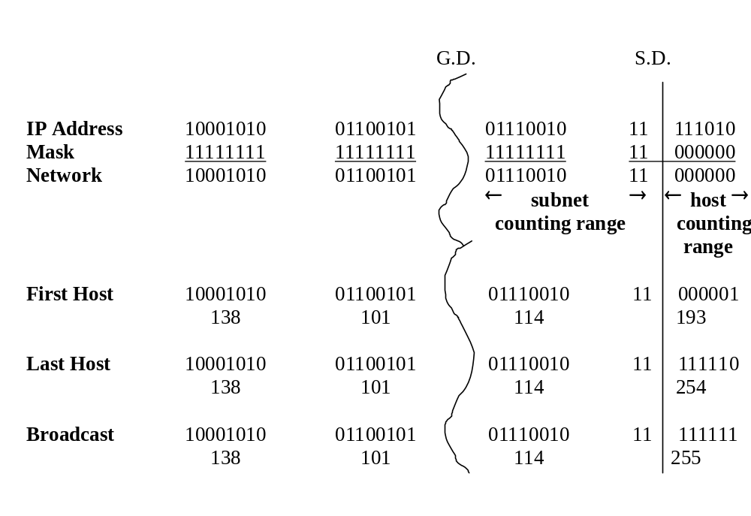
Step 4: First Host / Last Host
Host Portion
Subnet Address: all 0’s
First Host: all 0’s and a 1
Last Host: all 1’s and a 0
Broadcast: all 1’s
Prof. D. T. Bodake (SKNCOE)

Slide 29
Step 5: Total Number of Subnets
Total number of subnets
  Number of subnet bits 10
  2¹⁰ = 1,024
  1,024 total subnets
    Subtract one “if” all-zeros subnet cannot be used
    Subtract one “if” all-ones subnet cannot be used
Prof. D. T. Bodake (SKNCOE)

Slide 30
Step 6: Total Number of Hosts per Subnet
Total number of hosts per subnet
  Number of host bits 6
  2⁶ = 64
  64 host per subnets
    Subtract one for the subnet address
    Subtract one for the broadcast address
  62 hosts per subnet
Prof. D. T. Bodake (SKNCOE)

Slide 31
Summary
An IP address defines unique address of a device over a network
An IP address is a 32 Byte address and is divided into various classes namely Class A, Class B, Class C, Class D and Class E
In Classless addressing, network address field can extend further to Host Id field
Subnetting allows one to create multiple logical networks within a single Class A, B, or C address based network
A subnet mask is a 32-bit IP address, when bit-wise ANDed with given IP address provides with the address required to identify a subnet
Prof. D. T. Bodake (SKNCOE)

