Slide 1
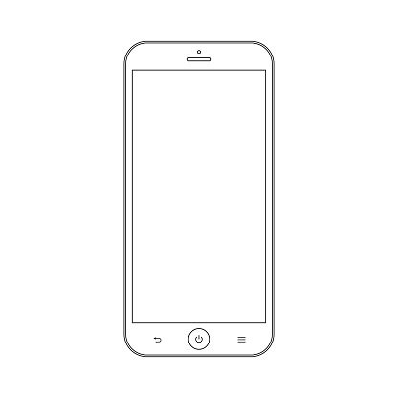
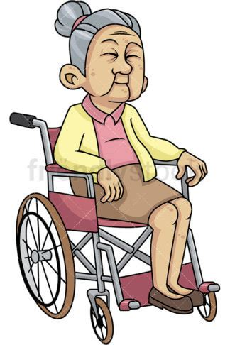




Slide 2
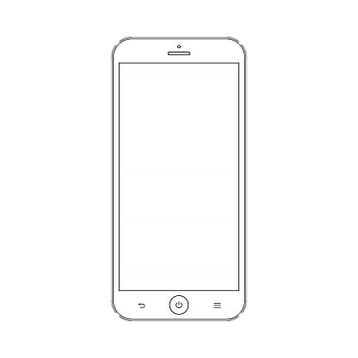

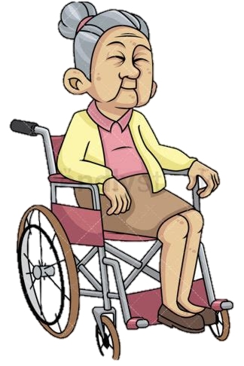


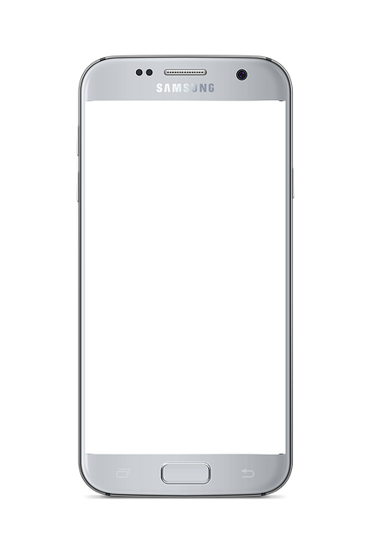
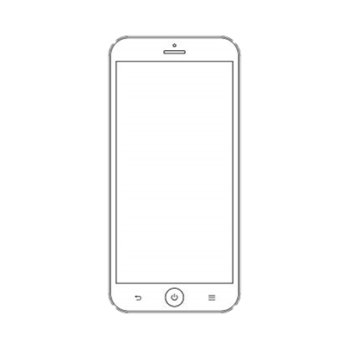
By utilizing Brain waves as a medium of communication.
The need for
autonomous hands or dexterity is not needed.

Slide 3
The need for
autonomous hands or dexterity is not needed.
By utilizing Brain waves as a medium of communication.

Slide 4
The need for
autonomous hands or dexterity is not needed.
By utilizing Brain waves as a medium of communication.

Slide 5
Optimum UX for people with Dexterity Loss due to Old age.
Ease of UX for people with Disabilities
Ease of use for People with Motor Disabilities.

Slide 6
Ease of UX for people with Disabilities
Optimum UX for people with Dexterity Loss due to Old age.
Ease of use for People with Motor Disabilities.

