Slide 1

Real-Time Traffic Prediction System
Welcome to our presentation on the Real-Time Traffic Prediction System, a project that aims to improve traffic management in urban areas using advanced Cloud, machine learning and data streaming technologies.
By TEAM 21: Aryan, Athish and Yang.

Slide 2
Project Overview
Objective
Technology Stack
Build a system for real-time traffic prediction utilizing machine learning techniques.
Technologies Used:
Python (backend, ML)
Implement an end-to-end data streaming pipeline for efficient data handling.
Apache Kafka (streaming)
TensorFlow (ML model)
Develop an interactive visualization dashboard.
FastAPI (web server)
WebSocket (real-time updates)
Docker & Kubernetes (containerization and orchestration)
AAAAAAAAAAAAAAAAAAAAAAAAAAAA

Slide 3
Motivation
Address the need for efficient traffic management in urban areas
Leverage real-time prediction to reduce congestion
Enhance the decision-making process for traffic control centers
Real-time traffic prediction enables efficient traffic management, reducing congestion and optimizing resource allocation.
Accurate real-time data and prediction models can improve the decision-making process for traffic control centers, leading to more effective traffic management.
Urban areas often experience significant traffic congestion, leading to wasted time, fuel consumption, and environmental pollution.
AAAAAAAAAAAAAAAAAAAAAAAAAAAA

Slide 4





Technology Choices
Python
Apache Kafka
TensorFlow
Docker
For backend development, machine learning, and data processing.
For real-time data streaming and event ingestion.
For building and training the LSTM model for real-time predictions.
For containerizing the ML model and Kafka services, ensuring portability and scalability.
Kubernetes
For orchestrating services and ensuring high availability.
AAAAAAAAAAAAAAAAAAAAAAAAAAAA

Slide 5
Cloud Infrastructure Setup
1
Cloud Provider: Azure
2
Core Services
- Selected Azure based on project requirements and budget
- Compute: Azure Virtual Machines
-Azure Kubernetes Service (AKS)
- Streaming: Kafka
3
Infrastructure as Code
4
Docker Integration
- Used Terraform to define and manage the Azure infrastructure
- Containerization of Kafka, ML model, and FastAPI ensures portability
- Reduces conflicts across environments and simplifies deployments
AAAAAAAAAAAAAAAAAAAAAAAAAAAA

Slide 6

Data Pipeline Flow
Data Layer
1
- NYC Traffic data (historical) feeds into the system -
- Data is serialized into JSON and sent through Kafka topics for streaming
2
Processing Layer
- Kafka consumers receive real-time data and process it
- LSTM model predicts traffic metrics (volume, speed) for the next time window
- Predictions are processed and forwarded to the presentation layer
Presentation Layer
3
- WebSocket delivers predictions and error analysis in real-time to the dashboard
- Visualization tools generate interactive time-series graphs and traffic insights
AAAAAAAAAAAAAAAAAAAAAAAAAAAA

Slide 7



System Architecture Components
Data Layer
Processing Layer
Presentation Layer
- NYC Traffic data (volume, speed, and occupancy) as the primary dataset
- LSTM model for real-time predictions
- Interactive web dashboard with real-time visualization
- Dockerized ML model and Kafka services for scalability
- Kubernetes to orchestrate services and ensure high availability
- Kafka streaming service for real-time data flow
AAAAAAAAAAAAAAAAAAAAAAAAAAAA

Slide 8
System Demo
1
Live data from NYC Traffic dataset processed through Kafka.
2
Dockerized components and Kubernetes setup for service orchestration.
3
Real-time ML predictions and dashboard updates.
4
Interactive features, such as time-series graphs and error analysis.
AAAAAAAAAAAAAAAAAAAAAAAAAAAA

Slide 9
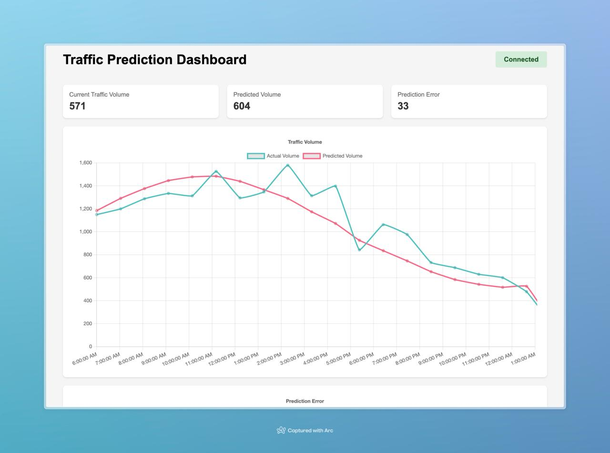
AAAAAAAAAAAAAAAAAAAAAAAAAAAA

Slide 10
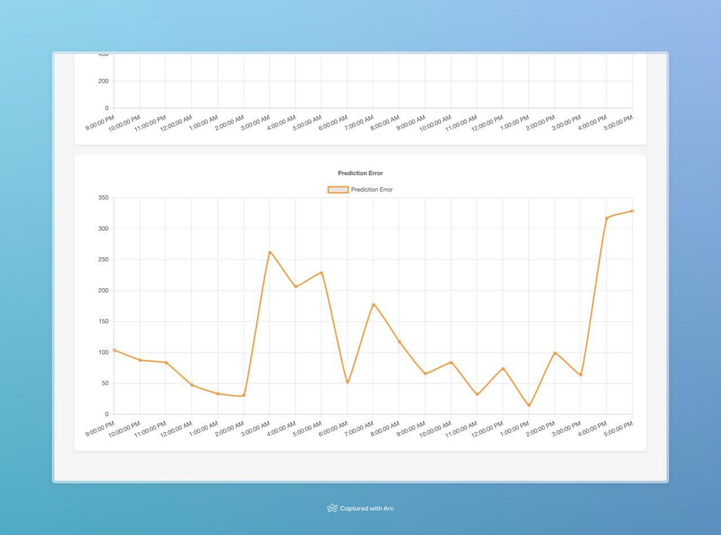
AAAAAAAAAAAAAAAAAAAAAAAAAAAA

Slide 11
Challenges:
1. Acquiring Real-Time Data
Data Availability: Limited access to sensors, APIs, and licenses.
Data Quality: Noisy or incomplete due to errors or environmental factors.
Data Integration: Challenges in unifying diverse data sources.
Latency: Delays in transmission affect real-time processing.
2. Extremely Resource Heavy
High Computational Costs: Resource-intensive models and datasets.
Scalability: Increased complexity with larger coverage areas.
Energy Consumption: High power requirements for continuous operations.
Infrastructure Dependency: Reliance on reliable computing networks.
AAAAAAAAAAAAAAAAAAAAAAAAAAAA

Slide 12
Future Enhancements
Data Sources
Model Improvements
System Scalability
- Integrate real traffic data - Incorporate multiple data sources - Include weather data integration
- Explore advanced ML architectures - Implement automated model retraining - Enhance feature engineering
- Implement distributed processing - Ensure load balancing - Achieve high availability
Automation using Jenkins
Live Feed
- Set up a Jenkins pipeline for automated testing and deployment - Integrate with GitHub for continuous integration - Configure triggers for automatic model retraining and redeployment
- Integrate with real-time traffic data feeds - Display live traffic updates and predictions on the dashboard - Leverage Azure Event Hubs for scalable data ingestion
AAAAAAAAAAAAAAAAAAAAAAAAAAAA

Slide 13



Teamwork:
Aryan
Dataset, FastAPI backend, Kubernetes deployment, Kafka producer setup
Alex
ML model training
Athish
Docker setup, Dashboard development
AAAAAAAAAAAAAAAAAAAAAAAAAAAA

