Slide 1
INTERNSHIP PROJECT | ARKTECQ
MES–PLM Data Pipeline
POC
End-to-End Data Pipeline, Analytics & Production Performance Dashboard
– Samskruthi S Kashyap
Notes:
Good morning/afternoon. Today I’ll be presenting the project I worked on during my internship at Arktecq.
The project is called the MES–PLM Data Pipeline POC. Basically, the idea of this project was to take manufacturing data coming from different sources, process it properly, calculate useful production KPIs, and finally make that information available for analysis through PostgreSQL and Power BI.
So in this presentation, I’ll take you through the complete flow — starting from the raw data, how we ingested and transformed it, how the KPIs were calculated, how the data was stored in PostgreSQL, and finally how I used it to build the Power BI dashboards.
I’ll also briefly show the CI automation that I implemented using GitHub Actions.

Slide 2
Problem Statement
Manufacturing data is generated from multiple sources such as MES, PLM and reference datasets.
These datasets contain production orders, machine logs, downtime events, product information and engineering change information.
The challenge is to:
• Bring data from different sources into a common pipeline. • Validate and clean incoming data. • Transform raw operational data into meaningful production KPIs. • Store processed data in a structured analytical database. • Provide an interactive dashboard for production and engineering analysis.
Project Objective
• Build an end-to-end MES–PLM data pipeline that: • Automates data ingestion and validation. • Converts raw data into Parquet-based landing and curated layers. • Calculates important production KPIs such as OEE, availability, performance, quality, defect rate and cycle time. • Loads analytical data into PostgreSQL. • Provides interactive Power BI dashboards for decision-making. • Introduces basic CI automation using GitHub Actions.
Notes:
So, first coming to the problem statement, the main issue was that the manufacturing data was not coming from just one place.
We had data from MES, PLM and also a reference dataset. Each of these contains different information — for example, production orders, machine logs, downtime information, product details and engineering change information.
So the main challenge was to bring all this different data into one proper pipeline. Once the data comes in, we need to validate it, clean it, transform it and then calculate useful production KPIs from it.
The goal was basically to build an end-to-end pipeline that handles all these steps instead of treating each dataset separately.
As part of the project, I worked on the ingestion and validation process, created the Parquet landing and curated layers, calculated KPIs like OEE, availability, performance, quality, defect rate and cycle time, and then loaded the analytical data into PostgreSQL.
Finally, the processed data was connected to Power BI so that we could actually visualize the production and engineering information through interactive dashboards.

Slide 3
End-to-End Architecture
Raw Data Sources
↓
Validation & Ingestion
↓
Landing - Parquet Files
↓
Transformation & KPI Calculation
↓
Curated KPI Dataset
↓
PostgreSQL - Analytics Layer
↓
Power BI- Dashboard
Notes:
This slide shows the complete architecture of the project.
We start with the raw data sources, which are the MES, PLM and reference datasets.
The factual processing step is validation and ingestion. Here we check the incoming files and bring them into the pipeline.
After ingestion, the data goes into the landing layer, where we store it in Parquet format.
From there, we perform the transformation and KPI calculations. We clean the data, join the required datasets and calculate the production-related KPIs.
The output from this stage is our curated KPI dataset.
After that, the processed data is loaded into PostgreSQL, which acts as our analytics layer.
Finally, the PostgreSQL data is used in Power BI, where we created the interactive dashboards.
So the overall flow is basically raw data → ingestion → landing → transformation → curated data → PostgreSQL → Power BI.

Slide 4
Data Sources & Datasets
MES - Manufacturing Execution System
machine_logs.csv
production_orders.csv
downtime_events.csv
Used for analyzing:
- Machine activity and Production quantities
- Cycle time ,Downtime and Production performance
PLM - Product Lifecycle Management
bom.csv
product_metadata.csv
ecn_requests.csv
Used for:
- Product and BOM-related information
- Engineering Change Requests and analysis
Reference Data
electrolyser_reference.csv
- Used as a reference dataset for calculating the Ideal Cycle Time during KPI transformation.
The reference values are used to determine the expected/ideal production cycle time, which is then used in downstream performance and OEE calculations.
Notes:
Now coming to the data sources, we mainly worked with three types of data.
The first one is MES, which is the Manufacturing Execution System. From MES, we have machine logs, production orders and downtime events. This data helps us understand things like how the machines are performing, how much production is happening, cycle time and downtime.
The second source is PLM, or Product Lifecycle Management. Here we have the BOM, product metadata and ECN requests. This gives us information about the products and also the engineering changes that happen to them.
Apart from these two, we also have one reference dataset called electrolyser_reference.csv.
This dataset is important because we use it to calculate the Ideal Cycle Time during the KPI transformation. The ideal cycle time is then used in the downstream performance and OEE calculations.

Slide 5
Data Ingestion & Landing
Ingestion Steps
Landing
Files
ingest_mes.py
ingest_plm.py
ingest_electrolyser_reference.py
Processing Steps
• Read raw CSV files.
• Validate expected schema and columns.
• Handle invalid or incorrect input files.
• Convert valid datasets into Parquet format.
• Store processed files in the landing layer.
• Record execution information in the ingestion log.
• Invalid files are handled separately under data/errors/
The landing file contains Parquet versions of:
• Machine logs
• Production orders
• Downtime events
• BOM
• Product metadata
• ECN requests
• Electrolyser reference data
Stored in: data/landing
Notes:
Next is the ingestion and landing part.
For ingestion, we have separate Python scripts for the MES data, PLM data and the electrolyser reference data.
The first thing we do is read the raw CSV files. Before processing them, we validate whether the files have the expected schema and columns.
If the input is valid, we convert the data into Parquet format and store it in the landing layer.
The landing layer contains Parquet versions of all our main datasets — machine logs, production orders, downtime events, BOM, product metadata, ECN requests and the electrolyser reference data.
We also have error handling. If an input file has a schema or validation issue, it is handled separately under the data/errors folder instead of continuing through the normal pipeline.
We also maintain an ingestion log in logs/ingest.log, so we have a record of what happened during the ingestion process.
So this stage basically makes sure that the raw data is validated and brought into a consistent format before we start doing the actual transformations.

Slide 6
Transformation & KPI Computation
Key KPIs | Purpose
Total Output | Measures actual production
Defects | Measures defective production
Defect Rate | Measures quality loss
Average Cycle Time | Measures production cycle performance
Availability | Measures equipment availability
Performance | Measures production performance
Quality | Measures output quality
OEE | Overall Equipment Effectiveness
Transformation
The main transformation logic is implemented in:
src/transform/transform_kpis.py
Major Transformation Activities
Data cleaning
Data validation
Dataset joins
Production KPI calculations
Handling production and machine-related information
Creating the curated production KPI dataset
Curated Output
data/curated/production_kpis.parquet
Notes:
Once the data is available in the landing layer, the next step is transformation.
The main transformation logic is present in transform_kpis.py.
Here, we perform the required data cleaning and validation, join the different datasets, and then calculate the production KPIs.
Some of the important KPIs we calculate are total output, defects, defect rate, average cycle time, availability, performance, quality and OEE.
One important part of the KPI calculation is the Ideal Cycle Time. The reference data contains the cycle-time information in its original electrolyser-specific format. We convert this value into milliseconds using a SQL formula so that it is in the same time unit as our production data. This converted Ideal Cycle Time is then used for calculating the performance-related KPIs and OEE.
fter all these transformations and calculations, we generate the curated dataset called production_kpis.parquet.
So at the end of this stage, instead of having separate raw operational datasets, we have a cleaned and transformed dataset containing the information required for our downstream analytics

Slide 7
PostgreSQL Analytics Layer
PostgreSQL was used as the analytical database layer for the transformed MES–PLM data.
Tables created:
Fact Table
fact_production_kpis — production KPI data
Dimension Tables
dim_machine — machine-related information
dim_product — product information
dim_time — date/time information
Analytical Tables
machine_performance — machine performance metrics
machine_downtime — downtime information
ecn_events — engineering change events
Analytics
queries.sql - SQL queries were created for production, quality, downtime, OEE and ECN analysis.
load_data.py - loads processed data into PostgreSQL tables.
The structured PostgreSQL data is used for downstream Power BI reporting.
Notes:
After the transformation stage, we move to the PostgreSQL analytics layer. PostgreSQL is used to store the transformed MES–PLM data in a structured way for further analysis.
We created seven tables — three dimension tables, one fact table and three analytical tables. The dimension tables are dim_machine, dim_product and dim_time. The main fact table is fact_production_kpis, and the analytical tables are machine_performance, machine_downtime and ecn_events.
We have two important parts here. First, load_data.py is used to load the processed data into the PostgreSQL tables. This helps populate the database from the transformed datasets.
Then we have queries.sql, where the 10 predefined analytical SQL queries are stored. These queries cover things like production efficiency, downtime, defect rate, OEE, production trends, production loss and ECN-related analysis.
So basically, load_data.py handles getting the data into PostgreSQL, while queries.sql contains the SQL analysis we perform on that data. The resulting structured data is then used for the Power BI reporting layer.

Slide 8
Power BI Dashboard
The transformed and analytical data is visualized through a 5-page Power BI dashboard.
01
02
03
04
05
Production Overview
Machine Performance
Quality Metrics
Downtime Analysis
Engineering Change
Impact
-Total Production orders
-Planned vs actual quantity
-Average OEE
-Monthly OEE trend
-3-month rolling average OEE
-Machine downtime ranking
-Top downtime reasons
-Average cycle time by machine
-Cycle-time distribution
-Total defects
-Average defect rate
-Defect analysis by product
-Defect trend
-Downtime by reason
-Downtime by machine
-Downtime over time
-Time-window analysis
-ECN-based analysis
-Before vs after change comparison
-OEE impact
-Defect-rate impact
Interactive Features
• Product filter • Machine filter • Date-range slicer • ECN ID and Change Type filters • Calculated Power BI measures
Notes:
Now coming to the Power BI part, this is where we convert all the processed data into something that is easier to understand and analyse.
We created five dashboard pages, and each page focuses on a different area.
The first is Production Overview, where we look at production orders, planned versus actual quantity and OEE trends.
The second is Machine Performance, where we analyse machine downtime, downtime reasons and cycle time.
The third is Quality Metrics, which focuses on defects and defect rate.
The fourth is Downtime Analysis, where we look more specifically at downtime by reason, machine and time.
And the fifth is Engineering Change Impact, where we connect the ECN information with production and quality KPIs.
We also made the dashboard interactive using filters for things like product, machine, date range, ECN ID and Change Type.
So instead of just displaying fixed charts, the user can select different filters and analyse the data based on what they are interested in

Slide 9
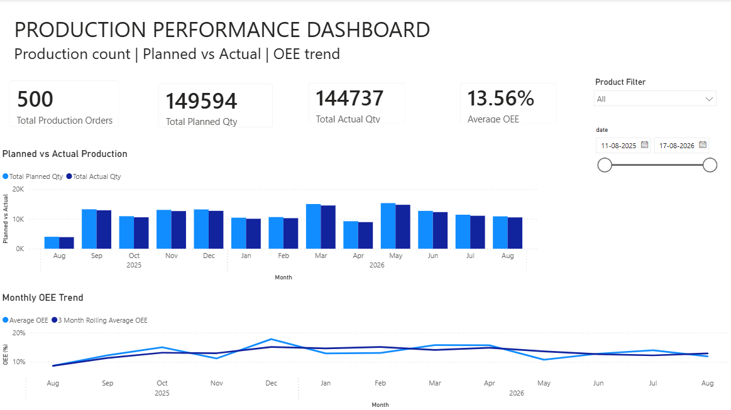
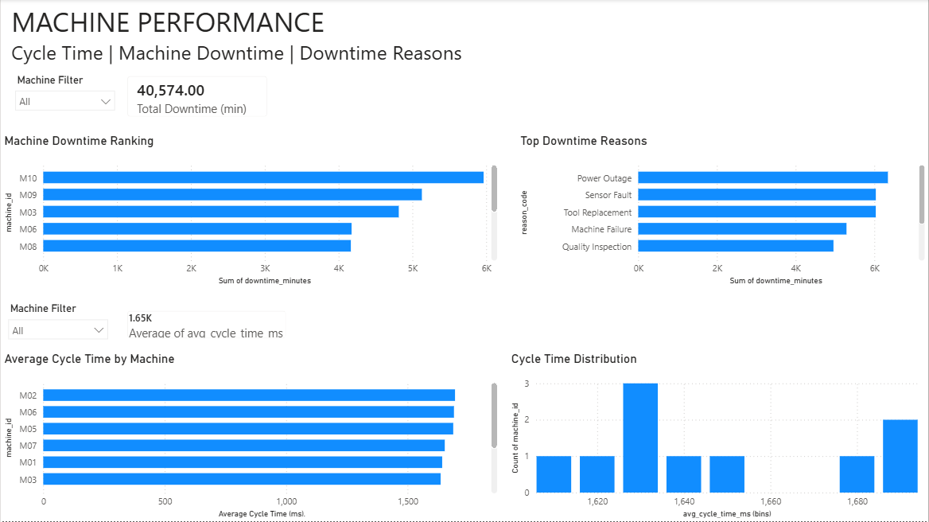
Snapshots of Production Overview & Machine Performance
Notes:
Here I'm showing the screenshots from the Production Overview and Machine Performance pages.
In the Production Overview, the main focus is on understanding how production is performing. We look at the total production orders, planned versus actual quantity and average OEE. We also have the monthly OEE trend.
One thing we added here is the 3-month rolling average of OEE. Instead of looking only at individual monthly values, the rolling average helps us see the overall trend more clearly.
Then on the Machine Performance page, we go one level deeper and look at individual machines.
We can see which machines have higher downtime, what the major downtime reasons are, and how the average cycle time differs between machines.
We also have the cycle-time distribution, which gives us a better view of how the cycle times are spread across the data.

Slide 10
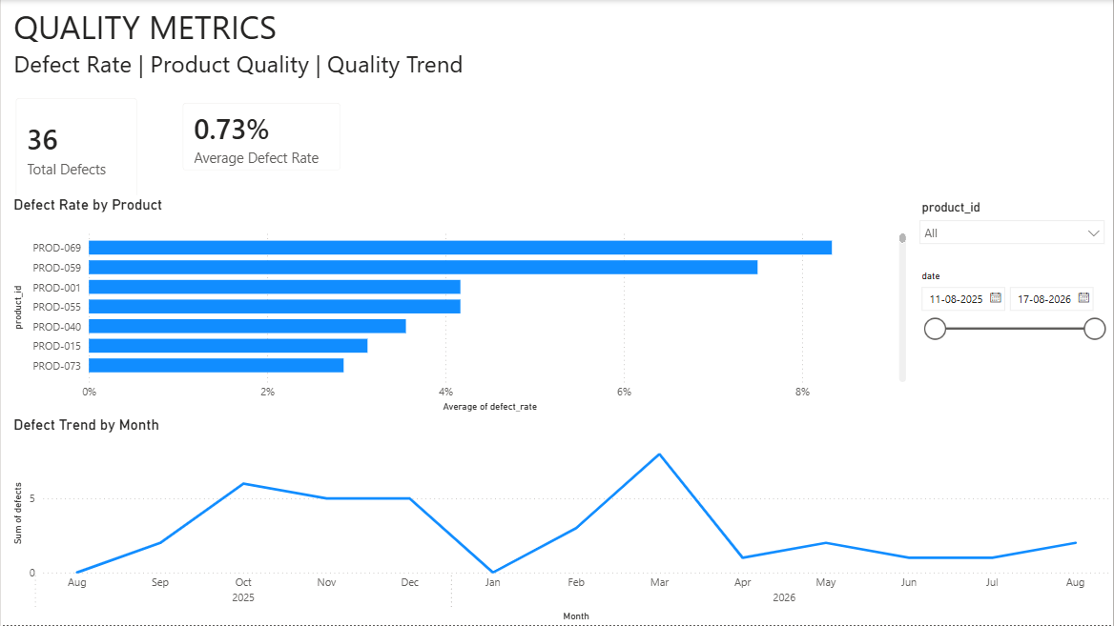
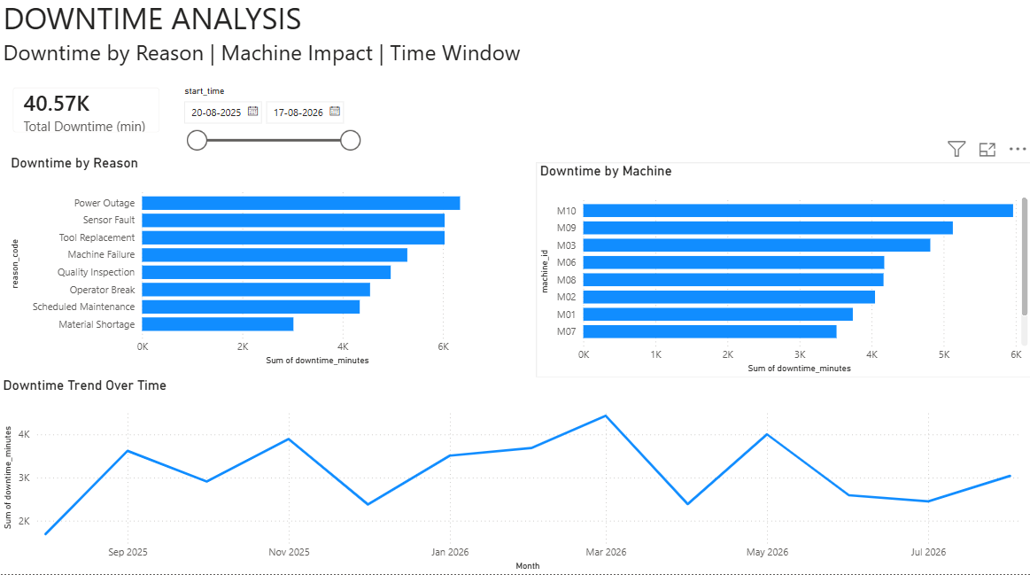
Snapshots of Quality Metrics & Downtime Analysis
Notes:
These two pages focus mainly on quality and downtime.
On the Quality Metrics page, we look at total defects and average defect rate. We can also analyse the defect rate by product and see how the quality is changing over time.
Then we have the Downtime Analysis page.
Here the idea is to understand where production time is being lost. We can analyse downtime by reason, by machine and over time. We also have the time-window analysis to look at downtime during different periods.
So together, these two pages help us understand both sides — whether we are having quality problems and where we are losing machine or production time.

Slide 11
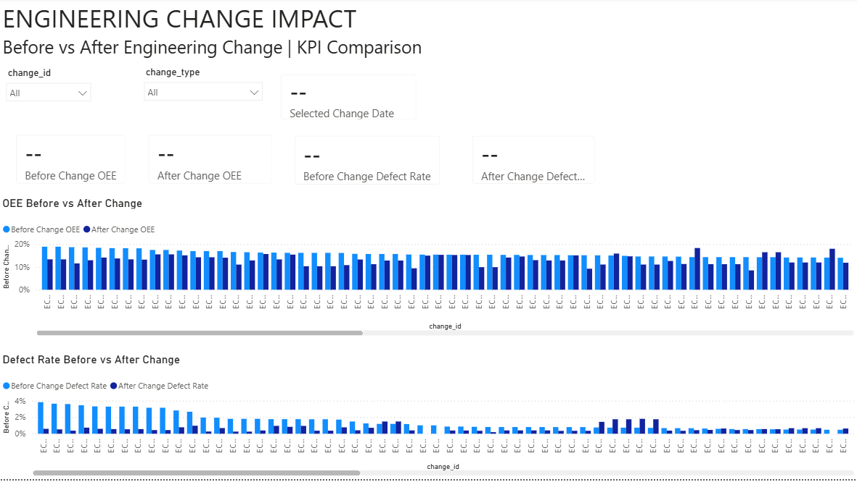
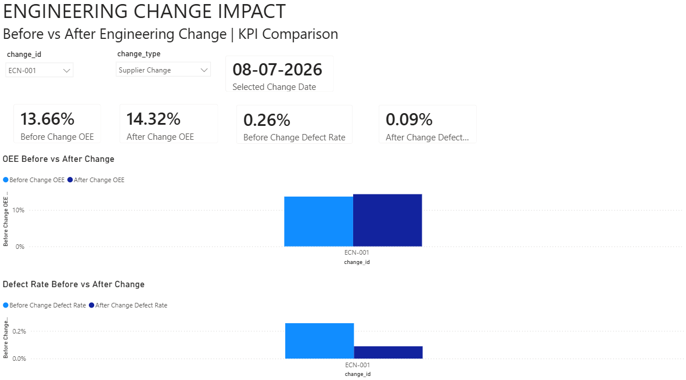
Snapshots of Engineering Change Impact
Before ECN Selection - Overall View
After ECN Selection - Selected ECN Impact
Notes:
This is one of the important pages because here we connect the PLM engineering change information with the manufacturing KPIs.
The page allows us to select an ECN ID and Change Type.
Before selecting an ECN, we have the overall view of the data. Once we select a particular engineering change, the dashboard responds to that selection and shows the corresponding analysis.
The main purpose is to compare the KPIs before and after the engineering change.
In particular, we look at OEE and defect rate to understand whether the engineering change had an impact on production performance or quality.
So this page basically helps us move from just looking at production data to actually understanding the possible impact of engineering changes on manufacturing performance.

Slide 12
CI Automation
Created docs/architecture_diagram.png using draw.io.
Added requirements.txt for Python dependencies.
Implemented GitHub Actions CI in .github/workflows/ci.yml.
CI successfully passed on GitHub Actions.
Conclusion
The project demonstrates an end-to-end MES–PLM analytics solution, from raw manufacturing data ingestion to KPI computation, PostgreSQL analytics and interactive Power BI reporting.
Notes:
Finally, coming to Week 6, we also added basic CI automation using GitHub Actions.
We added the required requirements.txt file and created the workflow under .github/workflows/ci.yml.
After pushing the changes to GitHub, the workflow was triggered automatically and the CI run completed successfully.
We also created the architecture diagram using draw.io as part of the final documentation.
So overall, the project covers the complete journey from raw MES and PLM data, through ingestion and transformation, KPI calculation, PostgreSQL analytics and finally Power BI visualization.
The main outcome is an end-to-end MES–PLM analytics solution where the data is processed systematically and converted into useful production and engineering insights.
That brings me to the end of my project presentation. Thank you.

