Slide 1
VOIP Project
By: Youssef Abdelrahman Ahmed Abdelrazek,
Ramez Mohamed Elmasry,
Abdelrahman khaled ahmed hussin,
Youssef Ayman Abdelsabour Abdelmoamen

Slide 2
JVoIP-Java SIP library
We used the JVoIP-Java SIP library to build the project.
The Mizu Java VoIP SDK (JVoIP) is a SIP client implemented as a platform independent java library.
Since it is based on the open standard Session Initiation Protocol, it can inter-operate with any other SIP-based device (servers and clients).
We used the JVoIP java library to be able to make calls to different peers by providing the username of the peer we want to call.
The VOIP server we’re using is “voip.mizu-voip.com”.

Slide 3
Most important used Functions
API_SetParameter (String param, String value):
Most of the parameters can be set with this function except gui parameters (like the colors). Some parameters can take effect only when JVoIP is reinitialized.
This function should be used only in special cases. You should be able to control the java sip client without using this function.
API_Start():
This has to be called only if you use JVoIP as and SDK or as a java voip library. It shouldn’t be called from JavaScript.

Slide 4
Most important used Functions
API_Call(int line, String peer):
Initiate call to a number or sip username, If the peer parameter is empty, then will redial the last number.
API_Hangup(int line, String reasontext):
Disconnect current call(s). If you set -2 for the line parameter, then all calls will be disconnected (in case if there are multiple calls in progress).

Slide 5
Most important used Functions
API_Accept(int line, int calltype):
Connect incoming call. You should call this function when there is an incoming ringing call if you wish to connect the call. The calltype parameter accepts the following values:
-1: default
0: audio only
1: with video
2: force video

Slide 6
Most important used Functions
API_CallEx(int line, String peer, int calltype)
Initiate call to a number or sip username.
If the peer parameter is empty, then will redial the last number.
The calltype can have the following values:
0: initiate voice call
1: initiate video call
2: initiate screensharing session
API_Reject(int line)
Disconnect incoming call.

Slide 7
AWT
AWT stands for Abstract window toolkit is an Application programming interface (API) for creating Graphical User Interface (GUI) in Java.
It allows Java programmers to develop window-based applications.
AWT provides various components like button, label, checkbox, etc. used as objects inside a Java Program.
We used the AWT API to implement a GUI for the project.

Slide 8
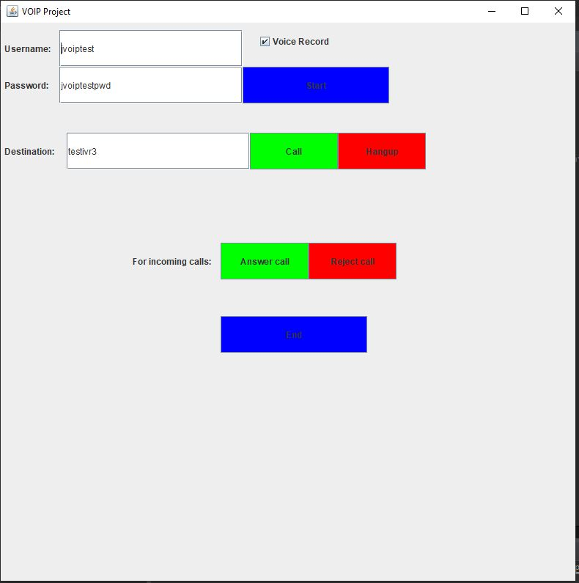
Implemented GUI

Slide 9
Start
The user enters his credentials(username and password) in the provided text field.
The user checks or unchecks the “Voice Record” checkbox to enable or disable the recording of the voice calls.
When the user clicks the “Start” button, we use the API_Start() method to initialize the SIP stack and register.
We call the sipnotifications.Start() method to start receiving the SIP notifications.
These notifications are very important to handle different events.

Slide 10
Voice calls recording
It is enabled if the “Voice Record” checkbox is checked.
Auto record the voice calls and save the records to the specified path.
We use it to ensure that the call was made successfully and the voice from both ends was sent and received successfully.

Slide 11
Making a call
To make a call the user can write the username of the destination(peer) that he wants to call then click the “Call” button.
The API_CallEx() method is used to make a call to a peer and we set the call type to 0 so that we’re making an audio only call.

Slide 12
Receiving a call
When we receive a call we will see the notification of incoming call in the console and we will hear a ringing tone.
The user can accept the incoming call by clicking the “Answer” button.
The API_Accept() method is used to accept the incoming call and we set its call type to 0 so that it’s an audio only call.
The user can reject the incoming call by clicking the “Reject” button.
The API_Reject() method is used to reject the incoming call.

Slide 13
Ending the session
The user can click the “End” button to end the session(unregister) and exit the program.
We use the API_Stop() method to stop the SIP stack and unregister.
We also use the sipnotifications.Stop() to stop JVoIP notification listener.

Slide 14
References
https://www.mizu-voip.com/Portals/0/Files/documentation/jvoip/index.html
https://datatracker.ietf.org/doc/html/rfc3261
https://en.wikipedia.org/wiki/Session_Initiation_Protocol
https://docs.oracle.com/javase/7/docs/api/java/awt/package-summary.html

Slide 15


