Slide 1
CASE #2: THE 'SOCIAL COLD' BUG
How social isolation blocks student cognitive resources

Slide 2
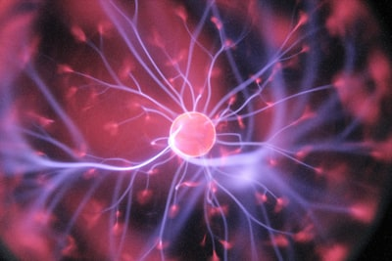
DRIVING QUESTION
• If the brain treats ostracism like physical pain, how can a student focus on complex problem-solving?
• Status: Analysis in progress...
• Objective: To bridge the gap between social wellbeing and academic performance.

Slide 3

BUG REPORT
• Status: UNPATCHED
• The Bug: A freshman moves to Astana and feels isolated.
• System Drain: This social pain drains the energy needed for their coding labs.

Slide 4
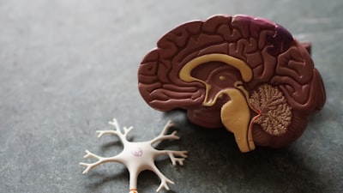
NEUROBIOLOGY OF PAIN
• Core Concept: The Brain Sees No Difference.
• Social rejection activates dACC and Anterior Insula.
• Fact: Social pain is processed by the same neural pathways as physical pain.

Slide 5
RESOURCE DRAIN
• System Overload: Scanning for social threats consumes massive energy.
• PFC Throttle: Prefrontal Cortex receives limited resources.
• Result: Significant drop in logical thinking and coding capacity.

Slide 6
THE DEBUG PROCESS
• Localization: Identifying apathy as a reaction, not laziness.
• Energy Audit: Monitoring anxiety-driven resource consumption.
• Standardization: Normalizing the experience for the student.

Slide 7

ASTANA CONTEXT
• Climate Impact: Long winters limit outdoor socialization.
• Isolation Loop: Physical cold amplifies the feeling of social 'coldness'.
• System Status: Cognitive hibernation to conserve metabolic heat.

Slide 8

THE PATCH: SOLUTIONS
• Personal: Mindfulness and micro-socialization goals.
• Systemic: Peer-programming and mentor support.
• Community: Creating 'Safe Harbors' within the university.

Slide 9
OPTIMIZATION RESULTS
• Efficiency: +40% Increase in concentration.
• Outcome: System stability restored, code compiles successfully.
• Status: Social belonging established.

Slide 10
REFERENCES (APA)
• Cacioppo & Hawkley (2009). Perceived social isolation and cognition.
• Eisenberger et al. (2003). Does rejection hurt? fMRI study.
• Lieberman (2013). Social: Why our brains are wired to connect.
• Rock (2008). SCARF: A brain-based model for collaboration.

