Slide 1
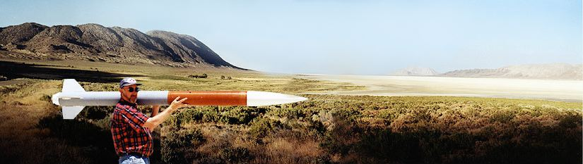
Winter Term Progress Report
CS Capstone Team 27
Client: Nancy Squires
Team member: Steven Silvers, Paul Minner,
Zhaolong Wu, Zachary DeVita

Slide 2

Project Overview
What is ARLISS?
A Rocket Launch for International Student Satellites
International payload design
competition in
Black Rock, Nevada ------------------>
Created by a professor of Stanford in 1999
What is the goal of ARLISS?
Design, integrate, fly, and analyze
data of a space experiment for
low Earth orbit and recovery
Teach the complete collaborative design process

Slide 3
Introduction
The Team:
Collaboration between ME, CS, and ECE students
ME designs structures, subsystems, and functionality
ECE implements electrical hardware
CS develops software to enable autonomous functions
Past OSU involvement:
None!
2017 ARLISS competition will mark OSU’s first participation

Slide 4

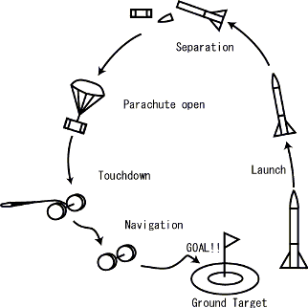
Requirements
CanSat Requirements:
Fit inside and weigh less than a soda can
Hence the term “CanSat”
4.8’’ length and 2.6’’ diameter
Maximum weight of 350 grams
Deploy from rocket at apogee
10,000 - 12,000 ft.
Land safely
Travel to GPS coordinate autonomously
Will need to physically touch target marker

