Slide 1
Zhaolong Wu Winter Term Progress Presetation
In charge of Navigation, Getting Unstuck from rover lands sideways, Payload fairing
Payload fairing is done
Navigation: Theoretically done, but It won’t work till I know how rover behaves, so I put a hold on the further development
Getting Unstuck from lands sideways: done, but no servo or other required data, currently under hold
Second half of the term
Navigation program?
Angle detection for finding the finishing pole.
Getting Unstuck from rover lands sideways.
Writing test cases based on the current understanding of the rover.

Slide 2
Progress
Navigation program?
Navi program has to work with the obstacle detection, getting unstack from obstacle and getting rover straight up when it on its side function
Looping through the Navi function to get a new shortest path
How the rover is going to behave on driving? If it does constantly drifting left or right? Giving
Angle of the moving is determined by a compass
Got to know this before finals weeks, originally was done by compare with the old coordinates to get an offset angle.
Angle detection for finding the finishing pole.
Wrote a program in C++ using OPENCV lib, will show the concepts in demo
Getting Unstuck from rover lands sideways.
Done but impossible to test and demo.
Writing test cases based on the current understanding of the rover
How the rover behaves on the driving? Turning? Still a lot of unknowns
How the servo is going to behave? How many steps? Unknowns

Slide 3
Problems and Chanllenge
The main problem we have throughout the whole winter term is our project is highly dependent on other’s progress.
Mechanical Team failed the rovers stress test in week 5, so there were 3 weeks delay on rover
Electrical Team suddenly disappeared in week 9 and 10, which they supposed to have all the electronic components ready and put into the rover, as well as PCB ready. However, they said the PCB will be ready on Thursday of finals week which give us the CS team no time to perform any tests.
Communication between ME, ECE and CS team.

Slide 4
Future
Finish off left pieces of program
Tones of testing when we got access to a functional rover
Getting ready for the expo and competition

Slide 5
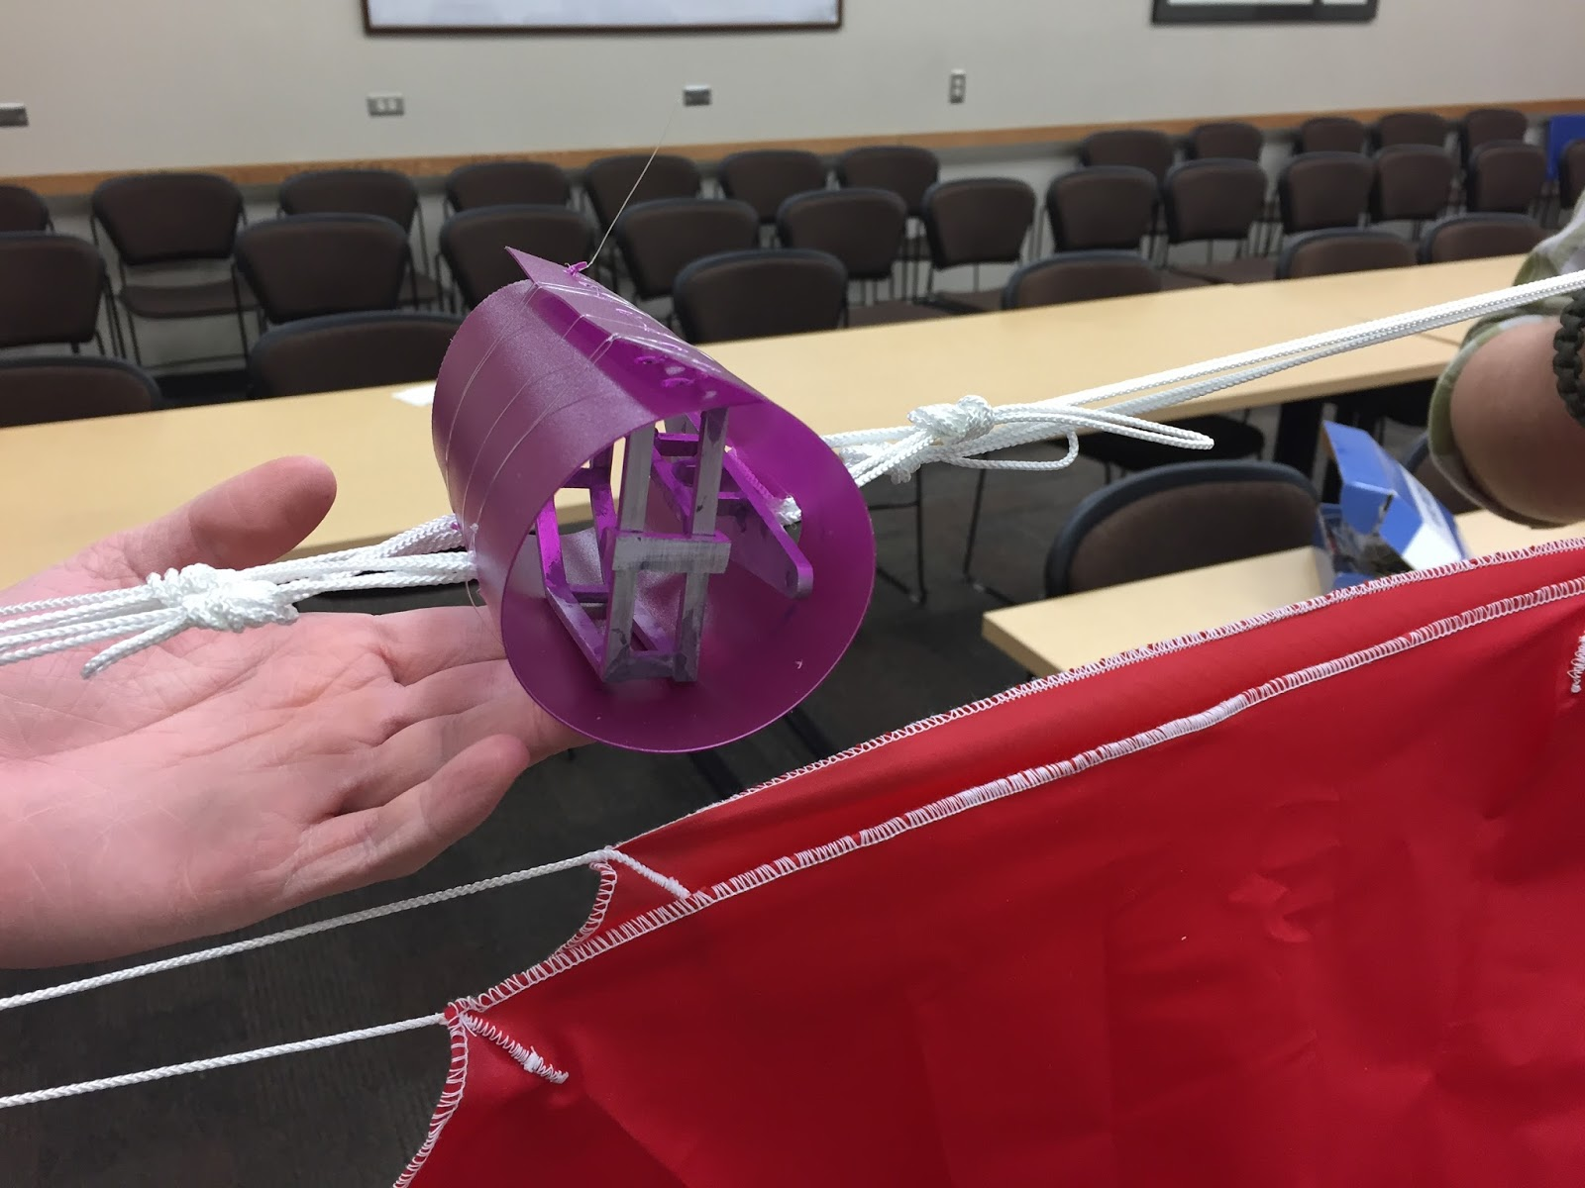
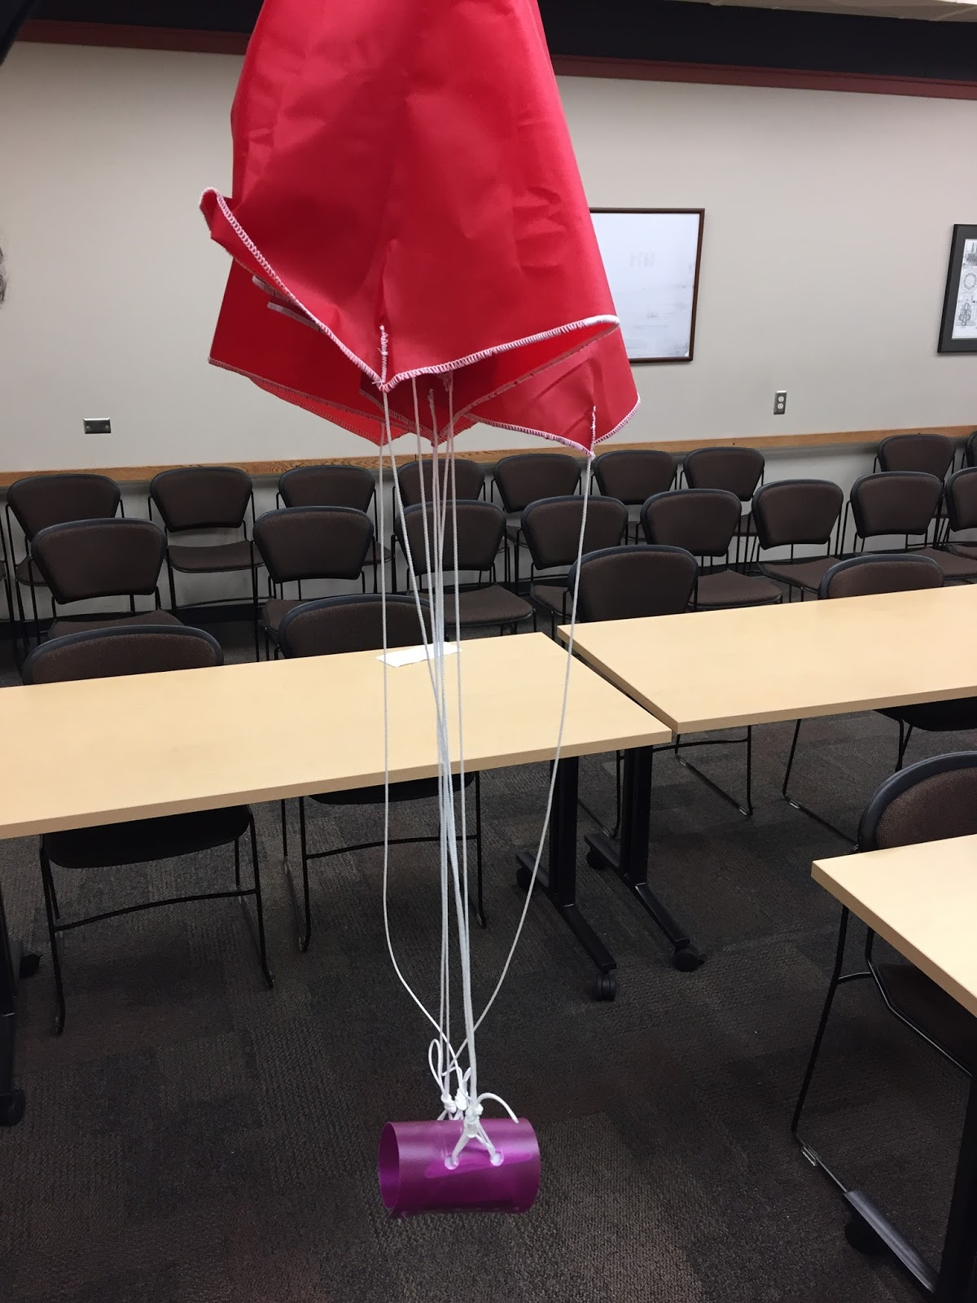
Demo
Angle detection
Unstack if landed sideways
Payload fairing

Slide 6
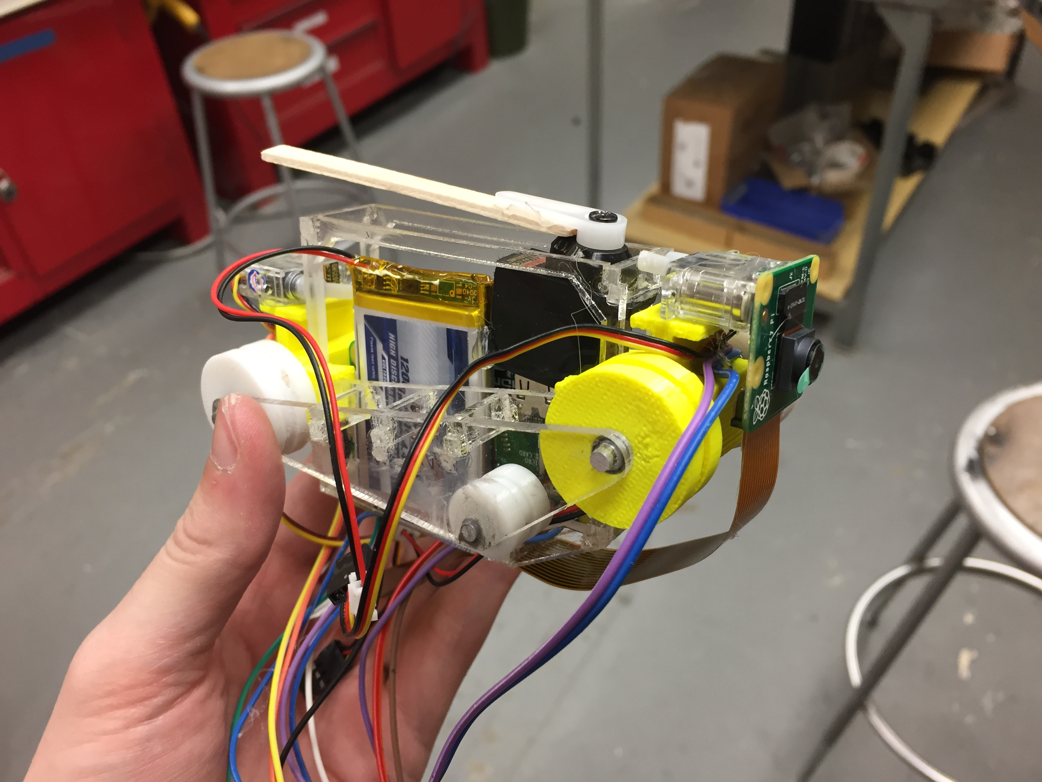
Demo

