Slide 1
Zachary DeVita – My Current Tasks
Creating Edge Detected Images from Video Frames
Using Machine Learning for Object Recognition
Building the Framework that Holds Together Individual Classes

Slide 2
Week 1
Wrote Program During Break
Converted 24-bit .bmp image to 2-dimensional array of binary values
Zeros indicate terrain is safe to traverse
Program Ended up Not being Used
Confusion and Disarray
Hadn’t Met with Team Yet

Slide 3
Week 2
Met with Mentor
Prototype Due Date at End of 6th Week
Still No Meeting with Collaborating Engineers
Still Don’t Know what Hardware is being Used

Slide 4
Week 3
Met with Extended Team!
Decided on a Microcontroller!!!
We know our Processor Speed!
C++ is Now an Option!!!
Began Writing Software for Edge Detection System
Uses a Combination of…
Grayscale, Blurring, Threshing, & Canny Filters

Slide 5
Week 4
Team Meeting with Client Present
Determined the Remainder of Hardware
Chose Camera
Memory
Capstone Lecture
Described Middle of Term Progress Report
Described Alpha Prototype
Contacted Bill Smart

Slide 6
Week 5
Capstone Lecture Again
Assigned Middle of Term Progress Report
Assigned 30 minute Presentation
Update Documents from Fall Term
Publish Documents on OneNote
Bill Smart’s Grad Students Help with Object Recognition
Machine Learning Research

Slide 7
Paul Minner
At the start of this term, I had the implementation of my modules planned, but not written yet.
Parachute Deployment
Deploy the parachute at the target altitude.
Getting Unstuck from Obstacles
Back up in different directions.
Finding/Touching the Finish Pole
Instruct rover which direction to move to hit the pole.

Slide 8
Week 1
Scheduled weekly meetings with TA
Researched hardware components I use
GPS – Altitude Sensor
1.5 times less accurate than horizontal coordinates
Thought about how to simulate hardware components
GPS
Camera object detection module (Written by other team member)

Slide 9
Week 2
Not much accomplished
Planned what needed to be completed for alpha build
Simulate each module.
Simulating some portions, like the object detection, was difficult.
ARLISS Group meetings planned for Tuesdays 6:00 PM

Slide 10
Week 3
Met with entire ARLISS group
Discussed other team’s due dates
Learned specific hardware (Raspberry Pi Zero)
Made significant progress on parachute deployment
Began work on getting unstuck from obstacles

Slide 11
Week 4
Continued working on modules
Began working on OneNote page
Revised Tech Review and Design Document (Minor)
Changed Technology for finding and touching finish pole

Slide 12
Week 5
Finished parachute deployment and getting unstuck from obstacles modules.
Simulated GPS by decreasing altitude by constant value after each call
Simulated Camera finding finish pole with a random value
Later, will need to test with actual hardware.

Slide 13
Week 6
Finished the find/touch the finish pole module.
All of my code is complete for alpha
Worked on writing progress report and presentation
Should easily finish by Friday deadline

Slide 14
Recap/Future
Created working simulations for my three modules
Will need to be tested later more thoroughly (With actual hardware)
By beta, all modules need to be combined to create one program, and program needs to run on real hardware.
Next term, individual modules need to be refined based on testing using the real hardware.

Slide 15
Demo
Parachute Deployment
Getting Unstuck from Obstacles
Finding/Touching the Finish Pole

Slide 16
Steven Silvers
Steven had fallen ill the day before this was to be recorded, and was only able to complete one take before his voice gave out.

Slide 17
Week 1
Winter Break
TA Meeting time set
ARLISS Team meeting time undecided

Slide 18
Week 2
Met with TA
Set what Alpha version would look like
Need to make simulators for testing

Slide 19
Week 3
First ARLISS Team meeting of the term
Control board set
Wheel system under development
Continued progress on alpha release

Slide 20
Week 4
Client was present at team meeting
Change to obstacle avoidance module
Change won’t be applied until after alpha release

Slide 21
Week 5
Continued work on obstacle avoidance module
Edits made to tech review and design document

Slide 22
Week 6
Write progress report
Short team meeting
Rover frame broke during testing

Slide 23
Control Board
Using Raspberry Pi Zero
Meets size constraints
Still powerful enough to run our software

Slide 24
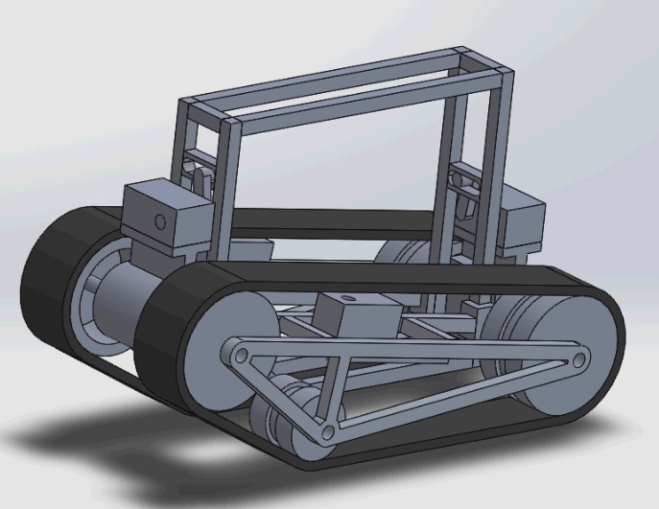
Wheel System
Designed and built by ME team
Three wheel caterpillar track
Hasn’t been built yet

Slide 25
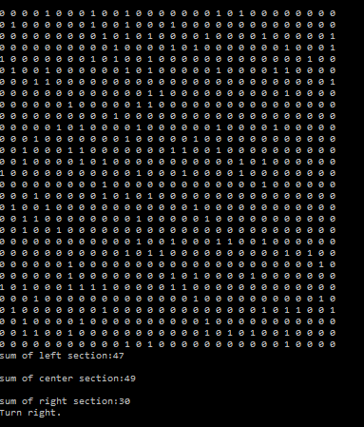
Obstacle Avoidance
Takes Zach’s image conversion as input
Split into three “lanes”

Slide 26
Zhaolong Wu Winter Term
CanSat's navigation system design.
Let rover go to the target pole
Payload fairing protocol development.
Parachute detachment, get rover out of the fairing
Getting CanSat unstuck if its fell sideways.
Rescue rover.

Slide 27
Week 1:
Class meeting
Officially start of implementation
Set the meeting with TA at every Tuesday 1:45-2:00 pm
Research
Haversine formula
It determines distance between two points on earth by have their longitudes and latitudes

Slide 28
Week 2:
Meeting with the TA first time of the term
Layout the structure of the term, alpha release.
Simulation protocals

Slide 29
Week 3:
Group meeting every Tuesday at 6pm
First Group meeting
Check every team’s status, team’s need.
At the end of week 6 ME team should have a prototype be ready to test.
Split up work
Start of implementation

Slide 30
Week 4:
Navigation Script
Obstacle Aviodence Pseudo Code
Onenote

Slide 31
Week 5:
Revising design document and tech review.
Changed payload fairing method to wrapping method per mechanical team’s request.
Changed rescue method to use mechanical arm per mechanical team’s request.
More testing

Slide 32
Week 6:
More testing of the navigation system
Need the hardware from ECE team to do real time testing.

Slide 33
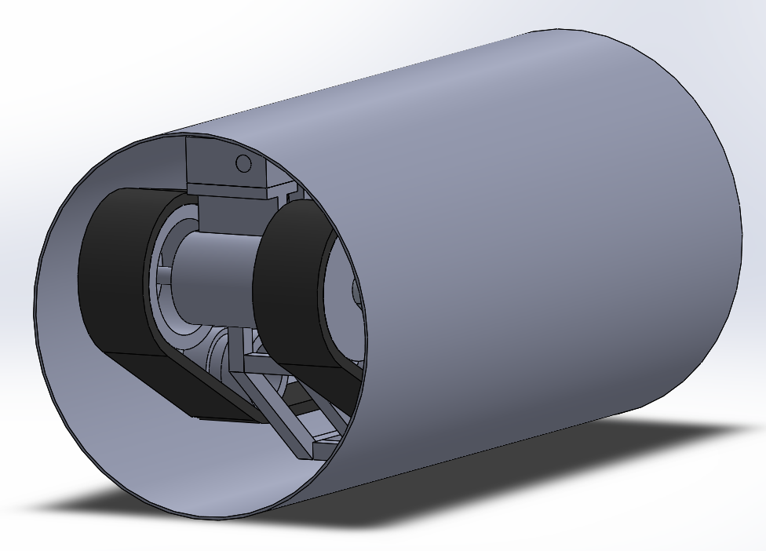
Demo
Navi
Payload fairing

Slide 34
Future of the term
Components integration testing

