Slide 1
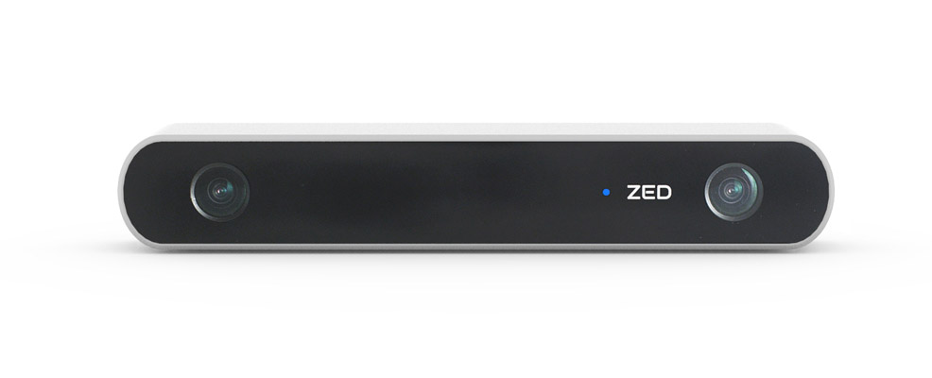
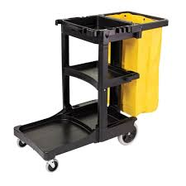
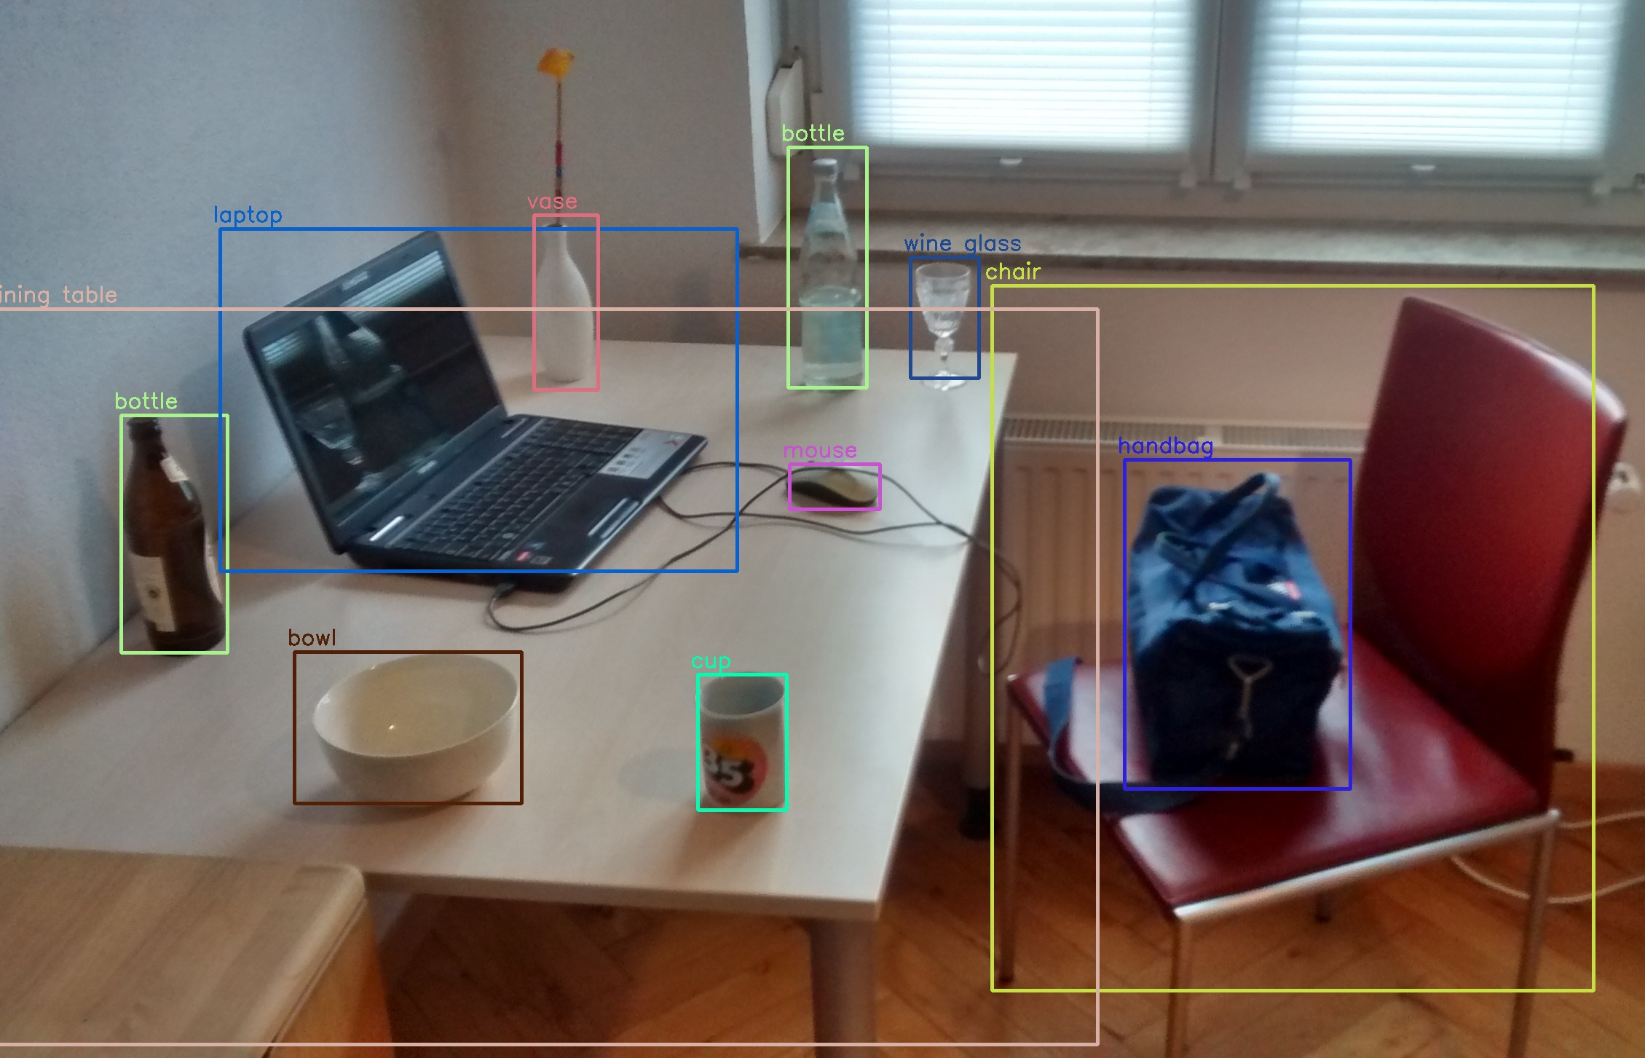
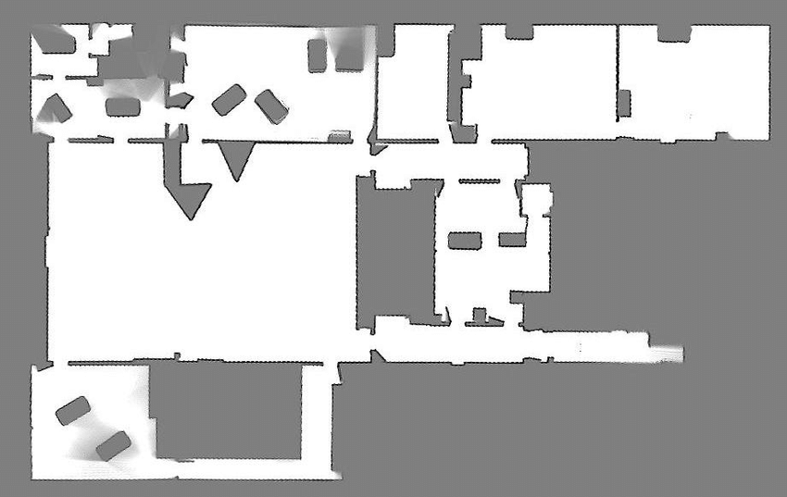

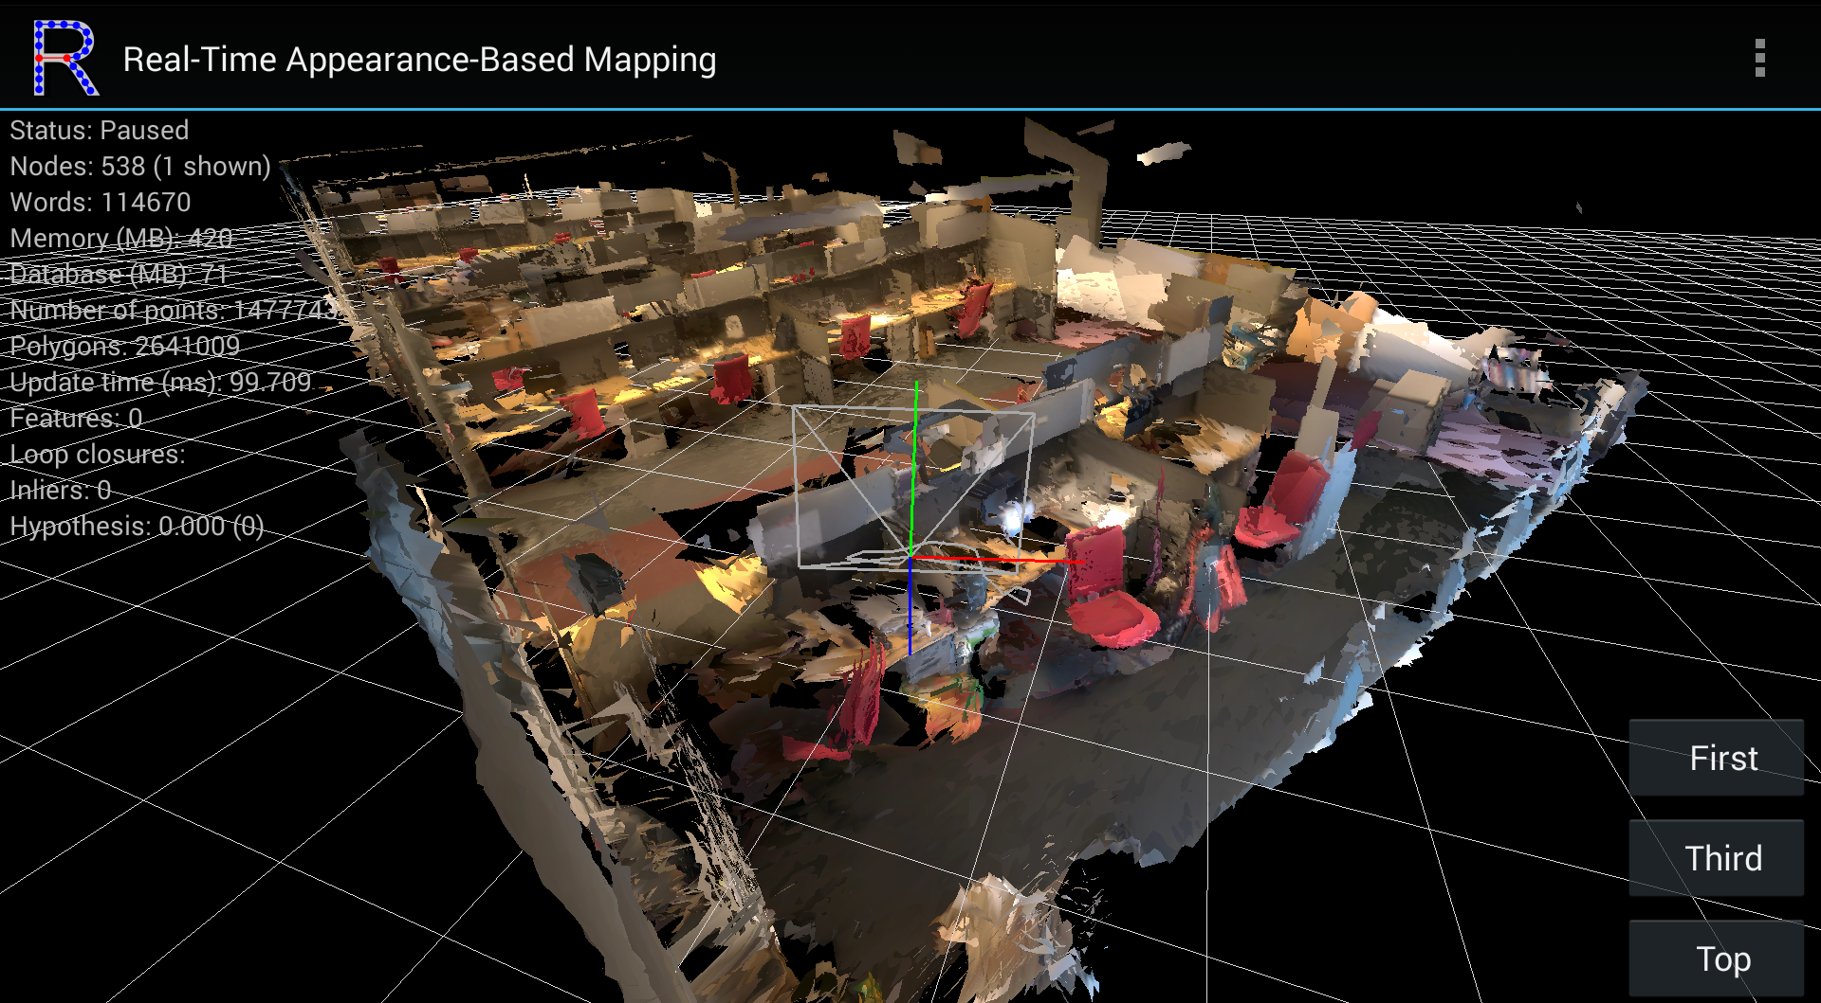



SLAM
RGB-D Mapping Session
Navigation
Annotation
Generate .bag file for use with navigation stack
RTABMAP
Point Aggregation
Object Detection and Global Localization
Generate .bag file for playback
Gate
Occupancy Grid
move_base
Doors
Stairs
Web Server
ROS Server
Sunlight
…
End User

