Slide 1
Accessibility Constraint Mapping for On-Road, Off-Road, To/From-Building, and Indoor Autonomous Transit & Delivery
Enea Dushaj, Joshua Eckels, Hani Awni
Notes:
I will present the first half of our accessibility constraint mapping research project which will discuss the background, motivation, overall problem and solution, as well as prior work done in the field and the long term and ultimate goals of what our research will hopefully be able to help achieve. I will be focusing on the broader scope of the project and Josh will talk more about the actual solution we implemented and what we did this summer.

Slide 2


Navigation
Notes:
One thing most humans will take for granted is our ability to fully perceive our environment and move around based on those perceptions.
The ability to recognize objects, locate ourselves in a space, and to be able to easily traverse any obstacles set before us is an incredible ability. This world is designed to mainly support the movement and transportation of right handed, bipedal humans with 20/20 vision.
However, have you ever thought about the difficulty a set of stairs or doors pose to a person in a wheelchair, a rover on treads? Some people lack the physical capabilities of moving over a path that most other people can take, and autonomous vehicles and robots cannot simply sense their surroundings without sensors and processors to aid them, and also share this difficulty moving around in certain environments. There are many untraversable obstacles in our environments, from curbs on streets, to muddy terrain that make getting from point A to B in a place like Virginia Tech’s campus much harder for certain people and automobiles, and this is the overall problem of what our research project is about. Determining accessibility constraints and locating them with robotic sensors for use on a hyper detailed map. Moving around is hard for certain people and robots. We want to make it easy to find the best path for them to take.

Slide 3
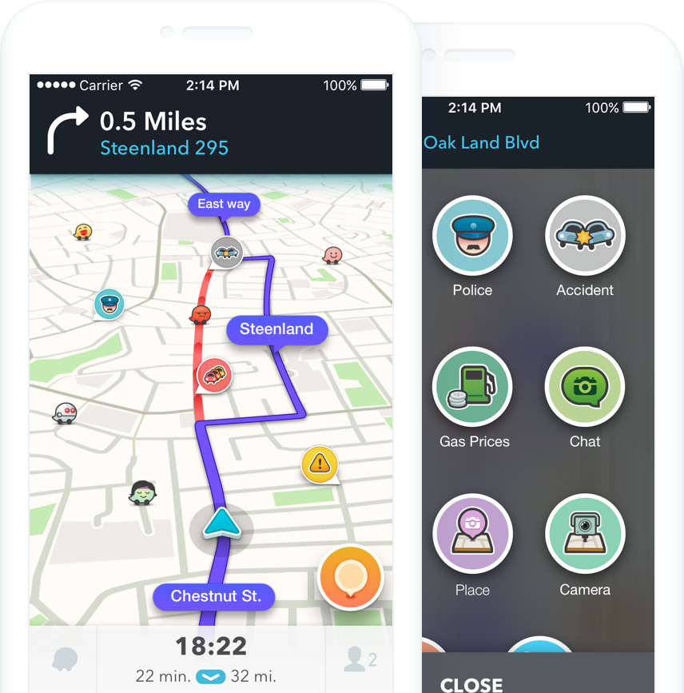
Background
Notes:
When I got a call from professor Bohn, he described the project as something similar to Waze. This is an app that, using input from other app users, allows cars navigating roadways to map an optimized path based on road conditions. This could be reports of a pothole, police ahead, or traffic that the app will then accordingly reroute or warn you about so that your path from A to B is as optimized as possible. This project aims to accomplish something similar, where a hyper detailed map can be created so that obstacles that prohibit specific users from crossing a space can be annotated on that map, and the navigation to destination takes into account barriers that that person or robot may have. Our focus this summer was on how to create this hyper detailed map, recognizing potential barriers using a typical sensors you might see on a rover for use by robots or humans with certain accessibility constraint to navigate an environment. The navigation of this map annotated with the barriers we recognized would be handled by our graduate student, Hani. The original description of the project detailed each of us separating to recognize different barriers – one dealing mostly with terrain, like recognizing grass, gravel, and dirt and the other dealing with physical objects like stairs or curbs, however given the drawbacks of the software we originally wanted to use, we decided to team up to create a more universal recognizer that Josh will discuss more.

Slide 4

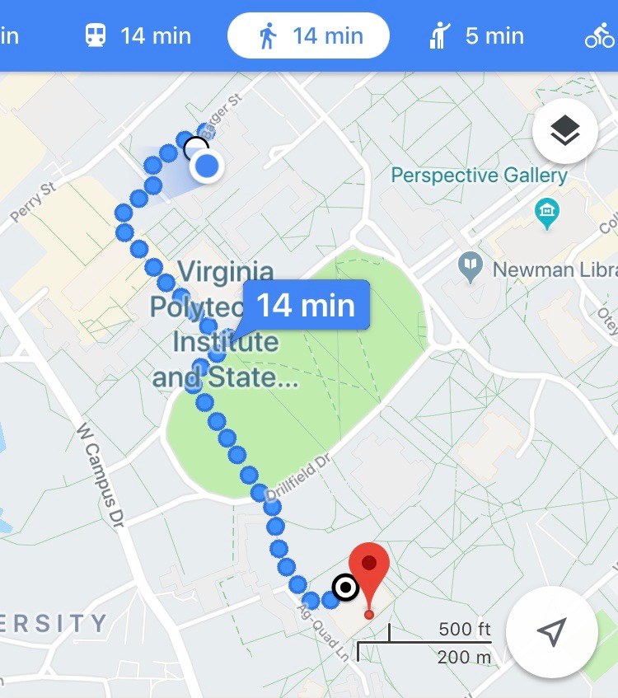


Possibilities
Notes:
The end goal to this project would be an interface where someone can describe their accessibility constraints – I can’t go down stairs because I am in a wheelchair and need elevators. We walked around campus and it opened our eyes to just how difficult moving around for someone with physical constraints would be. This end goal would implement the work we’ve done in locating certain barriers and putting them on a map. This map could also contain a bunch of other barrier information about the environment at every point, say on campus, and would navigate you around based on your specific needs. For example, I need to avoid the sun because I get sunburned very easily, or my robot needs to be in direct sunlight because that’s how it gets its energy, or I can’t roll myself up a hill with an incline steeper than 20 degrees, or I need my robot to stay within a certain Wi-Fi signal in order to communicate with it, or I have very sensitive ears and need to avoid construction zones because it gives me bad headaches. Google Maps has a similar function where you can specify if you want to travel by car, by bike, by foot, etc in which it has certain constraints tailored to each method of transportation and directs you on how to travel based on the needs of that vehicle. With our methods of mapping hyper detailed environments, we can have the user specify their needs themselves, the priority they require to avoid certain obstacles, and navigate them according to their constraints within the given environment.

Slide 5
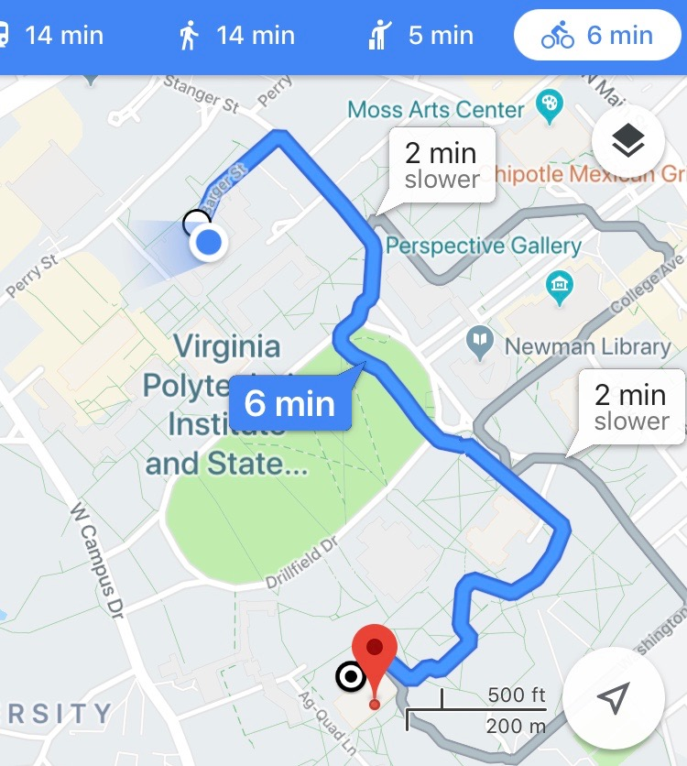
Possibilities
Notes:
The end goal to this project would be an interface where someone can describe their accessibility constraints – I can’t go down stairs because I am in a wheelchair and need elevators. We walked around campus and it opened our eyes to just how difficult moving around for someone with physical constraints would be. This end goal would implement the work we’ve done in locating certain barriers and putting them on a map. This map could also contain a bunch of other barrier information about the environment at every point, say on campus, and would navigate you around based on your specific needs. For example, I need to avoid the sun because I get sunburned very easily, or my robot needs to be in direct sunlight because that’s how it gets its energy, or I can’t roll myself up a hill with an incline steeper than 20 degrees, or I need my robot to stay within a certain Wi-Fi signal in order to communicate with it, or I have very sensitive ears and need to avoid construction zones because it gives me bad headaches. Google Maps has a similar function where you can specify if you want to travel by car, by bike, by foot, etc in which it has certain constraints tailored to each method of transportation and directs you on how to travel based on the needs of that vehicle. With our methods of mapping hyper detailed environments, we can have the user specify their needs themselves, the priority they require to avoid certain obstacles, and navigate them according to their constraints within the given environment.

Slide 6
Engineering for Social Justice
Students in wheelchairs at Virginia Tech
Broken infrastructure can be recognized quickly
Bring light to issues
Notes:
Furthermore, this research has important social and political implications. Virginia Tech I believe doesn’t have any students in wheelchairs at the school. That’s either because they visit campus and realize they can’t travel anywhere easily, or they come here and need to drop out because they can’t reasonably get anywhere. Perhaps the elevators don’t work, or the ADA access buttons that are supposed to automatically open doors for you don’t work and you can’t get into buildings, or you need to take the most convoluted path possible to get to your place of work. These are issues that the school wouldn’t normally address or pay much attention to, but if you can demonstrate to the school and to others that, given the environment that Virginia Tech has implemented for wheelchair users, a typical freshman undergrad mechanical engineer in a wheelchair would never be able to graduate because they would miss or be late to too many classes simply due to the sheer amount of time and difficulty it would take to get from one class to the next is extremely telling of how an institution cares about disabled students and can shed light on a situation that seriously needs the attention that it doesn’t get. This can also be used to point out failing infrastructure of the school, like access buttons that don’t work, and be able to report these issues quickly so that fixes can be implemented as soon as possible. Furthermore, if there is infrastructure in place that allows for the navigation of autonomous rovers on campus, then more money can be allocated to research programs that can better map the campus and point out its overwhelming accessibility constraints. The importance of this work, being able to map key features of an environment as barriers to movement, has a lot of potential that we tried to exploit but only really got to touch the tip of the iceberg on.

Slide 7
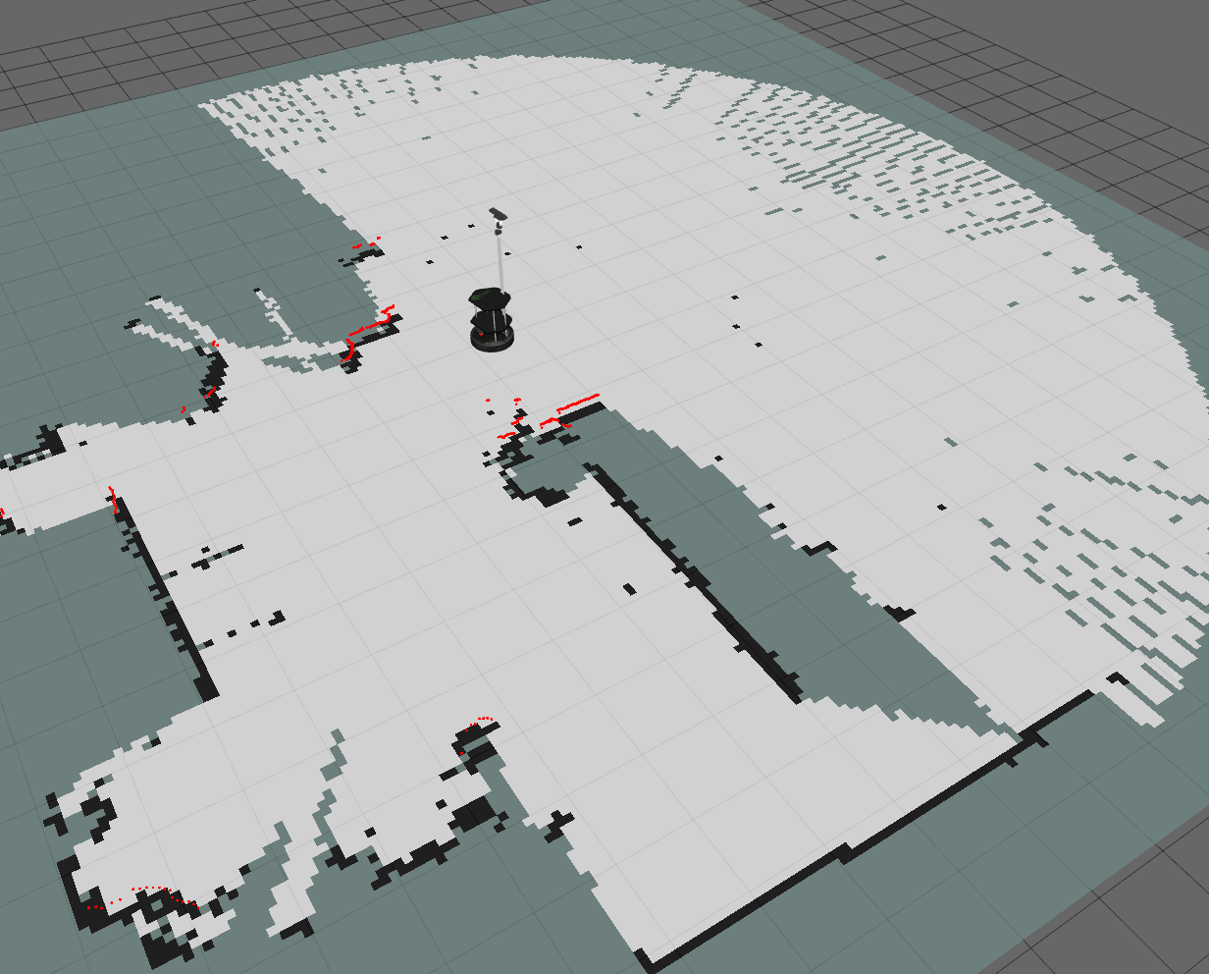
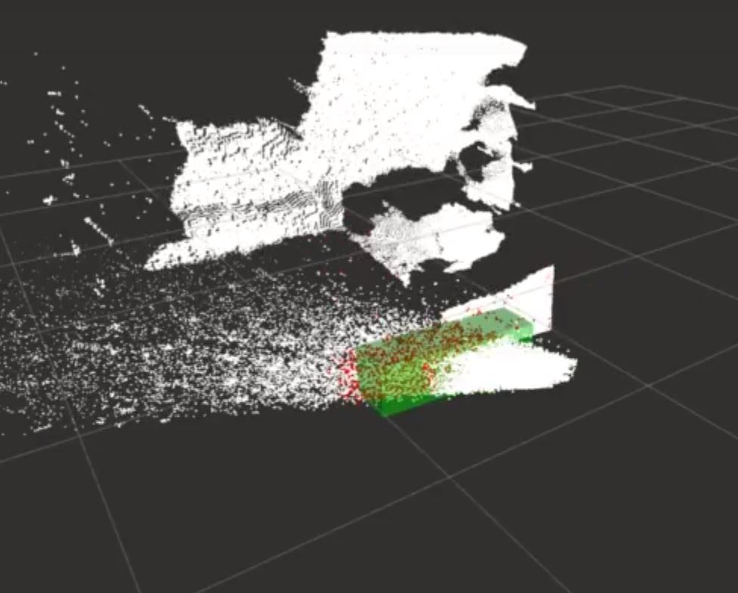
Prior Work
Notes:
Video: This picture is from a video of a master’s student who’s thesis work was object detection using OpenCV, ROS and the Point Cloud Library, which was what our initial approach to the problem was.
RTABMAP is a program that performs SLAM, which, using sensors, makes a map and tells you where you are, but it also creates an occupancy grid which is basically just a map that shows you where there is occupied space. This program however doesn’t really distinguish between what a wall might be and what a door might be, so to a robot, a closed door is just as good as a wall when in reality, it could be considered something the robot can pass given the right features or situation. Josh will talk more about RTABMAP.

Slide 8
Accessibility Constraint Mapping
Notes:
The method of barrier detection we developed is applicable to autonomous vehicles in that it can be used on many different obstacles and can be used to pick out a huge amount of different physical objects. Josh will talk a little more about this, but this kind of technology is what would allow a rover delivering an amazon package in a neighborhood with kids playing, dogs running around, puddles on the ground, etc, to understand their environment and be able to place themselves where they need to be given the various things going on around them until they reach your doorstep to give you your package. Amazon, for example, has opted to avoid solving this technical problem of dealing with obstacles on the ground by employing big blimps that will deploy quadcopters to deliver your package to your doorstep, however this has downsides in that it is wasteful of natural materials like helium and doesn’t solve a problem that other ground vehicles encounter.

