Slide 1
Python and ACT Tutorials

Slide 2
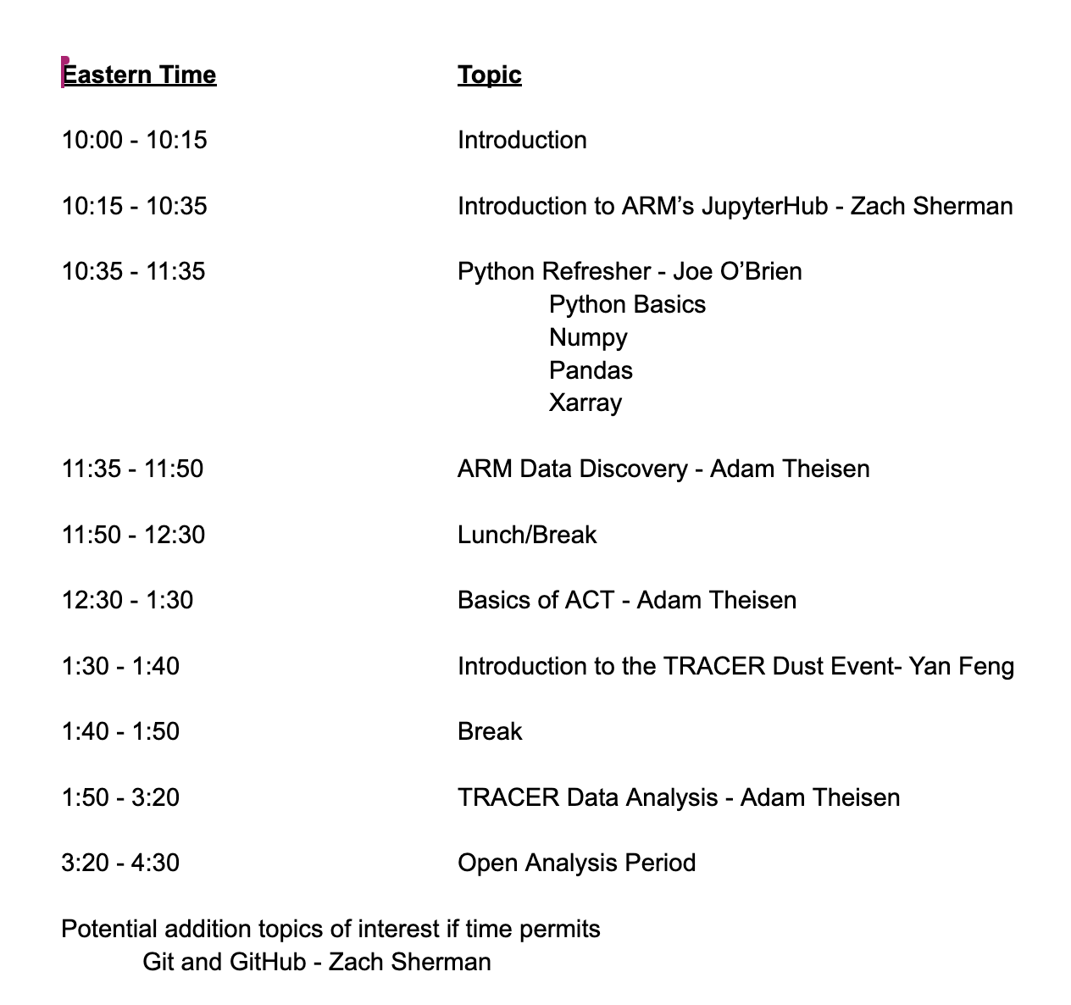
Agenda

Slide 3
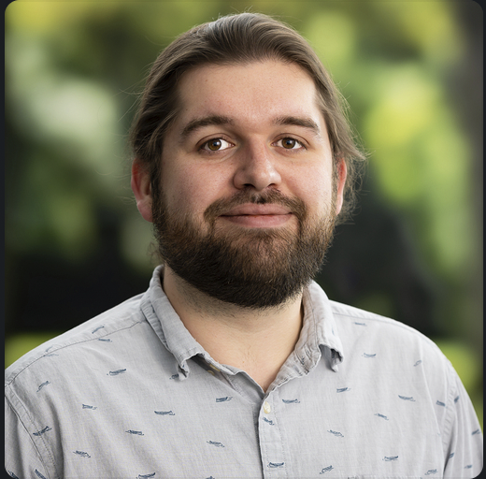
Joe O'Brien
Software Developer
Where you are from
South Amboy, New Jersey (now live in Naperville, IL)
College(s)
Millersville University of PA (BS in Meteorology)
Univ. of North Dakota (MS in Atmospheric Science)
What you are most excited about for the summer (work or non-work)?
Defending my Dissertation / Being done with my PhD

Slide 4
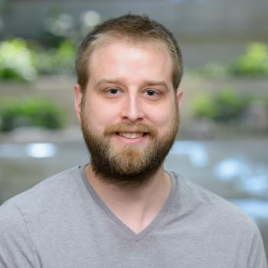
Zach Sherman
Software Developer
Where you are from
Plainfield, IL (Now live in Woodridge, IL)
College(s)
Lewis University (BS in Environmental Science and Sustainability)
What you are most excited about for the summer (work or non-work)?
Disc golfing, nice weather, and occasional PC gaming

Slide 5
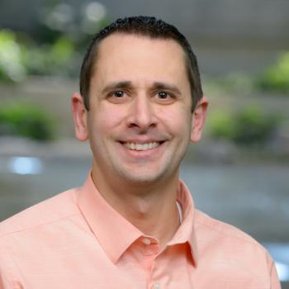
Adam Theisen
ARM Instrument Operations Manager
Where you are from
Upsala, MN
College(s)
University of North Dakota; BS/MS Atmospheric Science
What you are most excited about for the summer (work or non-work)?
Biking, Kayaking, and Storms

