Slide 1

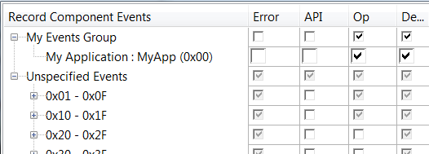
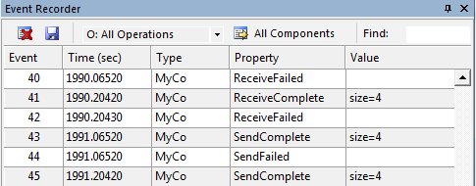
Event Recorder
Debugger
Application Code
Event Annotations
Event Recorder
Software Component Viewer Description (*.SCVD) file
Event Filter
Memory
Event Buffer

Slide 2
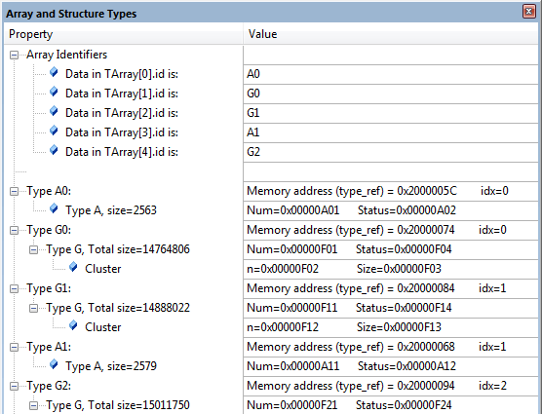
Component Viewer
Debugger
Application Code
Software Component Viewer Description (*.SCVD) file
Memory
Status Variables

Slide 3
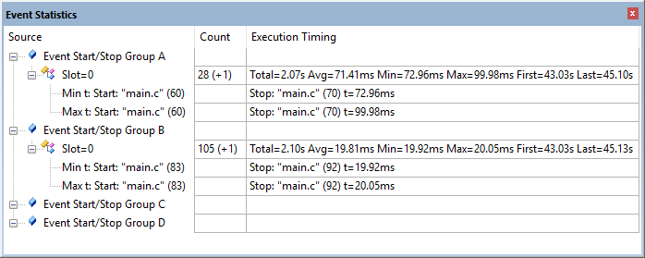
Event Statistics (timing only)
Debugger
Application Code
while (1) {
EventStartA(0);
// user code
EventStopA(0);
...
EventStartB(0);
// user code
EventStopB(0);
}
Event Recorder

Slide 4
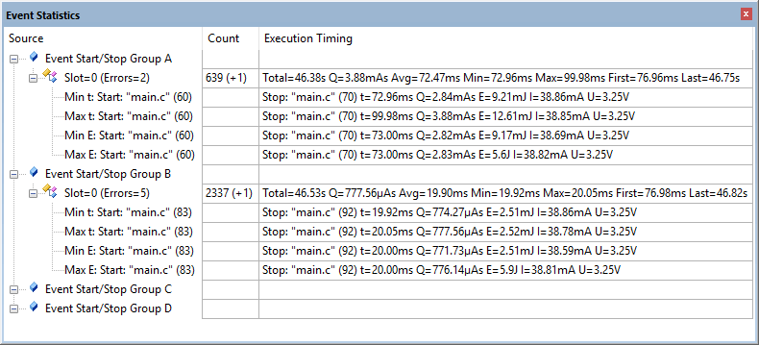

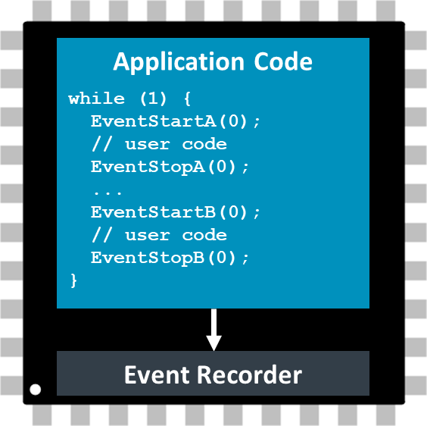

Event Statistics with energy measurement
Debugger

Slide 5
User Application
MyComponent
Initialize
Send
Receive
Event Functions
Event Recorder

Slide 6
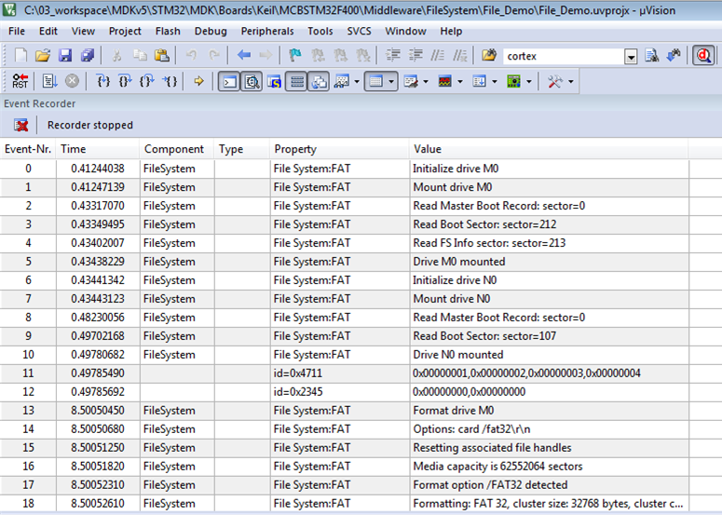

Event Recorder
Application Code
Event Annotations
Event Recorder
JTAG
SWD
Debug Unit
Memory
Event Buffer
Debugger

Slide 7
Fault Exception
Memory (uninitialized)
ARM_FaultSave()
ARM_FaultInfo
ARM_FaultExit()
System Restart
EventRecorderInitialize()
ARM_FaultOccured()
no
yes
ARM_FaultRecord()
Event Buffer
ARM_FaultRecord(): decode fault and store it using the EventRecorder
EventRecorderStop()
Resume Normal Operation

