Slide 1
CORE
Create startup_<device>.s with reset handler and exception/interrupt vectors
SVD
Create the System View Description (SVD) file
Flash
Use template project from ARM::CMSIS pack to create the flash programming algorithm
Create system_<device>.c/.h files which are used for system and clock configuration
Generate the device header file with svdconv.exe
Pack
Create a basic pack for selecting the device(s) in a development tool
Pack
Finalize the DFP by adding the all files, documentation, and feature descriptions
Debug
Create debug descriptions for debugger access via the CoreSight component

Slide 2
CMSIS-Pack
Benefits of software packs
Delivery
Software components, examples, code templates, documentation, device and board support files
Semantic versioning for lifecycle management using an embedded industry standard for reliable production
Specify dependencies upon other packs, software components, toolchains, and APIs
Automatically replace files based on hardware selection or toolchain requirements
Versioning
Dependency
Retargeting
Notes:
CMSIS-Packs can contain:
Source code, header files, and software libraries
Documentation, license grants
Source code templates and pre-built examples
Device parameters along with startup code and programming algorithms
CMSIS-Pack version specification is inspired by the Semantic Versioning 2.0.0. Under this scheme, version numbers and the way they are incremented convey a meaning about the underlying content quality and the significance of changes from one version to the next. A version consists of 3 mandatory and 2 optional sections:
MAJOR.MINOR.PATCH[-Pre Release][+Build Metadata]
Software components always have some dependency on the underlying hardware and the toolchain they are built with
The pack mechanisms help to retarget components
Conditions allow to check the environment (device, toolchain, board) in which the components are used

Slide 3
Software components
Interfaces to user application or other software components
Software component
API headers
User code templates
Configuration files
Source code/
libraries
Documentation
Debug view
description
Interfaces to device peripherals or other software components
A software component encapsulates a set of related functions.
Components should be substitutable by other components at design time.
Components can have dependencies on other components.
Notes:
Requires you to think about the API of the software component

Slide 4
Software components – Taxonomy
Software component have these attributes that are used to identify them:
Component Class (Cclass): examples are CMSIS, Device, File System
Component Group (Cgroup): examples are CMSIS:RTOS, Device:Startup, File System:CORE
Component Version (Cversion): the version number of the software component
Optionally, a software component may have additional attributes:
Component Sub-Group (Csub): examples are CMSIS:RTOS:MyRTOS, Device:Driver USBD:Full-speed
Component Variant (Cvariant): a variant of the software component: RTOS:FreeRTOS
Component Vendor (Cvendor): the supplier of the software component
Notes:
Requires you to think about the API of the software component

Slide 5
Bundles
A bundle is a variant on the Cclass level.
It specifies the attributes Cclass, Cversion and optionally Cgroup and Cvendor for a collection of interdependent components.
Components within a bundle inherit the attributes set by the bundle and must not set these attributes again.
Bundles ensure consistency of attributes across multiple interworking components and restrict the mix and match of components within a Cclass from different solutions.
Bundle
Component A
Component B
Component C
Component X
Component Y
Component Z
Notes:
Requires you to think about the API of the software component

Slide 6
Bundles
In case multiple inter-dependent components that belong to the same Cclass form part of a solution, these can be grouped into a bundle (Cbundle).
A Cbundle specifies identical attributes Cclass, Cversion and optionally Cgroup and Cvendor for several components.
Components within a bundle inherit these attributes set by the bundle and cannot alter these attributes (for example component version).
Bundles ensure consistency of attributes across multiple interworking components and restrict the mix and match of components within a Cclass from different software packs.

Slide 7
Relationships of packs and software components
Packs can require other packs to be available:
Components can have dependencies on other components; either from the same or from other packs:
Pack A
Version n
Pack B
Version m
Pack A, Version n
Pack B, Version m
Component A
Component B
Component C
Component A
Component B
Component C

Slide 8
Central API Interface definition for software components
Interfaces
A common problem: API headers evolve over time.
A central API definition shares header file and documentation of an API interface across multiple other software components to ensure consistency.
The API interface is distributed separate or as part of the software component that consumes this interface. The API header file is therefore.
An example is the CMSIS-Driver pack that contains various Ethernet and Flash drivers – all compatible with the CMSIS-Driver APIs that are published in the CMSIS Pack.
Software
component
API headers
Source code/
libraries
Central API definition
API headers (Definition)
Documentation of API
Implementation #1
Implementation #2
Implementation #3
Source code/
libraries
Source code/
libraries
Source code/
libraries
Notes:
Requires you to think about the API of the software component

Slide 9
API components
An API is a special form of a software component that only defines a C/C++ Application Programming Interface (API).
An API does not contain the actual implementation (usually provided by source code or library files) and cannot be selected in a development tool. One example is the CMSIS-RTOS API, which is specified as part of CMSIS. However, the actual RTOS implementation is provided by different vendors.
An API consists of a name, a brief description as well as one or more header files. It references a document containing the specification of the API.

Slide 10
Application example: TCP/IP network
Using network stack on STM32F407IG with internal MAC
Network:Socket:TCP
CMSIS:CMSIS-RTOS
Network:Interface:ETH
Network:CORE
CMSIS:CORE
Ethernet MAC
Middleware Pack
CMSIS Pack
Device:Startup
Ethernet PHY
External Driver Pack
Vendor 1 Pack

Slide 11
Application example: TCP/IP network
Using network stack on an NXP LPC54108 without MAC
Network:Socket:TCP
CMSIS:CMSIS-RTOS
Network:Interface:ETH
Network:CORE
CMSIS:CORE
Ethernet MAC and PHY
Middleware Pack
CMSIS Pack
Device:Startup
CMSIS-Driver SPI
External Driver Pack
Vendor 2 Pack

Slide 12
Managing software components in a project
Pack manager creates RTE_Components.h header file
RTE_Components.h is an inventory file that contains:
CMSIS_device_header #define for generic access to the selected device’s header file
All defines that are generated out of components from PDSC files:
<component Cgroup="Core" Cversion="10.0.1" condition="FreeRTOS"> <description>Core components API (Kernel, Tasks, Semaphores, Mutexes, Queues)</description> <RTE_Components_h> #define RTE_RTOS_FreeRTOS_CORE /* RTOS FreeRTOS Core */ </RTE_Components_h> . . . </component>
Is added to the RTE_Components.h file:
/* * Auto generated Run-Time-Environment Component Configuration File * *** Do not modify ! *** */ #ifndef RTE_COMPONENTS_H #define RTE_COMPONENTS_H /* Define the Device Header File: */ #define CMSIS_device_header "ARMCM3.h“ #define RTE_RTOS_FreeRTOS_CORE /* RTOS FreeRTOS Core */ #endif /* RTE_COMPONENTS_H */

Slide 13
CMSIS-CORE and CMSIS-Pack working together
Application usage example
startup_<device>.s CMSIS Device Startup Interrupt Vectors
User application includes the RTE_Components.h file and the CMSIS_device_header file to get access to device specifics and to check the availability of software components that should be defined in the inventory file
system_<device>.c CMSIS System & Clock Configuration
User Application
#include RTE_Components.h #include CMSIS_device_header main() { ... }
RTE_Components.h
#define CMSIS_device_header Defines from software components
<device>.h CMSIS Device Peripheral Access

Slide 14
PDSC file example
Supplier and release information, requirements for other packs
<package schemaVersion="1.4" xmlns:xs="http://www.w3.org/2001/XMLSchema-instance" xs:noNamespaceSchemaLocation="PACK.xsd"> <vendor>ARM</vendor> <name>CMSIS-FreeRTOS</name> <description>Bundle of FreeRTOS for Cortex-M and Cortex-A</description> <url>http://www.keil.com/pack/</url> <license>License/license.txt</license> <releases> <release version="10.0.1" date="2018-02-22"> FreeRTOS 10.0.0 Maintenance for CMSIS 5.3.0: - Added queue registry support to CMSIS:RTOS2:FreeRTOS component. - Updated CMSIS-FreeRTOS component view to display queue, mutex and semaphore objects. - Updated to CMSIS RTOS2 API 2.1.2 and OS Tick API 1.0.1. - Fixed context switch response latency for API calls from ISR. </release> </releases> <requirements> <packages> <package vendor="ARM" name="CMSIS" version="5.3.0-0"/> </packages> </requirements>
Supplier and release information
Dependency on other CMSIS-Packs

Slide 15
PDSC file example
Dependencies on toolchain, core, and other software components
Dependency on compiler
<conditions> <condition id="ARMCC6"> <accept Tcompiler="ARMCC" Toptions="AC6"/></condition> <condition id="ARMCC"> <require Tcompiler="ARMCC" Toptions="AC5"/> </condition> <condition id="GCC"> <require Tcompiler="GCC"/> </condition> <condition id="IAR"> <require Tcompiler="IAR"/> </condition> <condition id="CM0"> <description>Cortex-M0/M0+/SC000 processor based device</description> <accept Dcore="Cortex-M0"/> <accept Dcore="Cortex-M0+"/> <accept Dcore="SC000"/> </condition> <condition id="FreeRTOS"> <require condition="ARMCC GCC"/> <require Cclass="Device" Cgroup="Startup"/> <require Cclass="RTOS" Cbundle="FreeRTOS" Cgroup="Config"/> <require Cclass="RTOS" Cbundle="FreeRTOS" Cgroup="Heap"/> </condition> <condition id="FreeRTOS Core"> <require Cclass="RTOS" Cbundle="FreeRTOS" Cgroup="Core"/> </condition> </conditions>
Dependency on Arm core
Dependency on other software components

Slide 16
PDSC file example
Delivery of components, versioning, retargeting
Component version
<bundle Cbundle="FreeRTOS" Cclass="RTOS" Cversion="10.0.1"> <description>FreeRTOS Real Time Kernel</description> <doc>http://www.freertos.org/Documentation/FreeRTOS_Reference_Manual_V10.0.0.pdf</doc> <component Cgroup="Core" Cversion="10.0.1" condition="FreeRTOS"> <description>Core components API (Kernel, Tasks, Semaphores, Mutexes, Queues)</description> <RTE_Components_h> #define RTE_RTOS_FreeRTOS_CORE /* RTOS FreeRTOS Core */ </RTE_Components_h> <files> <file category="include" name="Source/include/"/> <file category="source" name="Source/list.c"/> <file category="source" name="Source/queue.c"/> <file category="source" name="Source/tasks.c"/> <file category="source" condition="CM0_ARMCC" name="Source/portable/RVDS/ARM_CM0/port.c"/> <file category="source" condition="CM0_ARMCC6" name="Source/portable/GCC/ARM_CM0/port.c"/> <file category="source" condition="CM0_GCC" name="Source/portable/GCC/ARM_CM0/port.c"/> </files> </component> <component Cgroup="Config" Cvariant="FreeRTOS" Cversion="10.0.1" condition="FreeRTOS Core"> <description>FreeRTOS API configuration file</description> <files> <file category="doc" name="CMSIS/Documentation/General/html/cre_freertos_proj.html#native_freertos_config"/> <file category="header" attr="config" name="Config/ARMCM/FreeRTOSConfig.h" version="10.0.0" condition="CoreM"/> <file category="header" attr="config" name="Config/ARMCA/FreeRTOSConfig.h" version="10.0.0" condition="CoreA"/> </files> </component>
Retargeting based on selected toolchain
Configuration file version
Retargeting based on selected device

Slide 17
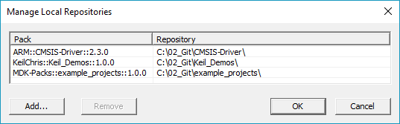
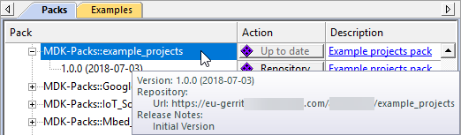
CMSIS-Pack
Packs can easily developed using a Git-based development flow
Git is widely used in the software industry today
While you develop your pack, you can point Pack Installer to the repository so that it picks up changes from there automatically
When done, ZIP the pack and publish it on your web server

Slide 18
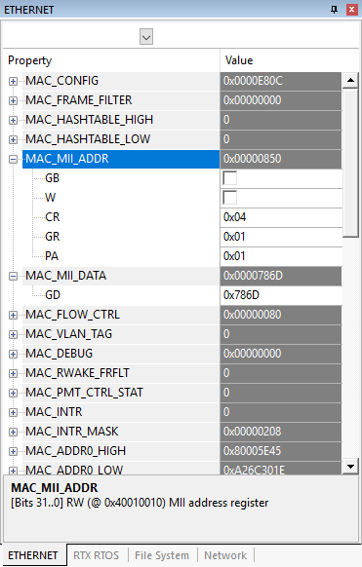
CMSIS-SVD
System description for debuggers
Enables human-readable system view in tools
Ensures consistency between the device header file and what is being displayed by the debugger
Displays detailed information about peripherals, registers, fields, and bit values as well as named interrupts from within the debugger, without the need to reference device documentation
Enables convenient access to new and updated descriptions
Improves software development efficiency

Slide 19
CMSIS-Driver peripheral mapping
Microcontroller
Software Packs
Device
Middleware
USB
USB Controller
Startup/System
Control
Structs
USB Device Driver
USB Device
Rx1/Tx1
USART
USBD0
USART Driver
USART1
Ethernet
Ethernet PHY
Ethernet PHY
TCP/IP Networking
ETH_PHY0
Ethernet MAC
Ethernet MAC
ETH_MAC0
SPI1
SPI #1
Graphics
SPI Driver
SPI1
SPI2
SPI2
SPI #2
File System
MCI Driver
MCI0
SDIO0
SDIO
NAND Flash Driver
NAND0
I/O
Memory Controller
USB Host Driver
USB Host
USBH0
USB
USB Controller
Configuration

Slide 20
CMSIS-Zone
Simplify the configuration of modern embedded systems
Today, many microcontrollers offer multiple cores and additional MPUs
Modern Armv8-M based microcontrollers allow great flexibility in handling secure and non-secure programming. Thus, System partitioning can become a complex task
CMSIS-Zone defines methods to describe system resources and to partition these resources into multiple projects and execution areas

Slide 21
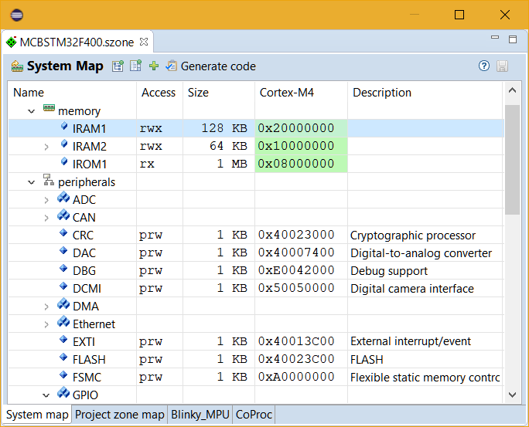
CMSIS-Zone – Development Workflow
Resource configuration for multi-processor systems and execution regions
List available system resources in multi-processor systems
System Resources
Select resources for independent software projects
Project Zones
Partition memory & peripherals for safe process execution
Execution Zones
Generate tool setup and
hardware configuration
Build
Resources may be imported from CMSIS-Pack and CMSIS-SVD files
Notes:
21

Slide 22
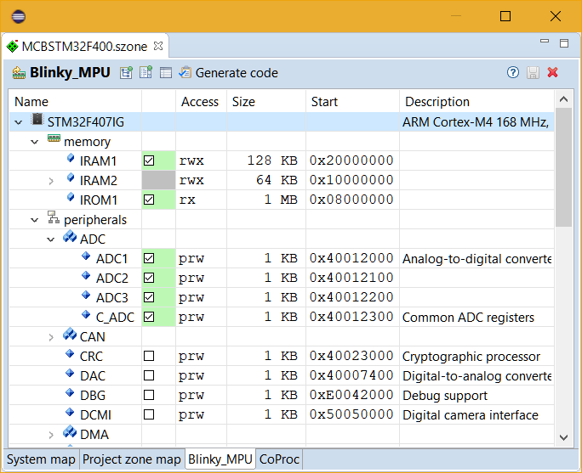
CMSIS-Zone – Development Workflow
Resource configuration for multi-processor systems and execution regions
List available system resources in multi-processor systems
System Resources
Select resources for independent software projects
Project Zones
Partition memory & peripherals for safe process execution
Execution Zones
Generate tool setup and
hardware configuration
Build
Notes:
22

Slide 23
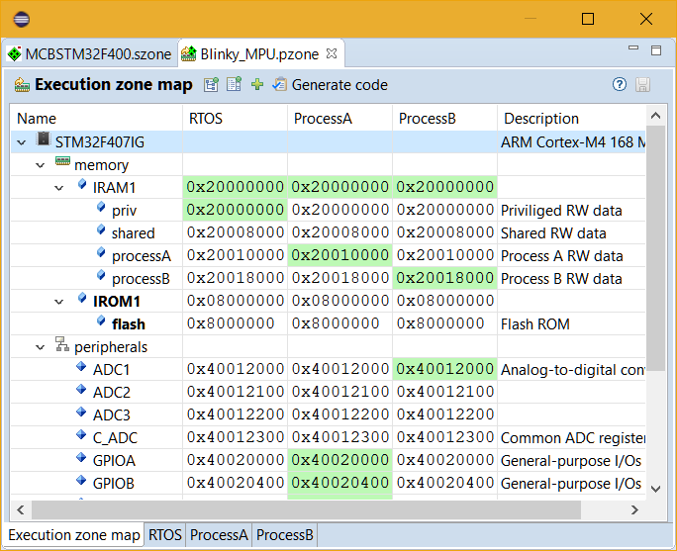
CMSIS-Zone – Development Workflow
Resource configuration for multi-processor systems and execution regions
List available system resources in multi-processor systems
System Resources
Select resources for independent software projects
Project Zones
Partition memory & peripherals for safe process execution
Execution Zones
Generate tool setup and
hardware configuration
Build
Notes:
23

Slide 24
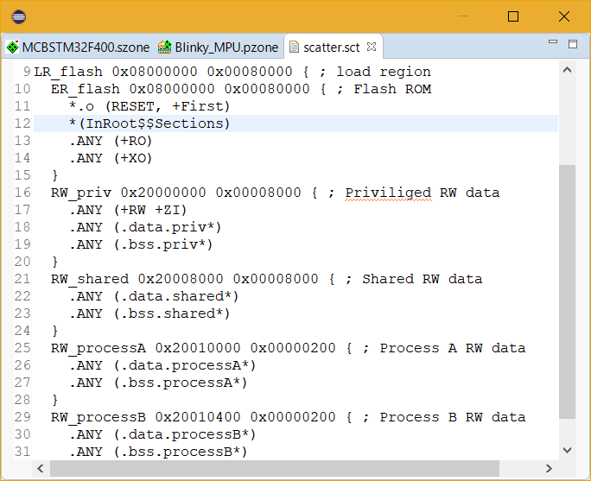
CMSIS-Zone – Development Workflow
Resource configuration for multi-processor systems and execution regions
List available system resources in multi-processor systems
System Resources
Select resources for independent software projects
Project Zones
Partition memory & peripherals for safe process execution
Execution Zones
Generate tool setup and
hardware configuration
Build
Notes:
24

Slide 25
system_<device >.h CMSIS system and clock configuration
startup_<device>.c Device startup
Interrupt vectors
system_<device >.c System and clock configuration
<device>.h Device peripheral access
<user>.c/c++ User application main() { ... }
CMSIS-CORE device files
CMSIS-CORE header files generated from CMSIS-SVD
User program

