Slide 1
File System Component
File System Component
Drive
File System Core
USB MSC
Mass Storage Class
SD/MMC
Memory Card
RAM
NOR Flash
NAND Flash
CMSIS-Driver
NAND
Flash
MCI
SPI

Slide 2
File System Type
FAT File System
EFS
Memory Card
M:/M0:, M1:
NAND
Flash
N:/N0:, N1:
USB Memory
U:/U0:, U1:
RAM
Disk
R:/R0:
NOR
Flash
F:/F0:, F1:
Media
Type
Drive

Slide 3
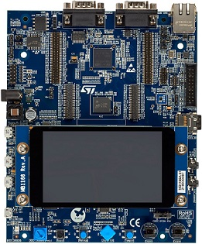


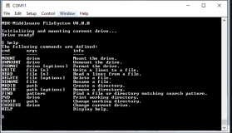
Flash / Debug
Virtual COM
SD Card

Slide 4

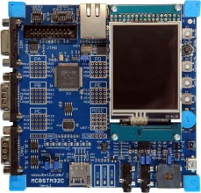
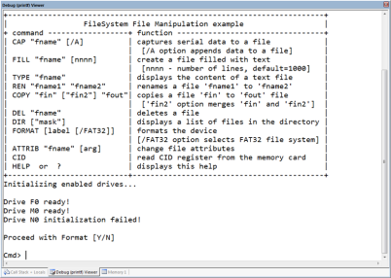

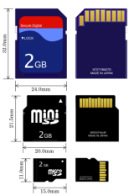
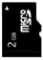
USB
NAND
NOR
SD Card

Slide 5
On-Chip ECC Configuration
Virtual Main Size
Virtual Spare Size
Main 0
Main 1
Main 2
Main 3
Spare 0
Spare 1
Spare 2
Spare 3
Main Codeword Size
Unprotected
User Data
ECC Protected
User Data
ECC
Data
Unprotected
User Data
ECC Protected
User Data
ECC
Data
Spare Codeword Offset
Spare Codeword Size
Spare Codeword Gap
ECC Data
Offset
ECC Data
Size
ECC Data
Gap

Slide 6
EFS Allocation Information
Flash Block
Block signature
Alloc. Info Filename a
Alloc. Info File a; Index 0
Alloc. Info Filename b
Alloc. Info File b; Index 0
Alloc. Info File a; Index 1
Free Space
Content of File a; Index 1
Content of File b; Index 0
Filename b
Content of File a; Index 0
Filename a
FFFF
FFFC
Alloc n
Alloc n+1
Allocation records
8 bytes each
Alloc n+2
Alloc n+3
Alloc n+4
End n+4
End n+3
File fragments
of variable size
End n+2
End n+1
End n
0000

