Slide 1
Network Component
Network Component
Service
Compact
Web Server
Full Web Server
Using File System
FTP Server
TFTP Server
Telnet
Server
SNMP
Agent
DNS Client
SNTP
Client
FTP Client
TFTP Client
SMTP
Client
Socket
CORE
with
IPv4/IPv6
Dual-
Stack
BSD
TCP
UDP
Interface
Ethernet
PPP (Serial)
SLIP (Serial)
CMSIS-Driver
Ethernet
USART

Slide 2
Network Component
Network Component
Service
Compact
Web Server
Full Web Server
Using File System
FTP Server
TFTP Server
Telnet
Server
SNMP
Agent
DNS Client
SNTP
Client
FTP Client
TFTP Client
SMTP
Client
Socket
CORE
with
IPv4/IPv6
Dual-
Stack
BSD
TCP
UDP
Interface
Ethernet
PPP (Serial)
SLIP (Serial)
CMSIS-Driver
SSL/TLS
Ethernet
USART
ARM mbed TLS

Slide 3
Network Component
2019/07
Network Component
Service
Compact Web Server
Full Web Server
Using File System
FTP Server
TFTP Server
Telnet
Server
SNMP
Agent
DNS Client
SNTP
Client
FTP Client
TFTP Client
SMTP
Client
Socket
CORE
IPv4/IPv6
Dual-Stack
BSD
TCP
UDP
Interface
Ethernet
WiFi
PPP (Serial)
SLIP (Serial)
CMSIS-Driver
SSL/TLS
Ethernet
WiFi
USART
MbedTLS

Slide 4
Secure Communication
Software Stack
Application Code
mbed TLS
Network Component
CMSIS-RTOS
Cortex-M-based
Microcontroller

Slide 5
Network library hierarchy
BSD sockets
TCP/UDP sockets
IPv4/IPv6 network
ETH, WiFi, PPP, SLIP I/F

Slide 6
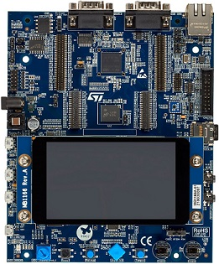


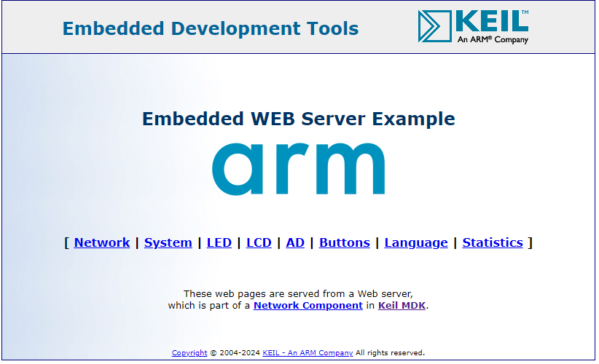
Flash / Debug
Ethernet
Local Area Network

Slide 7
Flash / Debug
Ethernet
Local Area Network

Slide 8
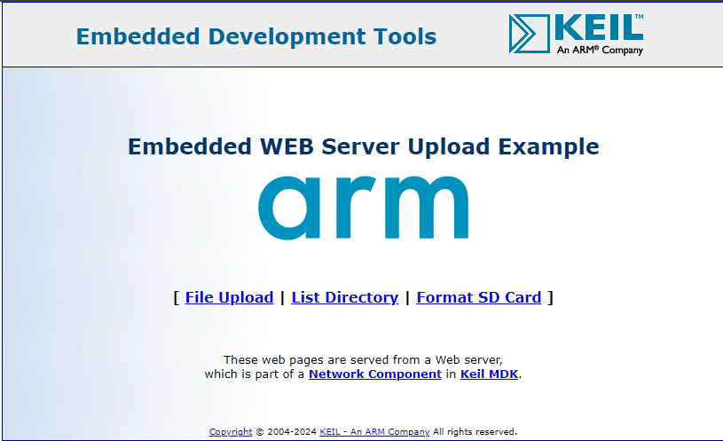
Flash / Debug
SD Card
Ethernet
Local Area Network

Slide 9
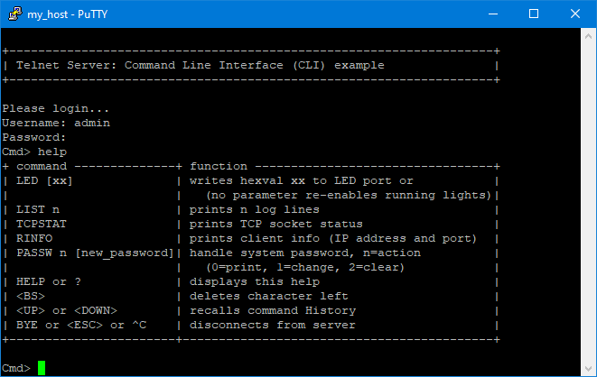
Flash / Debug
Ethernet
Local Area Network

Slide 10
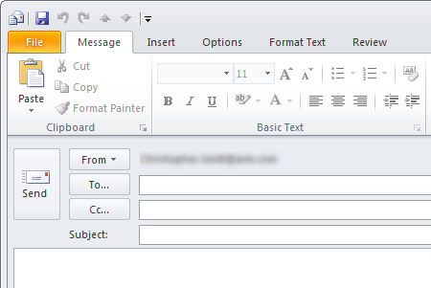
Flash / Debug
Ethernet
Local Area Network

Slide 11
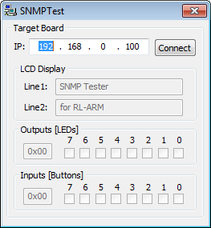
Flash / Debug
Ethernet
Local Area Network

Slide 12
BSD Server
BSD Client
Flash / Debug
Flash / Debug
Ethernet
Ethernet
Local Area Network

Slide 13

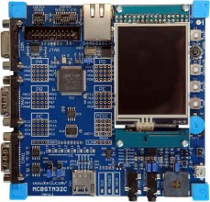
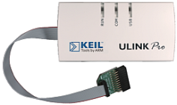
Local Area Network
Ethernet
Ethernet
USB
USB
BSD Server
BSD Client

Slide 14
Local Area Network
Ethernet
Ethernet
USB

Slide 15
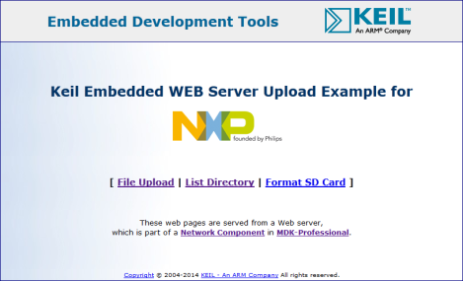
Local Area Network
Ethernet
Ethernet
USB

Slide 16
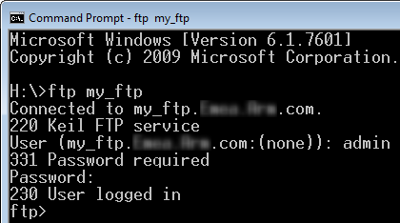
Local Area Network
Ethernet
Ethernet
USB

Slide 17
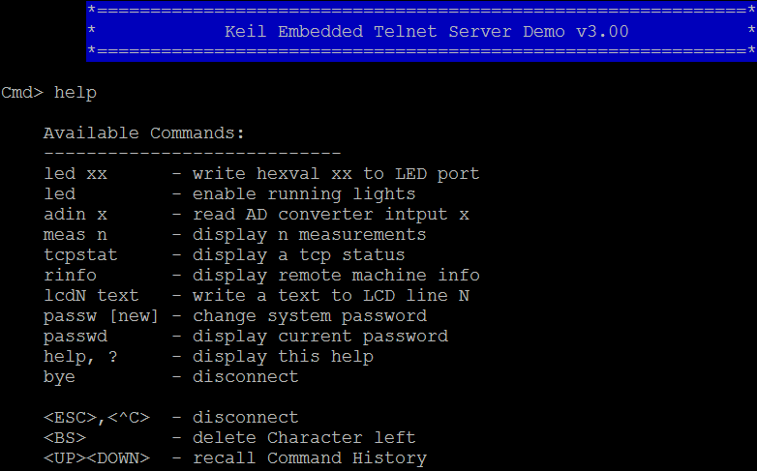
Local Area Network
Ethernet
Ethernet
USB

Slide 18
Local Area Network
Ethernet
Ethernet
USB

Slide 19
Local Area Network
Ethernet
Ethernet
USB
USB
BSD Server
BSD Client

Slide 20
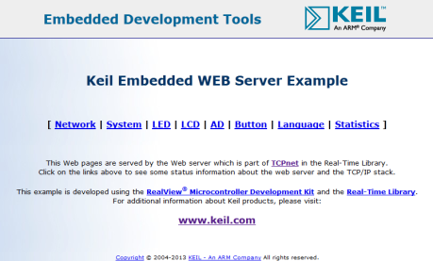
Local Area Network
Ethernet
Ethernet
USB

Slide 21
GET/SET Request
GET/SET Response
Trap
SNMP Community
SNMP Manager
SNMP Agent
Trap Receiver
Management Information Base (MIB)
Management Information Base (MIB)

Slide 22
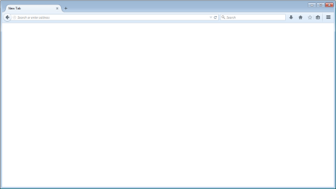
Browser
TCP, UDP
HTTP Server
Access and Multi-User Interface
CGI Interface for Dynamic Content Generation
File System Interface
Control Interface
Access Control
User Application
File Resources
Server Control

Slide 23
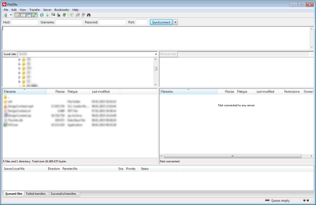
FTP Client
TCP
FTP Server
Access and Multi-User Interface
User Callback
File System Interface
Control Interface
Access Control
User Application
File Resources
Server Control

Slide 24
FTP Server
TCP
FTP Client
User Callbacks
File System Interface
Control Interface
User Application
File Resources
Client Control

Slide 25
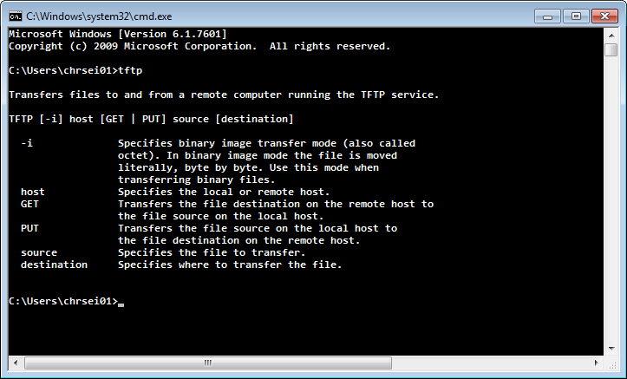
TFTP Client
UDP
TFTP Server
Access Interface
File System Interface
Control Interface
Access Control
File Resources
Server Control

Slide 26
TFTP Server
UDP
TFTP Client
User Callback
File System Interface
Control Interface
User Application
File Resources
Client Control

Slide 27
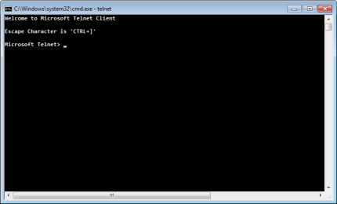
Telnet Client
TCP
TELNET Server
Access and Multi-User Interface
User Callbacks
Control Interface
Access Control
User Application
Server Control

Slide 28
SMTP Server
TCP
SMTP Client
User Callbacks
Control Interface
User Application
Client Control

Slide 29
Server path
CLOSED
(Start)
CONNECT/SYN
Client path
LISTEN
SYN
LISTEN
SYN
RECEIVED
SYN
SENT
Data exchange occurs
ACK
ESTABLISHED
ACK
CLOSE/FIN
FIN
Active CLOSE
Passive CLOSE
Timeout
CLOSED
(Go back to Start)
ACK

Slide 30


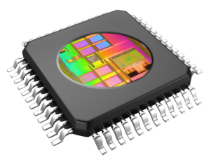
HTML
<body>
<h2>Magnetometer FRDM-K64F</h2>
<p>Magnetometer values are:
x = <input id="val_x" type="text" value="">,
y = <input id="val_y" type="text" value="">,
z = <input id="val_z" type="text" value=""></p>
</body>
JavaScript
<script type="text/javascript">
$(function() {
var json_sample = [];
function getData() {
//Request JSON data
$.getJSON("loc.cgx", function(loc) {json_sample = loc;});
//Update data fields in HTML
$('#val_x').val(json_sample.x);
HTTP GET Request
index.htm
JSON
Request
JSON Reply
netCGI_Script
HTTP Server
extern MAGNETOMETER_STATE magneto;
uint32_t cgi_script (const char *env, char *buf, uint32_t buflen, uint32_t *pcgi) {
uint32_t len = 0;
switch (env[0]) {
case 'l' : sprintf(buf, "{\"x\":\"%d\", \"y\":\"%d\", \"z\":\"%d\"}", magneto.x, magneto.y, magneto.z);
len = strlen(buf);
break;
}
return (len);
}
Magnetometer

