Slide 1
USB Component
USB Component
USB Device
HID
Human Interface Device
CDC
Communications Device
USB Device Core
MSC
Mass Storage Class
Custom
Custom Device Class
ADC
Audio Device Class
USB Host
HID
Human Interface Device
CDC
Communications Device
USB Host Core
MSC
Mass Storage Class
Custom
Custom Device Class
CMSIS-Driver
USB Device
USB Host

Slide 2
Pipe
Transfer
Transaction
Token
Packet
Data
Packet
Status
Packet

Slide 3
Packet Structure
Sync
Data Bytes
EOP

Slide 4

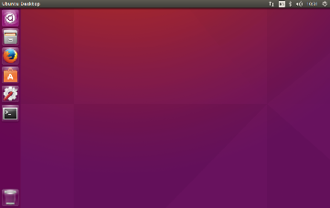

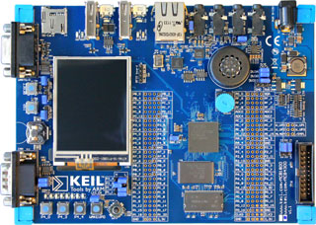
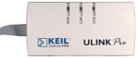
USB
To Network
USB

Slide 5

USB
To Network
USB

Slide 6
USBD_Config_HID_0.h
USBD_User_HID_0.c
USBD_User_Device_0.c
Configuration
File
User Code
Template
RTE Components
CDC 0
HID 0
HID 1
MSC 0
USB Device Class
USBD_Config_0.h
USB Device 0
USB Device 1
USB Device
Driver Configuration File
Driver_USBD0
Driver_USBD1
USB Device Driver
USB Controller 0
USB Controller 1
MCU Hardware

Slide 7
USB Controller
USB Controller
ULPI-I/F
Internal PHY
VBUS
DP
DM
ID
VBUS
DP
DM
ID
External PHY
USB Connector
USB Connector

Slide 8
USBH_Config_CDC.h
USBH_Config_MSC.h
USBH_Config_CustomClass.h
USBH_MSC.c
USBH_User_CustomClass.c
USBH_Config_HID.h
RTE Components
Supported USB Device Class
HID
CDC
MSC
Custom
Class
USBH_Config_0.h
USB Host 0
USB Host 1
USB Host
Driver_USBH0
Driver_USBH1
USB Host Driver
Driver Configuration File
USB Controller 0
USB Controller 1
MCU Hardware
Configuration
File
User Code
Template

Slide 9
USB Host
USB Device
USB Middleware
Hardware Dependent
USB Middleware
USB Host
Control Transfers
Message Pipes
Control IN Endpoint 0
USB Device
Control OUT Endpoint 0
Client
Interrupt Transfers
Stream Pipes
Interrupt IN Endpoint 1
Device Functionality 1
(e.g. HID Class)
Interrupt OUT Endpoint 1
Client
Bulk Transfers
Stream Pipes
Bulk IN Endpoint 2
Device Functionality 2
(e.g. MSC)
Bulk OUT Endpoint 2
Client
Interrupt Transfers
Stream Pipe
Interrupt IN Endpoint 3
Device Functionality 3
(e.g. CDC)
Bulk Transfers
Stream Pipes
Bulk IN Endpoint 4
Bulk OUT Endpoint 4
Client
Isochronous Transfers
Stream Pipe
Isochronous OUT Endpoint 5
Device Functionality 4
(e.g. ADC Class)
...
Client
IN Endpoint 15
Device Functionality n
Stream Pipes
OUT Endpoint 15

Slide 10
File System
File I/O functions
USB Host MSC Driver
USBH_MSC_GetDeviceStatus
USB Host
USBH_Initialize
USBH_Uninitialize
CMSIS-Driver USB Host

Slide 11
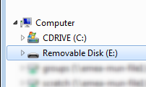
Storage Media
USB Device
File System
User Application

Slide 12
USBD_Config_HID_0.h
(Configuration File)
USBD_User_HID_0.c
(User Code Template)
RTE Components
CDC 0
HID 0
HID 1
MSC 0
USB Device Class
USBD_Config_0.c
(Configuration File)
USB Device 0
USB Device 1
USB Device
Driver_USBD0
Driver_USBD1
USB Device Driver
RTE_Device.h
(Configuration File)
USB Controller 0
USB Controller 1
MCU Hardware

Slide 13
USBD_Config_HID_0.h
USBD_User_HID_0.c
USBD_User_Device_0.c
Configuration
File
User Code
Template
RTE Components
CDC 0
HID 0
HID 1
MSC 0
USB Device Class
USBD_Config_0.c
USB Device 0
USB Device 1
USB Device
RTE_Device.h
Driver_USBD0
Driver_USBD1
USB Device Driver
USB Controller 0
USB Controller 1
MCU Hardware

Slide 14
USBH_Config_CDC.h
USBH_Config_MSC.h
USBH_Config_CustomClass.h
USBH_MSC.c
USBH_User_CustomClass.c
USBH_Config_HID.h
RTE Components
Supported USB Device Class
HID
CDC
MSC
Custom
Class
USBH_Config_0.c
USB Host 0
USB Host 1
USB Host
Driver_USBH0
Driver_USBH1
RTE_Device.h
USB Host Driver
USB Controller 0
USB Controller 1
MCU Hardware
Configuration
File
User Code
Template

Slide 15
Software Architecture
USBD_User_HID_0.c
Application
main.c
USBD_Config_HID_0.h
Middleware/OS
USBD_Config_0.c
Peripheral Driver
RTE_Device.h
Configuration
File
User Code

Slide 16
USB Controller
USB Controller
ULPI-I/F
Internal PHY
External PHY
VBUS
DP
DM
ID
VBUS
DP
DM
ID
USB Connector
USB Connector

Slide 17
User Thread
USBD_ClassInitialize
USBD_Initialize
USBD_CoreThread(0)
USBD_Class_Thread
USBD_Connect
USBD_Core
USBD_Class_EventEpInt
USBD_Class_Func
USBD_Eventx
ADC Device
CDC Device
HID Device
MSC Device

Slide 18
User Thread
USBH_Initialize
USBH_CoreThread(0)
Wait for OS
Polling USB
USBH_Class_Func
USBH_Engine
USBH_EnumerateDevice
Connect
Disconnect
HID Device
USBH_DevicesUninitialize
MSC Device

Slide 19
USB Host
USB Device
USB Middleware
Hardware Dependent
USB Middleware
USB Host
Control Transfers
Message Pipes
Control IN Endpoint 0
USB Device
Control OUT Endpoint 0
Client
Interrupt Transfers
Stream Pipes
Interrupt IN Endpoint 1
Device Functionality 1
(e.g. HID Class)
Interrupt OUT Endpoint 1
Client
Bulk Transfers
Stream Pipes
Bulk IN Endpoint 2
Device Functionality 2
(e.g. MSC)
Bulk OUT Endpoint 2
Client
Interrupt Transfers
Stream Pipe
Interrupt IN Endpoint 3
Device Functionality 3
(e.g. CDC)
Bulk Transfers
Stream Pipes
Bulk IN Endpoint 4
Bulk OUT Endpoint 4
Client
Isochronous Transfers
Stream Pipe
Isochronous OUT Endpoint 5
Device Functionality 4
(e.g. ADC Class)
...
Client
IN Endpoint 15
Device Functionality n
Stream Pipes
OUT Endpoint 15

Slide 20
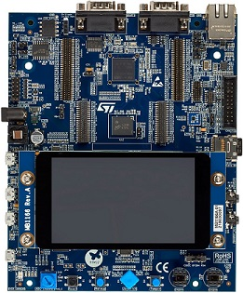
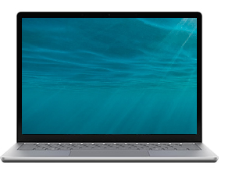

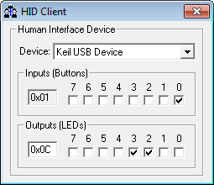
LEDs / Buttons
Flash / Debug
USB

Slide 21
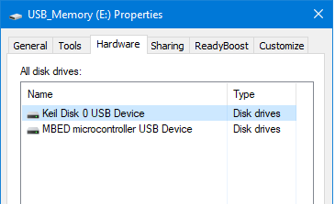
Flash / Debug
USB

Slide 22
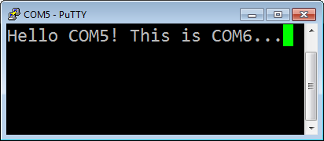
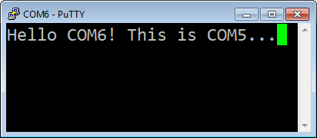
Flash / Debug
USB
RS232

Slide 23
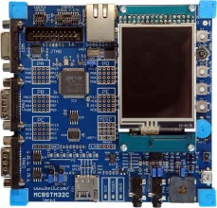
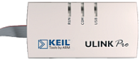
USB
USB
RS232

Slide 24

Flash / Debug
USB Memory

Slide 25
USB
USB

Slide 26
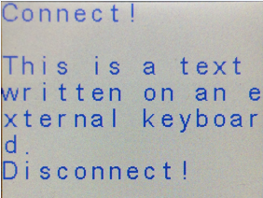
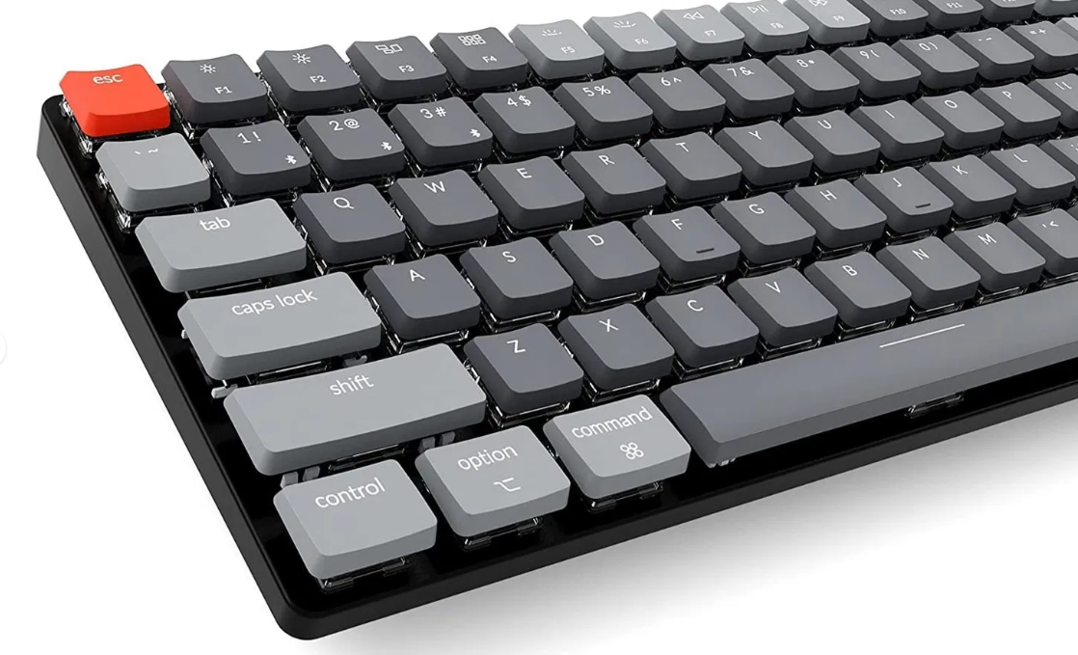
Flash / Debug
USB

Slide 27
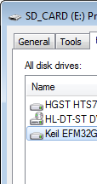

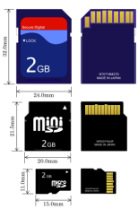
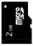
USB
Pushbuttons
LEDs
USB
SD Card

Slide 28

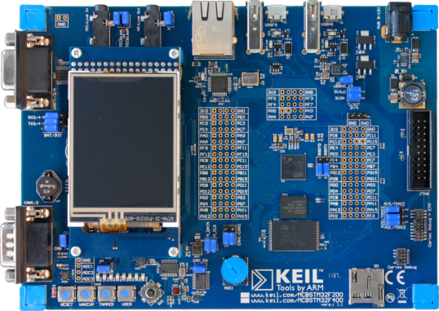
RS232
USB

Slide 29
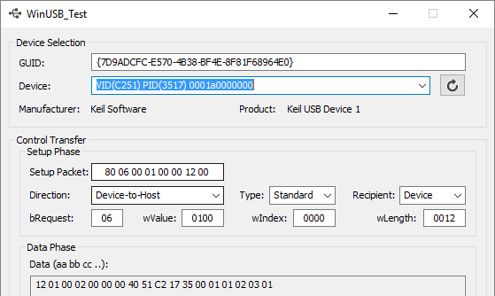
USB to host PC
USB

Slide 30

USB to host PC
USB

Slide 31
RS232
USB
USB

Slide 32

USB
USB
Joystick

Slide 33
USB
Ethernet
USB

Slide 34

USB
Speaker
USB

Slide 35
File System
File I/O functions
USB Host MSC Driver
USBH_MSC_GetDeviceStatus
USB Host
USBH_Initialize
USBH_Uninitialize
CMSIS-Driver USB Host

Slide 36
Storage Media
USB Device
File System
User Application

Slide 37
Deprecated
Software Packs
Device
CMSIS
MDK Professional Middleware
System/Startup
CMSIS-CORE
TCP/IP
Networking
Driver 1: SPI
CMSIS-DSP
USB Host
File System
Driver2: Ethernet
…
CMSIS-RTOS
USB Device
Graphic
Driver n: USB

Slide 38
USB Host Component
Class
CORE
HID
Human Interface Device
CDC
Communication Device
Deprecated
MSC
Mass Storage
Custom
Custom Device
USB Host
Driver
USBH
High-Speed
Full-Speed
Notes:
The USB Host library is an embedded USB stack supporting USB Mass Storage (MSC) and Human Interface Device (HID) classes. Supporting MSC means that you can connect any USB stick to your device for the purpose of data exchange. You can either store data on the stick or read data from the stick (e.g. for firmware downloads done by a service technician). Using the stck with the HID class support will enable you to accept any HID class equipment as an input device for human-machine interface communication. For connecting a custom device, support for a custom class is also integrated. The USB Host library has been designed deliver the highest performance while using as little memory as possible.
The Abstraction layer driver (USBH) allows a standard API to be used for different USB Host controllers. Today, there is built-in support for the generic Open Host Controller Interface (OHCI), low level driver support for NXP LPC17xx/23xx/24xx devices, and custom Host controller driver for STM32F2xx/4xx devices.
You can attach devices that support USB 1.1 Low Speed (1.5Mbit/s) up to USB 2.0 Full Speed (12Mbit/s). Real-life data rates up to 670 kB/sec while only occupying about 6 kB of code size are possible.
In conjunction with the File System it is possible to support USB Flash drives and SD/SDHC/MMC card storage devices. Needless to say that the USB Host fully works with the RTX Real-Time Operating System.

Slide 39
USB Device Component
Class
HID
Human Interface Device
CDC
Communication Device
CORE
Deprecated
MSC
Mass Storage
ADC
Audio Device
Custom
Custom Device
USB Device
Driver
USBD
High-Speed
Full-Speed
Notes:
The USB Host library is an embedded USB stack supporting USB Mass Storage (MSC) and Human Interface Device (HID) classes. Supporting MSC means that you can connect any USB stick to your device for the purpose of data exchange. You can either store data on the stick or read data from the stick (e.g. for firmware downloads done by a service technician). Using the stck with the HID class support will enable you to accept any HID class equipment as an input device for human-machine interface communication. For connecting a custom device, support for a custom class is also integrated. The USB Host library has been designed deliver the highest performance while using as little memory as possible.
The Abstraction layer driver (USBH) allows a standard API to be used for different USB Host controllers. Today, there is built-in support for the generic Open Host Controller Interface (OHCI), low level driver support for NXP LPC17xx/23xx/24xx devices, and custom Host controller driver for STM32F2xx/4xx devices.
You can attach devices that support USB 1.1 Low Speed (1.5Mbit/s) up to USB 2.0 Full Speed (12Mbit/s). Real-life data rates up to 670 kB/sec while only occupying about 6 kB of code size are possible.
In conjunction with the File System it is possible to support USB Flash drives and SD/SDHC/MMC card storage devices. Needless to say that the USB Host fully works with the RTX Real-Time Operating System.

Slide 40
USB Middleware
USB Host Classes
USB CORE
Deprecated
HID
Human Interface Device
MSC
Mass Storage
USB Device Classes
HID
Human Interface Device
MSC
Mass Storage
USB Host
CDC
Communication Device
ADC
Audio Device
USB Device
Driver
USB
High-Speed
Full-Speed

Slide 41
USB Middleware
USB Host Classes
USB CORE
Deprecated
HID
Human Interface Device
MSC
Mass Storage
USB Device Classes
HID
Human Interface Device
CDC
Communication Device
USB Host
MSC
Mass Storage
ADC
Audio Device
Custom
Custom Device
USB Device
Driver
USB
High-Speed
Full-Speed

Slide 42
USB Middleware
USB Host Classes
USB CORE
HID
Human Interface Device
CDC
Communication Device
Deprecated
MSC
Mass Storage
Custom
Custom Device
USB Device Classes
HID
Human Interface Device
CDC
Communication Device
USB Host
MSC
Mass Storage
ADC
Audio Device
Custom
Custom Device
USB Device
Driver
USB
High-Speed
Full-Speed

Slide 43
USB Host
USB Device
USB Middleware
Hardware Dependent
USB Middleware
Client
Endpoint 15 In
Device Functionality n
...
Endpoint 15 OUT
Client
Isochronous Transfers
Stream Pipe
Isochronous OUT Endpoint 5
Device Functionality 4
(e.g. ADC Class)
Client
Interrupt Transfers
Stream Pipe
Interrupt In Endpoint 3
Device Functionality 3
(e.g. CDC)
Bulk Transfers
Stream Pipe
Bulk In Endpoint 4
Bulk OUT Endpoint 4
Client
Bulk Transfers
Stream Pipe
Bulk In Endpoint 2
Device Functionality 2
(e.g. MSC)
Bulk OUT Endpoint 2
Client
Interrupt Transfers
Stream Pipe
Interrupt In Endpoint 1
Device Functionality 1
(e.g. HID Class)
Interrupt OUT Endpoint 1
USB System
Control Transfers
Message Pipe
Endpoint IN/OUT 0
USB Logical Device
Hardware Dependent
USB Host Controller
Actual Communication
USB Bus Interface

