Slide 1
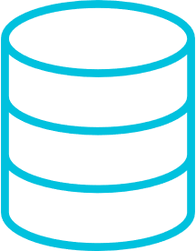



Development Flow for Edge AI Devices
CLASSIC EMBEDDED DEVELOPMENT
Sensor
Input Interface
Signal Conditioning
Optimized ML Model
Output Interface
SDS Data Capturing
Audio
Video
ML MODEL DEVELOPMENT (MLOps)
Model searcher
Model Compressor
Trained
ML Model
Weight clustering
Quantization
Compile
Validate
Optimized ML Model
Data
Use-Case
Arm tools integrate here
Notes:
But how is such an Edge AI application developed? Let’s take a look.
An Edge AI Device has a classic embedded part that integrates an Optimized ML Model. The classic embedded software interfaces to the sensor, audio or video input of your device, and contains DSP algorithms for signal conditioning. And of course, the output interface.
For the ML Development you need real-world data. Arm offers the SDS software component for data capturing which we will demonstrate in a dedicated webinar later this year. The data is fed into the MLOps system and Edge Impulse is one of our partners in this space.
In the MLOps system, you specify your use-case, and a model searcher helps identifying the right model. Afterwards, compression, training, clustering, and quantization is applied to the model to fit it into the memory of constrained edge devices. Finally, this is compiled, validated, and delivered to the classic embedded development flow for integration.
Edge Impulse will now show us how this works in practice with their system. Over to you Alessandro!

Slide 2
Development Flow for Edge AI Devices
DATA STREAM
Sensor
Input Interface
Signal Conditioning
Optimized ML Model
Output Interface
Audio
SDS Recorder Interface
SDS Recorder Interface
SDS Recorder Interface
Video
Physical Sensor Input Data
ML Input Data
ML Output Data
Notes:
But how is such an Edge AI application developed? Let’s take a look.
An Edge AI Device has a classic embedded part that integrates an Optimized ML Model. The classic embedded software interfaces to the sensor, audio or video input of your device, and contains DSP algorithms for signal conditioning. And of course, the output interface.
For the ML Development you need real-world data. Arm offers the SDS software component for data capturing which we will demonstrate in a dedicated webinar later this year. The data is fed into the MLOps system and Edge Impulse is one of our partners in this space.
In the MLOps system, you specify your use-case, and a model searcher helps identifying the right model. Afterwards, compression, training, clustering, and quantization is applied to the model to fit it into the memory of constrained edge devices. Finally, this is compiled, validated, and delivered to the classic embedded development flow for integration.
Edge Impulse will now show us how this works in practice with their system. Over to you Alessandro!

Slide 3

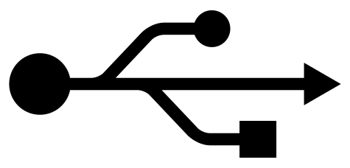
SDS-Framework: Record Real-world Data and Playback to AVH
Simplify Development of Embedded Applications that utilize DSP or ML algorithms with Sensor/Audio Input
SDS Data Files have multiple use cases:
Input for ML Algorithm development
Input for Filter Designers (i.e. ASN)
When capturing Algorithm outputs, validation for regression
SDS Interfaces can be based on
https://github.com/ARM-software/CMSIS-DSP/tree/main/ComputeGraph
Currently under development
https://github.com/RobertRostohar/SDS-Framework
MICROCONTROLLER HARDWARE
SIMULATION
Algorithm under Development
Algorithm under Development
SDS Recorder
Input Interface
SDS Player
Sensor Input
SDSIO Server
Semihosting Interface
Physical Sensor
Physical Sensor Data
Physical Sensor Data
Record physical sensor (real-world) data using MCU hardware
Playback real-world data in CI

Slide 4
Development Flow for Edge AI Devices
DATA STREAM UNDER DEVELOPMENT
DATA STREAM UNDER DEVELOPMENT
Input Interface
Signal Conditioning
Optimized ML Model
Output
Signal Conditioning
Optimized ML Model
Output
Sensor
SDS Recorder
SDS Recorder
SDS Recorder
SDS Player
SDS Recorder
SDS Recorder
Audio
SDSIO INTERFACE
SDSIO INTERFACE
Video
or
or
SDSIO Server running on development host system
SDSIO Server running on development host system
Physical Sensor Input Data
ML Input Data
ML Output Data
Physical Sensor Input Data
ML Input Data
ML Output Data
Notes:
But how is such an Edge AI application developed? Let’s take a look.
An Edge AI Device has a classic embedded part that integrates an Optimized ML Model. The classic embedded software interfaces to the sensor, audio or video input of your device, and contains DSP algorithms for signal conditioning. And of course, the output interface.
For the ML Development you need real-world data. Arm offers the SDS software component for data capturing which we will demonstrate in a dedicated webinar later this year. The data is fed into the MLOps system and Edge Impulse is one of our partners in this space.
In the MLOps system, you specify your use-case, and a model searcher helps identifying the right model. Afterwards, compression, training, clustering, and quantization is applied to the model to fit it into the memory of constrained edge devices. Finally, this is compiled, validated, and delivered to the classic embedded development flow for integration.
Edge Impulse will now show us how this works in practice with their system. Over to you Alessandro!

Slide 5

Challenge: Validate and Optimize Algorithms with Real World Data
github.com/ARM-software/SDS-Framework
Capture real-world data streams in hardware
Use same data streams to repeat tests
DATA STREAM UNDER DEVELOPMENT
DATA STREAM UNDER DEVELOPMENT
Input Interface
Signal Conditioning
Optimized ML Model
Output
Signal Conditioning
Optimized ML Model
Output
Sensor
SDS Recorder
SDS Recorder
SDS Recorder
SDS Player
SDS Recorder
SDS Recorder
Audio
SDSIO INTERFACE
SDSIO INTERFACE
Video
SDSIO Server running on development host or file system on target
SDSIO I/O Server running on development host or AVH simulation
Physical Sensor Input Data
ML Input Data
ML Output Data
Physical Sensor Input Data
ML Input Data
ML Output Data
Notes:
But how is such an Edge AI application developed? Let’s take a look.
An Edge AI Device has a classic embedded part that integrates an Optimized ML Model. The classic embedded software interfaces to the sensor, audio or video input of your device, and contains DSP algorithms for signal conditioning. And of course, the output interface.
For the ML Development you need real-world data. Arm offers the SDS software component for data capturing which we will demonstrate in a dedicated webinar later this year. The data is fed into the MLOps system and Edge Impulse is one of our partners in this space.
In the MLOps system, you specify your use-case, and a model searcher helps identifying the right model. Afterwards, compression, training, clustering, and quantization is applied to the model to fit it into the memory of constrained edge devices. Finally, this is compiled, validated, and delivered to the classic embedded development flow for integration.
Edge Impulse will now show us how this works in practice with their system. Over to you Alessandro!

Slide 6
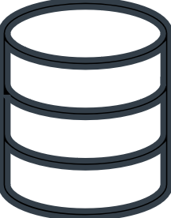
DATA STREAM UNDER DEVELOPMENT
DATA STREAM UNDER DEVELOPMENT
Input Interface
Signal Conditioning
Optimized ML Model
Output
Signal Conditioning
Optimized ML Model
Output
Sensor
SDS Recorder
SDS Recorder
SDS Recorder
SDS Player
SDS Recorder
SDS Recorder
Audio
SDSIO INTERFACE
SDSIO INTERFACE
Video
FILE ACCESS
FILE ACCESS
SCinput.0.sds
SCoutput.0.sds
MLoutput.0.sds
timestamp
timestamp
timestamp
block size
block size
block size
data block
data block
data block
timestamp
timestamp
timestamp
block size
block size
block size
data block
data block
data block
timestamp
block size
timestamp
timestamp
block size
block size
Notes:
But how is such an Edge AI application developed? Let’s take a look.
An Edge AI Device has a classic embedded part that integrates an Optimized ML Model. The classic embedded software interfaces to the sensor, audio or video input of your device, and contains DSP algorithms for signal conditioning. And of course, the output interface.
For the ML Development you need real-world data. Arm offers the SDS software component for data capturing which we will demonstrate in a dedicated webinar later this year. The data is fed into the MLOps system and Edge Impulse is one of our partners in this space.
In the MLOps system, you specify your use-case, and a model searcher helps identifying the right model. Afterwards, compression, training, clustering, and quantization is applied to the model to fit it into the memory of constrained edge devices. Finally, this is compiled, validated, and delivered to the classic embedded development flow for integration.
Edge Impulse will now show us how this works in practice with their system. Over to you Alessandro!

Slide 7
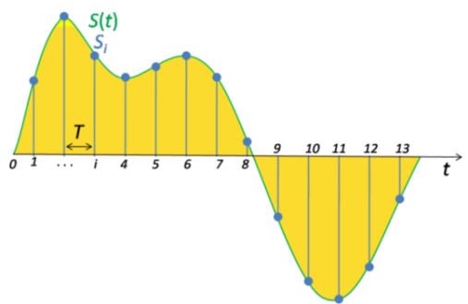
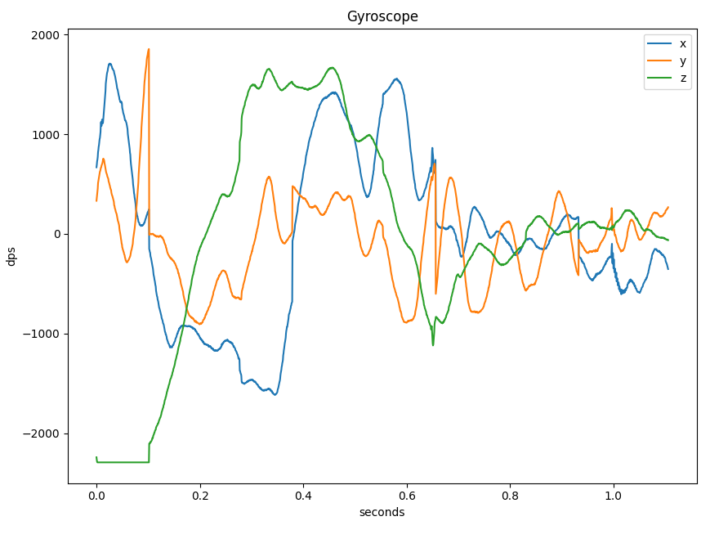
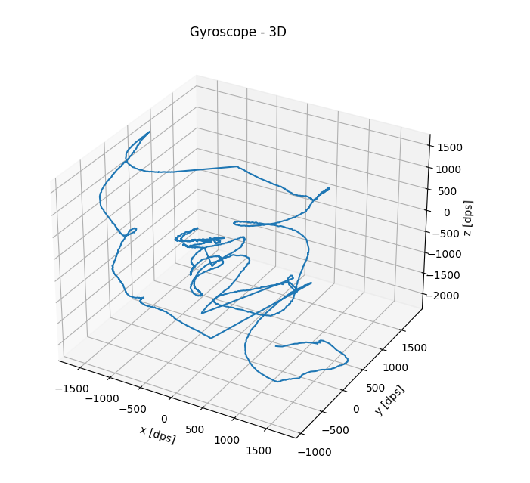
SDS: flexible stream management for sensor and audio data
Supports the whole development cycle: data recording, analysis, ML training, playback
Single or multiple data streams, including sensor fusion with clock deviations
Sensors may have independent clock sources with tolerances
SDS Metadata file describes content of SDS data files
Python-based utilities for recording, playback, visualization, data conversion, and algorithm verification with off-line tools
audio signal capturing with 8kHz
SDS Data Files ‘SensorX.<idx0>.sds’ ‘SensorX.<idx1>.sds’
X         
Y         
Z         
SDS Metadata File ‘SensorX.sds.yml’
MEMS capturing with 3,5kHz ±5%
t
data block #1
data block #2

Slide 8
SDS Data Buffer and Record / Playback Interface
sds_buffer.c/h Circular Buffer Handling
A circular buffer management for each data stream triggers events back to the Recorder and Playback interface when a buffer threshold is reached.
sds_rec_play.c/h Recorder/Player Interface
The Recorder and Playback application API to the application is non-blocking, thread-safe and can be called any time to write or read data.
sdsio_x.c/sdsio.h Blocking R/W Interface
SDSIO implements a blocking read/write interfaces to the communication channel that accesses the *.sds data files. Multiple SDSIO implementations are available that interface to file system, network, UART, or USB.
*.sds data files

Slide 9
SDS Recorder https://github.com/Arm-Examples/sds-examples
SDS_<sdsio>.csolution.yml Data streaming for DSP and ML algorithm testing
target-types select between hardware
and simulation
DataTest.cproject.yml
AlgorithmTest.cproject.yml
Check SDSIO interface with user configurable bandwidth parameters
Verify and optimized user algorithms with repeatable data
Add user algorithm and data stream input interface
Layer Type: Board
Layer Type: SDSIO
Board Hardware Interface Provided in BSP
Record/Playback SDS Data Files via Network, USB, File System
build-types select between recording and playback

Slide 10
Challenge: Validate and Optimize Algorithms with Real World Data
github.com/ARM-software/SDS-Framework
Capture real-world data streams in hardware
Use same data streams to repeat tests
ALGORITHM UNDER DEVELOPMENT
ALGORITHM UNDER DEVELOPMENT
Input Interface
Algorithm
Output
Algorithm
Output
SDS Recorder
SDS Recorder
SDS Player
SDS Recorder
SDSIO INTERFACE
SDSIO INTERFACE
SDSIO Server running on development host or file system on target
SDSIO I/O Server running on development host or AVH simulation
Physical Input Data
Algorithm Output Data
Physical Input Data
Algorithm Output Data
Notes:
But how is such an Edge AI application developed? Let’s take a look.
An Edge AI Device has a classic embedded part that integrates an Optimized ML Model. The classic embedded software interfaces to the sensor, audio or video input of your device, and contains DSP algorithms for signal conditioning. And of course, the output interface.
For the ML Development you need real-world data. Arm offers the SDS software component for data capturing which we will demonstrate in a dedicated webinar later this year. The data is fed into the MLOps system and Edge Impulse is one of our partners in this space.
In the MLOps system, you specify your use-case, and a model searcher helps identifying the right model. Afterwards, compression, training, clustering, and quantization is applied to the model to fit it into the memory of constrained edge devices. Finally, this is compiled, validated, and delivered to the classic embedded development flow for integration.
Edge Impulse will now show us how this works in practice with their system. Over to you Alessandro!

Slide 11
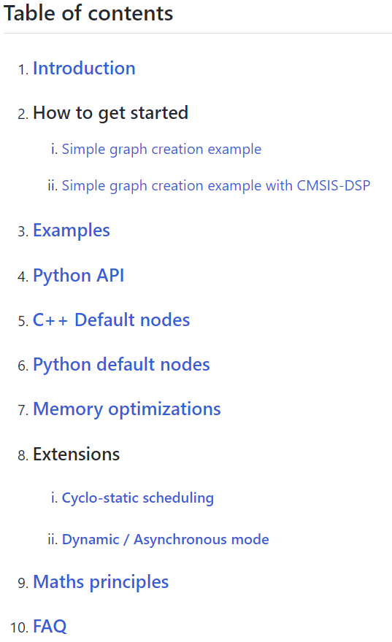


Current Status of CMSIS-DSP Compute Graph
Documentation and several usage examples available today
Usage Steps with current tool flow:
Describe the graph using Python
Consider: No. of I/O of each node, data types, number of I/O samples produced/consumed
Compute the optimized static scheduling from the graph (using Python)
Generate the C++ scheduler
Create C++ wrapper for the algorithm nodes (if they are not already available)
Signal conditioning
Filters
Echo, noise canceller
White balance
Feature extraction
Spectral data
MFCC (audio)
Convolution (pixel)
Classifier
Classical ML Deep learning (NN)
In
Out
The smarter the features, the lower the complexity of the classifier.
More “DSP” pre-processing helps lowering the system complexity
We propose to form a working group with eco-system partners
→ Video Recording of partner meeting

Slide 12
Record real-world data with Synchronous Data Streaming (SDS)
Simplify Development of Embedded Applications that utilize DSP or ML algorithms with Sensor/Audio Input
Microcontroller Hardware
Software on Physical Board
The SDS framework provides methods to record real-world data for analysis and development.
Input to Digital Signal Processing (DSP) development tools such as filter designers
Input to Machine Learning (ML) model classification, training, and performance optimization.
SDS framework is an open-source project: github.com/Arm-Software/SDS-Framework
Algorithm under Development
MEMS Sensor Interface
Audio Interface
SDS Recorder Interface
MCU Device
SDS Recorder connects via different channels
Gyroscope Sensor
Microphone Input
Test Data
x
SDS Data Files
*.gyroscope.sds
SDS Data Files
*.microphone.sds
Validation Data
y
Data conversion to ML training platform can be automated.
z
Training Data
Capture physical sensor (real-world) data using the original Microcontroller target hardware

Slide 13
SDS enables playback of real-world data for algorithm testing
Combined with AVH it enables repeatable test automation in CI systems and MLOps cloud services
Microcontroller Hardware
Arm Virtual Hardware (AVH-FVP)
Software on Physical Board
Software on Arm Virtual Hardware
Algorithm under Development
Same algorithm is verified on precise processor simulation model
Algorithm under Development
MEMS Sensor Interface
Audio Interface
SDS Recorder Interface
VSI Sensor Interface
VSI Audio Interface
MCU Device
SDS Recorder connects via different channels
AVH VSI
Gyroscope Sensor
Microphone Input
Virtual Streaming Interface #1
Virtual Streaming Interface #2
x
SDS Data Files
gyroscope.*.sds
SDS Data Files
microphone.*.sds
SDS Data Files
gyroscope.*.sds
SDS Data Files
microphone.*.sds
y
z

Slide 14
SDS Data Buffer and Record / Playback Interface
Data Playback via File I/O, STDIO, Socket, or AVH VSI
sdsPlay.h Data Playback Interface
Data Recording via File I/O, STDIO, Socket
*.sds Data Files ‘sensorX.0.sds’ ‘sensorX.1.sds’
sdsRec.h Data Recording Interface
sds.h Circular Buffer Handling
Circular Data Buffers
Data I/O via blocking devices (fread, fwrite)
sdsio.h Blocking R/W Interface (i.e. file I/O)
Meta Info User supplied ‘sensorX.sds.yml’

Slide 15
*.sds Data Files ‘sensorX.0.sds’ ‘sensorX.1.sds’
Meta Info User supplied ‘sensorX.sds.yml’

