Slide 1
Development Flow for Edge AI Devices
CLASSIC EMBEDDED DEVELOPMENT
Sensor
Input Interface
Signal Conditioning
Optimized ML Model
Output Interface
SDS Data Capturing
Audio
Video
ML MODEL DEVELOPMENT (MLOps)
Model searcher
Model Compressor
Trained
ML Model
Weight clustering
Quantization
Compile
Validate
Optimized ML Model
Data
Use-Case
Arm tools integrate here
Notes:
But how is such an Edge AI application developed? Let’s take a look.
An Edge AI Device has a classic embedded part that integrates an Optimized ML Model. The classic embedded software interfaces to the sensor, audio or video input of your device, and contains DSP algorithms for signal conditioning. And of course, the output interface.
For the ML Development you need real-world data. Arm offers the SDS software component for data capturing which we will demonstrate in a dedicated webinar later this year. The data is fed into the MLOps system and Edge Impulse is one of our partners in this space.
In the MLOps system, you specify your use-case, and a model searcher helps identifying the right model. Afterwards, compression, training, clustering, and quantization is applied to the model to fit it into the memory of constrained edge devices. Finally, this is compiled, validated, and delivered to the classic embedded development flow for integration.
Edge Impulse will now show us how this works in practice with their system. Over to you Alessandro!

Slide 2
Development Flow for Edge AI Devices
DATA STREAM
Sensor
Input Interface
Signal Conditioning
Optimized ML Model
Output Interface
Audio
SDS Stream Interface
SDS Stream Interface
SDS Stream Interface
Video
Physical Sensor Input Data
ML Input Data
ML Output Data
Notes:
But how is such an Edge AI application developed? Let’s take a look.
An Edge AI Device has a classic embedded part that integrates an Optimized ML Model. The classic embedded software interfaces to the sensor, audio or video input of your device, and contains DSP algorithms for signal conditioning. And of course, the output interface.
For the ML Development you need real-world data. Arm offers the SDS software component for data capturing which we will demonstrate in a dedicated webinar later this year. The data is fed into the MLOps system and Edge Impulse is one of our partners in this space.
In the MLOps system, you specify your use-case, and a model searcher helps identifying the right model. Afterwards, compression, training, clustering, and quantization is applied to the model to fit it into the memory of constrained edge devices. Finally, this is compiled, validated, and delivered to the classic embedded development flow for integration.
Edge Impulse will now show us how this works in practice with their system. Over to you Alessandro!

Slide 3

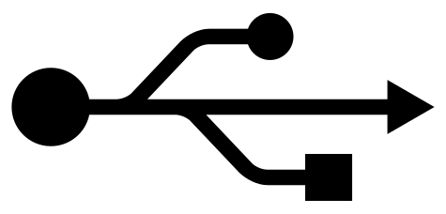
SDS-Framework: Record Real-world Data and Playback to AVH
Simplify Development of Embedded Applications that utilize DSP or ML algorithms with Sensor/Audio Input
SDS Data Files have multiple use cases:
Input for ML Algorithm development
Input for Filter Designers (i.e. ASN)
When capturing Algorithm outputs, validation for regression
SDS Interfaces can be based on
https://github.com/ARM-software/CMSIS-DSP/tree/main/ComputeGraph
Currently under development
https://github.com/ARM-software/SDS-Framework
MICROCONTROLLER HARDWARE
SIMULATION
Algorithm under Development
Algorithm under Development
SDS Stream
Input Interface
SDS Stream
Sensor Input
SDSIO-Server
SDSIO-Server
Physical Sensor
Physical Sensor Data
Physical Sensor Data
Record physical sensor (real-world) data using MCU hardware
Playback real-world data in CI

Slide 4
Development Flow for Edge AI Devices
DATA STREAM UNDER DEVELOPMENT
DATA STREAM UNDER DEVELOPMENT
Input Interface
Signal Conditioning
Optimized ML Model
Output
Signal Conditioning
Optimized ML Model
Output
Sensor
SDS Stream
in write mode
SDS Stream
in write mode
SDS Stream
in write mode
SDS Stream
in read mode
SDS Stream
in write mode
SDS Stream
in write mode
Audio
SDSIO INTERFACE
SDSIO INTERFACE
Video
or
or
or
or
RTT
RTT
SDSIO-Server running on development host system
SDSIO-Server running on development host system
Physical Sensor Input Data
ML Input Data
ML Output Data
Physical Sensor Input Data
ML Input Data
ML Output Data
Notes:
But how is such an Edge AI application developed? Let’s take a look.
An Edge AI Device has a classic embedded part that integrates an Optimized ML Model. The classic embedded software interfaces to the sensor, audio or video input of your device, and contains DSP algorithms for signal conditioning. And of course, the output interface.
For the ML Development you need real-world data. Arm offers the SDS software component for data capturing which we will demonstrate in a dedicated webinar later this year. The data is fed into the MLOps system and Edge Impulse is one of our partners in this space.
In the MLOps system, you specify your use-case, and a model searcher helps identifying the right model. Afterwards, compression, training, clustering, and quantization is applied to the model to fit it into the memory of constrained edge devices. Finally, this is compiled, validated, and delivered to the classic embedded development flow for integration.
Edge Impulse will now show us how this works in practice with their system. Over to you Alessandro!

Slide 5

Challenge: Validate and Optimize Algorithms with Real World Data
github.com/ARM-software/SDS-Framework
Capture real-world data streams in hardware
Use same data streams to repeat tests
DATA STREAM UNDER DEVELOPMENT
DATA STREAM UNDER DEVELOPMENT
Input Interface
Signal Conditioning
Optimized ML Model
Output
Signal Conditioning
Optimized ML Model
Output
Sensor
SDS Stream
in write mode
SDS Stream
in write mode
SDS Stream
in write mode
SDS Stream
in read mode
SDS Stream
in write mode
SDS Stream
in write mode
Audio
SDSIO INTERFACE
SDSIO INTERFACE
Video
SDSIO-Server running on development host or file system on target
SDSIO-Server running on development host or AVH simulation
Physical Sensor Input Data
ML Input Data
ML Output Data
Physical Sensor Input Data
ML Input Data
ML Output Data
Notes:
But how is such an Edge AI application developed? Let’s take a look.
An Edge AI Device has a classic embedded part that integrates an Optimized ML Model. The classic embedded software interfaces to the sensor, audio or video input of your device, and contains DSP algorithms for signal conditioning. And of course, the output interface.
For the ML Development you need real-world data. Arm offers the SDS software component for data capturing which we will demonstrate in a dedicated webinar later this year. The data is fed into the MLOps system and Edge Impulse is one of our partners in this space.
In the MLOps system, you specify your use-case, and a model searcher helps identifying the right model. Afterwards, compression, training, clustering, and quantization is applied to the model to fit it into the memory of constrained edge devices. Finally, this is compiled, validated, and delivered to the classic embedded development flow for integration.
Edge Impulse will now show us how this works in practice with their system. Over to you Alessandro!

Slide 6
DATA STREAM UNDER DEVELOPMENT
DATA STREAM UNDER DEVELOPMENT
Input Interface
Signal Conditioning
Optimized ML Model
Output
Signal Conditioning
Optimized ML Model
Output
Sensor
SDS Stream
in write mode
SDS Stream
in write mode
SDS Stream
in write mode
SDS Stream
in read mode
SDS Stream
in write mode
SDS Stream
in write mode
Audio
SDSIO INTERFACE
SDSIO INTERFACE
Video
FILE ACCESS
RTT
FILE ACCESS
RTT
SCinput.0.sds
SCoutput.0.sds
MLoutput.0.sds
timeslot
timeslot
timeslot
block size
block size
block size
Playback:
SCinput.*.sds files are the input (as per sdsio.yml)
New SCoutput.*.sds and Mloutput.*.p.sds files are generated
data block
data block
data block
timeslot
timeslot
timeslot
block size
block size
block size
data block
data block
data block
timeslot
block size
timeslot
timeslot
block size
block size
Notes:
But how is such an Edge AI application developed? Let’s take a look.
An Edge AI Device has a classic embedded part that integrates an Optimized ML Model. The classic embedded software interfaces to the sensor, audio or video input of your device, and contains DSP algorithms for signal conditioning. And of course, the output interface.
For the ML Development you need real-world data. Arm offers the SDS software component for data capturing which we will demonstrate in a dedicated webinar later this year. The data is fed into the MLOps system and Edge Impulse is one of our partners in this space.
In the MLOps system, you specify your use-case, and a model searcher helps identifying the right model. Afterwards, compression, training, clustering, and quantization is applied to the model to fit it into the memory of constrained edge devices. Finally, this is compiled, validated, and delivered to the classic embedded development flow for integration.
Edge Impulse will now show us how this works in practice with their system. Over to you Alessandro!

Slide 7
SDS software developer framework DSP / ML algorithm design
DSP / ML algorithms operate on time-series data streams, such as sensor data, audio samples, or video frames, using fixed or variable-size blocks.
SDS is a software developer framework for DSP / ML:
Handle sensor, audio, and video streams flexibly.
Multiple streams with time-drift handling for sensor fusion.
Record real-world target data for analysis and development.
Replay streams on hardware or simulation for validation.
Captured data streams simplify development:
Validate input streams and algorithm outputs.
Provide input for DSP filter design or ML model training.
Enable reproducible regression tests.
Use artificially generated input data for algorithm testing.
SDS v3 adds a control interface in the SDSIO-Server:
Operate through SDS VS Code extension on in CLI mode.
Record and playback mode in the same firmware image.
Use flags to configure algorithms or run A/B tests.
Manage playback streams for regression testing.
Deploy to hardware: → SDS Template Application
DATA STREAM UNDER DEVELOPMENT
Input Interface
Signal Conditioning
Optimized ML Model
Output
Sensor
Active during
SDS
Stream
SDS Stream
SDS
Stream
SDS
Stream
Audio
Recording
Playback
Any mode
SDSIO INTERFACE
Video
SCinput
SCoutput
MLoutput
timeslot
timeslot
timeslot
block size
block size
block size
Metadata files describe data stream content
data block
data block
data block
timeslot
timeslot
timeslot
block size
block size
block size
data block
data block
data block
timeslot
block size
timeslot
timeslot
block size
block size
Notes:
But how is such an Edge AI application developed? Let’s take a look.
An Edge AI Device has a classic embedded part that integrates an Optimized ML Model. The classic embedded software interfaces to the sensor, audio or video input of your device, and contains DSP algorithms for signal conditioning. And of course, the output interface.
For the ML Development you need real-world data. Arm offers the SDS software component for data capturing which we will demonstrate in a dedicated webinar later this year. The data is fed into the MLOps system and Edge Impulse is one of our partners in this space.
In the MLOps system, you specify your use-case, and a model searcher helps identifying the right model. Afterwards, compression, training, clustering, and quantization is applied to the model to fit it into the memory of constrained edge devices. Finally, this is compiled, validated, and delivered to the classic embedded development flow for integration.
Edge Impulse will now show us how this works in practice with their system. Over to you Alessandro!

Slide 8
SDS software developer framework DSP / ML algorithm design
DSP / ML algorithms operate on time-series data streams, such as sensor data, audio samples, or video frames, using fixed or variable-size blocks.
SDS is a software developer framework for DSP / ML:
Handle sensor, audio, and video streams flexibly.
Multiple streams with time-drift handling for sensor fusion.
Record real-world target data for analysis and development.
Replay streams on hardware or simulation for validation.
Captured data streams simplify development:
Validate input streams and algorithm outputs.
Provide input for DSP filter design or ML model training.
Enable reproducible regression tests.
Use artificially generated input data for algorithm testing.
SDS v3 adds a control interface in the SDSIO-Server:
Operate through SDS VS Code extension on in CLI mode.
Record and playback mode in the same firmware image.
Use flags to configure algorithms or run A/B tests.
Manage playback streams for regression testing.
Deploy to hardware: → SDS Template Application
DATA STREAM UNDER DEVELOPMENT
Input Interface
Signal Conditioning
Optimized ML Model
Output
Sensor
Active during
SDS
Stream
SDS Stream
SDS
Stream
SDS
Stream
Audio
Recording
Playback
Any mode
SDSIO INTERFACE
Video
SCinput
SCoutput
MLoutput
timeslot
timeslot
timeslot
block size
block size
block size
Metadata files describe data stream content
data block
data block
data block
timeslot
timeslot
timeslot
block size
block size
block size
data block
data block
data block
timeslot
block size
timeslot
timeslot
block size
block size
Notes:
But how is such an Edge AI application developed? Let’s take a look.
An Edge AI Device has a classic embedded part that integrates an Optimized ML Model. The classic embedded software interfaces to the sensor, audio or video input of your device, and contains DSP algorithms for signal conditioning. And of course, the output interface.
For the ML Development you need real-world data. Arm offers the SDS software component for data capturing which we will demonstrate in a dedicated webinar later this year. The data is fed into the MLOps system and Edge Impulse is one of our partners in this space.
In the MLOps system, you specify your use-case, and a model searcher helps identifying the right model. Afterwards, compression, training, clustering, and quantization is applied to the model to fit it into the memory of constrained edge devices. Finally, this is compiled, validated, and delivered to the classic embedded development flow for integration.
Edge Impulse will now show us how this works in practice with their system. Over to you Alessandro!

Slide 9
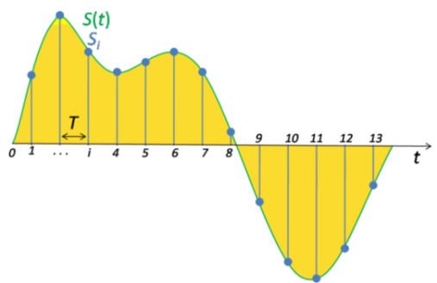
Data Labelling and Regression Test Configuration
SDS file format
Split SDS files
SCinput.0.sds
SCinput.0+case1.sds
timeslot
timeslot
timeslot
granularity: tick-frequency
block size
block size
block size
sample #0
sample-frequency
data block
data block
block-frequency
data block
sample #1
:
timeslot
timeslot
timeslot
sample #n
audio signal capturing with 8kHz sample frequency
block size
block size
block size
data block
data block
data block
Binary input or output of a compute node
X         
Y         
Z         
timeslot
timeslot
block size
block size
SCinput.0+case2.sds
timeslot
MEMS capturing with 3,5kHz ±5% sample frequency
t
block size
data block #1
data block #2

Slide 10
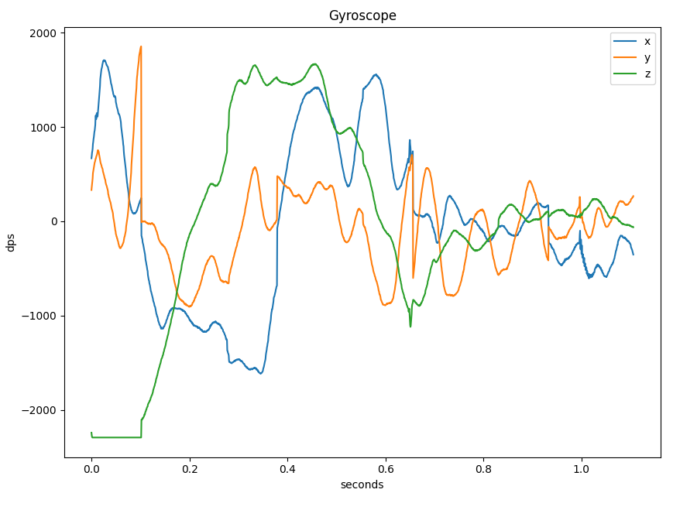
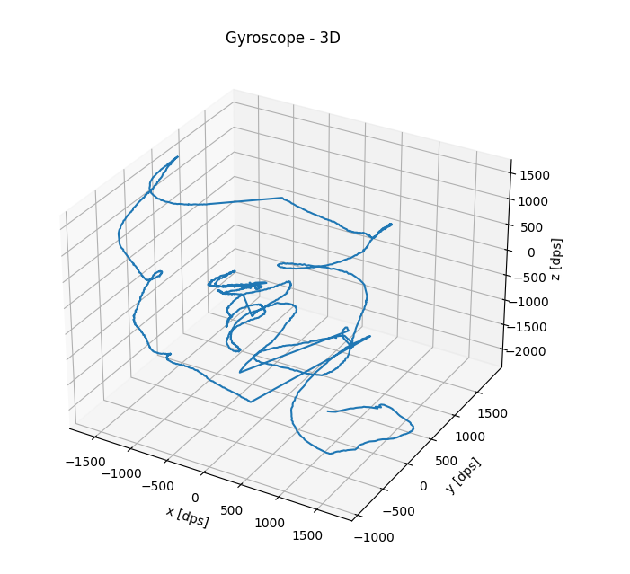
SDS: flexible stream management for sensor and audio data
Supports the whole development cycle: data recording, analysis, ML training, playback
Single or multiple data streams, including sensor fusion with clock deviations
Sensors may have independent clock sources with tolerances
SDS Metadata file describes content of SDS data files
Python-based utilities for recording, playback, visualization, data conversion, and algorithm verification with off-line tools
audio signal capturing with 8kHz
SDS Data Files ‘SensorX.<idx0>.sds’ ‘SensorX.<idx1>.sds’
X         
Y         
Z         
SDS Metadata File ‘SensorX.sds.yml’
MEMS capturing with 3,5kHz ±5%
t
data block #1
data block #2

Slide 11
Data stream application under development
sds.c/h SDS Stream Interface
The SDS Stream Interface implements non-blocking, thread-safe functions to read or write data streams.
sds_buffer.c/h Circular Buffer Handling
A circular buffer management for each data stream triggers events back to the SDS Stream Interface when a buffer threshold is reached.
sdsio_x.c/sdsio.h SDSIO Client Interface
This SDSIO Client Interface implements the access to *.sds data files. Multiple SDSIO Client implementations are available that interface to file system, network, UART, USB, or RTT.
*.sds data files

Slide 12
SDS Recorder https://github.com/Arm-Examples/sds-examples
SDS.csolution.yml Data streaming test framework for DSP and ML algorithms
target-types select between hardware
and simulation
DataTest.cproject.yml
AlgorithmTest.cproject.yml
Check SDSIO interface with user configurable bandwidth parameters
Verify and optimize user algorithms with repeatable data
Add user algorithm and data stream input interface
Layer Type: Board
Layer Type: SDSIO
Board Hardware Interface Provided in BSP
Record/Playback SDS Data Files via Network, RTT, USB, File System
Start/stop, recording, and playback selected at runtime using sdsFlags

Slide 13
Challenge: Validate and Optimize Algorithms with Real World Data
github.com/ARM-software/SDS-Framework
Capture real-world data streams in hardware
Use same data streams to repeat tests
ALGORITHM UNDER DEVELOPMENT
ALGORITHM UNDER DEVELOPMENT
Input Interface
Algorithm
Output
Algorithm
Output
SDS Stream
in write mode
SDS Stream
in write mode
SDS Stream
in read mode
SDS Stream
in write mode
SDSIO INTERFACE
SDSIO INTERFACE
RTT
RTT
SDSIO-Server running on development host or file system on target
SDSIO-Server running on development host or AVH simulation
Physical Input Data
Algorithm Output Data
Physical Input Data
Algorithm Output Data
Notes:
But how is such an Edge AI application developed? Let’s take a look.
An Edge AI Device has a classic embedded part that integrates an Optimized ML Model. The classic embedded software interfaces to the sensor, audio or video input of your device, and contains DSP algorithms for signal conditioning. And of course, the output interface.
For the ML Development you need real-world data. Arm offers the SDS software component for data capturing which we will demonstrate in a dedicated webinar later this year. The data is fed into the MLOps system and Edge Impulse is one of our partners in this space.
In the MLOps system, you specify your use-case, and a model searcher helps identifying the right model. Afterwards, compression, training, clustering, and quantization is applied to the model to fit it into the memory of constrained edge devices. Finally, this is compiled, validated, and delivered to the classic embedded development flow for integration.
Edge Impulse will now show us how this works in practice with their system. Over to you Alessandro!

Slide 14
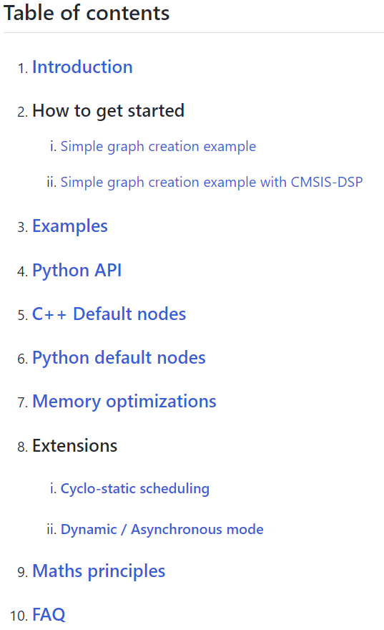
Current Status of CMSIS-DSP Compute Graph
Documentation and several usage examples available today
Usage Steps with current tool flow:
Describe the graph using Python
Consider: No. of I/O of each node, data types, number of I/O samples produced/consumed
Compute the optimized static scheduling from the graph (using Python)
Generate the C++ scheduler
Create C++ wrapper for the algorithm nodes (if they are not already available)
Signal conditioning
Filters
Echo, noise canceller
White balance
Feature extraction
Spectral data
MFCC (audio)
Convolution (pixel)
Classifier
Classical ML Deep learning (NN)
In
Out
The smarter the features, the lower the complexity of the classifier.
More “DSP” pre-processing helps lowering the system complexity
We propose to form a working group with eco-system partners
→ Video Recording of partner meeting

Slide 15
Record real-world data with Synchronous Data Streaming (SDS)
Simplify Development of Embedded Applications that utilize DSP or ML algorithms with Sensor/Audio Input
Microcontroller Hardware
Software on Physical Board
The SDS framework provides methods to record real-world data for analysis and development.
Input to Digital Signal Processing (DSP) development tools such as filter designers
Input to Machine Learning (ML) model classification, training, and performance optimization.
SDS framework is an open-source project: github.com/Arm-Software/SDS-Framework
Algorithm under Development
MEMS Sensor Interface
Audio Interface
SDS Stream
Interface
MCU Device
SDS Stream connects via different channels
Gyroscope Sensor
Microphone Input
Test Data
x
SDS Data Files
*.gyroscope.sds
SDS Data Files
*.microphone.sds
Validation Data
y
Data conversion to ML training platform can be automated.
z
Training Data
Capture physical sensor (real-world) data using the original Microcontroller target hardware

Slide 16
SDS enables playback of real-world data for algorithm testing
Combined with AVH it enables repeatable test automation in CI systems and MLOps cloud services
Microcontroller Hardware
Arm Virtual Hardware (AVH-FVP)
Software on Physical Board
Software on Arm Virtual Hardware
Algorithm under Development
Same algorithm is verified on precise processor simulation model
Algorithm under Development
MEMS Sensor Interface
Audio Interface
SDS Stream
Interface
VSI Sensor Interface
VSI Audio Interface
MCU Device
SDS Stream connects via different channels
AVH VSI
Gyroscope Sensor
Microphone Input
Virtual Streaming Interface #1
Virtual Streaming Interface #2
x
SDS Data Files
gyroscope.*.sds
SDS Data Files
microphone.*.sds
SDS Data Files
gyroscope.*.sds
SDS Data Files
microphone.*.sds
y
z

Slide 17
SDS Data Buffer and Stream Interface
Data Playback via File I/O, Serial, Socket, or AVH VSI
sds.h Data Stream Interface in read mode
Data Recording via File I/O, Serial, Socket
*.sds Data Files ‘sensorX.0.sds’ ‘sensorX.1.sds’
sds.h Data Stream Interface
in write mode
sds_buffer.h Circular Buffer Handling
Circular Data Buffers
Data I/O via blocking devices (fread, fwrite)
sdsio.h Blocking R/W Interface (i.e. file I/O)
Meta Info User supplied ‘sensorX.sds.yml’

Slide 18
*.sds Data Files ‘sensorX.0.sds’ ‘sensorX.1.sds’
Metadata User supplied ‘sensorX.sds.yml’

Slide 19
Development Flow for Edge AI Devices
Input Interface
Signal Conditioning
Optimized ML Model
Output Interface
Optimized ML Model
Output Interface
Video
SDS Stream (optional) in write mode
SDS Stream in read/write mode
SDS Stream
in write mode
SDS Stream
in read mode
SDS Stream
in write mode
Video_In SDS Files
ML_In SDS Files
ML_Out SDS Files
ML_In SDS Files
ML_Out SDS Files
Notes:
But how is such an Edge AI application developed? Let’s take a look.
An Edge AI Device has a classic embedded part that integrates an Optimized ML Model. The classic embedded software interfaces to the sensor, audio or video input of your device, and contains DSP algorithms for signal conditioning. And of course, the output interface.
For the ML Development you need real-world data. Arm offers the SDS software component for data capturing which we will demonstrate in a dedicated webinar later this year. The data is fed into the MLOps system and Edge Impulse is one of our partners in this space.
In the MLOps system, you specify your use-case, and a model searcher helps identifying the right model. Afterwards, compression, training, clustering, and quantization is applied to the model to fit it into the memory of constrained edge devices. Finally, this is compiled, validated, and delivered to the classic embedded development flow for integration.
Edge Impulse will now show us how this works in practice with their system. Over to you Alessandro!

Slide 20
SDS.csolution.yml Data streaming test framework for DSP and ML algorithms
target-types select between hardware
and simulation
Layer Type: AI / ExecuTorch
AlgorithmTest.cproject.yml
Trained PyTorch Model with ExecuTorch run-time optimized for Ethos-U85
Configured example for Alif AppKit-E8-AIML Video input/output
Layer Type: Board
Layer Type: SDSIO
Board Hardware Interface Copied from Alif DFP/BSP Adopted for Video input/output
Record/Playback
SDS data files via
SDSIO-Server USB
Start/stop, recording, and playback selected at runtime using sdsFlags

Slide 21
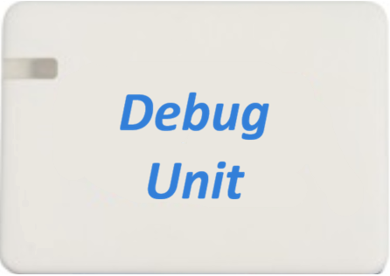
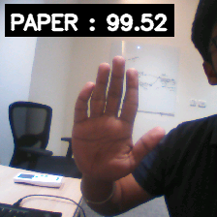
Connect to CMSIS-DAP Unit and pyOCD
JTAG Debug
Camera
SDSIO-Server USB
USB SoC
J-Link Server Serial Monitor
USB Debug UART
Alif AppKit-E8-AIML

Slide 22
SDSIO-Server Firmware / Monitor Interface
Firmware
Firmware Protocol
SDSIO-Server
Monitor Protocol
Monitor program
or
or

Slide 23
Target hardware with SDS firmware configured for USB interface
Host Computer
SDSIO-Server USB Mode
SDS VS-Code extension or
MLOps system
USB
Monitor Interface
Target hardware with SDS firmware configured for Network interface
LAN
Host Computer
Ethernet
SDSIO-Server Socket Mode (listen)
SDS VS-Code extension or
MLOps system
Monitor Interface
Target hardware with SDS firmware configured for RTT interface
Host Computer
SDSIO-Server Socket Mode (connect)
SDS VS-Code extension or
MLOps system
Debug
Monitor Interface

