Slide 1
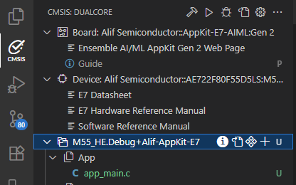
Build / Stop
Load & Run / Stop
Load & Debug / Attach
Open csolution.yml
Manage Solution
Solution name
Menu
Clang active
Open cproject.yml
Select components
Add groups/files

