Slide 1
The Internet of Bins
IoT-enabled Wearable SmartBin

Slide 2
Your Rubbish. Quantified.
State of the art Fullness Detect
Green
Twitter enabled
Smart

Slide 3
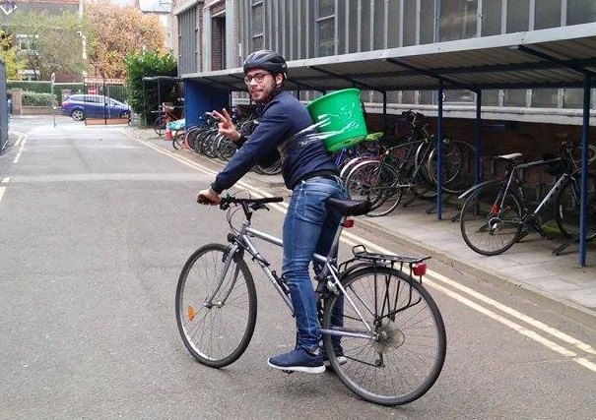
Wearable.

Slide 4
#TrashTag
The SmartBin will:
Weigh your rubbish
Notify you on twitter when your bin is full
(you can’t see when the lid is closed)
Quantified self: graph your rubbish history
Compare yourself online against fellow trashtaggers
Eco warrior or eco disaster?

Slide 5
Thank you
Questions?

