Slide 1
..
SNUZ
Z
alarmingly simple

Slide 2
Product Concept
A wristband designed to gently wake the wearer through vibration, enabling wake up without disturbing others around them.
This is enabled through connection to a smartphone, which would include a user interface for setting alarm times, vibration intensity and other features
At the time of the alarm the wristband vibrates until either the snooze button is depressed or the wristband is removed
In-built LEDs warn the user if they are wearing the wristband without having an alarm set
If the wristband is not being worn at the time of an alarm then an alarm sounds on the phone

Slide 3
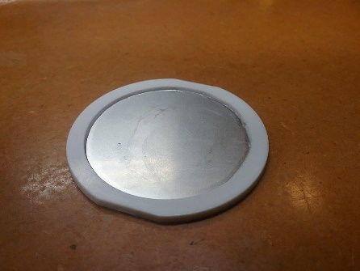
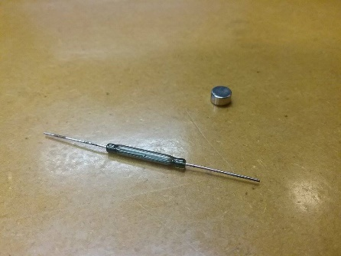
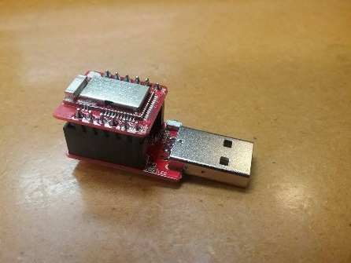
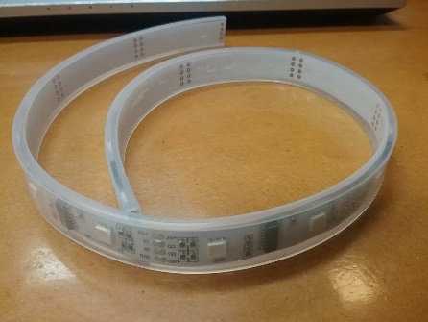
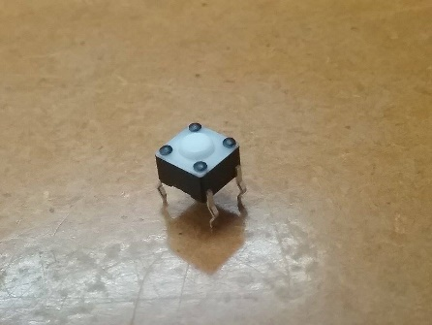
Technical Overview
In product the vibration would be achieved using a vibration motor but for the sake of our prototype a representative piezo speaker was used
The wristband is able to detect whether it is being worn using a reed sensor/ magnet combination integrated into the clasp
The smartphone can connect to the wristband using the BLE nano kit
LED strip forms structural base of prototype as well as displaying status to user
Snooze button formed of tactile switch. This requires sufficient force to not be accidentally activated
In product a rechargeable battery pack would be used but for the sake of the prototype a 5V USB connection was used.

Slide 4
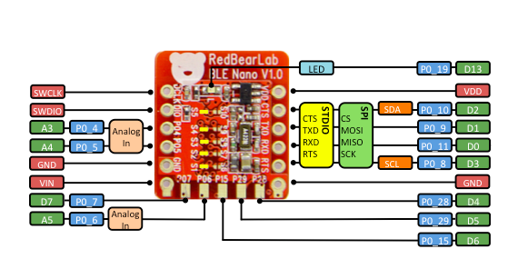
Pin Allocation
LED, reed
LED DI
Battery GND
LED CI
Battery in
Piezo, LED, reed
Piezo out
Switch in
Reed in

Slide 5


6:45
6:45
M Tu W Th Fr
M Tu W Th Fr
8:00
Sa
ADD ALARM
ADD ALARM

