Slide 1
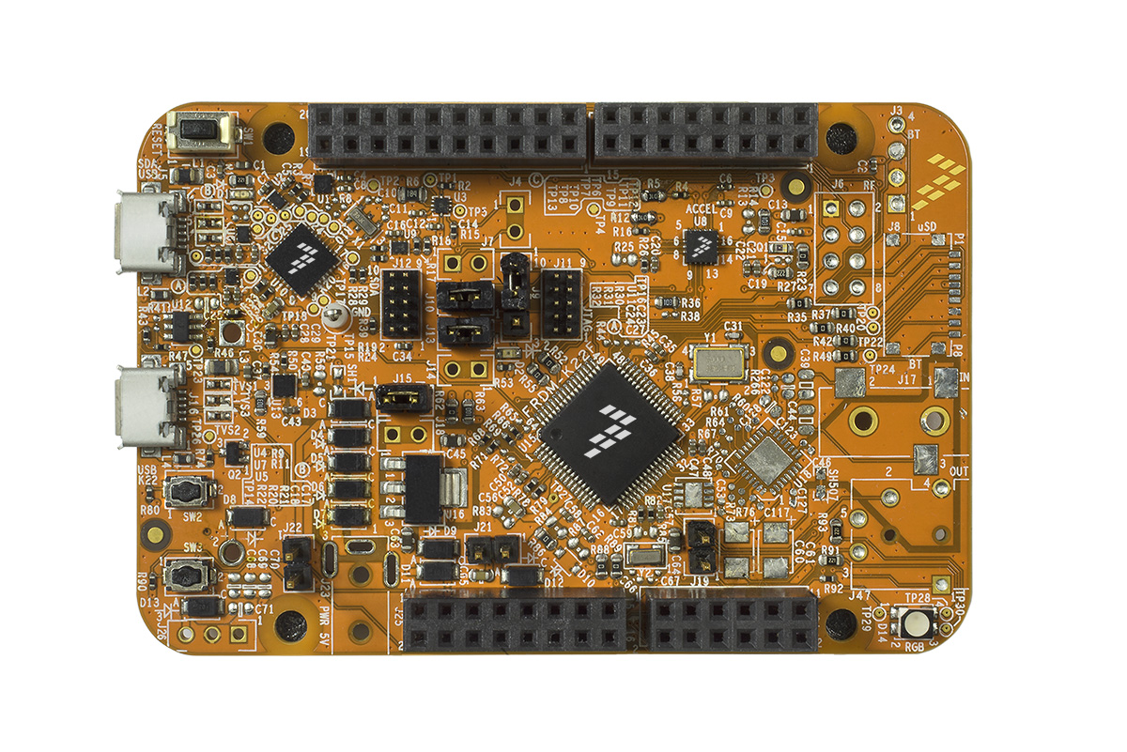
Company Logo Here
<board-name>
Arduino Headers
SCL
SDA
I2C1
PTE1
D15
PTE0
D14
AREF
SCK
MISO
MOSI
GND
IOREF
SPI1
PTD5
D13
RESET
PTD7
D12
+3v3
PTC11
PTD6
D11
+5v
PTC0
PWM
PTD4
D10
GND
PWM
PTA1
D9
GND
VREF_OUT
PWM
PTB19
D8
VIN
5v – 9v
PTC5
PTC6
D7
PTC10
PWM
PTC3
D6
A0
PTB0
Analog In
ADC0_DP0
PTC7
PWM
PTB18
D5
A1
PTB1
ADC0_DM0
PTC9
PWM
PTA4
D4
A2
PTC1
ADC0_DP3
PTC8
PWM
PTA2
D3
A3
PTC2
ADC0_DM3
PTA12
PTB16
D2
A4
PTB3
PTC4
PTA13
UART2
PTD3
D1
TX
RX
A5
PTB2
DAC0_OUT
PTA5
PTD2
D0
Notes:
This slide is primarily for referencing what pins are connected to the outer Arduino headers (A05, D0-15). If you have a large number of peripherals on the inner rows we suggest having a second image showing those.
Make sure to change the names of the pins in the blue boxes to match the pin names on your board.
Note how the board is greyed out and emphasis is put on the color coded pin types.
Make sure the Company Logo and board image are high quality PNG's, otherwise they will degrade poorly later on.

Slide 2
Company Logo Here
PTB17
PTC1
SW3
SW2
<board-name>
Additional Peripherals
FXOS8700CQ
Accelerometer
Magnetometer
SDA
SCL
INT1
INT2
PTB3
PTB2
PTD0
PTD1
Light
Sensor
ADC0_DP3
PTA1
PWM
LED1
PTA2
RGB LED
LED2
PWM
PTD5
PWM
LED3
Notes:
Second image for additional peripherals that are unique to your platform

Slide 3
Firmware Update
http://os.mbed.com/teams/<company>/wiki/<board-name>-interface-firmware
Choose color that has high visibility
Notes:
Firmware update instructions / what users have to physically interact with ( for example press reset button, plug in device)

Slide 4
http://os.mbed.com/platforms/<board-name>/#downloading-a-program
DAPLink
USB
RESET
STATUS
LED
LED1
LED2
LED3
Notes:
Instructions on how to download a program.
For example, do users have to press reset to restart the board or does it reset automatically? Which LED blinks while code is being loaded? Do the LED's change color at all?

Slide 5
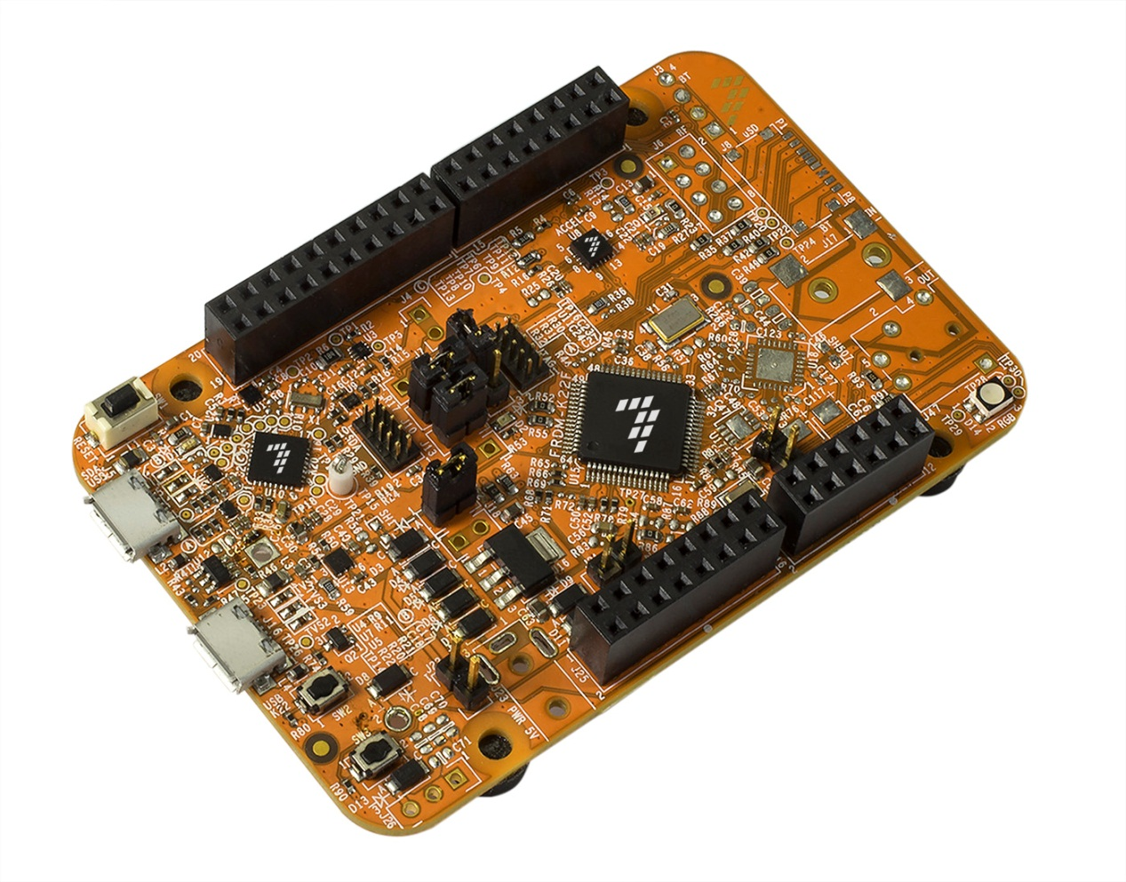
Platform Page main image
http://os.mbed.com/platforms
Notes:
Platform page main image, something angled

