Slide 1
Sweet Momma Bs

Slide 2
Local Bakery Website
Allows for a guest or user view
Shows recommendations from customers, baked goods for sale
Allows for point/click interface for quick admin updates

Slide 3
Express
Node
MySQL/Sequelize
Passport
EJS
ReactJS

Slide 4
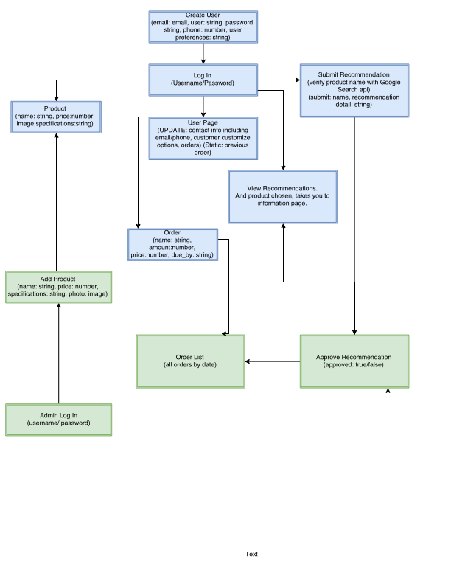

Slide 5
Future updates
Updates include further admin functionality
Email updates on order receipt
Image upload in admin portal

