Slide 1
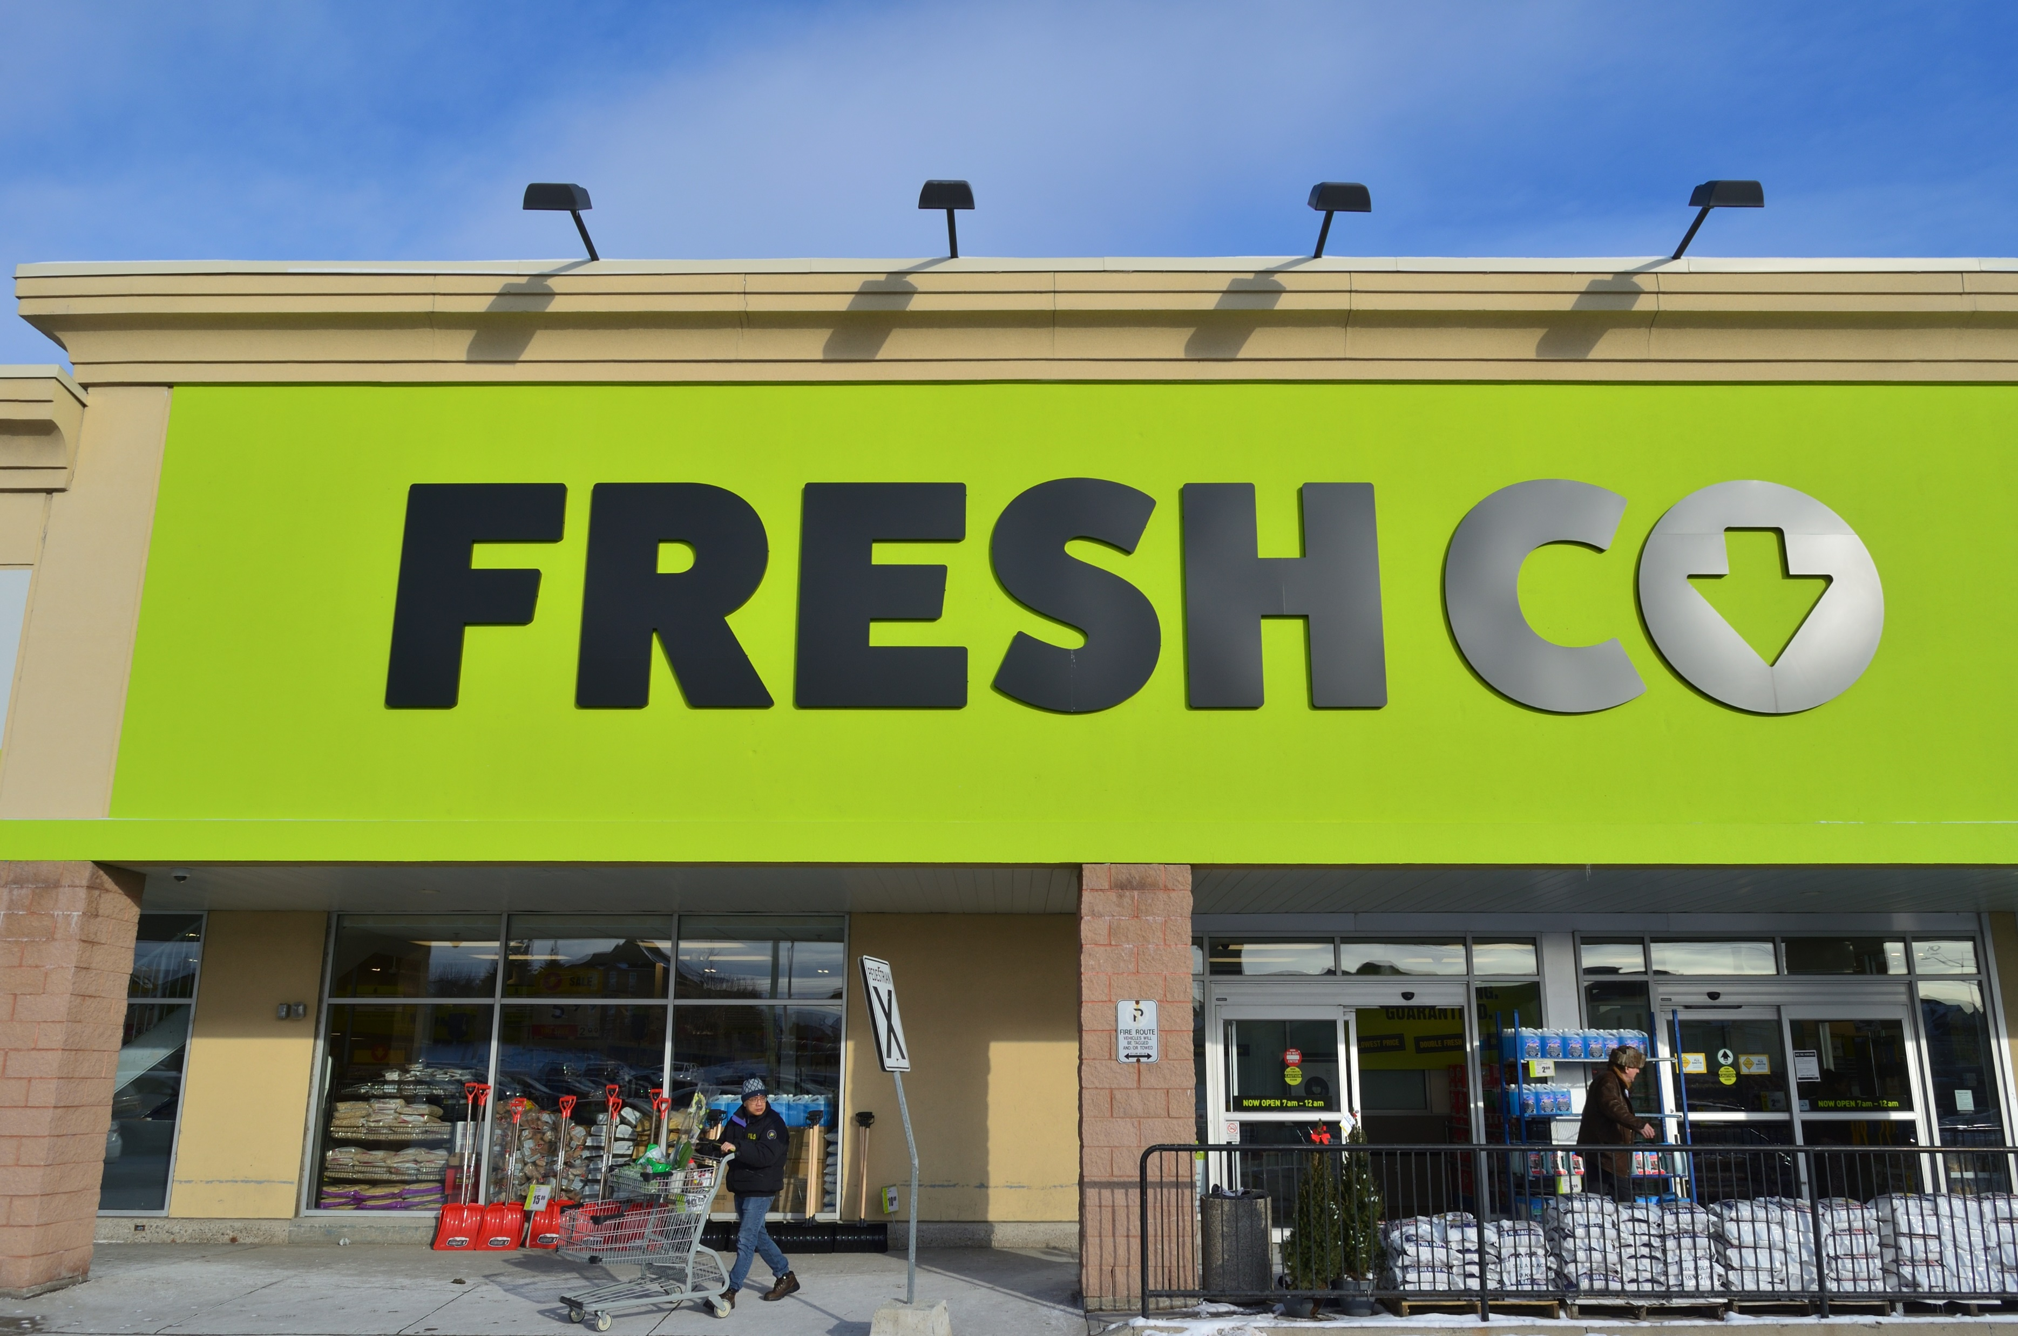
FRESHCO HYPERMARKET CAPESTONE PROJECT PRESENTED BY - ABHIJEET RANJAN

Slide 2
INTRODUCTION
This presentation is about the analysis of database of Freshco Hypermarket and representation of the same divided into 4 major sections as follow :
Order level analysis
Completion rate analysis
Customer level analysis
Delivery level analysis

Slide 3
ORDER LEVEL ANALYSIS
Order distribution at slot and delivery level area
Order distribution at Monthwise orders and area wise.
Delivery charge as a percentage of product amount at slot and monthwise.
Discount as a percentage of product amount at slot and monthwise.

Slide 4
Order distribution at slot and delivery level area
OBSERVATION :
This table gives the distribution of no of orders(count of order id) placed across the delivery area vs slot.
Highest no of orders are placed in the HSR layout.
Reason : Within the local vicinity of HSR layout by the local residents as the freshco hypermarket is situated in HSR Layout .
Slotwise the highest no of orders are placed in the afternoon
Reason: It may possibly be because of the lunch hours of the office time.

Slide 5
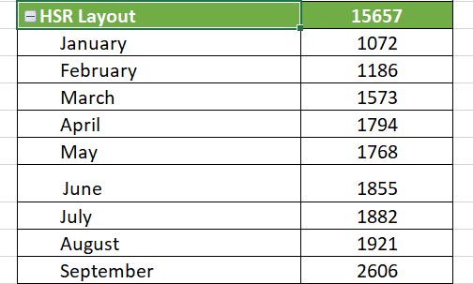
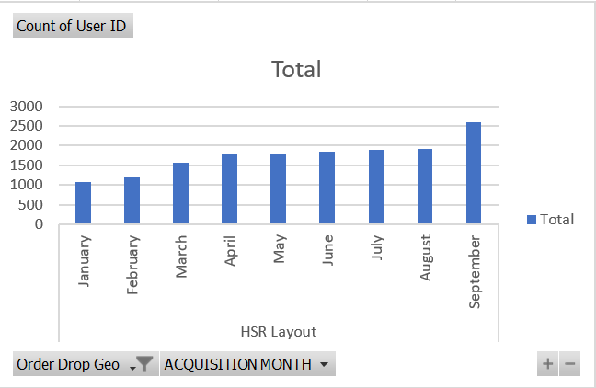
Order distribution across month-wise and area-wise
Highest absolute increase in orders from Jan to sept happened in HSR LAYOUT.
Reason : Local customers would reach out to the local outlet(Freshco hypermarket) preferably due to easy accessibility.
Order distribution monthwise in HSR Layout shows that there is a highest number of order being placed in the month of september, due to festive season .
.

Slide 6
Delivery charges as a percentage of product amount at slot and month level.
Formula used : (Delivery charge/product amount)*100
Across the months delivery charge as a percentage of product amount is the highest in January i.e, 10.716% with gradual decrement from January to september . In september it is the lowest at 2.077%.
Across the slot, highest during the late night i.e,12.258% and lowest during the afternoon i.e,5.095%

Slide 7
Discount as a percentage of product amount at slot and month level.
Across the months discount as a percentage of product amount is the highest in the month of August (i.e,20.823%) and lowest in the month of February.
Across the slot it is the highest in the night time (i.e,6.819%) and the lowest during the late night(i.e,3.726%).

Slide 8
Completion Rate Analysis
Completion rate at slot vs day of the week (Sunday to Saturday) level.
Completion rate at drop area level.
Completion rate at number of products ordered level.

Slide 9
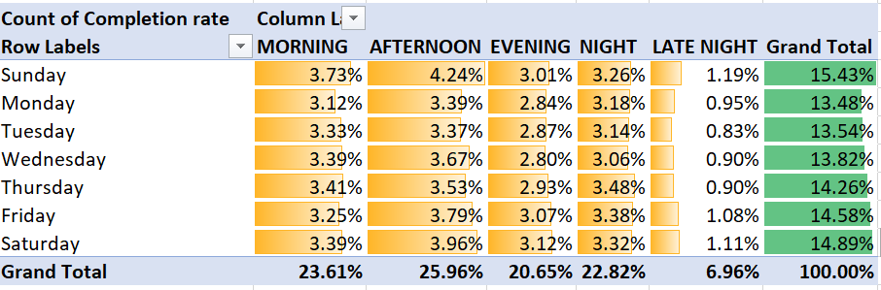
Completion rate at slot and days of the week (Sunday to Saturday) level.
Across the slots the completion rate is highest during the afternoon and lowest during the late night.
Across the days of the week it can be observed that the completion rate is the highest during the weekends(i.e on Sat/Sun) as compared to the other days of the week and especially it is the highest on Sunday.

Slide 10
Completion rate at drop area level.
OBSERVATION:
Completion rate at drop area level is the highest for HSR Layout.
REASON:
1) More order being placed from HSR Layout(i.e,68.6%) as compared to the other locality.
2)More delivery partner are readily available to complete the order in the HSR Layout as compared to other locality.

Slide 11
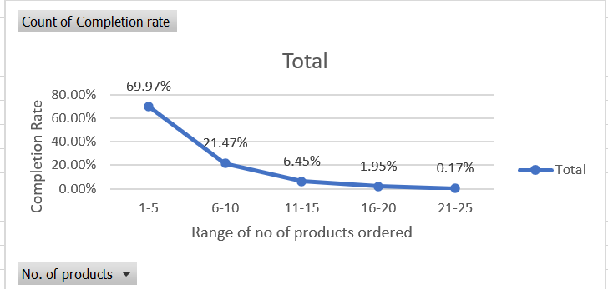
Completion rate at number of products ordered level.
OBSERVATION :
As the number of order placed increases the completion rate decreases.
REASONS:
This could be because of the reluctance of the delivery partner to deliver more number of products for a single order because of the less commission he will get and more efforts he has to put in.
Or he has to cover longer distance to fetch different products of the order.
Distance he has to cover to deliver different orders may also be far away.

Slide 12
Customer level analysis
Completion rate at source level.
LTV(Lifetime value) for every customer.
Aggregated LTV at customer acquisition source level.
Aggregated LTV at acquisition month level.
Average Revenue(Product amount after discount) per order at different customer acquisition source level.
Average Revenue(Product amount after discount) per order at acquisition month level.
Slot and order rate analysis .

Slide 13
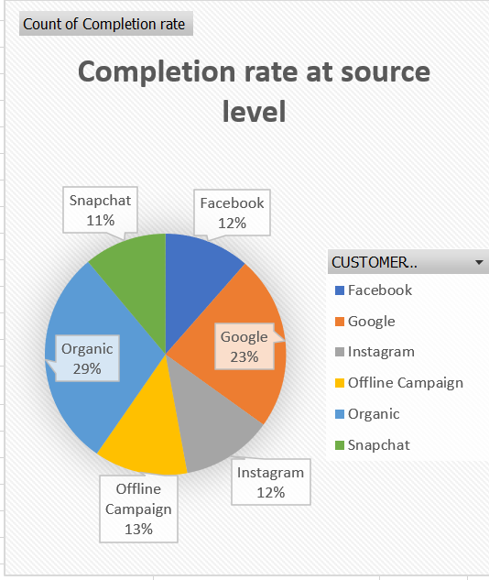
Completion rate at source level
Completion rate at acquisition source level is highest for Organic i.e,29%.
Completion rate at acquisition source level is lowest for Snapchat i.e, 11%.

Slide 14
LTV – LIFETIME VALUE OF CUSTOMER
Formula used to calculate LTV
LTV = Product amount + Delivery charge
Note: LTV calculated does not include the discount given .
Aggregated LTV
Aggregated LTV = Sum of LTV / total no. of customer
Formula used to calculate revenue :
Revenue = (Product amount + Delivery charge)-discount

Slide 15
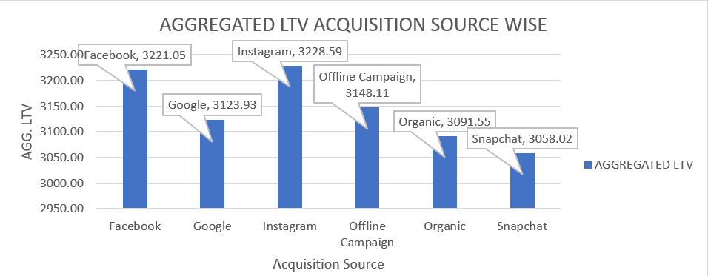
Aggregated LTV at customer acquisition source level.
Highest aggregated LTV at customer acquisition level is for Instagram i.e,3228.59
Lowest aggregated LTV at customer acquisition level is for Snapchat i.e,3058.02

Slide 16
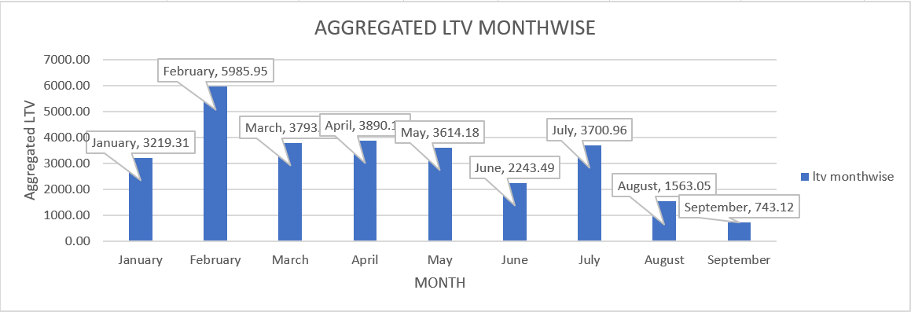
Aggregated LTV at acquisition month level
Highest aggregated LTV at acquisition month level is for JANUARY month i.e, 5986.
Lowest aggregated LTV at the acquisition month level is for SEPTEMBER i.e, 723.12.

Slide 17
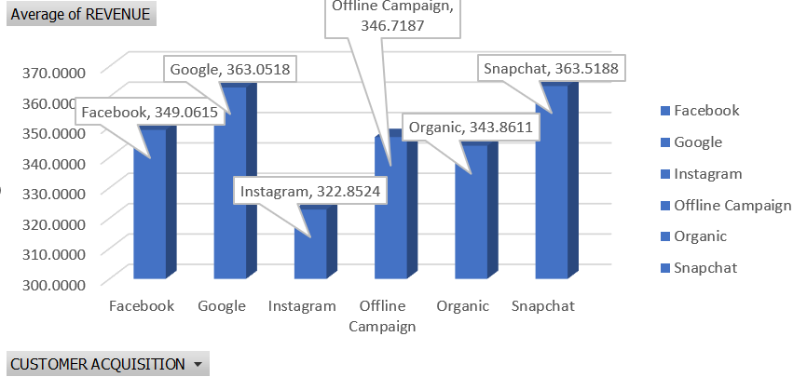
Average Revenue(Product amount after discount) per order at different customer acquisition source level.
Highest average revenue from acquisition source is from Snapchat i.e,363.52.
Lowest average revenue from acquisition source is from Instagram i.e,322.85

Slide 18
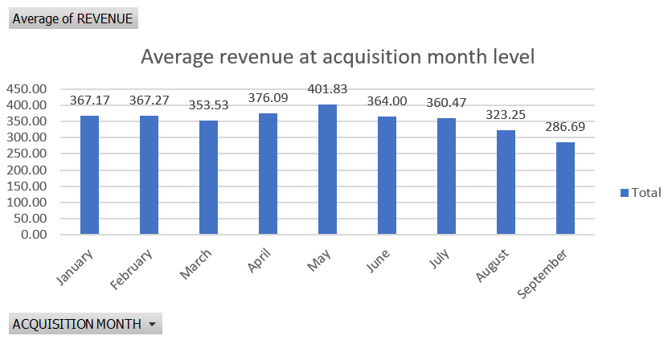
Average Revenue(Product amount after discount) per order at acquisition month level
Highest average revenue at the acquisition month level is for MAY i.e, 402.
Lowest average revenue at the acquisition month level is for the month of September i.e,287

Slide 19
Analysis of pattern in order rating across slots, number of items placed, delivery charges, discount
Analysis of order rating across the slots.
Across the slots highest rating is during the afternoon and lowest rating is given for the orders placed during the late night.
Across the slots for the orders placed the maximum no. of orders are given 5 star rating while the minimum no. of orders are given 2 start rating.
Order rating across the number of items placed order for.
As the no. of order placed increases the overall rating decreases.
Order rating across the delivery charge
As the range of delivery charge increases the overall rating decreases.
Order rating across the discount applied
As the discount range increases the overall rating trend decreases.

Slide 20
Delivery level analysis
Average overall delivery time at month and delivery area level.
Average overall delivery time at month and weekday/weekend level.
Average overall delivery time at slot level.
Pattern in delivery charges with slot or delivery area.
Pattern in delivery time and delivery area.

Slide 21
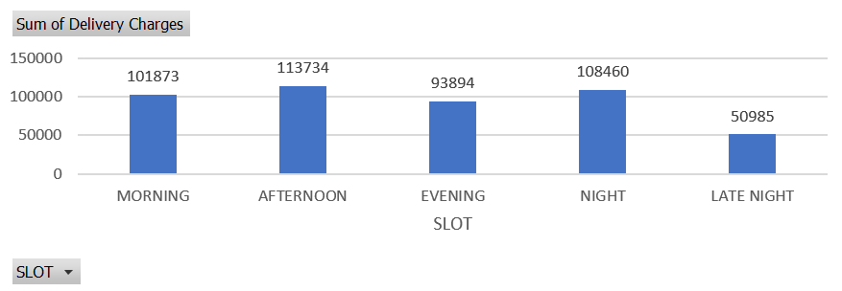
Delivery charges with slot
Observation 1) : Highest sum of delivery charges is during the afternoon slot.
Reason : More orders are being placed during the afternoon time leading to more delivery charges.
Observation 2): Lowest sum of delivery charges are during late night slot
Reason : No of orders placed during the late night are comparatively low as compared to other time slot of the day so therefore the cumulative sum of delivery charge during the late night is low.

Slide 22
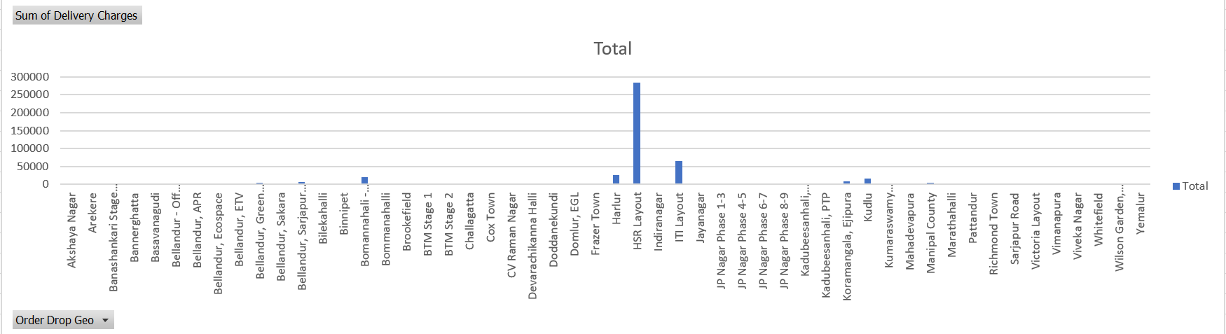
Delivery charges with drop area
Observation :
Looking at the above graph of drop area vs. sum of delivery charges it can be concluded that the maximum order are placed for HSR LAYOUT accounting for max cumulative delivery charges.

Slide 23
Analysis of relation between delivery time and drop area
Observation :
Max cumulative delivery time from pickup to drop area is for BTM STAGE 2
Reasons:
Travelling time from Freshco hypermarket which is in HSR Layout to BTM STAGE 2 is the largest because of its distance.
Scattered traffic in the route due to longer distance.
Lesser availability of delivery partner.

Slide 24
THANK YOU !!!!!

