Slide 1


QMM FINAL EXAM – Mathematical Modeling
Presenting By :- Avinash Ravipudi

Slide 2

Factors Effecting :
GPA
Experience
Skills

Slide 3





Data Collection
University Data
Surveys
GPA
Experience
Skills

Slide 4
Model Formulation – Decision Variables
Decision Variables members of groups, xij uses as decision variable
Xij where
Students are divided in 4 group and each group consists of 3 members
i represents the student number and
j represents the student group number

Slide 5
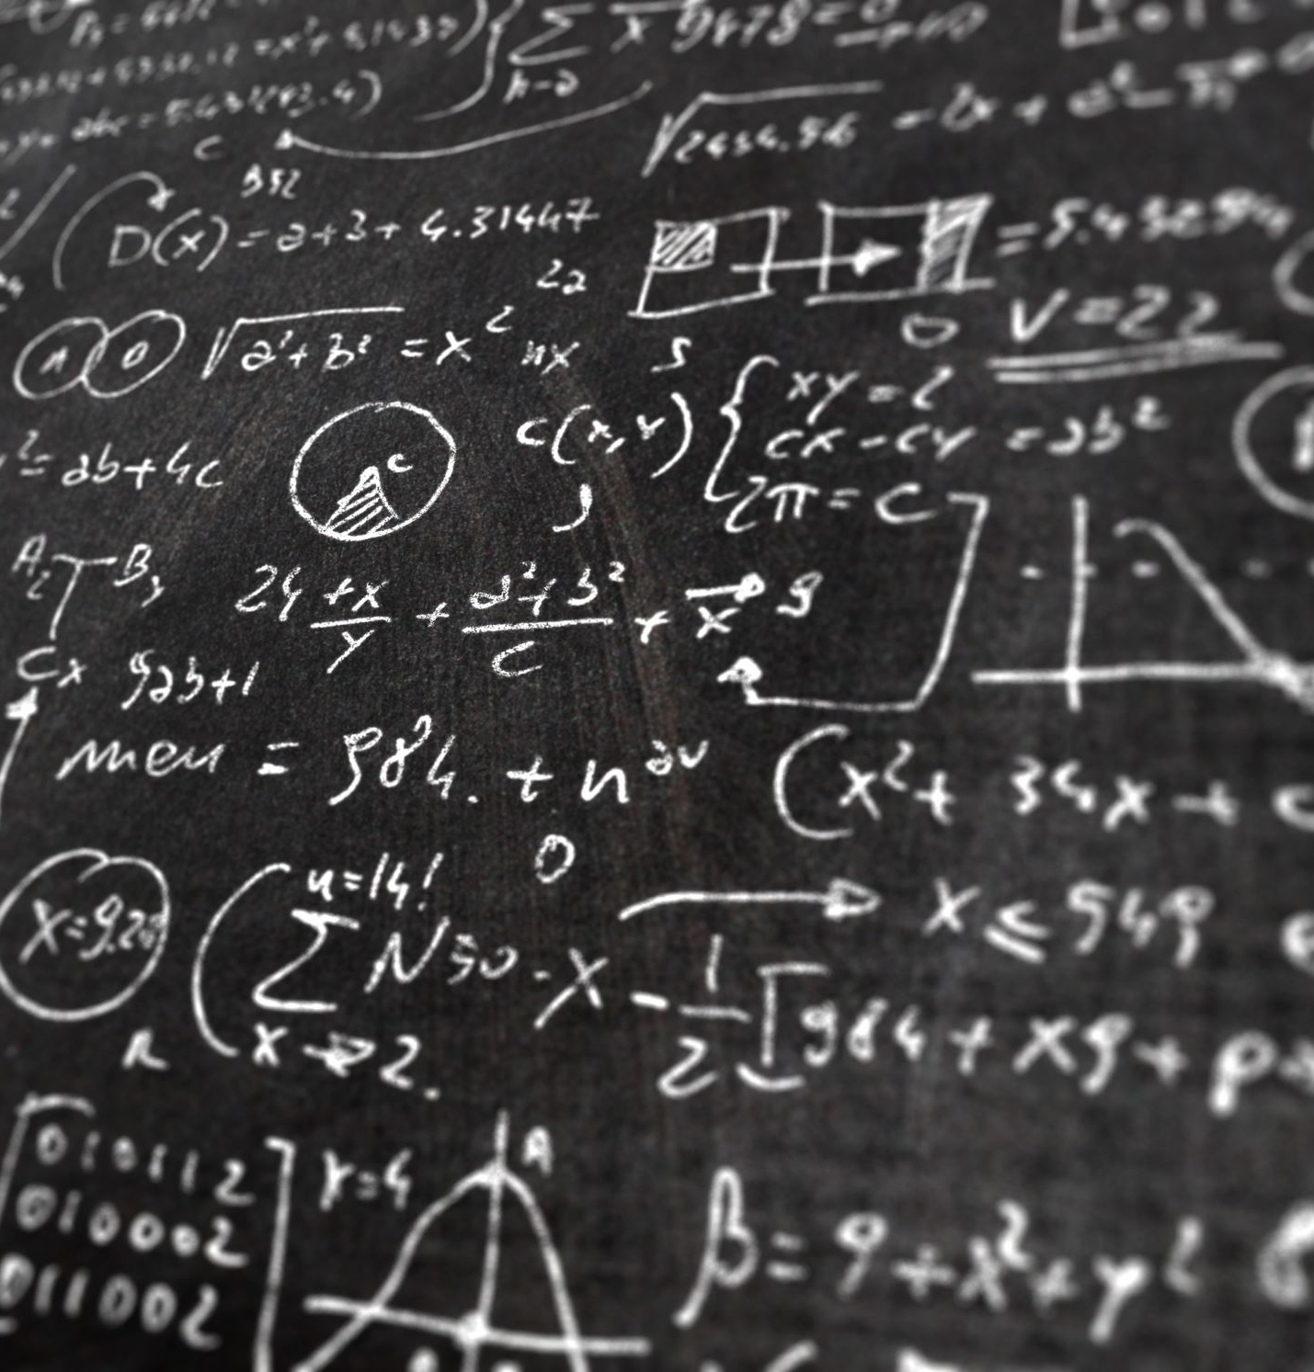
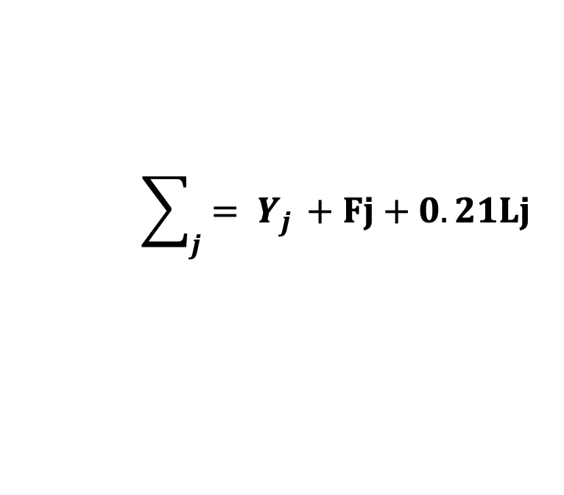
Model Formulation – Objective Function
The purpose of this program is to improve the chances of success for each specific group. Because all of the groups have equal chances of success, we only need to compute the success rate of one group.
$$\sum_{j}{= Y_{j }}+Fj+0.21Lj$$
Where :
Yj – student GPA
Fj – similar priority experience
Lj - Skills

Slide 6

Constraints:
The following constraints are considering for this model
There are only four groups, each with three members.
Each person can only be a part of one group.
There are integer constraints.

Slide 7

Results:
Group -1
Person 4
Person 6
Person 7
Group – 2
Person 3
Person 8
Person 11
Group – 3
Person 2
Person 5
Person 12
Group – 4
Person 1
Person 9
Person 10

Slide 8

Thank You

