Slide 1




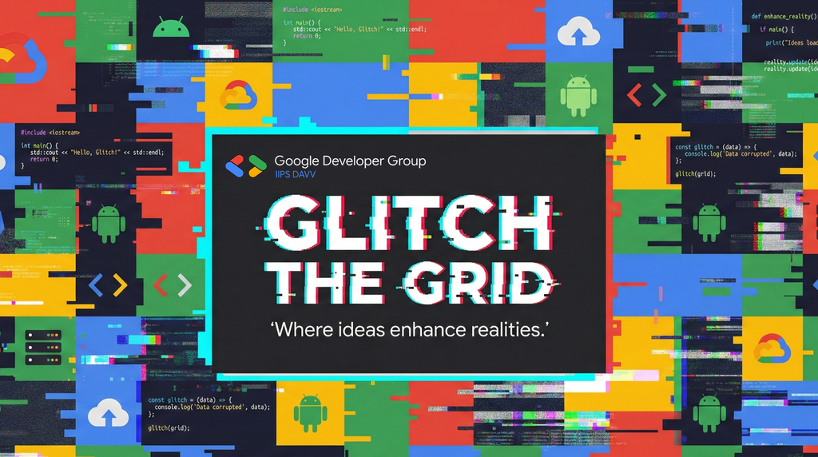
GLITCH THE GRID 2025
Theme: __________________________________
Problem Statement Title: __________________
Team Name: _______________________________
Team Members: _____________________________
Open Innovation
IIPS-Placement-Portal
GRIND
Arpan, Mradul, Animesh, Chinmay

Slide 2
PROBLEM STATEMENT
Campus placement management at IIPS is done manually, error-prone processes that can create significant inefficiencies :
Who is Affected:
Students- struggle to track multiple placement drives, eligibility criteria, and application statuses across different companies
Training & Placement Officers (TPO)- are overwhelmed by managing spreadsheets, manual eligibility verification, and tracking hundreds of applications
Why It Matters:
Manual eligibility checking leads to 5-10% error rate in application screening
Students miss opportunities due to lack of centralized information
TPOs spend 60% of their time on administrative tasks instead of strategic planning
No standardized system for tier-based placement rules (Regular/Dream/Super Dream)
Real-World Relevance: With over 5,000+ engineering colleges in India conducting campus placements annually, an estimated 2 million+ students face these challenges every year. The current fragmented approach results in placement delays, missed opportunities, and administrative burnout.

Slide 3
IDEA SUMMARY
Proposed Solution: IIPS Placement Portal
A comprehensive, AI-powered campus placement management system that digitizes and automates the entire placement lifecycle.
How It Solves the Problem:
Centralized Platform: Single dashboard for students, TPO, and administrators to manage all placement activities
AI-Powered Resume Analysis: Google Gemini automatically extracts skills from uploaded resumes, eliminating manual data entry
Automated Eligibility Engine: Real-time eligibility checking based on CGPA, program, backlogs, and tier-based rules
Smart Tier Management: Automatic enforcement of Regular/Dream/Super Dream placement policies
Real-Time Analytics: Instant insights into placement rates, company-wise statistics, and student progress
Key Outcome: Transform placement management from a 2-week manual process to a streamlined 2-day digital workflow with 99% accuracy.

Slide 4
SOUTION DESCRIPTION
The IIPS Placement Portal is a full-stack web application built with Next.js and Firebase that automates campus placements. Students upload resumes, and Google Gemini AI extracts technical skills automatically. The eligibility engine instantly validates student qualifications against drive criteria including CGPA, programs, and tier restrictions. TPOs create and manage drives through an intuitive admin panel, while students browse, apply, and track applications in real-time. The platform enforces tier-based placement rules (Regular/Dream/Super Dream) automatically, preventing policy violations. Real-time analytics dashboards provide actionable insights on placement progress, helping institutions make data-driven decisions and improve placement outcomes.

Slide 5
INNOVATION
What Makes This Solution Unique
1. AI-Powered Skill Extraction- Unlike traditional portals requiring manual skill entry, our system uses Google Gemini's multimodal capabilities to directly analyze PDF resumes and extract normalized skills automatically.
2. Intelligent Tier Management System- automated tier-based placement logic:
Regular tier (< 10 LPA): Open to all eligible
Dream tier (10-20 LPA): Only unplaced or regular-placed
Super Dream tier (> 20 LPA): Progressive eligibility
3. Real-Time Eligibility Engine- Instant, rule-based eligibility checking that considers multiple factors simultaneously (CGPA, program, batch, backlogs, placement tier).
Gap Addressed: Existing solutions either lack AI integration, don't support tier-based placement rules, or require expensive enterprise licenses. Our solution brings enterprise-grade features with modern AI to educational institutions affordably.

Slide 6
OPPORTUNITIES
Comparison with Existing Solutions:
Problem-Solving Approach:
Scalability: Cloud-native architecture handles 10,000+ students without performance degradation
Accuracy: Automated checks eliminate human error in eligibility verification
Time Savings: Reduces TPO administrative work by 60%
Accessibility: Web-based platform accessible from any device
Transparency: Students see real-time status, reducing TPO query load
Market Opportunity:
5,000+ engineering colleges in India
Growing EdTech market (₹30,000 crore by 2025)
Increasing demand for placement automation post-COVID
Feature | Traditional Systems | Our Solution
Resume Parsing | Manual entry | AI-automated
Eligibility Check | Spreadsheet formulas | Real-time engine
Tier Management | Manual tracking | Automated rules
Analytics | Basic reports | Interactive dashboards
Cost | ₹5-10 lakhs/year | Open source

Slide 7
PROPOSED FEATURES & CAPABILITIES
Core Features :
For Students:
📝 Profile management with academic details
📄 AI-powered resume upload and skill extraction
🔍 Browse and filter placement drives
✅ Real-time eligibility status
📊 Application tracking dashboard
🔔 Status update notifications
For TPO/Admin:
🏢 Company and drive management
📋 Bulk application processing
👥 Student management and debarment
📈 Real-time analytics and reports
📥 CSV export functionality
⚙️ Role-based access control
Advanced Capabilities:
🤖 Google Gemini AI integration for resume analysis
🎯 Multi-factor eligibility engine
📊 Tier-wise placement tracking
🔐 Secure Firebase authentication
📱 Responsive design for mobile access

Slide 8
GOOGLE TECHNOLOGIES PLANNED
Implementation Details :
1. Firebase Authentication
Purpose: Secure user authentication and session management
Implementation: Email/password authentication with custom claims for role management (student/tpo/admin)
Benefit: Enterprise-grade security without managing auth infrastructure
2. Cloud Firestore
Purpose: Real-time NoSQL database for all application data
Implementation: Collections for users, drives, applications, companies with real-time listeners
Benefit: Instant data sync across all users, offline support
3. Firebase Admin SDK
Purpose: Server-side operations with elevated privileges
Implementation: Session management, user role verification, secure data operations
Benefit: Secure server-to-Firebase communication

Slide 9
GOOGLE AI TOOLS INTEGRATED
Google Gemini AI Integration :
Purpose of AI Integration: Automate the tedious and error-prone task of extracting technical skills from student resumes.
How AI Improves the Solution:-
1. Multimodal PDF Analysis
Gemini 1.5 Flash directly processes PDF documents
No need for intermediate text extraction libraries
Handles various resume formats and layouts
2. Skill Normalization
AI understands context: "js" → "JavaScript“
Deduplication of similar skills
Categorization (language/framework/tool)
Value Delivered:
⏱️ Reduces resume review time from 10 minutes to 10 seconds
✅ 95%+ accuracy in skill extraction
🔄 Consistent normalization across all resumes
📊 Enables skill-based analytics and matching
API Used: @google/generative-ai with gemini-1.5-flash model
Input: PDF Resume
Gemini AI Analysis
Output: ["JavaScript", "React", "Node.js", "Python", "MongoDB"]

Slide 10
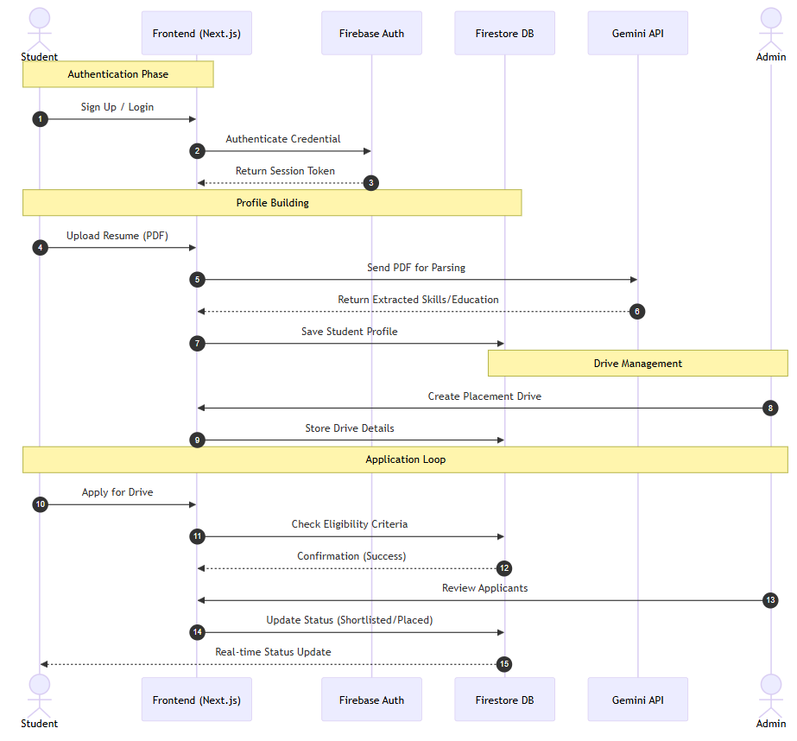
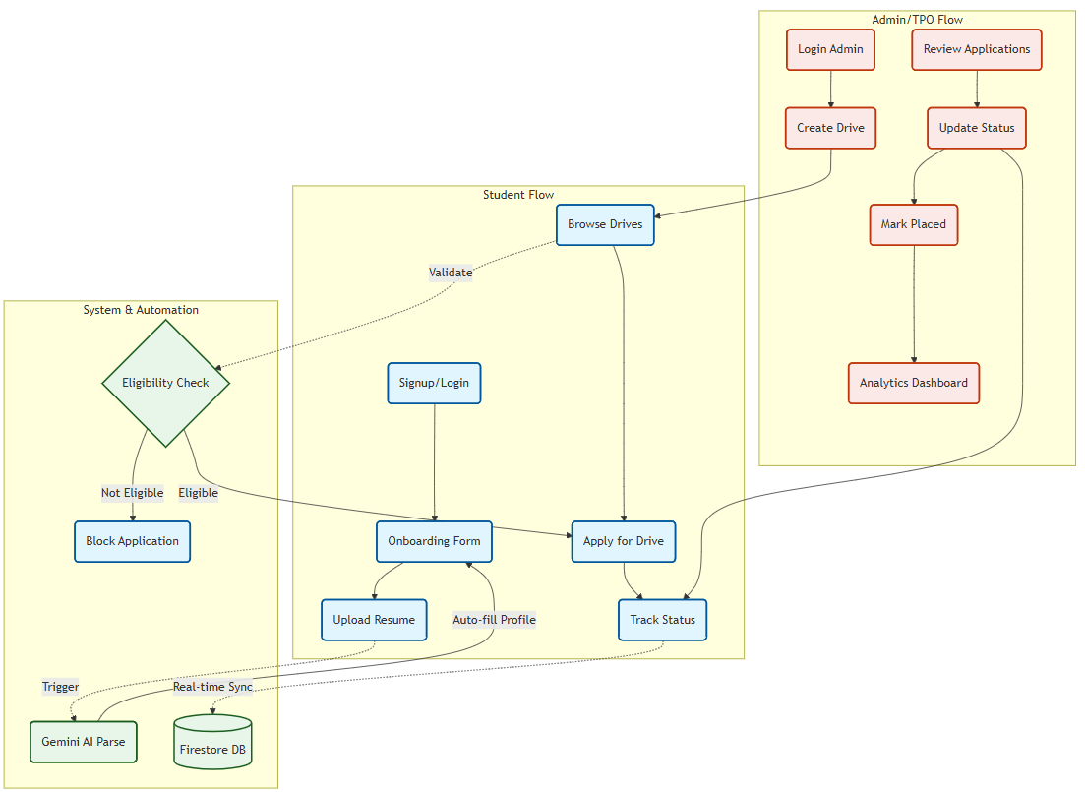
PROCESS FLOW DIAGRAM
Sequence Diagram :
System Workflow Diagram :

Slide 11
FEASIBILITY & FUTURE SCOPE
Technical Feasibility :
Current Implementation Status:
✅ Fully functional MVP with all core features
✅ Tested with sample data (students, drives, applications)
✅ Deployed on development environment
✅ All Google integrations working (Auth, Firestore, Gemini)
Resource Requirements:
Firebase Spark Plan (Free) supports 50K reads/day
Gemini API free tier provides 60 requests/minute
Vercel free tier for hosting
Future Scope :
Phase 2 (3-6 months):
📱 Mobile app (React Native)
🔔 Push notifications
📧 Email integration
🤖 AI-based job recommendations
Phase 3 (6-12 months):
🎥 Video interview scheduling
📝 Online assessment integration
🤝 Alumni network features
📊 Predictive placement analytics
Phase 4 (12+ months):
🏢 Multi-institution support (SaaS model)
🔗 LinkedIn integration
💼 Direct company portal
🌐 Nationwide placement network

Slide 12
MVP & DEMO DETAILS
MVP Link:
GitHub Repository Link:
3-Minute Demo Video Link:
https://glitch-the-grid.vercel.app/
https://github.com/ARPANPATRA111/Glitch_The_Grid
https://youtu.be/o6jZ8qzXbgI

Slide 13
RESEARCH & REFERENCES
Official Documentation :
Next.js Official Documentation https://nextjs.org/docs
Next.js 16 Release Blog https://nextjs.org/blog/next-16
Firebase Official Documentation https://firebase.google.com/docs
Google Gemini API Documentation https://ai.google.dev/gemini-api/docs
Articles, Blogs & Tutorials Referred :
"How to Build a Full Stack App with Next.js 13 and Firebase" https://www.freecodecamp.org/news/create-full-stack-app-with-nextjs13-and-firebase/
"Next.js and Firebase DB full-stack app tutorial“ https://blog.logrocket.com/nextjs-cloud-firestore-full-stack-app-tutorial/
"Integrate Firebase with a Next.js app" https://firebase.google.com/codelabs/firebase-nextjs
"Gemini AI with Next.js 15: A Comprehensive Guide" https://dev.to/shubhamtiwari909/gemini-ai-next-js-15-tailwind-1247
"How to use Gemini API (Next.js Tutorial)" https://avionmission.com/blog/gemini-api-tutorial/
"Build an AI UI Generator with Gemini API, Next.js” https://avionmission.com/blog/gemini-nextjs-generative-ui-tutorial/ Case Studies & Inspiration Sources :
Fireship.io Next.js + Firebase Full Course (Social blogging platform demo) https://fireship.io/courses/react-next-firebase/
GitHub Projects for Inspiration:
Next.js + Firebase Starter Templates https://github.com/milliorn/nextjs-firebase-starter
College/Student Portal Examples https://github.com/Sahil-Sayyad/Placement_Portal
Placement Cell Applications https://github.com/Ayush-Kanduri/Placement-Cell-Application

