Slide 1
Node.js
Current Version – 8.11.1
4/27/2018

Slide 2
Node.js?
An open source JavaScript runtime built on Chrome's V8 JavaScript engine
Asynchronous
Non-blocking I/O model
Event driven (JavaScript is event driven)
Designed to build scalable network applications
Lightweight and efficient
Without threads or new processes
HTTP is a first class citizen
Notes:
Event Driven – This means that instead of waiting for a response before moving on, JavaScript will keep executing while listening for other events.
HTTP is a first class citizen in Node, designed with streaming and low latency in mind. This makes Node well suited for the foundation of a web library or framework.

Slide 3

JavaScript Callbacks
I got your message
I will work on your task
And I’ll call you back later
Callbacks are functions
Executes after another function
Function argument
playTennis(onWinning, onLosing);
function onWinning(){
console.log(‘rejoice’);
console.log(‘go back to work’);
}
function onLosing(){
console.log(‘go back to work’);
}
Notes:
In Node there is no such start-the-event-loop call. Node simply enters the event loop after executing the input script. Node exits the event loop when there are no more callbacks to perform. This behavior is like browser JavaScript — the event loop is hidden from the user.

Slide 4
Event Loop
JavaScript is single threaded
Node.js supports
Non-blocking I/O operations
High concurrency to build scalable network applications
Event Loop
Libuv library implements Event Loop
Runs Node.js application
An app is execution of one or more callbacks
Event Loop queues and executes callbacks
Notes:
Event loop is a construct of how Node.js executes javascript resulting in non-blocking I/O operations that allows high concurrency even though javascript is executed in a single thread in Node.js.

Slide 5
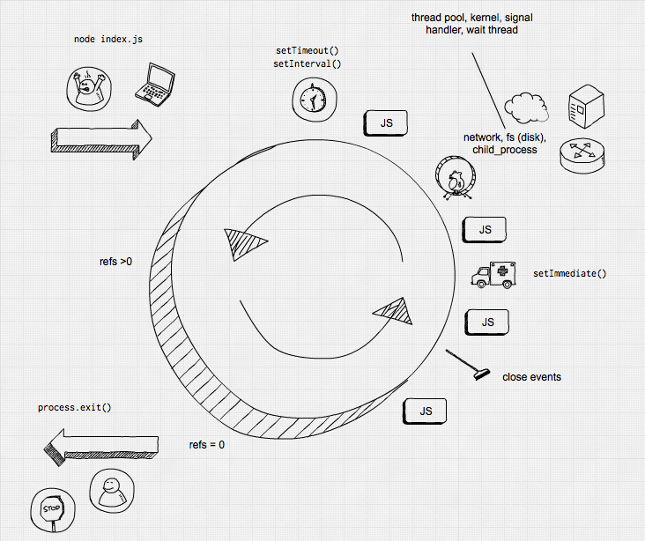
Event Loop
Notes:
Timers - Everything that was scheduled via setTimeout() or setInterval() will be processed here.
IO Callbacks - Here most of the callbacks will be processed. As all userland code in Node.js is basically in callbacks (e.g a callback to an incoming http request triggers a cascade of callbacks), this is the userland code.
IO Polling - Polls for new events to be processed on the next run.
Set Immediate - Runs all callbacks registered via setImmediate().
Close - Here all on(‘close’) event callbacks are processed

Slide 6
Event Loop & Cluster Module
The event loop and the JavaScript code runs in the same thread
Single-threaded!
Multicore processors?
Cluster module to spawn child processes per processor
Each child process has its own event loop
Master module distributes load

Slide 7
Worker Pool
Handles expensive tasks like file I/O or CPU intensive tasks.
Thread pool created by Libuv to execute asynchronous work
Or, also can use Operating System’s asynchronous interfaces
Defaults to 4 threads
Notes:
These are the Node module APIs that make use of this Worker Pool:
I/O-intensive
DNS: dns.lookup(), dns.lookupService().
File System: All file system APIs except fs.FSWatcher() and those that are explicitly synchronous use libuv's threadpool.
CPU-intensive
Crypto: crypto.pbkdf2(), crypto.randomBytes(), crypto.randomFill().
Zlib: All zlib APIs except those that are explicitly synchronous use libuv's threadpool.

Slide 8
Node Package Manager (npm)
Manager for Node.js packages (or modules)
Separately maintained but included in Node.js installation
NPM website, CLI and the registry
Module are JavaScript library
Package contains all files for module
Global or local installation of packages
Largest software registry
3 billion package downloads per week!
Notes:
Some tools for task automations
Bower
Gulp
Grunt
Webpack
Express

Slide 9
Node.js caveat!
It is application’s responsibility to ensure:
Lightweight calls
No blocking calls in Event Loop
No blocking calls in Worker Pool
“Node is fast when the work associated with each client at any given time is "small”
Callbacks on Event Loop
Tasks on Worker Pool

Slide 10
Node.js - yay
One language to rule them all
Real time applications with low latency (Uber)
Live chat
Real time collaborative document editing
Online gaming
E-commerce transaction (Paypal, ebay)
Fast and scalable environment
Single Page Applications
Process high volumes of non-CPU-intensive IO requests
Object DB API
Expose JSON data over REST API from MongoDB; MEAN stack
Data Streaming (Netflix)
Proxy
Dashboard
Notes:
Can serve more requests than ASP.NET web forms on IIS or Ruby on Rails
Proxy – nn example: consider a server-side application communicating with third-party resources, pulling in data from different sources, or storing assets like images and videos to third-party cloud services.
Dashboard – Brokerage – strock trader’s dashboard, application monitoring dashboard, system monitoring dashboard.

Slide 11
Node.js comparisons
Vs ASP.NET WebForms in IIS
VS ASP.NET MVC with async await
Vs C# .NET Core
http://benchmarksgame.alioth.debian.org/u64q/compare.php?lang=csharpcore&lang2=node

Slide 12
Demo
npm init
index.js
const http = require('http’); const hostname = '127.0.0.1'; const port = 8080; const server = http.createServer((request, response) => { response.statusCode = 200; response.setHeader(‘Content-Type’, ‘text/plain’); response.end(‘Hello World\n’); });
server.listen(port, hostname, () => { console.log(‘Listening at port:${port}‘); });
node index

Slide 13
Questions?

