Slide 1
Reproducing a Stochastic Cluster-Based Channel Model for Sub-THz Outdoor D2D Links at 145 GHz
Independent Python implementation, numerical verification and statistical validation of Cheng et al., IEEE Transactions on Wireless Communications, 2026
Contributors
23116075 - Piyush Bhaskar
23116005 - Akersheet Tripathi
23116017 - Arpit Kumar Pandey

Slide 2
Contributors
Enrolment no. | Name
23116075 | Piyush Bhaskar
23116005 | Akersheet Tripathi
23116017 | Arpit Kumar Pandey
• Joint work on paper analysis, implementation, experiments and documentation
• Repository: sub-thz-d2d-channel-model/ (Python 3.12, numpy/scipy, pytest)
• Paper authors are credited in the references; the paper PDF, its data and the authors' toolkit are not part of this work
Reproduction of Cheng et al., IEEE TWC 2026 - 145 GHz D2D cluster model
2

Slide 3
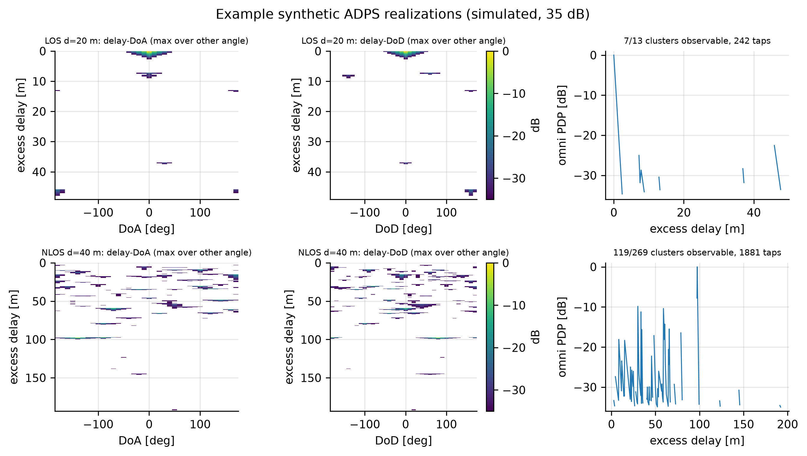
Motivation and problem
Why a dynamic-range-aware cluster model at 145 GHz?
• Sub-THz D2D links (1.5 m terminals, 1-100 m) need double-directional channel models for beam management and system design
• Cluster models describe the channel by a few parametric clusters (delay, DoA, DoD, power, spreads)
• Measured clusters are only seen above a 35 dB dynamic-range cut-off: weak clusters vanish and spreads shrink
• Key idea of the paper: model what is observable, then invert the truncation when generating channels
• Our task: re-implement the whole chain from the paper, verify each step numerically, and validate what can be validated without the measurement data
Our generator output (simulated): LoS 20 m and NLoS 40 m
Reproduction of Cheng et al., IEEE TWC 2026 - 145 GHz D2D cluster model
3

Slide 4
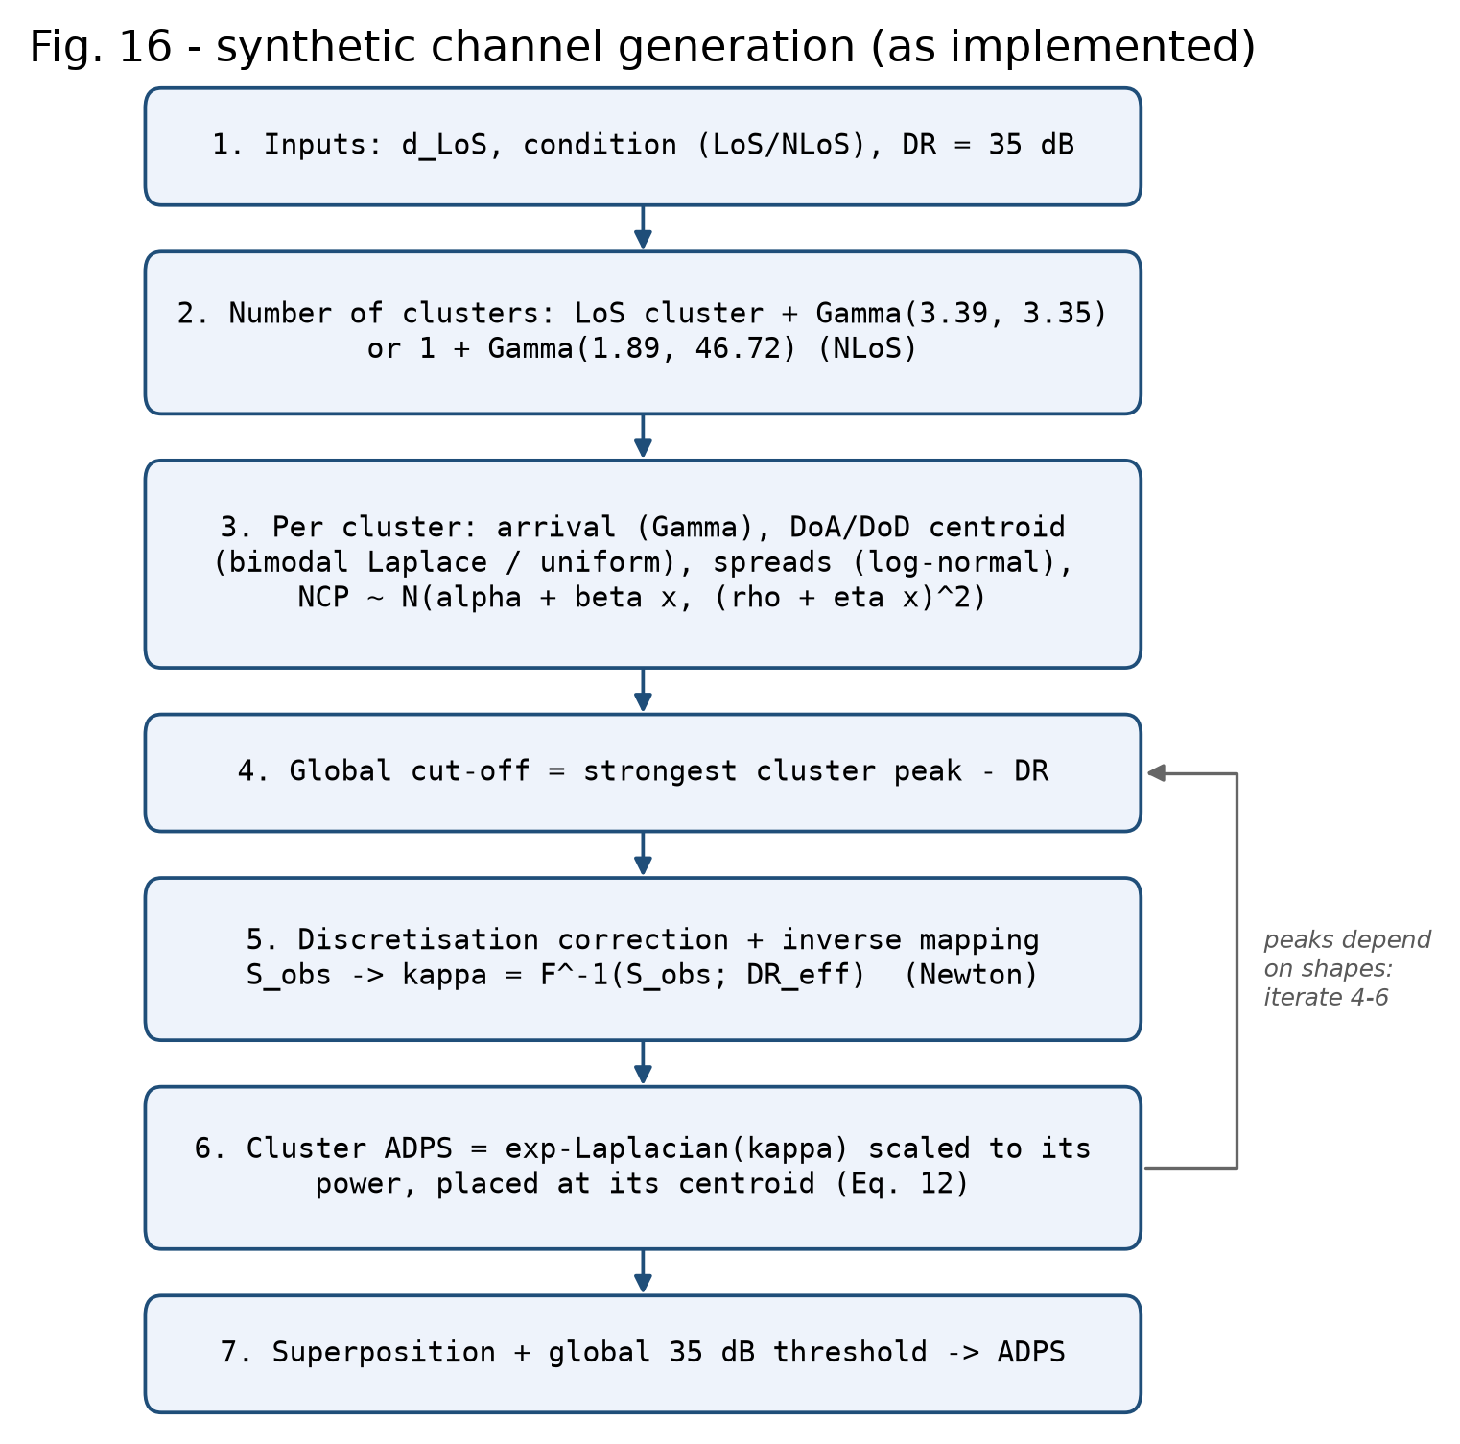
The paper in one slide
Cheng, Abbasi, Gomez-Ponce, Zhang, Molisch - IEEE TWC 25 (2026)
• Measurements: 145-146 GHz VNA sounder, 1001 tones (1 ns bins), 13 deg horns rotated in 10 deg steps, 21 LoS + 17 NLoS links
• ADPS (Eq. 1) -> MPC taps within 35 dB -> multi-level KPD clustering
• Table I: Gamma cluster numbers / arrivals, bimodal-Laplace centroids, log-normal spreads, distance-ratio NCP model
• Truncation-aware MLE for the cluster power (Eqs. 10-11)
• Generator: exponential-Laplacian cluster ADPS whose decay constants are found by inverting the DR-truncated spreads
• Validation: CvM distances of channel spreads (Fig. 17), path-loss parameters (Table II)
Reproduction of Cheng et al., IEEE TWC 2026 - 145 GHz D2D cluster model
4

Slide 5
What could be reproduced - data availability
Item | Status | Consequence
Raw measurements / ADPSs / cluster lists | not published | measured fits cannot be re-run
Authors' MATLAB toolkit [60] | behind a Google Form - not requested (personal data) | no code-level comparison
Table I, Table II, CvM values | used as published | basis of all simulations
Figs. 2, 6, 10, 11, 17 (CDF curves) | digitised from vector graphics | labelled 'measured (digitized)' / 'paper synthetic (digitized)'
Link distances | from [21] Table II | validation channels at measured distances
Paper PDF | used locally, not redistributed | copyright respected
Integrity rule followed throughout: no invented measurement data, no published numbers copied in as our results. Every curve is labelled as measured (digitized), paper synthetic (digitized), Table I model, or ours (simulated).
Reproduction of Cheng et al., IEEE TWC 2026 - 145 GHz D2D cluster model
5

Slide 6
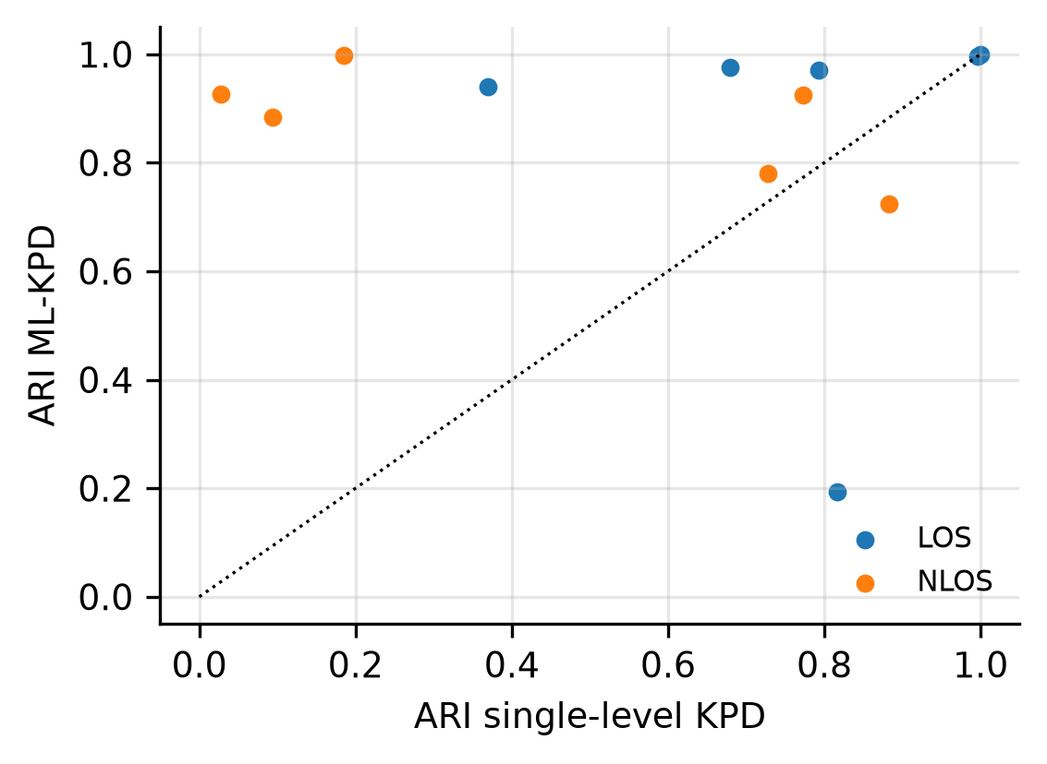
Measurement-side pipeline: ADPS, taps and ML-KPD
Implemented and tested on synthetic sounder data and generator output
• ADPS = |IFFT(H)|^2 / N_f per orientation pair, 5x delay oversampling (max per bin) against scalloping
• MPC taps: all samples within 35 dB of the global maximum
• KPD: kNN density weighted by exp(normalised power), relative density, key points, merge by connectivity threshold
• ML-KPD: split clusters whose delay/DoA/DoD projection is multimodal (5/3/3-bin smoothing, dip ratio 0.8); K' = sqrt(M_c/2), threshold searched from 1 in 0.01 steps
• Not K-means / DBSCAN - the paper's algorithm is kept
Experiment 5 - clustering generated ADPSs (exact labels)
condition | true clusters | KPD | ML-KPD | ARI KPD | ARI ML-KPD
LOS | 9.5 | 3.3 | 10.0 | 0.776 | 0.846
NLOS | 29.7 | 7.7 | 27.8 | 0.448 | 0.873
Reproduction of Cheng et al., IEEE TWC 2026 - 145 GHz D2D cluster model
6

Slide 7
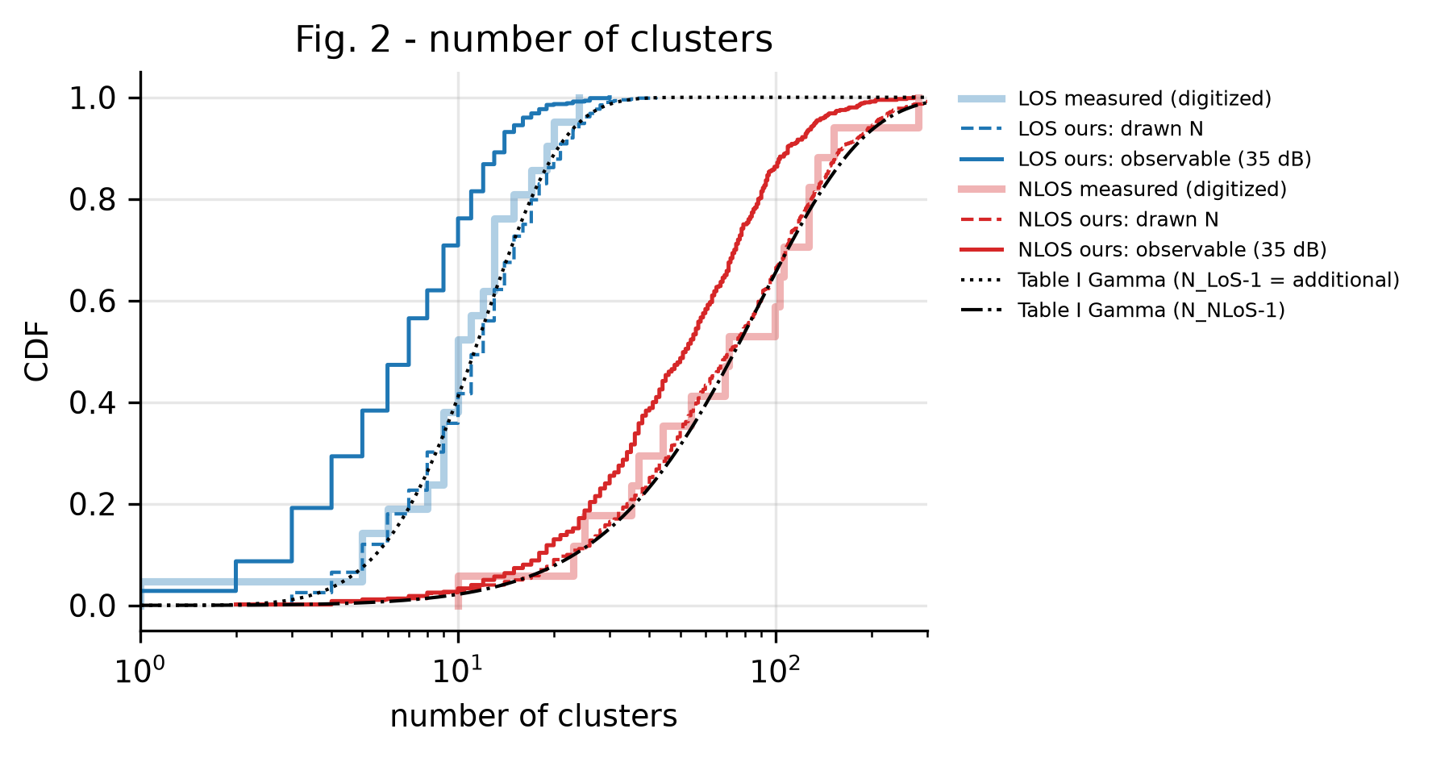
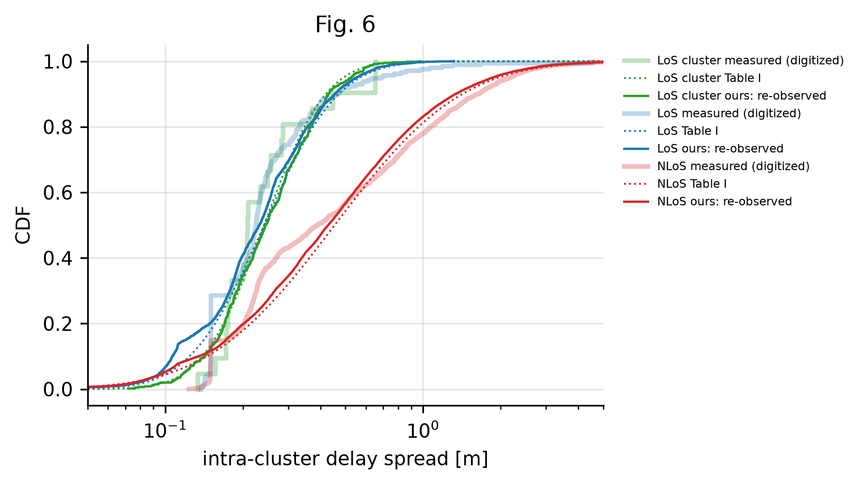
Statistical cluster model (Table I) and our samples
Simulated from the published parameters vs digitised measured CDFs
Drawn cluster numbers follow the measured CDF (as Table I intends), but only part of them survives the 35 dB cut-off (solid lines). Re-observed intra-cluster spreads match Table I - the inverse mapping works per cluster.
Reproduction of Cheng et al., IEEE TWC 2026 - 145 GHz D2D cluster model
7

Slide 8
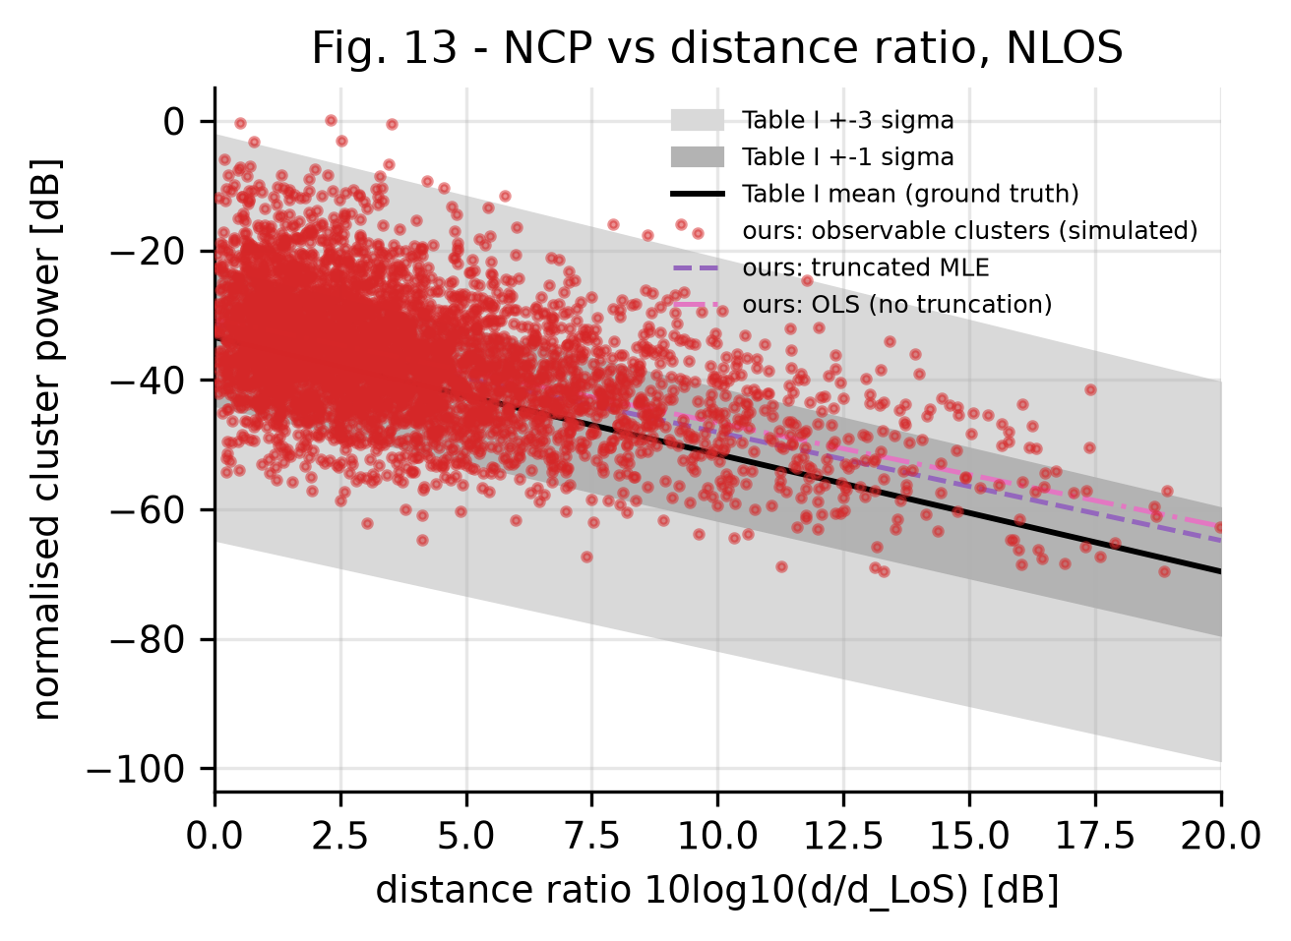
Cluster power: truncation-aware MLE (Eqs. 10-11)
Experiment 4 - ground truth known (Table I), estimator tested on observable simulated clusters
case | truth beta | MLE beta | OLS beta | truth alpha | MLE alpha | OLS alpha | N obs.
LOS | -1.19 | -0.5 | -0.54 | -20.69 | -18.26 | -17.65 | 2612
NLOS | -1.81 | -1.67 | -1.6 | -33.41 | -31.36 | -30.62 | 23769
• Eq. 10 distance-equalisation weights, 20 bins; LLF with ln Phi truncation term; analytic gradient
• Alternating (alpha,beta)/(rho,eta) ascent, learning rate 1e-3, multi-start; L-BFGS only as a check
• NLoS: MLE slope -1.67 vs OLS -1.60 (truth -1.81) - truncation correction helps, as in the paper
• LoS: MLE -0.50, OLS -0.54 vs truth -1.19 - both biased: in the generator visibility depends on cluster shape, not a sharp NCP threshold
• NLoS coverage +-1 sigma: 72.3 % (paper, measured: 67.79 %)
Reproduction of Cheng et al., IEEE TWC 2026 - 145 GHz D2D cluster model
8

Slide 9
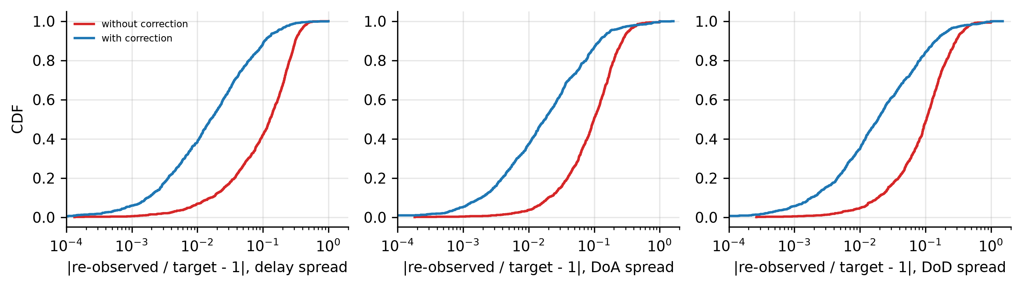
Dynamic range truncation of a cluster
Exponential-Laplacian cluster, cut-off L = DR_eff ln10 / 10
• Cluster ADPS ~ exp(-tau/k_tau - |phiR|/k_R - |phiT|/k_T); observed only where the exponent <= L
• Moments written as nested integrals: inner two in closed form (incomplete gamma), outer by piecewise Gauss-Legendre
• Angular spreads independent of k_tau; S_tau = k_tau * g(L, k_R, k_T) -> 3-D inversion reduces to 2-D Newton + closed form
• Complex-step Jacobian (exact to machine precision) + backtracking + bisection start
• Verified against brute-force integration (< 1 %) and DR -> infinity limits
• Four regimes: an angle saturates when L >= pi/k (14.48, 21.71, 36.19 dB for Fig. 14/15)
Experiment 3: 2000 random (kappa, DR) cases, 100.0 % converged, max relative kappa error 8.7e-10, 3.77 ms per cluster.
Reproduction of Cheng et al., IEEE TWC 2026 - 145 GHz D2D cluster model
9

Slide 10
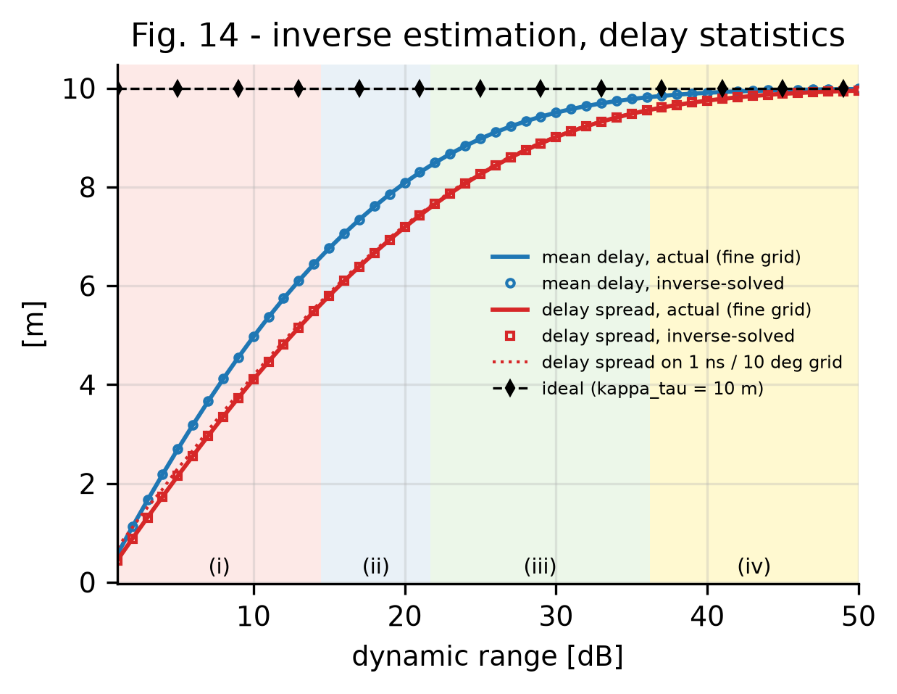
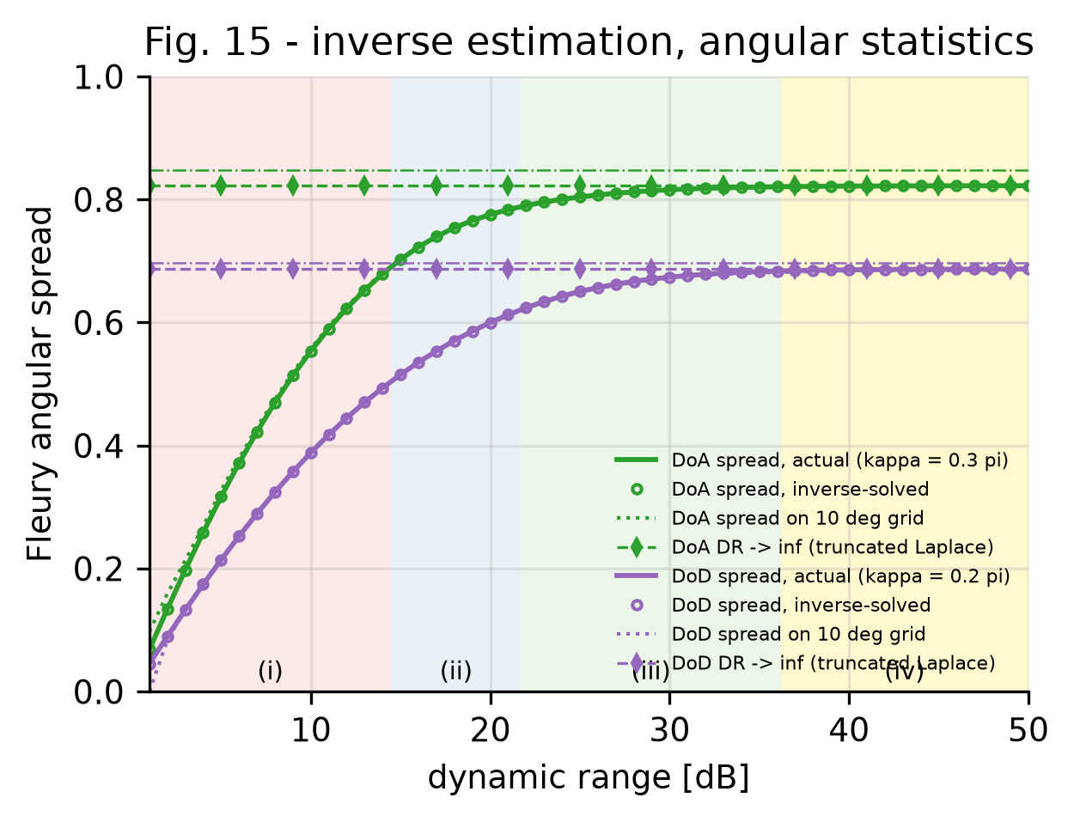
Figs. 14-15 reproduced: inverse estimation vs dynamic range
kappa_tau = 10 m, kappa_DoD = 0.2 pi, kappa_DoA = 0.3 pi, DR = 1...50 dB
Independent numerical reproduction: inverse-solved spreads coincide with the actual ones in all four regimes; dotted lines = same cluster on the 1 ns / 10 deg grid (discretisation error that step 5 corrects).
Reproduction of Cheng et al., IEEE TWC 2026 - 145 GHz D2D cluster model
10

Slide 11
Generator: correction, inverse mapping and the cut-off fixed point
• Drawn cluster power is an observable power (sum of surviving taps) -> peak depends on shape, shape on DR_eff, DR_eff on all peaks
• We solve this explicitly: iterate cut-off <-> shapes, damped cut-off update; converges in 2-3 sweeps
• Discretisation correction table Delta(DR, kappa) = grid - continuum spreads (22 x 26 x 24 x 24, built once, ~2 min)
• Bounded correction (|Delta| <= 50 % of target): an unbounded correction ran away for weak, narrow clusters (kappa_tau of thousands of metres) - found and fixed during this work
• Each cluster contributes only its own above-cut-off taps, exactly the truncated shape the inversion assumed
Exp. 6 - re-observed vs drawn spreads (median)
cond. | correction | |err| delay | |err| DoA | |err| DoD
LOS | on | 0.037 | 0.048 | 0.045
LOS | off | 0.215 | 0.099 | 0.098
NLOS | on | 0.017 | 0.025 | 0.025
NLOS | off | 0.182 | 0.084 | 0.086
Exp. 1 - cost per realization (1 process): LoS 0.72 s, NLoS 2.19 s on the full 1001 x 36 x 36 grid.
Reproduction of Cheng et al., IEEE TWC 2026 - 145 GHz D2D cluster model
11

Slide 12
Implementation and verification
Module | Content
distributions / parameters | Table I laws, Fleury spread, YAML config with paper alternatives
adps / mpc_extraction | Eq. 1 with oversampling, 35 dB taps, test sounder
kpd_clustering | KPD and ML-KPD (Algorithm 1)
power_model | Eqs. 6-11, weights, MLE, OLS
dynamic_range | continuous + exact discrete truncation, regimes
inverse_mapping | 2-D Newton inverse, correction table
channel_generator / metrics | 7-step generator, omni/max-dir metrics
path_loss / validation | alpha-beta / CI fits with CIs, CvM, bootstrap null
• pytest: 55 tests passed, 0 failed
• brute-force checks of the truncation integrals; FD check of the LLF gradient; MLE recovers known parameters
• integration test: full generator, 35 dB cut-off, determinism, no runaway decay constants
• every realization has its own SeedSequence stream -> identical results for any worker count
• profiles smoke / standard / full
Reproduction of Cheng et al., IEEE TWC 2026 - 145 GHz D2D cluster model
12

Slide 13
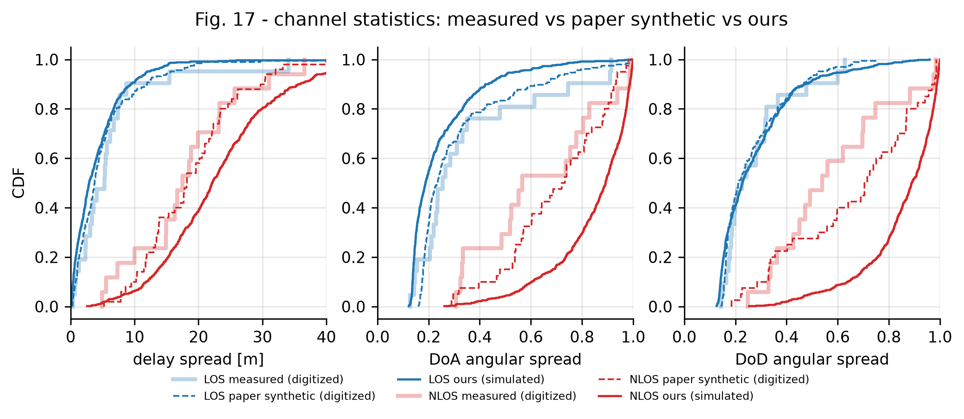
Validation 1: channel spreads (Fig. 17)
Ours (simulated at the measured link distances) vs measured and paper-synthetic CDFs (digitized)
600 realizations per condition (profile 'standard'). LoS agrees closely with the measured CDFs; NLoS channels come out more dispersive than measured and than the authors' own generator.
Reproduction of Cheng et al., IEEE TWC 2026 - 145 GHz D2D cluster model
13

Slide 14
Validation 1: Cramer-von Mises distances
metric | cond. | paper (published) | paper (recomputed, digitized) | ours vs measured | sampling null 95 % | median ours | median measured
delay | LOS | 0.004 | 0.0057 | 0.0155 | 0.023 | 2.896 | 5.281
doa | LOS | 0.007 | 0.0089 | 0.0347 | 0.0228 | 0.188 | 0.254
dod | LOS | 0.003 | 0.0043 | 0.0053 | 0.0217 | 0.227 | 0.226
delay | NLOS | 0.007 | 0.0046 | 0.031 | 0.0252 | 22.126 | 17.468
doa | NLOS | 0.02 | 0.0153 | 0.0897 | 0.029 | 0.892 | 0.566
dod | NLOS | 0.029 | 0.0228 | 0.1374 | 0.0275 | 0.889 | 0.539
• omega^2 = mean of (F_a - F_b)^2 over the pooled sample; recomputing the paper's values from digitised curves gives the same magnitude
• Sampling null: omega^2 of two samples of the same law with the same sizes (21/17 measured) - the floor explainable by finite data
• 2 of 6 statistics within the sampling null; consistent: delay LOS, dod LOS
Reproduction of Cheng et al., IEEE TWC 2026 - 145 GHz D2D cluster model
14

Slide 15
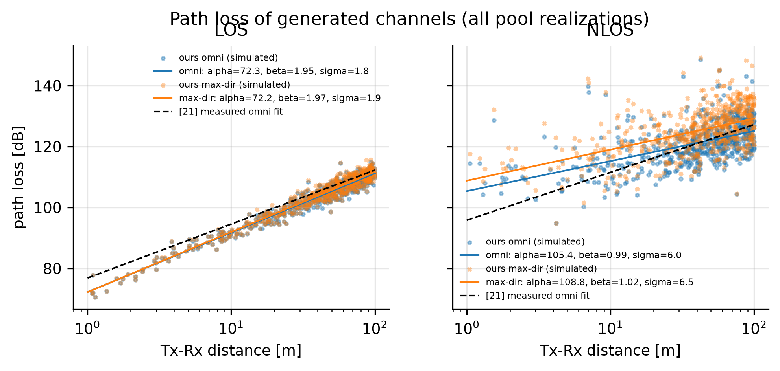
Validation 2: path loss (Table II)
50 channels, d ~ U(1, 100) m, repeated draws from the generated pool
case | param | [21] measured | paper synthetic | ours median | ours 95 % range | CI overlap
los_omni | alpha | 76.86 | 76.37 | 72.19 | [70.54, 74.60] | 80 %
los_omni | beta | 1.77 | 1.8 | 1.96 | [1.82, 2.06] | 100 %
los_omni | sigma_ab | 1.28 | 1.98 | 1.76 | [1.39, 2.11] | 98 %
los_omni | n_cim | 1.83 | 1.86 | 1.75 | [1.72, 1.78] | 0 %
los_maxdir | alpha | 76.68 | 76.34 | 72.19 | [70.41, 74.43] | 88 %
los_maxdir | beta | 1.84 | 1.82 | 1.97 | [1.84, 2.10] | 99 %
los_maxdir | sigma_ab | 1.63 | 2.02 | 1.82 | [1.51, 2.21] | 100 %
los_maxdir | n_cim | 1.9 | 1.88 | 1.77 | [1.73, 1.80] | 0 %
nlos_omni | alpha | 95.84 | 96.22 | 105.1 | [97.18, 112.80] | 100 %
nlos_omni | beta | 1.57 | 1.56 | 1.03 | [0.57, 1.48] | 99 %
nlos_omni | sigma_ab | 5.07 | 6.98 | 5.73 | [4.54, 7.65] | 94 %
nlos_omni | n_cim | 2.86 | 2.92 | 2.75 | [2.66, 2.86] | 98 %
nlos_maxdir | alpha | 99.69 | 99.62 | 107.8 | [98.58, 117.50] | 100 %
nlos_maxdir | beta | 1.54 | 1.61 | 1.07 | [0.53, 1.61] | 99 %
nlos_maxdir | sigma_ab | 7.03 | 8.04 | 6.4 | [5.12, 7.86] | 92 %
nlos_maxdir | n_cim | 3.05 | 3.18 | 2.99 | [2.87, 3.11] | 98 %
CI overlap = share of our 50-channel repeats whose 95 % CI overlaps the published one.
Reproduction of Cheng et al., IEEE TWC 2026 - 145 GHz D2D cluster model
15

Slide 16
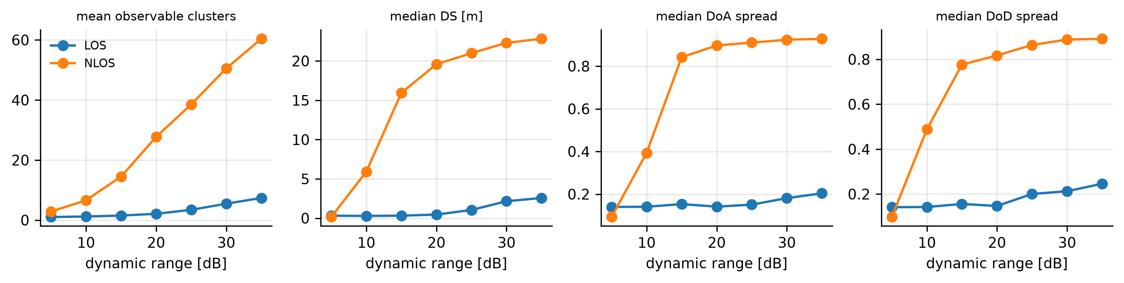
Sensitivity: dynamic range and ambiguous parameters
Experiments 2 and 7
cond. | variant | median DS [m] | median ASA | median ASD | cvm_delay | cvm_doa | cvm_dod
LOS | table_I | 2.78 | 0.2021 | 0.2317 | 0.0135 | 0.0285 | 0.0068
LOS | text_arrival | 2.9327 | 0.2023 | 0.2304 | 0.0119 | 0.0298 | 0.0057
LOS | wrapped_laplace | 2.8749 | 0.2159 | 0.228 | 0.0201 | 0.0195 | 0.0051
NLOS | table_I | 20.9243 | 0.8768 | 0.8722 | 0.0191 | 0.0831 | 0.13
NLOS | text_arrival | 20.9425 | 0.8899 | 0.8753 | 0.0209 | 0.0809 | 0.1296
Reproduction of Cheng et al., IEEE TWC 2026 - 145 GHz D2D cluster model
16

Slide 17
Inconsistencies found in the paper
Documented in docs/PAPER_ANALYSIS.md; each choice is configurable
Item | Paper | Our choice
Eq. (4) angular spread | typeset without sqrt | Fleury sqrt (max 1, matches Fig. 15 and [21])
Eq. (1) | |.|^2 inside the sum | |sum|^2
Eq. (10) | 1 % in equation, 2 % in text | 1 % (2 % configurable)
Arrival-time Gamma | Table I vs text values differ | Table I (text in exp. 7)
Figs. 14/15 | text: DoD 0.2 pi / DoA 0.3 pi, legend reversed | text
Fig. 2 NLoS fit | plotted fit matches Gamma on N, stated on N-1 | as stated (N-1)
Cluster count vs truncation | counts of observed clusters, then power truncation removes more | as described; effect quantified
Reproduction of Cheng et al., IEEE TWC 2026 - 145 GHz D2D cluster model
17

Slide 18
Reproduction status
Result | Classification
Table I distributions, Figs. 2-11 model curves | Statistical reproduction using published parameters
Cluster ADPS (Eqs. 12-13), truncation map, Figs. 14-15 | Independent numerical reproduction
Inverse mapping + discretisation correction | Independent numerical reproduction (correction design ours)
Truncated MLE (Figs. 12-13 method) | Independent numerical reproduction (on simulated data)
ML-KPD clustering | Approximate reproduction (unspecified details)
Fig. 17 / CvM | Statistical reproduction: LoS consistent, NLoS deviates
Table II path loss | Statistical reproduction using published parameters
Measured fits (Table I extraction), Fig. 1 | Not reproducible - measurement data unavailable
Reproduction of Cheng et al., IEEE TWC 2026 - 145 GHz D2D cluster model
18

Slide 19
Limitations and future work
• No measured data: Table I cannot be re-extracted and Figs. 3-5, 7-9, 12-13 cannot be compared with measured scatter/histograms
• Digitised curves carry small reading errors (<= 0.015 in CDF for most curves)
• Several algorithmic details are unspecified (KPD features and level-1 threshold, oversampling factor, correction-table design, NCP threshold, peak/cut-off coupling) - our choices are documented
• NLoS channels are more dispersive than measured: with ~90 clusters, uniform centroids and ~10 dB NCP spread, many off-boresight clusters stay observable
• Synthetic-sounder test data with un-windowed IFFT sidelobes make (ML-)KPD over-segment strong clusters
• Future work: compare against the authors' toolkit once obtained through the official form; validate on new measurements
Reproduction of Cheng et al., IEEE TWC 2026 - 145 GHz D2D cluster model
19

Slide 20
References
• Y. Cheng, N. A. Abbasi, J. Gomez-Ponce, Z. Zhang, A. F. Molisch, "Stochastic Cluster-Based Channel Modeling for Sub-Terahertz Outdoor Device-to-Device Radio Propagation at 145 GHz", IEEE TWC, vol. 25, pp. 20883-20899, 2026, doi: 10.1109/TWC.2026.3714332.
• N. A. Abbasi et al., "THz band channel measurements and statistical modeling for urban D2D environments," arXiv:2109.13693 ([21]).
• R. He et al., "A kernel-power-density-based algorithm for channel multipath components clustering," IEEE TWC, 2017 (KPD).
• B. H. Fleury, "First- and second-order characterization of direction dispersion and space selectivity in the radio channel," IEEE Trans. IT, 2000.
• T. W. Anderson, "On the distribution of the two-sample Cramer-von Mises criterion," Ann. Math. Statist., 1962.
• USC WiDeS, Channel Generation Toolkit for sub-THz Outdoor D2D Links at 145 GHz, wides.usc.edu/research_matlab.html ([60]).
Reproduction of Cheng et al., IEEE TWC 2026 - 145 GHz D2D cluster model
20

