Slide 1

Phishing Website Prediction Model
Submitted to:
Ms. Madhuri Sharma
Submitted by:
Sparsh Garg [RA2211003030192]
Arpit Singhal [RA2211003030197]

Slide 2
ABSTRACT
This project explores the application of machine learning to classify website URLs as either legitimate ('good') or malicious ('bad'). By leveraging natural language processing (NLP) techniques and supervised learning algorithms, the model achieves high accuracy in phishing detection. The saved pipeline enables easy deployment for real-time predictions

Slide 3

INTRODUCTION
- Background on phishing attacks and their threats.
- Emphasis on the need for automated and accurate detection systems.
- Objectives of the project: Detect phishing websites based on URL patterns.

Slide 4
Motivation
Highlight the increasing number of phishing attacks globally.
Stress the challenges in manual detection due to sophisticated phishing techniques.
Motivated by the goal of protecting users from phishing threats and minimizing cyber fraud.

Slide 5

EXISTING PROBLEM
Dependence on blacklists.
Delayed recognition of new phishing sites.
High false-positive rates in traditional detection methods.

Slide 6

PROPOSED SOLUTION
A machine learning-based approach to classify URLs:
Automated preprocessing (tokenization, stemming, feature extraction).
Supervised learning using Logistic Regression and Multinomial Naive Bayes.
Modular pipeline for scalability and real-time predictions.
Visualization of results for better interpretability (word clouds, charts, etc.).

Slide 7





TECHNOLOGIES USED
Programming: Python
Libraries:
- pandas, numpy for data manipulation and analysis.
- NLTK for tokenization and stemming.
- scikit-learn for feature extraction and model training.
- matplotlib, seaborn, WordCloud for visualization.
- pickle for saving and loading models.
Tools: Jupyter Notebook, or any IDE.

Slide 8
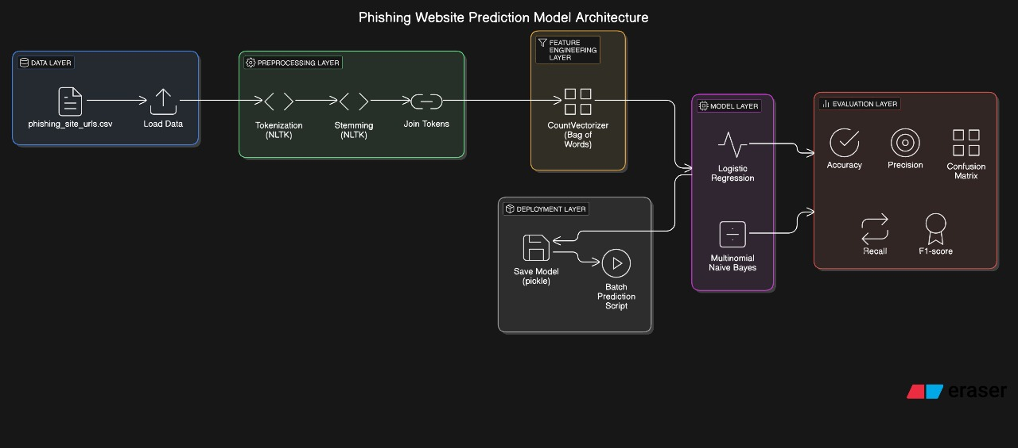
ARCHITECTURAL DESIGN

Slide 9
WORKING
1. Data Preprocessing:
- Steps: Tokenization, Stemming, Joining Tokens.
- Tools: RegexpTokenizer, SnowballStemmer.
2. Model Development:
- Algorithms used (Logistic Regression, Multinomial Naive Bayes).
- Pipeline creation using make_pipeline.

Slide 10
WORKING
3. Training and Optimization:
- Splitting dataset into training and testing sets.
- Measuring accuracy, precision, recall, and F1-score.
4. Deployment:
- Saving and loading model with pickle.

Slide 11
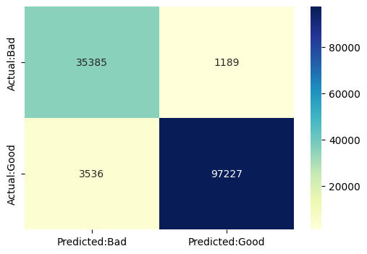
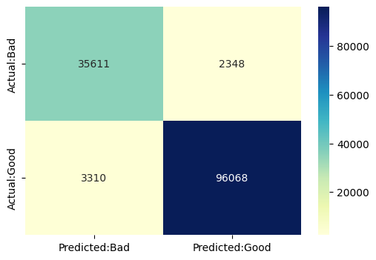
RESULTS
- Accuracy: 96.4% (Logistic Regression), 95.8% (Multinomial Naive Bayes).
- Confusion Matrix visualization.

Slide 12
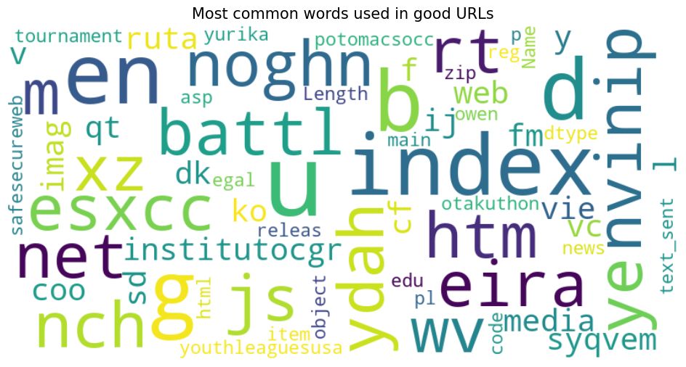
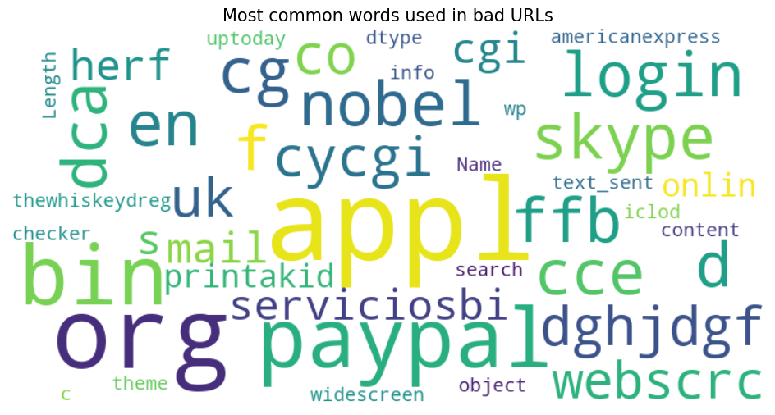
RESULTS
- Include word clouds for "good" and "bad" URLs

Slide 13
CONCLUSION
1. Summary:
- This project demonstrated a machine learning approach for phishing website detection using URL analysis.
2. Limitations:
- Reliance on labeled data.
- Performance might drop with unseen URL formats.
3. Future Work:
- Expand dataset for more diverse URLs.
- Explore deep learning methods for improved performance.
- Develop a real-time monitoring system.

Slide 14
REFERENCES
Kaggle: Eswarchand’s phishing-website-detector Notebook.
NLTK documentation.
Pandas Documentation.
Numpy Documentation.
Python Documentation.
Various research papers and articles available on google.

Slide 15
THANK YOU

