Slide 1

React-CHAT-APP By : Arpit Gupta 2016666 Mentor: Ms. Tanusha Mittal

Slide 2
CANDIDATE’S DECLARATION
I hereby certify that the work which is being presented in the project report entitled “Chat App” in partial fulfillment of the requirements for the award of the Degree of Bachelor of Technology in Computer Science and Engineering of the Graphic Era , Dehradun shall be carried out by the under the mentorship of Ms Tanusha Mittal, Department of Computer Science and Engineering, Graphic Era , Dehradun

Slide 3
Introduction
Email, newsgroup and messaging applications provide means for communication among people but these are one-way mechanisms and they do not provide an easy way to carry on a real-time conversation
This project is to create a react chat application to allow the users to chat with each other with just an easy way
To develop an instant messaging solution to enable users to seamlessly communicate with each other

Slide 4
Motivation
The motivation behind choosing this project was my keen interest to learn React Js and learn about Firebase version 9 and explore in the field of web development
React Js is an open source front end javascript library for building user interfaces and to build single web page applications
Google Firebase is a development software that allows the user to develop IOS,Androids and WebApps

Slide 5
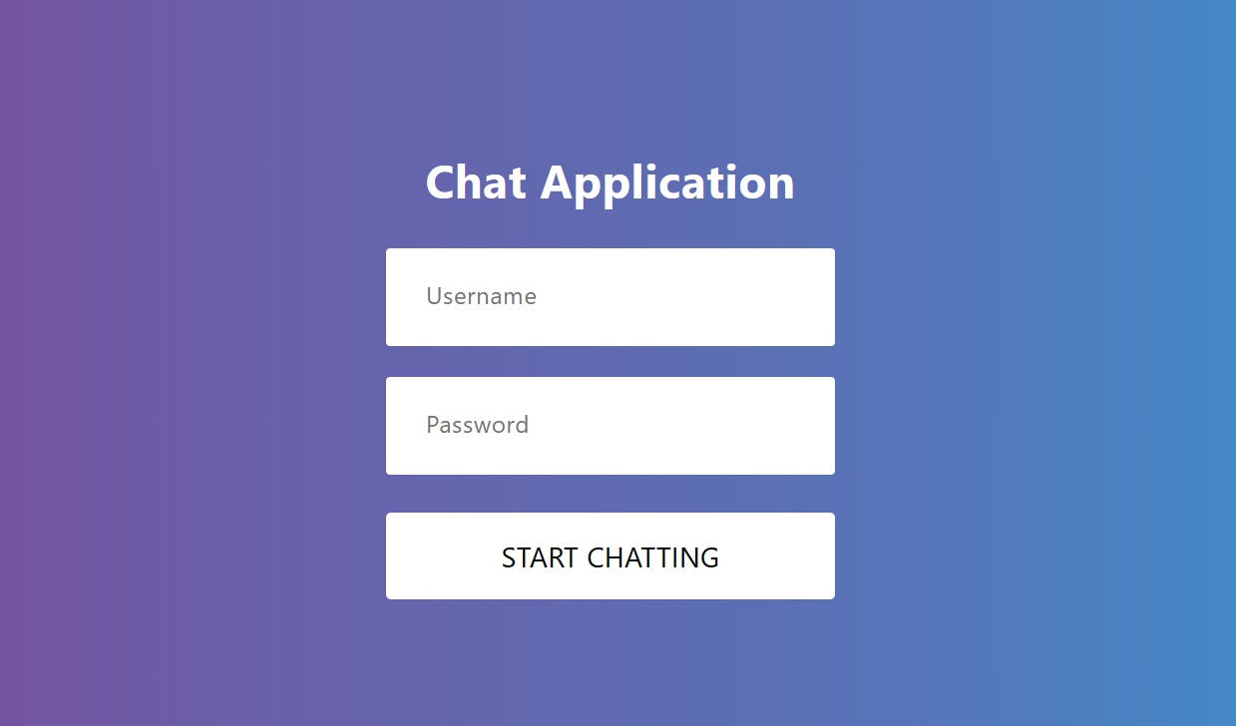
Methodology
Step 1 : User will land on the Signup page

Slide 6
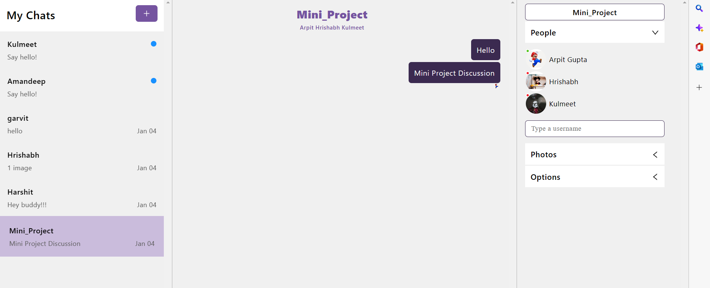
Step-2 User will start the direct or group chat.

Slide 7
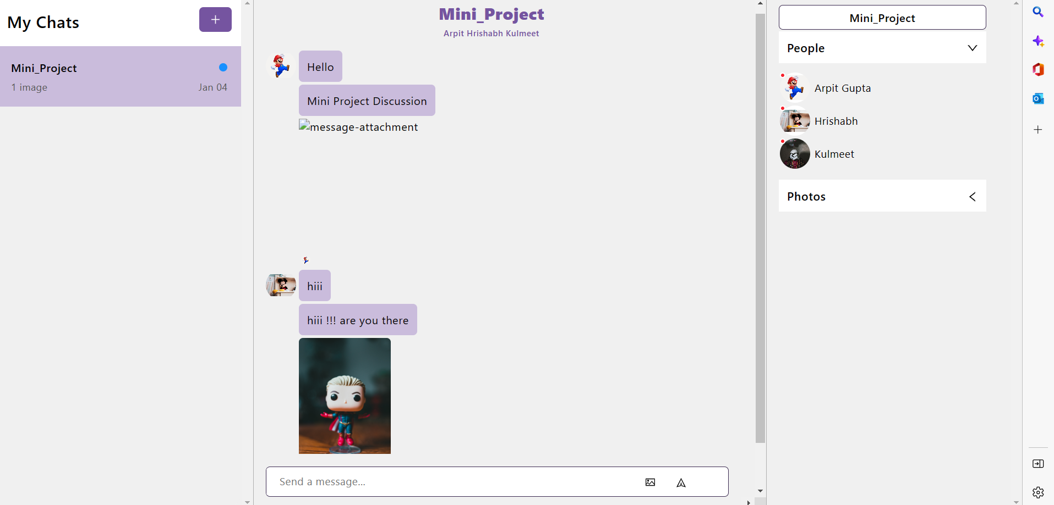
Step-3 User can type and send the messages

Slide 8
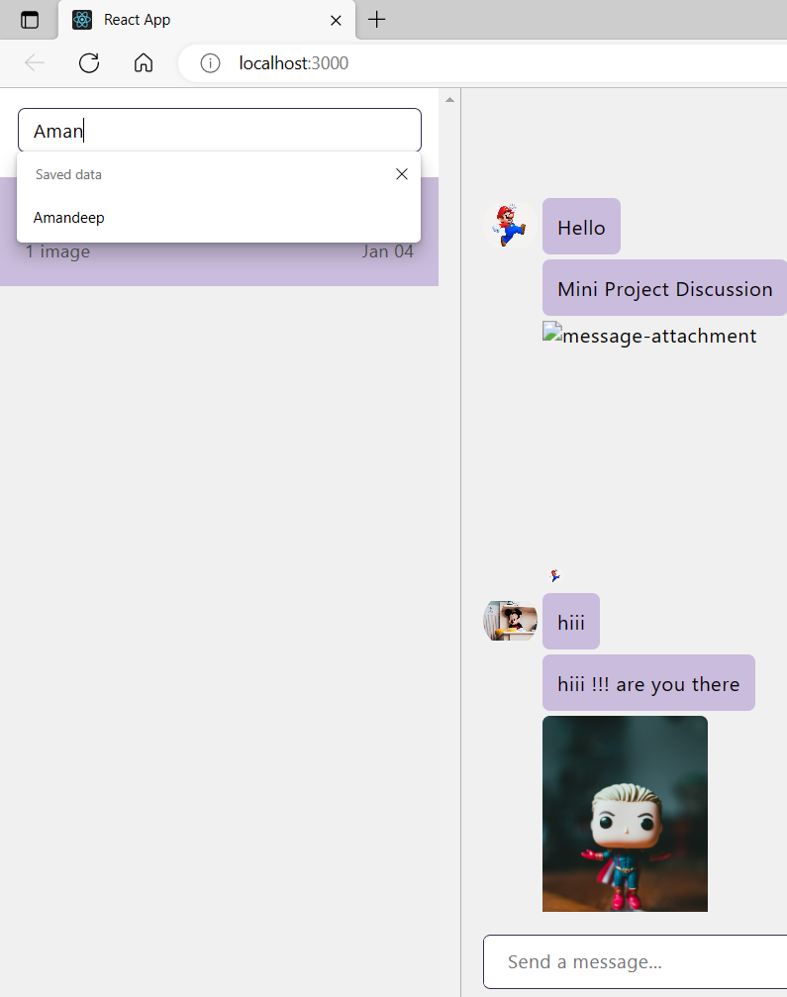
Step-4 User can upload and send images in group chat.

Slide 9
Result and Discussion
Chat refers to the process of communicating, interacting and/or exchanging messages over the Internet.
Chat is also known as chatting, online chat or Internet chat.
Chat application is a text box where you type messages where all the previous messages in the conversation are shown.
If user sends anything without typing any message it also displays an alert indicating user to type something.

Slide 10
Conclusion and Future Work
This chat-application provides real-time chatting features to users
But still, there's a lot of scope for improvement here
There could have been the chat room feature where multiple users can chat with each other
There could have been the feature to send audio,video or any document file.
There could have been the feature to authenticate the user with username and password.

