Slide 1
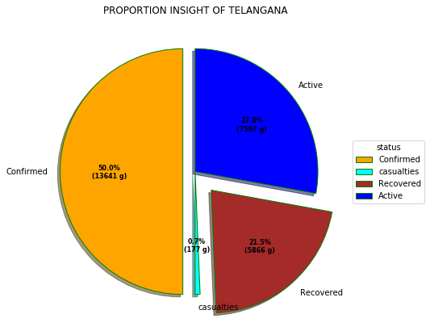
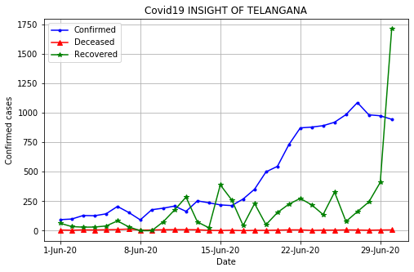
ANALYSIS OF TELANGANA
This insight help to make pro active plans about the no of beds needed and the current occupancy rate .
Also, provide the insight to determine whether there should be given some relaxtion in Lockdown or not

Slide 2
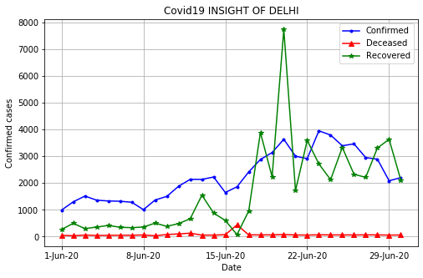
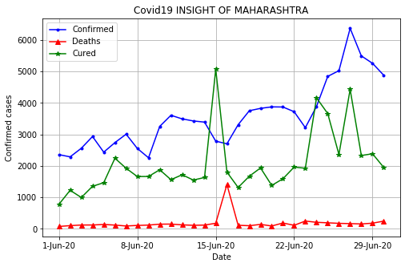
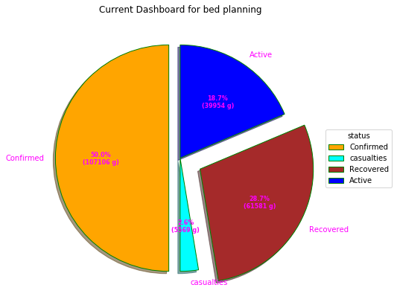
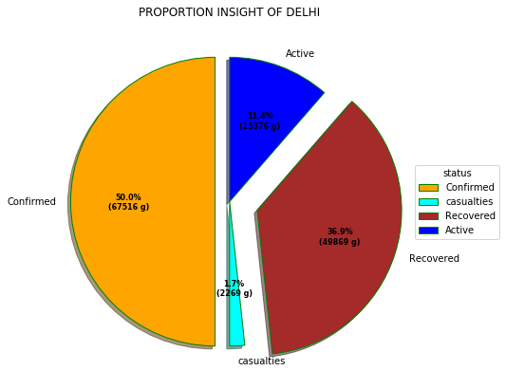
Major cities with an Adverse effect of Covid-19

Slide 3
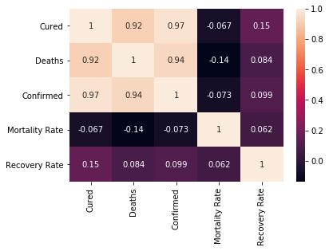
Heat Map: Explaining correlation

Slide 4
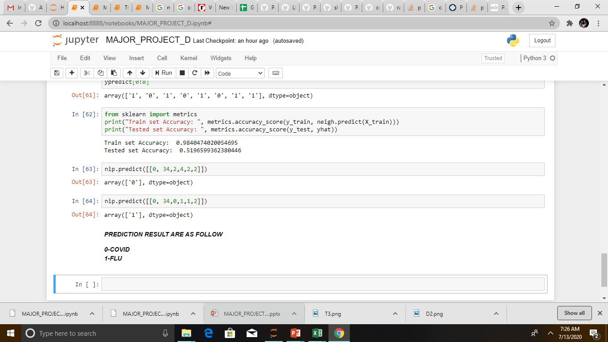
Classifier: A Differentiator Covid VS Flu

