Slide 1
Evaluating the Consistency of Machine Learning and Deep Learning Models for Banking Stock Prediction Under Feature-Engineered Conditions: A Multi-Bank Study in Bangladesh
B.Sc. Final-Defense
Name: Arifur Rahman
ID : 222-15-6168
Department : CSE
Daffodil International University

Slide 2
Outline
Introduction
Objective
Background Study
Gap Analysis
Methodology
Results & Analysis
Novelty of the Work
Sample Dataset
Conclusion
References
B.Sc. Final-Defense

Slide 3
Introduction
Predicting the future is very difficult in the stock market. The Dhaka Stock Exchange is big, and banking stocks are the most traded on the Dhaka Stock Exchange. Predicting the price of banking stocks will reduce risks for investors or policymakers. This work focuses on stock price prediction using time series data (2010–2026) with machine learning and deep learning models to make short and long-term predictions.
B.Sc. Final-Defense

Slide 4
Objective
To evaluate and compare how well machine learning and deep learning models perform at predicting banking stock prices when using carefully engineered features.
To analyze how consistent and reliable these models are across different banking datasets by testing them all under the same fair and unified experimental setup.
To understand how feature engineering affects the performance of simple models versus more complex (deep learning) models in financial time-series forecasting.
B.Sc. Final-Defense

Slide 5
Background Study
Author (s) | Year | Title | Methodology | Key Findings
S. Islam, M. S. Sikder, M. F. Hossain, and P. Chakrabo rty [14] | 2021 | Predicting the daily closing price of selected shares on the Dhaka Stock Exchange using machine learning techniques. | Linear SVR, KNN, Regression. | The research found that the Support Vector Regression (SVR) algorithm outperformed the Knearest neighbor (KNN) regression in predicting stock prices on the Dhaka Stock Exchange.
C. Fjellström [3] | 2022 | Long Short-Term Memory Neural Network for Financial Time Series | LSTM | The LSTM ensemble provided better average daily returns and higher cumulative returns over time when applied to the Stockholm OMX30 index.
G. Velarde, P. Brañez, A. Bueno, R. Heredia, and M. LópezLedezma [6] | 2022 | An Open Source and Reproducible Implementation of LSTM and GRU Networks for Time Series Forecasting | CNN, LSTM, RNN | LSTM and GRU networks can be effectively trained using a single time series to forecast unseen time series.
B.Sc. Final-Defense

Slide 6
Background Study
Author (s) | Year | Title | Methodology | Key Findings
M. N. R. Khan, S. M. R. Reza, O. Al Tanim, M. S. Salsabil, K. M. Hasib, and M. S. Alam [16] | 2022 | A hybrid method based on machine learning to predict the stock prices in Bangladesh | Hybrid Model (Regression, RNN) | They proposed a hybrid model that combines Regression and RNN. Also, use historical data to forecast
T. Muhamm ad et al. [9] | 2022 | Transformerbased deep learning model for stock price prediction: A case study on the Bangladesh stock market. | Transformerbased learning model with time2vec encoding. | The transformer model can effectively predict stock prices in the Dhaka stock exchange.
R. Parvin [15] | 2022 | The relationship between Bangladesh’s financial development, exchange rates, and stock market capitalization: An empirical study using the NARDL model and machine learning | NARDL | Changes in financial development and exchange rates positively impact stock market capitalization in Bangladesh
B.Sc. Final-Defense

Slide 7
Background Study
Author (s) | Year | Title | Methodology | Key Findings
Z. Lin [2] | 2023 | Comparative Study of LSTM and Transformer for A-Share Stock Price Prediction | LSTM, Transformer | LSTM outperforms Transformer in terms of MSE and MAE.
S. Zaheer et al. [1] | 2023 | A multiparameter forecasting for stock time series data using LSTM and a Deep Learning Model | Hybrid deeplearning (CNN, LSTM, RNN) | The model forecasts the close price and the high price for the next day. The proposed model improves forecasting accuracy by up to 2.2%.
H. Widiputr a and E. Juwono [4] | 2023 | Parallel multivariate deep learning models for timeseries prediction: A comparative analysis in Asian stock markets | CNN, LSTM, StackedLST M, CNNLSTM, ConvLSTM. | Showcased the potentialPotential of blockchain to enhance supply chain transparency.
B. Pashshoe v and D. A. Petrusevi ch [5]. | 2023 | Neural network analysis in time series forecasting | LSTM, GRU, RNN, ARIMA. | Neural network models (LSTM, GRU, RNN) outperformed standard models (ARIMA, ETS) in forecasting.
B.Sc. Final-Defense

Slide 8
Background Study
Author (s) | Year | Title | Methodology | Key Findings
M. A. Islam, M. R. Sikder, S. M. Ishtiaq, and A. Sattar [10] | 2023 | Stock market prediction of Bangladesh using multivariate long short-term memory with sentiment identification | LSTM | Incorporating external factors like news sentiment and economic indicators significantly improved accuracy
M. N. R. Khan, O. Al Tanim, M. S. Salsabil, S. M. R. Reza, K. M. Hasib, and M. S. Alam [11] | 2023 | A multi-modal deep learning approach for predicting the Dhaka stock exchange. | LSTM, GRU, Transformer | A reliable and accurate approach for forecasting stock prices in the Dhaka stock exchange using a combination of LSTM, Transformer, and GRU..
M. Z. Islam et al. [13] | 2023 | The impact of big data analytics on stock price prediction in the Bangladesh stock market: A machine learning approach. | Machine learning techniques and sentiment analysis. | The research demonstrated that big data analytics and machine learning techniques significantly enhance the accuracy of stock price predictions in the Bangladesh stock market.
B.Sc. Final-Defense

Slide 9
Background Study
Author (s) | Year | Title | Methodology | Key Findings
T. Shi and K. Shide [7] | 2024 | Comparative Analysis of LSTM, GRU, and Transformer Models for Stock Price Prediction. | LSTM, GRU, Transformer. | The LSTM model achieved a high prediction accuracy rate of 94% in the stock price of Tesla.
M. A. B. Jeet, R. M. Haque, M. A. I. Sayem, A. Arman, and R. M. Rahman [8] | 2024 | Using deep learning models and FinBERT to predict the stock price of top banks in the Dhaka stock exchange. | LSTM, GRU | Built a web application that predicts stock prices for seven banks listed on the Dhaka stock exchange.
M. S. I. Yousuf, S. M. R. H. Nijhum, and M. I. Khan [12] | 2024 | HybStock: A hybrid deep learning-based model to predict the stock market on the Dhaka Stock Exchange. | Hybrid CNNLSTM | The hybrid CNNLSTM model outperforms traditional models like moving average, linear regression, KNN, Auto ARIMA, and LSTM in the Dhaka Stock Exchange.
B.Sc. Final-Defense

Slide 10
Background Study
Author (s) | Year | Title | Methodology | Key Findings
A. I. Kabir, S. Vyas, S. Mitra, M. M. Uddin, and Jakowan [17] | 2024 | Evaluating the machine learning-based momentum stock trading strategies with back-testing: An emerging market perspective | Machine Learning models. | The study developed a machine learningbased trading strategy for the DSEX index and validated it.
Aslam Mahmud [18] | 2025 | Unveiling the Drivers of Stock Prices and Volatility in the Banking Sector of Bangladesh: An Explainable Machine Learning Approach. | OLS, Ridge, LASSO, Elastic Net, SVR, Decision Tree, Bagging, Random Forest, XGBoost. | The study identifies operating turnover per share, earnings per share, price-tobook ratio, book value per share, and exchange rate as the most influential predictors of bank stock prices in Bangladesh.
B.Sc. Final-Defense

Slide 11
Gap Analysis
Features | M. A. B. Jeet, R. M. Haque, M. A. I. Sayem, A. Arman, and R. M. Rahman [8] | T. Muham mad et al. [9] | M. A. Islam, M. R. Sikder, S. M. Ishtiaq, and A. Sattar [10] | M. Z. Islam et al. [13] | S. Islam, M. S. Sikder, M. F. Hossain, and P. Chakrabort y [14] | A. I. Kabir, S. Vyas, S. Mitra, M. M. Uddin, and Jakowan [17] | Proposed Methodol ogy
Banks Stocks Price | YES | NO | NO | YES | NO | NO | YES
Historical Data on Banks | NO | NO | NO | YES | NO | NO | YES
Added new features based on (OHLCV) | NO | NO | NO | YES | NO | NO | YES
Machine learning models training | NO | NO | NO | YES | YES | YES | YES
Deep learning models training | YES | YES | YES | NO | NO | NO | YES
Next day close price prediction | YES | YES | NO | NO | YES | NO | YES
Error Calculation using RMSE, MAE, R² | YES | YES | YES | NO | YES | YES | YES
B.Sc. Final-Defense

Slide 12
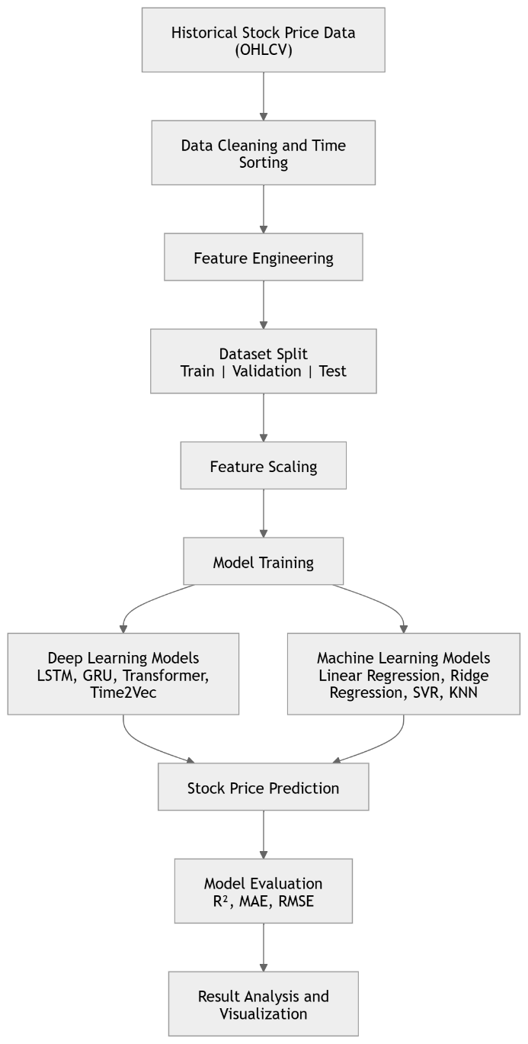
Methodology
This methodology diagram illustrates the complete workflow of the proposed stock price prediction system. The process begins with collecting historical stock market data (OHLCV), followed by data cleaning, time-based sorting, and feature engineering to prepare meaningful input features. The dataset is then divided into training, validation, and testing sets, and feature scaling is applied for improved model performance.
After preprocessing, both Machine Learning models (Linear Regression, Ridge Regression, SVR, and KNN) and Deep Learning models (LSTM, GRU, Transformer, and Time2Vec) are trained to predict future stock prices. Finally, the models are evaluated using performance metrics such as R², MAE, and RMSE, followed by result analysis and visualization to compare prediction accuracy and overall effectiveness.
B.Sc. Final-Defense

Slide 13
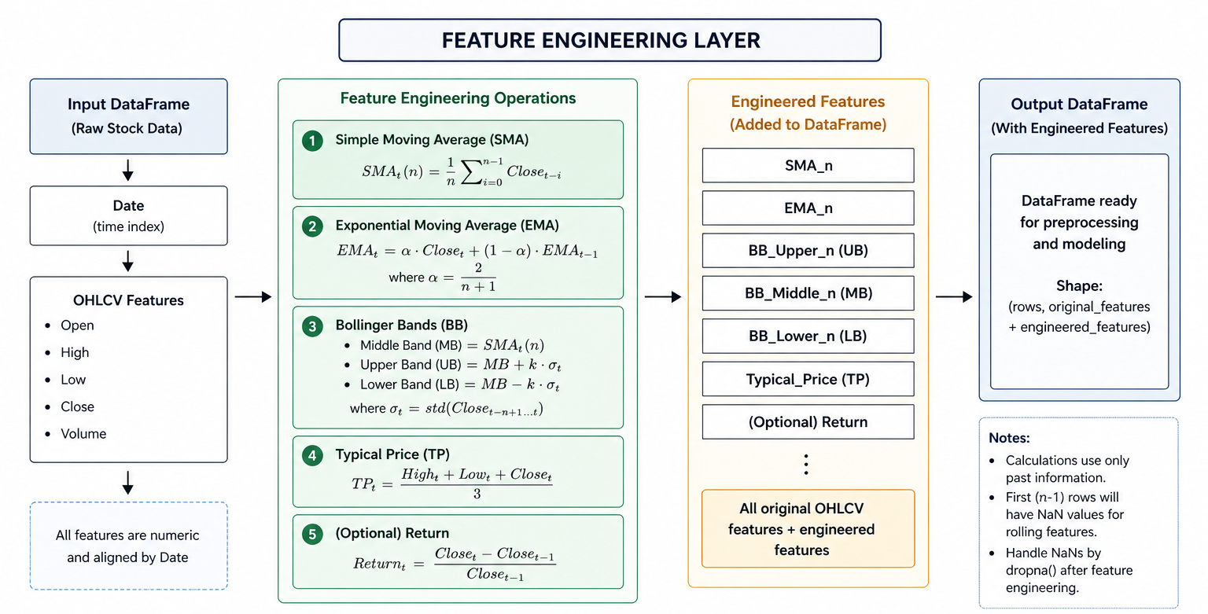
Feature Engineering
B.Sc. Final-Defense

Slide 14
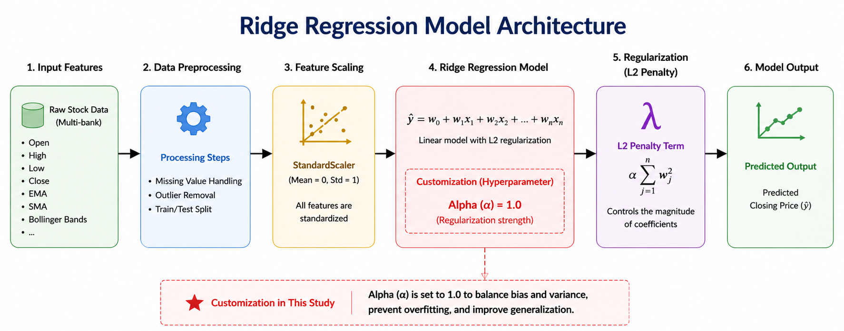
Model Architecture
B.Sc. Final-Defense

Slide 15
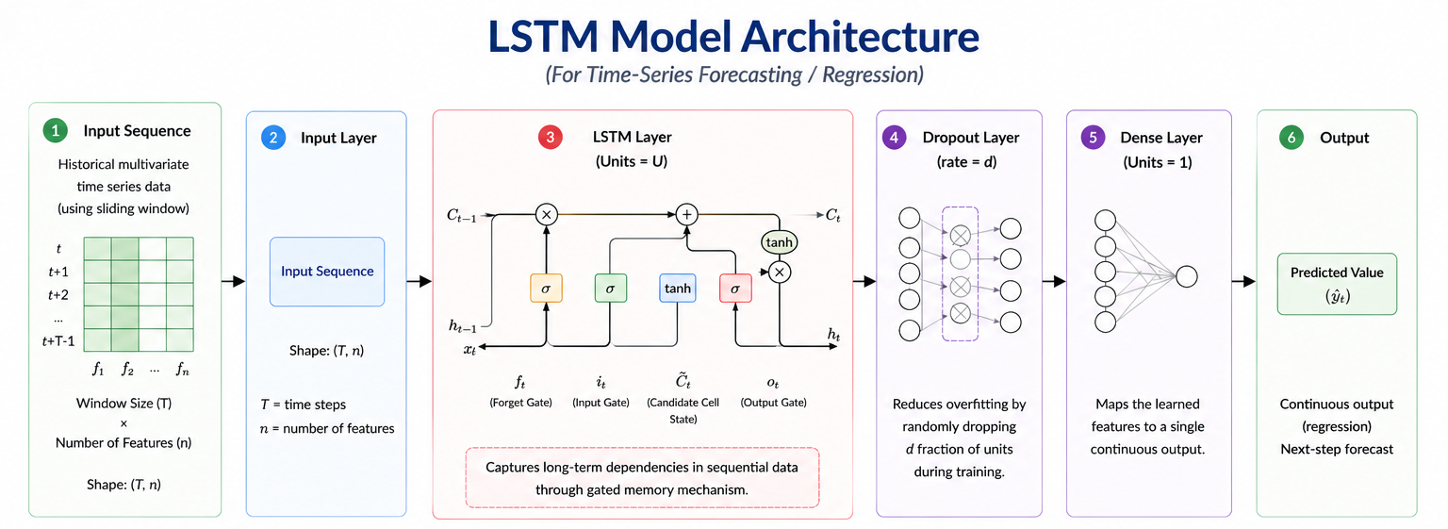
Model Architecture
B.Sc. Final-Defense

Slide 16
Result and Analysis
Model | BRAC BANK | CITY BANK | EASTERN BANK | AVG R²
Linear Regression | 0.9726 | 0.8973 | 0.8809 | 0.9169
SVR | 0.9850 | 0.9412 | 0.5598 | 0.8286
KNN | 0.9609 | 0.9467 | 0.2878 | 0.7318
Ridge | 0.9841 | 0.9698 | 0.9561 | 0.97
LSTM | 0.9420 | 0.9011 | 0.7528 | 0.8653
GRU | 0.9282 | 0.8883 | 0.6603 | 0.8256
Transformer | 0.8955 | 0.7036 | 0.6617 | 0.7536
Table: R² result table
B.Sc. Final-Defense

Slide 17
Result and Analysis
Model | BRAC BANK | CITY BANK | EASTERN BANK | AVG RMSE
Linear Regression | 1.7316 | 0.8714 | 0.5665 | 1.0565
SVR | 1.2822 | 0.6594 | 1.0893 | 1.0103
KNN | 2.0700 | 0.6277 | 1.3855 | 1.3610
Ridge | 1.3202 | 0.4728 | 0.3439 | 0.7123
LSTM | 2.4604 | 0.8897 | 0.8419 | 1.3973
GRU | 2.7375 | 0.9458 | 0.9870 | 1.5567
Transformer | 3.3023 | 1.5403 | 0.9849 | 1.9425
Table: RMSE result table
B.Sc. Final-Defense

Slide 18
Result and Analysis
Model | BRAC BANK | CITY BANK | EASTERN BANK | AVG MAE
Linear Regression | 0.8698 | 0.3149 | 0.2301 | 0.4716
SVR | 0.8381 | 0.3038 | 0.4765 | 0.5394
KNN | 1.4478 | 0.4299 | 1.0121 | 0.9632
Ridge | 0.8478 | 0.2775 | 0.2157 | 0.447
LSTM | 1.7663 | 0.5347 | 0.6033 | 0.9681
GRU | 1.6761 | 0.5617 | 0.7646 | 1.0008
Transformer | 2.5510 | 1.0373 | 0.7447 | 1.4443
Table: MAE result table
B.Sc. Final-Defense

Slide 19
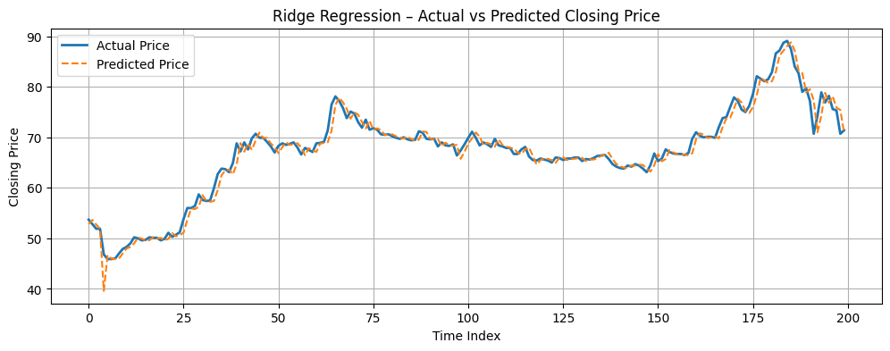
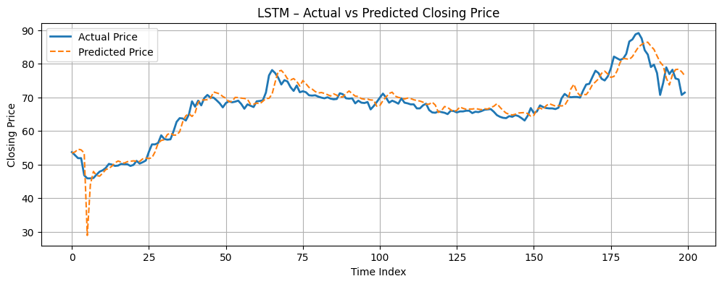
BRAC BANK
B.Sc. Final-Defense

Slide 20
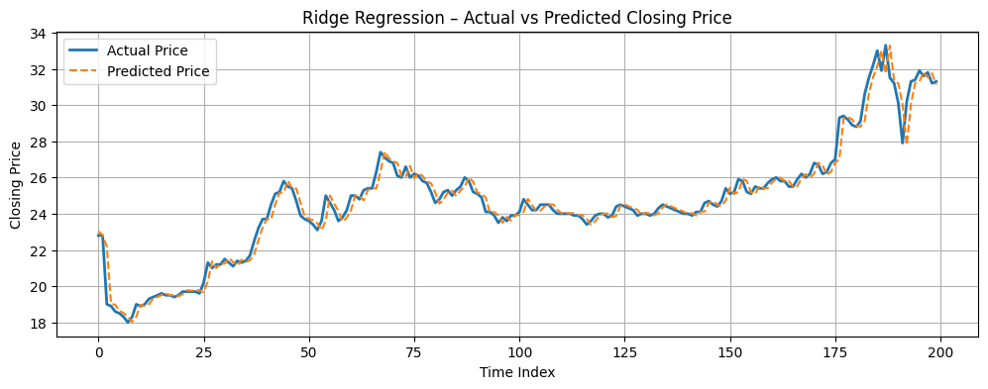
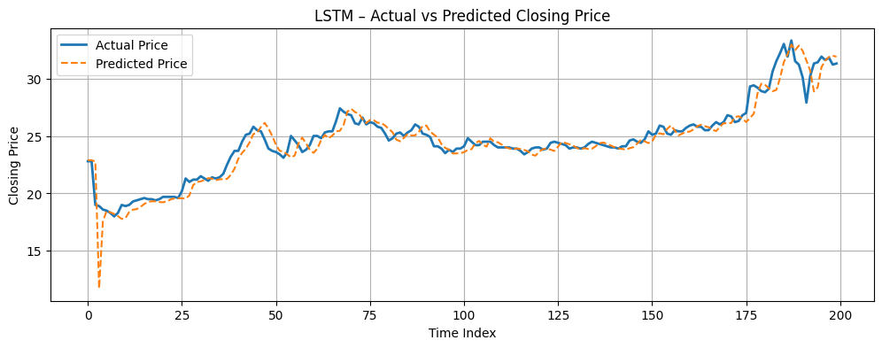
CITY BANK
B.Sc. Final-Defense

Slide 21
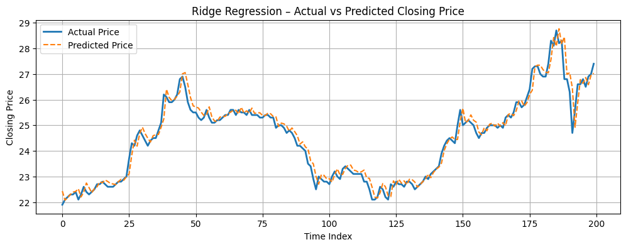
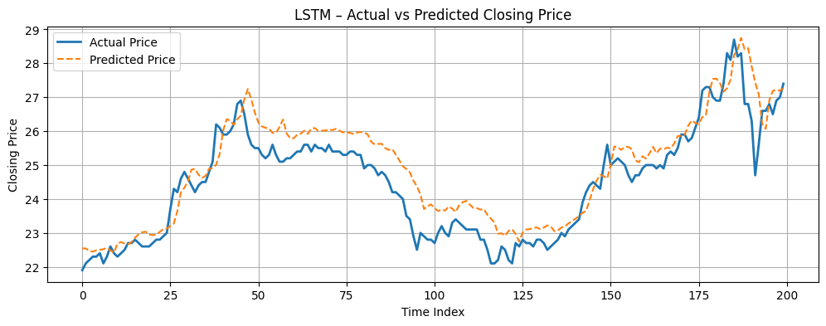
EASTERN BANK
B.Sc. Final-Defense

Slide 22
Novelty of the Work
Unified Pipeline Across Multiple Banks.
ML vs DL under feature-Engineered conditions.
Consistency-based Evaluation across datasets.
B.Sc. Final-Defense

Slide 23
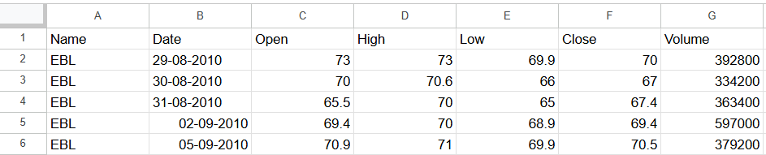
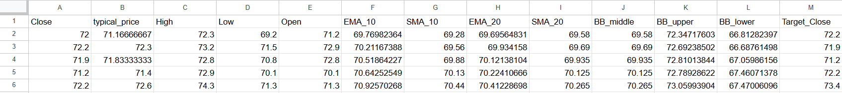
Sample dataset
Before Feature Engineering
After Feature Engineering
B.Sc. Final-Defense

Slide 24
Conclusion
The findings indicate that effective feature engineering can significantly improve prediction performance and reduce the dependency on complex deep learning architectures. Although deep learning models are capable of capturing temporal patterns, simpler machine learning models performed better under the engineered feature conditions used in this study.
Overall, this research highlights the importance of model consistency, fair comparative evaluation, and feature engineering in financial time-series forecasting. The proposed framework can serve as a useful reference for future research and decision-support applications in the banking and financial sectors.
B.Sc. Final-Defense

Slide 25
References
[1] S. Zaheer et al., “A multi-parameter forecasting for stock time series data using LSTM and deep learning model,” Mathematics, vol. 11, no. 3, p. 590, 2023.
[2] Z. Lin, “Comparative study of LSTM and transformer for A-share stock price prediction,” in Atlantis Highlights in Intelligent Systems, Dordrecht: Atlantis Press International BV, 2023, pp. 72–82.
[3] C. Fjellström, “Long short-term memory neural network for financial time series,” arXiv [q-fin.ST], 2022.
[4] H. Widiputra and E. Juwono, “Parallel multivariate deep learning models for timeseries prediction: A comparative analysis in Asian stock markets,” IAES Int. J. Artif. Intell. (IJ-AI), vol. 13, no. 1, p. 475, 2024.
[5] B. Pashshoev and D. A. Petrusevich, “Neural network analysis in time series forecasting,” Rossijskij tehnologičeskij žurnal, vol. 12, no. 4, pp. 106–116, 2024.
[6] G. Velarde, P. Brañez, A. Bueno, R. Heredia, and M. Lopez-Ledezma, “An open source and reproducible implementation of LSTM and GRU networks for time series forecasting,” in The 8th International Conference on Time Series and Forecasting, 2022, vol. 323, p. 30.
B.Sc. Final-Defense

Slide 26
References
[7] T. Shi and K. Shide, “A comparative analysis of LSTM, GRU, and Transformer models for construction cost prediction with multidimensional feature integration,” J. Asian Archit. Build. Eng., vol. 25, no. 1, pp. 634–649, 2026.
[8] M. A. B. Jeet, R. M. Haque, M. A. I. Sayem, A. Arman, and R. M. Rahman, “Using deep learning models and FinBERT to predict the stock price of top banks in the Dhaka stock exchange,” in 2024 IEEE/ACIS 24th International Conference on Computer and Information Science (ICIS), 2024, pp. 121–126.
[9] T. Muhammad et al., “Transformer-based deep learning model for stock price prediction: A case study on Bangladesh stock market,” arXiv [q-fin.ST], 2022.
[10] M. A. Islam, M. R. Sikder, S. M. Ishtiaq, and A. Sattar, “Stock market prediction of Bangladesh using multivariate long short-term memory with sentiment identification,” Int. J. Electr. Comput. Eng. (IJECE), vol. 13, no. 5, p. 5696, 2023.
[11] M. N. R. Khan, O. Al Tanim, M. S. Salsabil, S. M. R. Reza, K. M. Hasib, and M. S. Alam, “A multi-modal deep learning approach for predicting Dhaka stock exchange,” in 2023 IEEE 13th Annual Computing and Communication Workshop and Conference (CCWC), 2023, pp. 0879–0885.
[12] M. S. I. Yousuf, S. M. R. H. Nijhum, and M. I. Khan, “HybStock: A hybrid deep learning-based model to predict stock market on Dhaka stock exchange,” in 2024 6th International Conference on Electrical Engineering and Information & Communication Technology (ICEEICT), 2024.
B.Sc. Final-Defense

Slide 27
References
[13] M. Z. Islam, Gannon University, PA, USA. BBA- Accounting & Information Systems (AIS), United International University, MBA- Accounting & Information Systems (AIS), University of Dhaka, Dhaka, Bangladesh, M. M. H. Chowdhury, M. M. Sarker, Business Development Manager, UNICAP Securities Limited, Dhaka, Bangladesh. MBA-Northern University Bangladesh. BBS-Accounting, Government College of Commerce, Chattogram. Under the National University, Bangladesh, and Executive Commercial, Bengal Group of Industries, Dhaka, Bangladesh. MBA. BSSAccounting, University of Chittagong, Bangladesh. “The impact of big data analytics on stock price prediction in the Bangladesh stock market: A machine learning approach,” International Journal of Science and Business, vol. 28, no. 1, pp. 219– 228, 2023.
[14] S. Islam, M. S. Sikder, M. F. Hossain, and P. Chakraborty, “Predicting the daily closing price of selected shares on the Dhaka Stock Exchange using machine learning techniques,” SN Bus. Econ., vol. 1, no. 4, 2021.
[15] R. Parvin, “The relationship between Bangladesh’s financial development, exchange rates, and stock market capitalization: An empirical study using the NARDL model and machine learning,” Pertanika J. Sci. Technol., vol. 30, no. 4, pp. 2493–2508, 2022.
[16] M. N. R. Khan, S. M. R. Reza, O. Al Tanim, M. S. Salsabil, K. M. Hasib, and M. S. Alam, “A hybrid method based on machine learning to predict the stock prices in Bangladesh,” in 2022 IEEE 13th Annual Information Technology, Electronics and Mobile Communication Conference (IEMCON), 2022.
[17] A. I. Kabir, S. Vyas, S. Mitra, M. M. Uddin, and Jakowan, “Evaluating the machine learning-based momentum stock trading strategies with back-testing: An emerging market perspective,” in AIP Conference Proceedings, 2024, vol. 2919, p. 090001.
[18] A. Mahmud, “Unveiling the Drivers of Stock Prices and Volatility in the Banking Sector of Bangladesh: An Explainable Machine Learning Approach,” 2025, p. Vol 14, Issue 1 & 2.
B.Sc. Final-Defense

Slide 28
Drive Link
Drive link
B.Sc. Final-Defense

Slide 29
THANK YOU
B.Sc. Final-Defense

