Slide 1
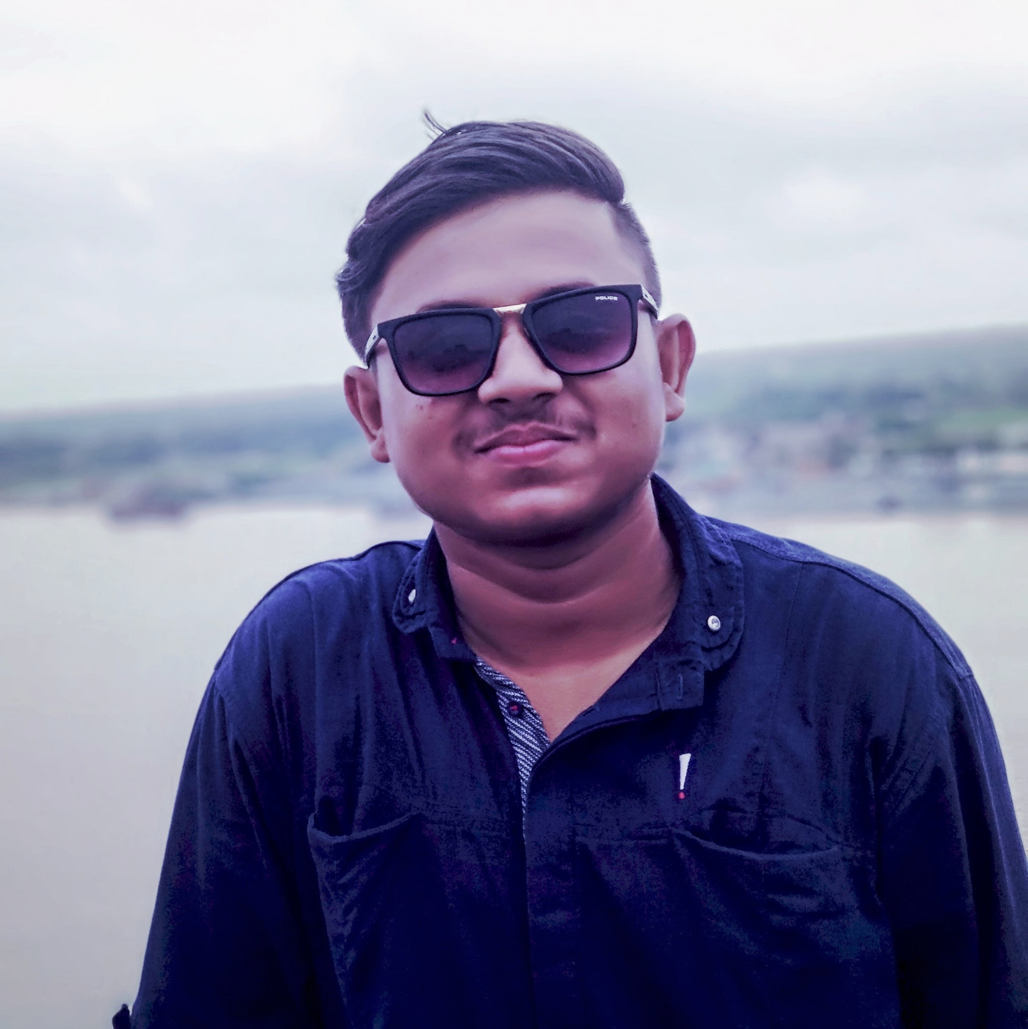

Hello!
I’m Arifur Rahman
Dhaka , Bangladesh
Welcome to my presentation resume!

Slide 2

Academic Qualification
Secondary school certificate:
School name : Banaripara Union Model Secondary School
Passing Year : 2018

Slide 3

Higher Secondary Certificate:
College Name: Gov’t Syed Hatem Ali College , Barisal
Passing Year : 2020

Slide 4

B.Sc. In computer science and Engineering:
University Name: Daffodil International University
Batch : 62

Slide 5
Personal Information
Date of Birth: 19 October , 2003
Blood Group: O+
Religion : Islam
Nationality : Bangladeshi

Slide 6
Hobbies & Interests

Slide 7
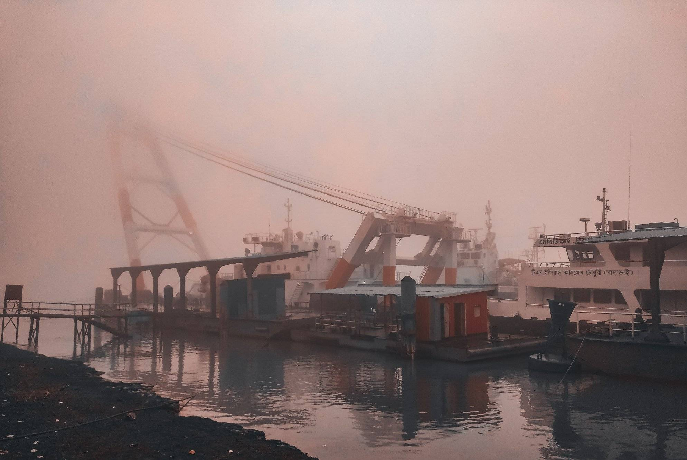
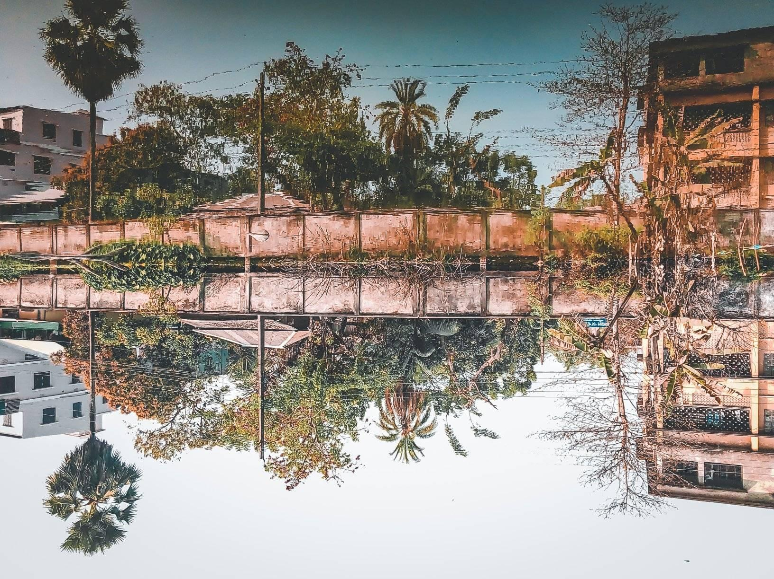

Photography

Slide 8


IT SKILLS
Microsoft Office
C language

Slide 9



Interested In:
JavaScript Language
Python Language
C++

Slide 10
Scopes in Future
Data scientist
Software tester
Web developer
System analyst
Business analyst
Product manager
Network architect
Software engineer
Full-stack Developer
Artificial intelligence and machine learning engineer
Engineering manager
User interface designer
Database administrator
Cloud computing engineer
Information security manager
Computer science professor
Chief information Security officer
Software quality assurance manager
Information technology specialist
Mobile application designer
Research and development scientist

Slide 11
Future Goals
Be an expert in cyber security
According to The US Bureau of Labor Statistics' Information Security Analyst's Outlook, cybersecurity jobs are among the fastest-growing career areas nationally.

Slide 12
That ladies and gentlemen, was what I wanted to share with you

