Slide 1
IFN 712 Research In IT ASWIN JAYARAMAN-COMPUTER SCIENCE
A Comparative Study of Railway Infrastructure Availability Calculation Methodologies Supervisor: Dr. Krishna Behara and Dennis Noble CLUSTER 3

Slide 2
Completed experiments and data collection work and data analysis work
Analysed QR dataset
Finding infrastructure availbility

Slide 3
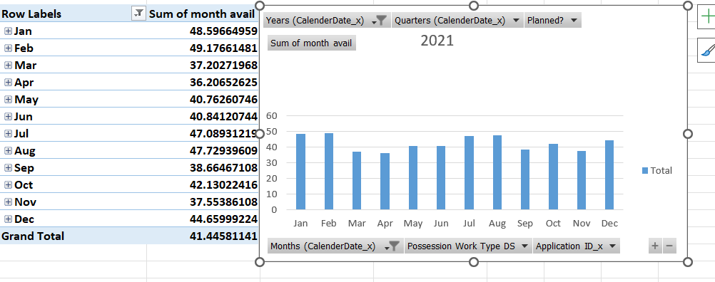
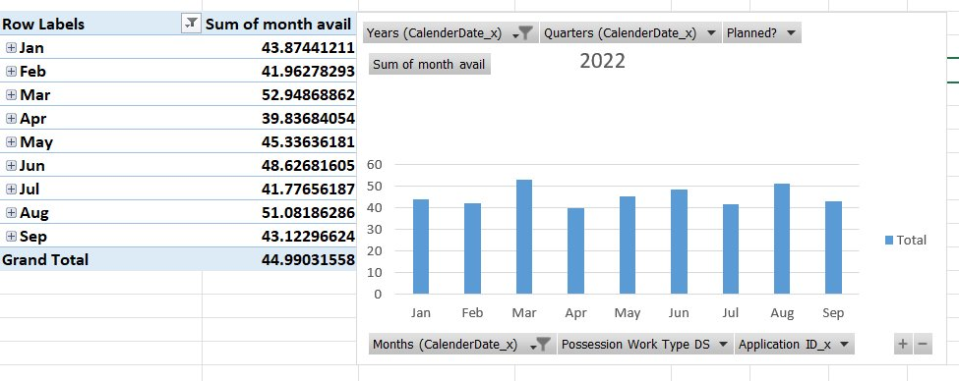
RESULTS – AVAILABILITY 2021- 2022

Slide 4
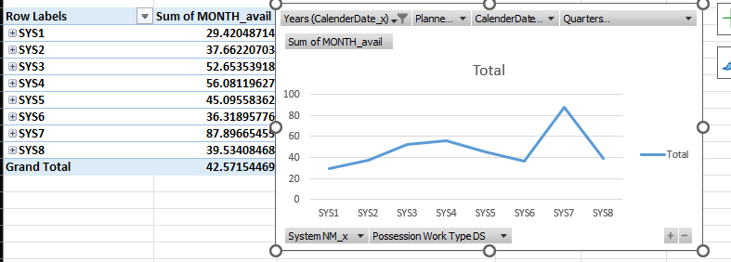
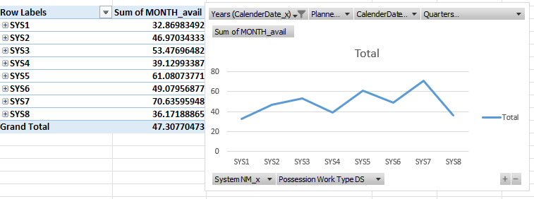
SYSTEM 2021-2022

Slide 5
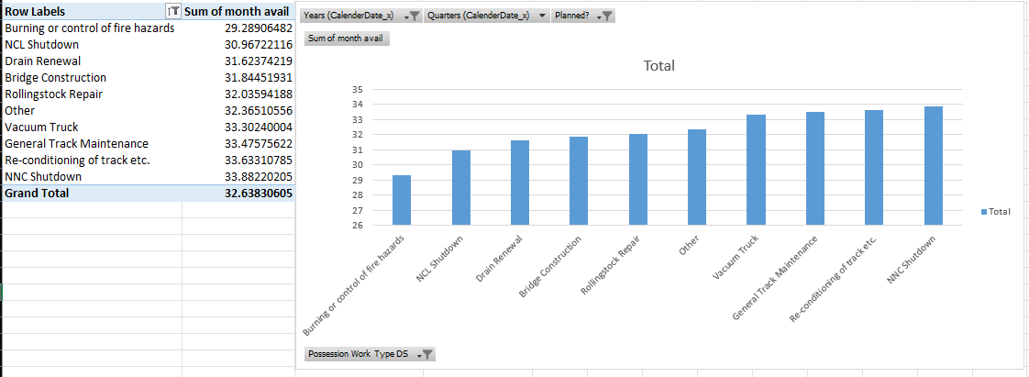
POSESSION TYPE CAUSING LOW AVAILABILITY

Slide 6
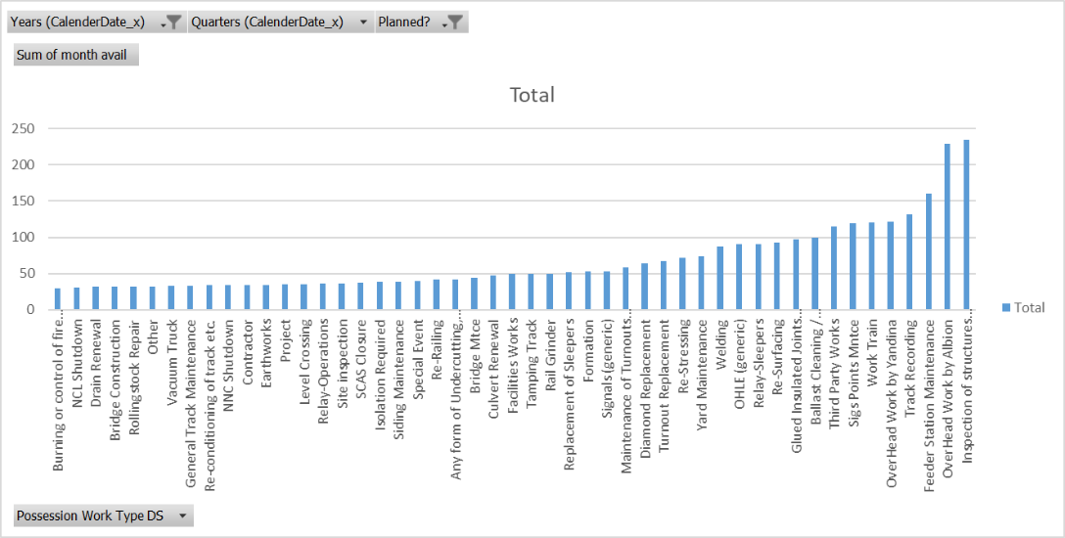

Slide 7
Main findings and relation to the revised research question
Factors Affecting Railway Availability:
Maintenance Work: Track repairs, bridge construction, rolling stock maintenance.
Operational Shutdowns: NCL/NNC shutdowns for safety or projects.
Infrastructure Failures: Drain renewal, reconditioning of tracks.
Safety Measures: Fire hazard control, vacuum truck use.
2021 Analysis:
Planned and reactive maintenance involve the same possession types, indicating:
Poor maintenance practices.
Possession types more prone to failure.
2022 Insights:
Similar issues with possession types, but overall improvement in maintenance and reliability.

Slide 8
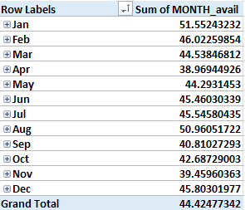
FINDINGS
FACTORS AFFECTING AVAILABILITY
Burning or Control of Fire Hazards
NCL Shutdown
Drain Renewal
Bridge Construction
Rolling Stock Repair
Vacuum Truck Use
General Track Maintenance
Reconditioning of Track
Shutdowns (e.g., NNC)
AVAILABILITY (2021 - 2022)
JAN & AUG has high availability
SYSTEM WISE AVAILABILITY
SYS 7 BEST PERFORMING
SYS 1 IS WORST PERFORMING

