Slide 1

IBM SkillsBuild Decoding Data PBL Program 2025
Final Project Presentation
Student Performance Analysis

Slide 2
Introduction & Objective
Overview of the Project:
Analyze students’ academic scores to derive meaningful performance insights.
Objective:
Identify patterns in student performance across gender, subjects, and test preparation status using data visualization and statistical analysis.

Slide 3
Problem Identification
Problem Statement:
There is limited visibility into academic performance gaps among students due to gender, preparation background, and socio-economic factors.
Significance of the Problem:
Understanding these gaps can help educational institutions take targeted actions to support underperforming groups.
Relevant SDGs:
SDG 4: Quality Education

Slide 4
Data Collection
Sources of Data:
Kaggle (Students Performance Dataset)
Data Description:
1000+ rows with fields such as gender, parental education, test prep status, and subject-wise scores.
Data Collection Methods:
Publicly available structured dataset from Kaggle.

Slide 5
Data Preprocessing
Data Cleaning Methods:
Removed duplicates, standardized labels (e.g., capitalized “female” to “Female”).
Handling Missing Values:
No missing values found.
Data Transformation Techniques:
Added average score column.
Renamed columns for clarity.

Slide 6
Data Analysis
Analytical Tools and Methods Used:
Microsoft Excel for cleaning and statistics.
Power BI for dashboard and interactive visuals.
Key Findings:
Females perform better in reading and writing.
Test preparation has a positive impact.
Insights Derived:
Students with better support and preparation tend to perform higher.

Slide 7
Hypothesis Development
Formulated Hypothesis:
Students who complete the test preparation course have higher average scores.
Rationale Behind the Hypothesis:
Exploratory analysis showed better scores among prepared students.
Method for Testing the Hypothesis:
Compare group averages using Excel and Power BI visualizations.

Slide 8
Solution Design
Proposed Solution:
Create interactive dashboards for educators to monitor student performance trends by gender, subject, and preparation.
Implementation Plan:
Clean data regularly.
Automate dashboard refresh.
Share reports with educators.
Alignment with SDGs:
Promotes SDG 4: Quality Education

Slide 9
Visualization
Prominent Features of the Dashboard:
Column charts for subject-wise performance.
Gender and Class filters using slicers.
Average, max, and min scores are displayed via card visuals.
Site Map:
Dashboard Home
Gender Insights
Subject Comparison
Slicer Filters

Slide 10
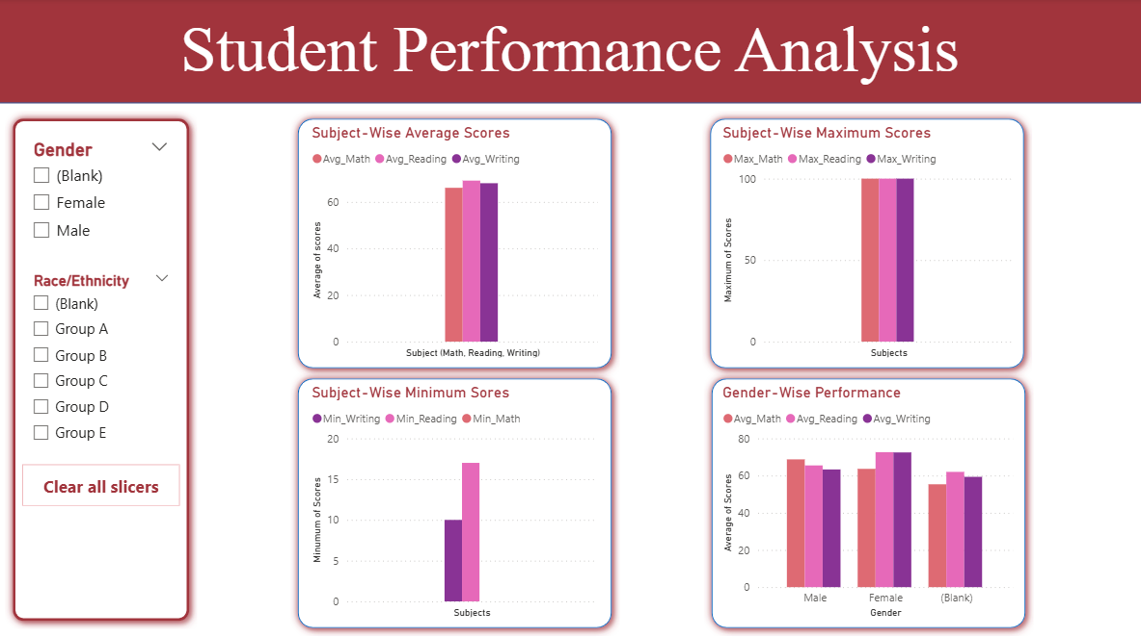
Conclusion
Screenshot of Dashboard:
Impact of Proposed Solution:
Helps educators identify struggling groups.
Promotes data-driven interventions.
Future Work:
Link live academic data systems.
Integrate predictive analytics.

Slide 11
References
Tools and Software Used:
Microsoft Excel
Microsoft Power BI
Additional References:
Kaggle Student Performance Dataset
UN Sustainable Development Goals (SDGs)
IBM SkillsBuild Program Materials

