Slide 1
PantryPal
DEVOPS COURSE · SESSION 21 CAPSTONE
A pantry expiry tracker taken through the whole DevOps lifecycle: code, tests, containers, CI/CD, security scanning, Terraform, Kubernetes and monitoring.
github.com/ARRY7686/pantrypal
FastAPI · React · PostgreSQL · Docker · GitHub Actions · Trivy · Terraform · Helm · Prometheus · Grafana
Notes:
PantryPal is my own standalone project for the capstone. Everything in this deck is in the public repository, with terminal and browser screenshots for every module.

Slide 2
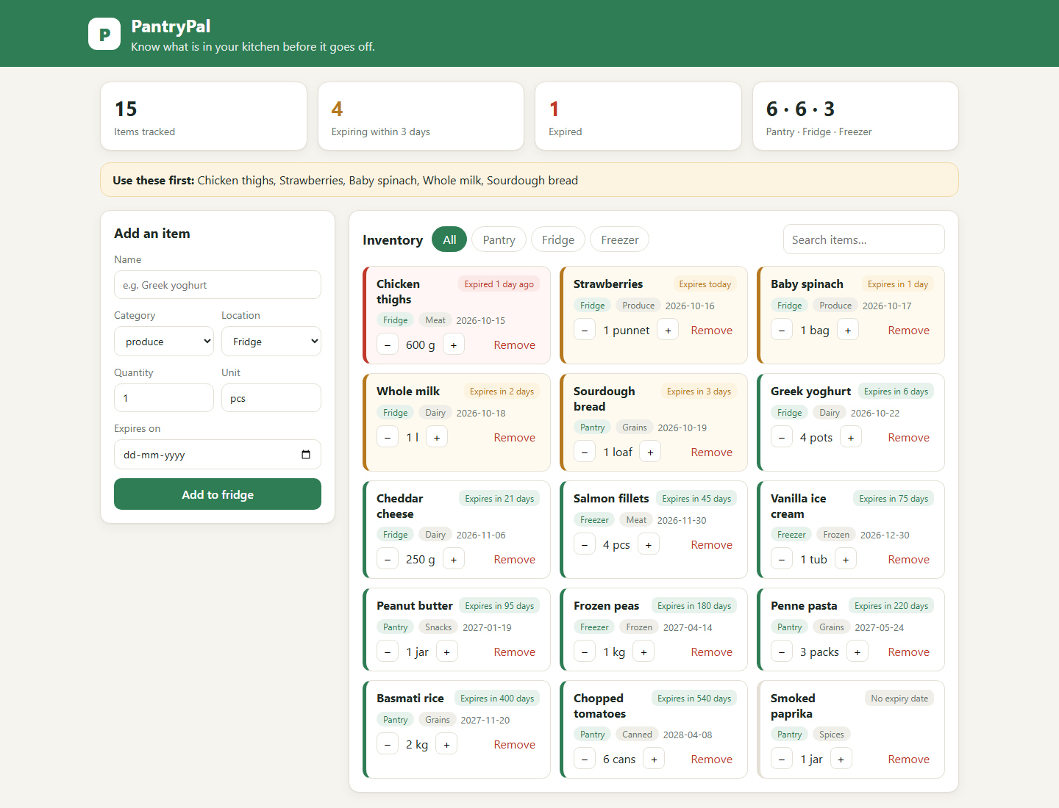
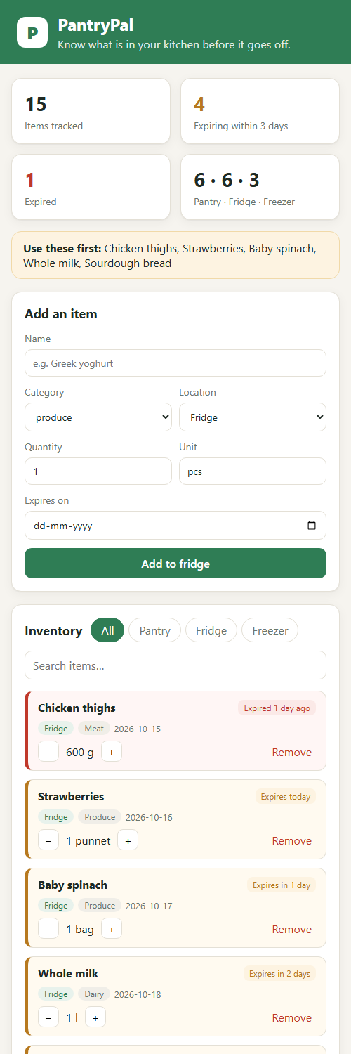
What PantryPal does
01 · THE APPLICATION
Know what’s in your kitchen before it expires.
Add items with quantity and expiry date
Filter by pantry, fridge or freezer; search by name
Use items up with +/− buttons
Expiring-soon and expired warnings
Out-of-stock badge and per-location counts
PantryPal · DevOps capstone
2
Notes:
The domain is my own: a kitchen inventory that warns before food expires. The screenshots are the real app running under Docker Compose, on desktop and at phone width. The layout is responsive.

Slide 3






How the pieces fit
02 · ARCHITECTURE
minikube cluster · namespace pantrypal · one Helm release
frontend ×2
Grafana
nginx-unprivileged · route /
PantryPal API dashboard
Browser
Ingress
backend ×2
Prometheus
React SPA, desktop + mobile
ingress-nginx · pantrypal.local
FastAPI + Alembic · route /api
ServiceMonitor scrapes /metrics
PostgreSQL 16
StatefulSet + PVC
PantryPal · DevOps capstone
3
Notes:
Traffic enters through ingress-nginx on host pantrypal.local: slash goes to the React frontend, slash api goes to the FastAPI backend. Both run two replicas behind ClusterIP Services. PostgreSQL runs as a StatefulSet with a persistent volume. Prometheus scrapes the backend’s metrics endpoint through a ServiceMonitor, and Grafana reads from Prometheus. The whole application is one Helm chart.

Slide 4
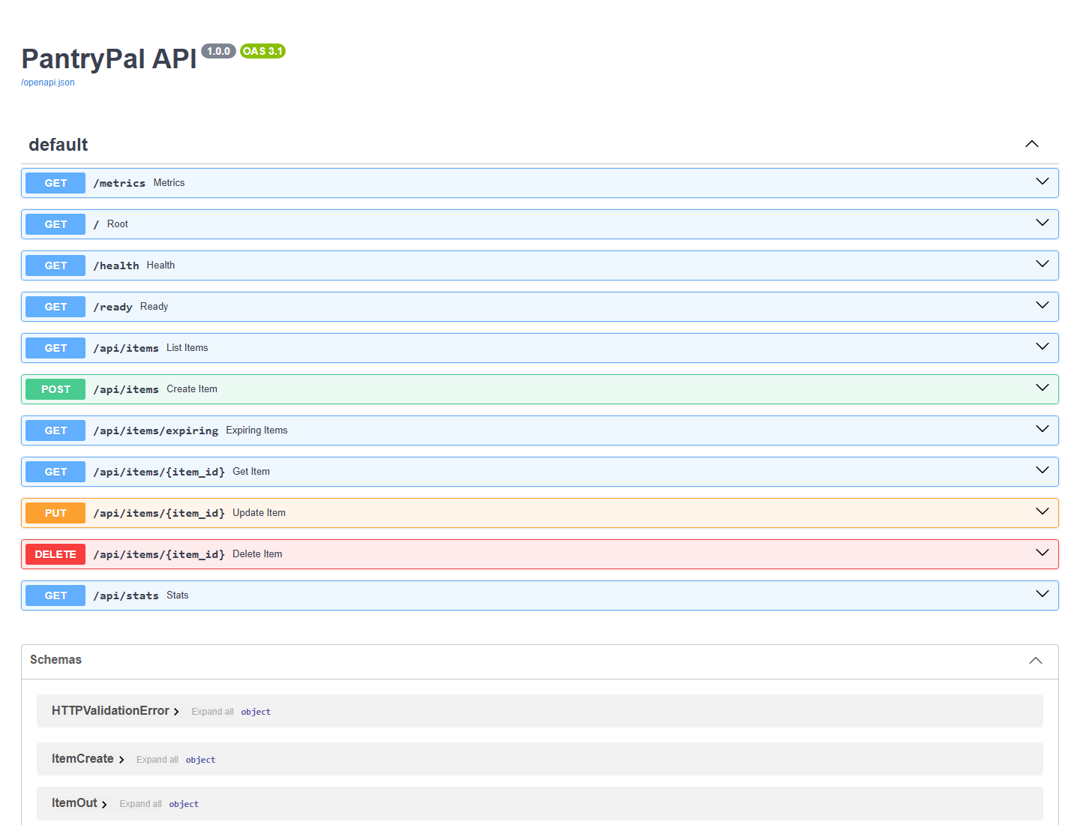
FastAPI, PostgreSQL and Alembic
03 · BACKEND API
Method | Path | Purpose
GET | /health | Liveness probe
GET | /ready | Readiness: database reachable
GET | /metrics | Prometheus metrics
GET, POST | /api/items | List (?location, ?q), create
GET, PUT, DELETE | /api/items/{id} | Read, update, delete
GET | /api/items/expiring | Expiring soon and expired
GET | /api/stats | Counts per location
Schema: one items table, created by Alembic migration 0001. Migrations take a PostgreSQL advisory lock, so two backend replicas starting together never race.
PantryPal · DevOps capstone
4
Notes:
Full CRUD on items plus filtering by location and a name search, an expiring endpoint and a stats endpoint. Health and readiness are separate: readiness checks the database, which is what the Kubernetes readiness probe uses. The right side is the auto-generated Swagger page.

Slide 5
Tests gate every build
04 · TESTING
12
99%
0
pytest tests passed, covering every endpoint
line coverage of the backend
ruff lint and format findings
Each test runs against its own SQLite database from a conftest.py fixture, so tests never touch PostgreSQL or each other. In CI the pytest step comes first: if it fails, no image is built.
PantryPal · DevOps capstone
5
Notes:
Twelve tests cover create, read, update, delete, the location filter and search, the expiring list, stats, validation errors and the health endpoints. Coverage is 99 percent. The test database is isolated per test with a fixture, and pytest.ini holds the settings.

Slide 6
Non-root images, health-gated startup
05 · DOCKER
backend
frontend
postgres
python:3.12-slim
node:22 → nginx
postgres:16-alpine
Two stages: dependencies built apart, copied in
Runs as uid 10001
Runs Alembic migrations, then uvicorn on :8000
HEALTHCHECK on /health
Node stage builds the Vite bundle
nginx-unprivileged serves it as uid 101 on :8080
Backend address set by BACKEND_URL at start-up
Named volume keeps the data
pg_isready healthcheck
Compose starts each service only after the one before it is healthy
PantryPal · DevOps capstone
6
Notes:
docker compose up --build brings the whole stack up. Startup is health-gated: postgres must be healthy before the backend runs its migrations, and the backend must be healthy before the frontend starts. Both app images are multi-stage and run as non-root users.

Slide 7


One GitHub Actions workflow, push to deploy
06 · CI/CD
Lint + test
ruff, then pytest; a failure stops the run
Build images
Trivy scan
Push to GHCR
Helm deploy
backend and frontend, tagged with the commit SHA
fails on fixable HIGH or CRITICAL CVEs
on main only; public packages
helm upgrade to the new SHA, once a cluster is connected
Frontend build
npm ci and Vite production build
Images are never tagged latest: every tag is a commit SHA, so each deployment traces back to one commit. The workflow was also run locally with act before the first push.
PantryPal · DevOps capstone
7
Notes:
The tests and the frontend build run in parallel. The image job is a matrix over backend and frontend: build, scan with Trivy, push to GitHub Container Registry. The deploy job is gated on a repository variable and a kubeconfig secret; with no real cluster connected it is skipped, which is why its box is dashed.

Slide 8
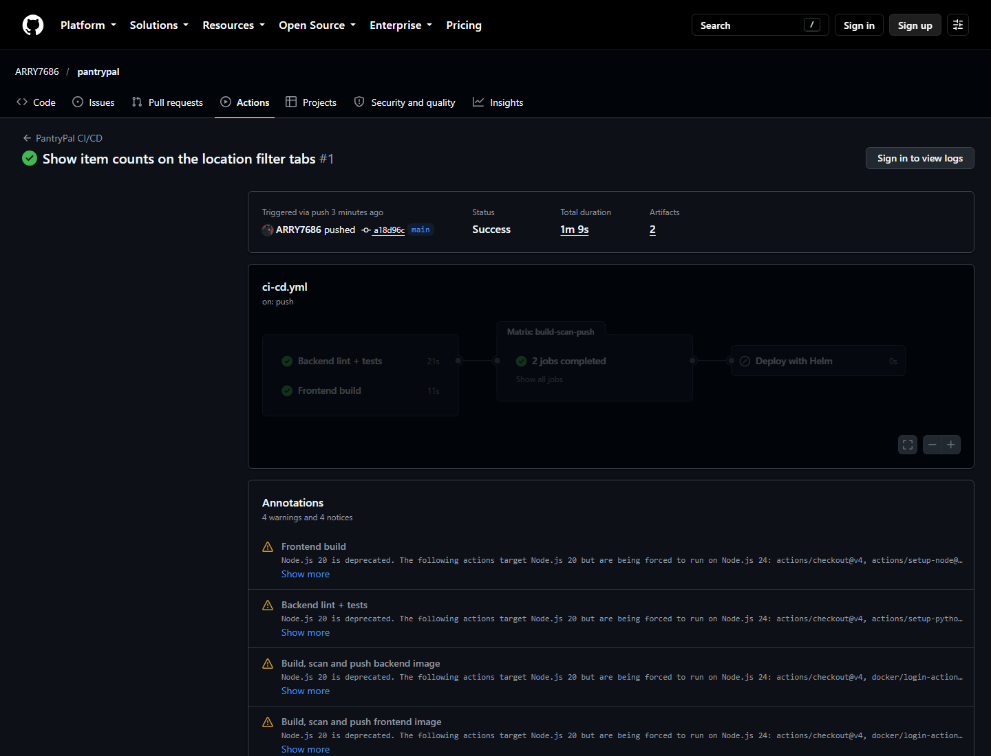
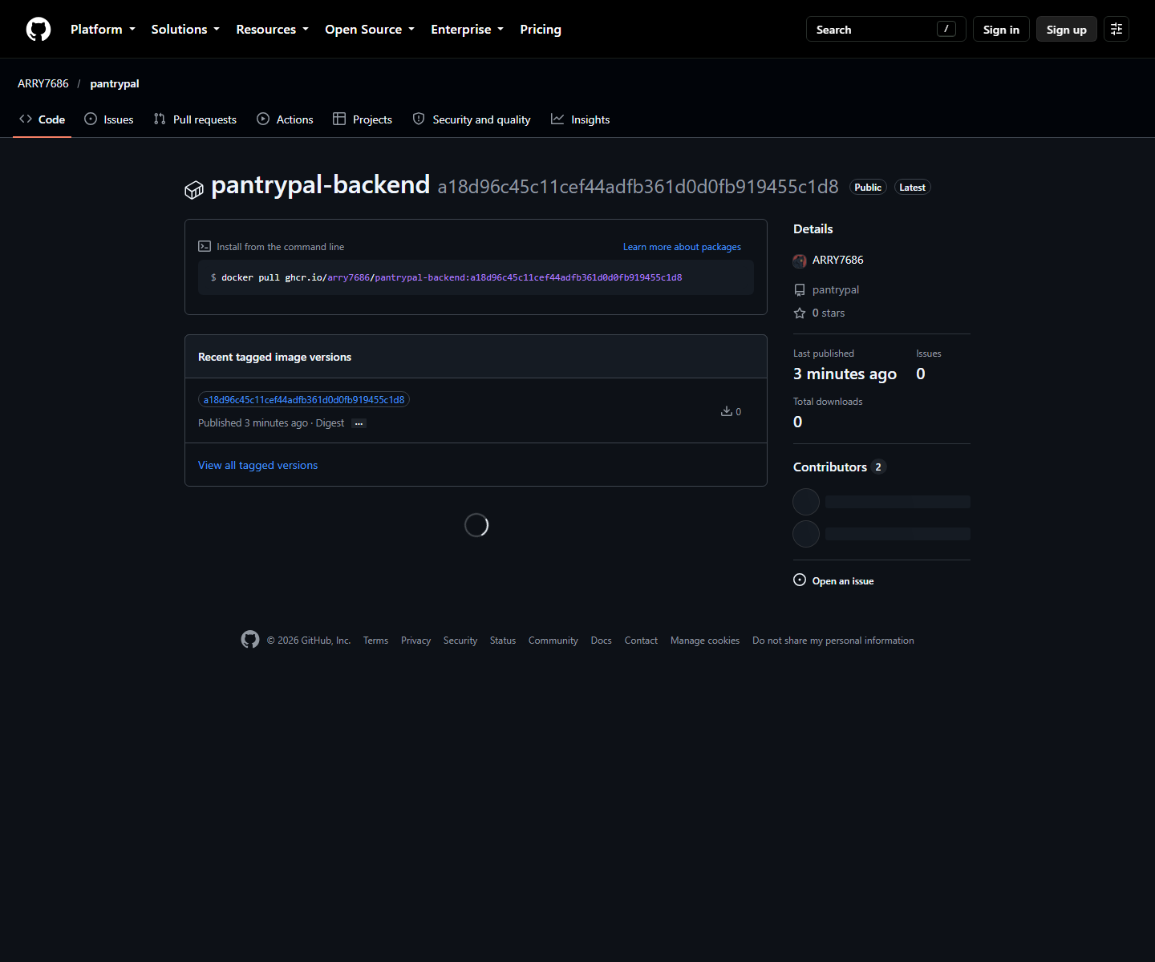
Green on GitHub, images on GHCR
06 · CI/CD
Actions run: tests, frontend build, both image builds, Trivy scans and pushes succeeded; deploy skipped
GHCR: ghcr.io/arry7686/pantrypal-backend and -frontend, tagged with the full commit SHA
PantryPal · DevOps capstone
8
Notes:
These are the real runs on GitHub. Every push to main has been green. The packages are public, so anyone can pull the images by SHA.

Slide 9
Trivy failed the first build, and it was right
07 · DEVSECOPS
3 HIGH CVEs
Upgrade
0 fixable
found in starlette 0.46.2, pulled in by FastAPI 0.115
FastAPI 0.143.2 with Starlette 1.8.0; tests still green
HIGH or CRITICAL findings left in either image; the gate passes
The gate uses --severity HIGH,CRITICAL --ignore-unfixed --exit-code 1. CVEs in the Debian base with no released fix are still reported but do not block, since there is nothing to upgrade to yet.
PantryPal · DevOps capstone
9
Notes:
This is the DevSecOps story. Trivy scans every OS package and every Python package in both images. The very first scan of the backend failed the pipeline on three HIGH vulnerabilities in Starlette. I upgraded FastAPI, which pulled in a fixed Starlette, re-ran the tests, and the scan went clean. The base image still lists 44 HIGH CVEs with no fix released; ignore-unfixed keeps those out of the gate, and they go away when the base image is rebuilt after Debian ships fixes.

Slide 10
AWS VPC and EKS as code
08 · TERRAFORM
52
52
52
to add in terraform plan
added by terraform apply
removed by terraform destroy
VPC 10.30.0.0/16: 2 public + 2 private subnets, NAT gateway
EKS 1.31 cluster pantrypal-dev-eks in ap-south-1
Managed node group: t3.medium, min 1, desired 2, max 3
There was no AWS account, so apply and destroy ran on Moto, a local AWS emulator. Only environment variables differ: with real credentials the same commands build the real cluster.
PantryPal · DevOps capstone
10
Notes:
The configuration uses the community VPC module 5.8.1 and EKS module 20.37.1. terraform fmt, init and validate pass. Plan, apply and destroy each touched the same 52 resources, including IAM roles and a KMS key, and the state was empty afterwards. A terraform.tfvars.example documents the inputs. The rubric’s AWS Console screenshot needs a real account, which I did not have.

Slide 11
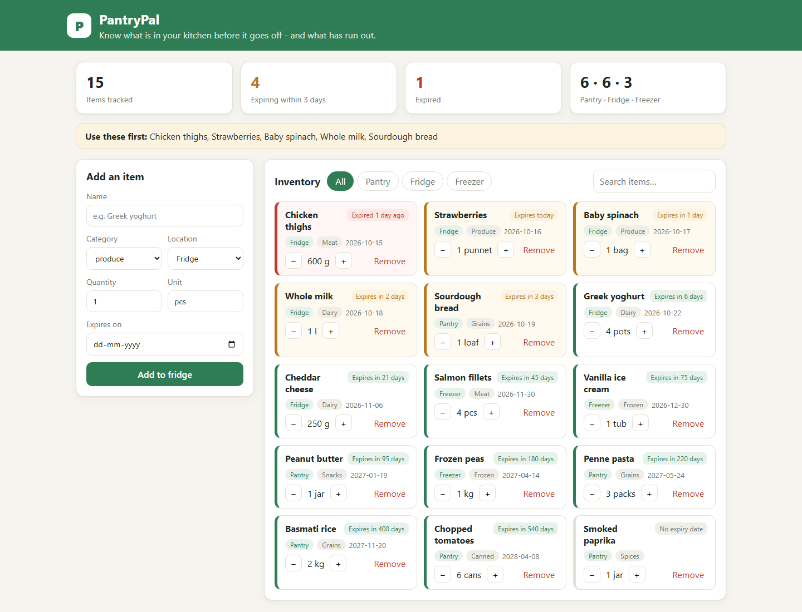
One Helm chart runs the whole app
09 · KUBERNETES + HELM
Namespace pantrypal from k8s/namespace.yaml
backend ×2 and frontend ×2 behind ClusterIP Services
PostgreSQL StatefulSet with a persistent volume
Ingress pantrypal.local: / to the frontend, /api to the backend
Readiness on /ready, liveness on /health
Read-only root filesystem, all Linux capabilities dropped
On minikube: STATUS deployed, all 5 pods Running, app served through the Ingress.
PantryPal · DevOps capstone
11
Notes:
helm upgrade --install with values-local.yaml on minikube with the ingress-nginx addon. An init container waits for PostgreSQL with pg_isready before the backend starts. While testing I found the init container never saw the database as ready, because the pod runs as a uid with no user name; passing the user explicitly fixed it. An optional HPA is in the chart, off by default.

Slide 12
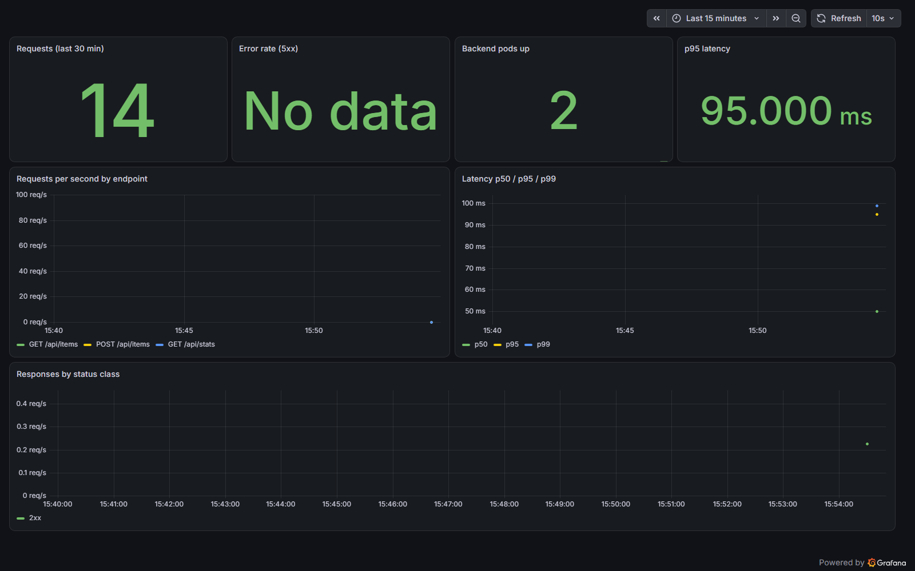
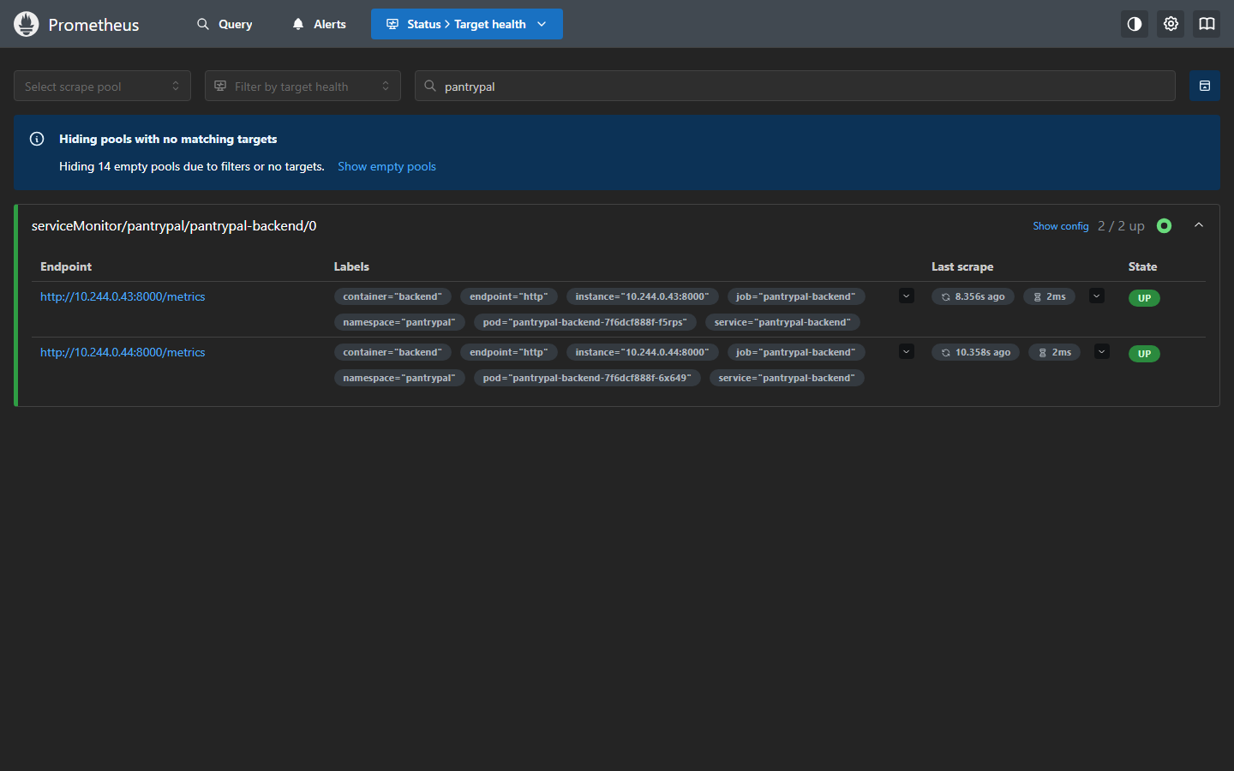
Prometheus scrapes it, Grafana shows it
10 · OBSERVABILITY
Prometheus: both backend pods up, found through a ServiceMonitor; the backend exposes /metrics.
Grafana: dashboard shipped by the chart. Requests per endpoint, 2 pods up, p95 latency about 95 ms.
PantryPal · DevOps capstone
12
Notes:
kube-prometheus-stack is installed from monitoring/kube-prometheus-stack-values.yaml. The PantryPal chart ships a ServiceMonitor and the dashboard as a ConfigMap, so monitoring comes with the app. After a load loop, PromQL sum by handler of http_requests_total showed live counts per endpoint. The 5xx panel reads No data because no request failed.

Slide 13
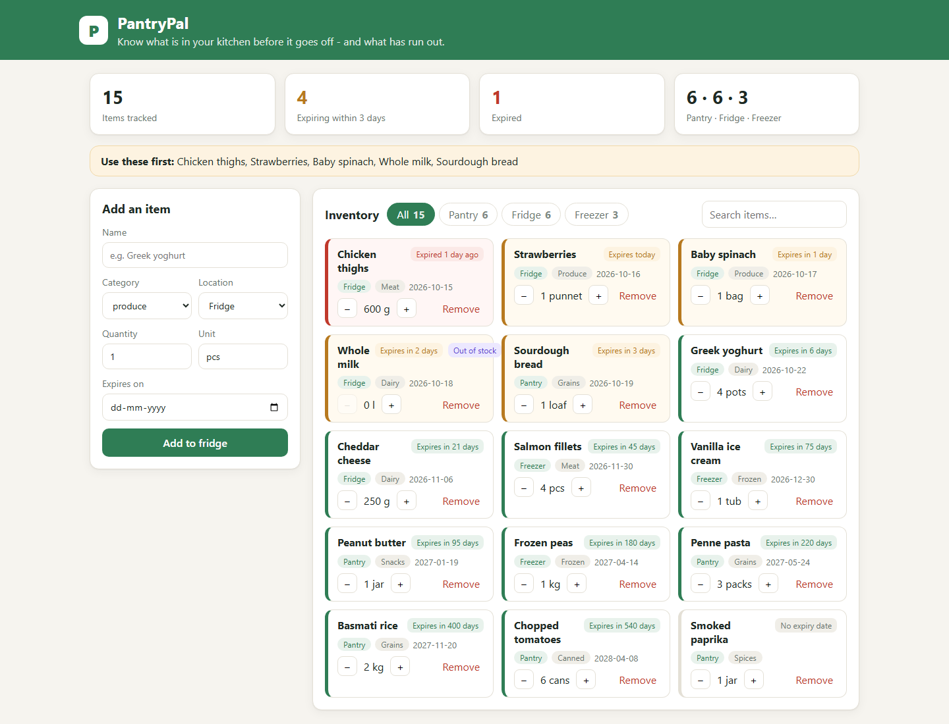
From commit to running pods
11 · DEMO
1
Commit a change
“Show item counts on the location filter tabs”, pushed to main
2
Pipeline runs
Tests pass, both images build clean under Trivy and land on GHCR as tag a18d96c
3
Deployment updates
helm upgrade to tag a18d96c gives Helm revision 2; the browser shows the new tab counts
PantryPal · DevOps capstone
13
Notes:
The tabs now read All 15, Pantry 6, Fridge 6, Freezer 3. Pods after the upgrade run the images tagged with the commit SHA. The commit’s SHA in the current history is 862cf45; the image tag a18d96c is the SHA it had when the pipeline ran, and the README maps the two. On a real cluster the deploy job does step 3 automatically once DEPLOY_ENABLED and KUBE_CONFIG are set.

Slide 14
All ten modules, with evidence
SUMMARY
Module | What was built | Result
M1 Application | React + FastAPI + PostgreSQL, Alembic migration | Runs with docker compose up
M2 Testing | 12 pytest tests on an isolated SQLite DB | 12 passed, 99% coverage
M3 Git | Public repo, 19 commits, .gitignore | gitleaks: no leaks
M4 Docker | Multi-stage, non-root; health-gated compose | All 3 services healthy
M5 CI/CD | Actions: tests → build → Trivy → GHCR | Green runs, images tagged by SHA
M6 DevSecOps | Trivy gate on both images | 3 HIGH CVEs caught and fixed
M7 Terraform | VPC + EKS 1.31 + managed node group | Plan, apply, destroy: 52 each
M8 Kubernetes | Namespace, Helm chart, 2+2 replicas, Ingress | All pods Running on minikube
M9 Observability | /metrics, Prometheus, Grafana dashboard | Targets up, panels live
M10 Docs + demo | README with evidence; commit-to-deploy demo | Helm revision 2 on the new SHA
PantryPal · DevOps capstone
14
Notes:
Each row has terminal output and screenshots in the repository under docs, and the README has the same table with links to each file.

Slide 15
What is not proven yet, and what comes next
HONEST LIMITS
Limits
Next steps
Terraform ran on the Moto emulator, so there is no AWS Console screenshot
The deploy job is skipped: no real cluster is connected to GitHub
Actions warns that some actions still use the Node 20 runtime
Apply the same Terraform to a real AWS account
Set DEPLOY_ENABLED and KUBE_CONFIG so every push deploys
Turn on the HPA and add Prometheus alert rules
PantryPal · DevOps capstone
15
Notes:
Everything that needs paid cloud resources was run against local stand-ins, and the deck says so. The code and pipeline are already wired for the real thing: credentials and a kubeconfig secret are all that is missing.

Slide 16
Thank you
Code, screenshots and terminal output for every module:
github.com/ARRY7686/pantrypal
Notes:
Questions welcome. The README has a rubric table that links each module to its evidence.

