Slide 1




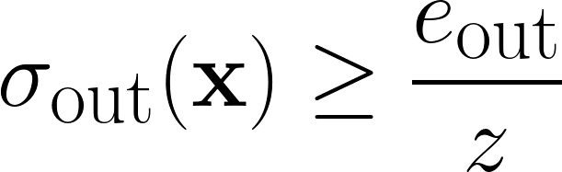
Distributed Multi-Robot Ergodic
Coverage Control for Estimating Time-Varying Spatial Processes
University of Modena and Reggio Emilia
Department of Sciences and
Methods for Engineering
mattia.mantovani@unimore.it
Connect!
Paper!
01–06 June, 2026
Mattia Mantovani, Mattia Catellani and Lorenzo Sabattini
What’s happening here?
What’s happening here?
Cool results
What’s happening here?
What’s happening here?
What’s happening here?
Multi-robot systems are increasingly deployed in tasks where they must not only cover large complex environments but also estimate spatial processes evolving over time. These scenarios are particularly challenging because the underlying fields are unknown and time-varying, requiring robots to constantly balance between exploring new regions and covering key areas.
Key contributions are:
A fully distributed ergodic coverage framework for multi-robot exploration and adaptive monitoring of unknown, time-varying spatial processes.
A novel ergodic metric based on a dynamic goal density function that accounts for both exploration and coverage of key areas in the environment.
A temporal decay mechanism for continuous adaptation to evolving spatial phenomena.
What’s happening here?
What’s happening here?
Bla Bla
Things here
What’s happening here?
What’s happening here?

