Slide 1
Front End Engineering-I Project
Team Details:
Project Group No. : PG-14
Arshdeep Singh (2310990129)
Arpit Uppal (2310990128)
Arpan (2310990127)
Arshita (2310990130)
Faculty Coordinator:
DR. AMANDEEP KAUR
:
Chitkara University Institute of Engineering and Technology,
Chitkara University, Punjab

Slide 2
Table of Contents
Introduction
Problem Statement
Technical Details
Key Features
Project Highlights
Bonus Feature(optional)
Conclusion
References/Links used

Slide 3
Introduction
SEO-FRIENDLY WEBSITE
This project could not have been successfully completed without the combined efforts of the respective team members : Arshdeep Singh, Arpan, Arpit Uppal and Arshita .
The project titled “SEO-Friendly website“ is about SEO (Search Engine Optimization ) and SERPs (Search Engine Results Page) which enhances the productivity and organic network traffic over websites
Theoretically, Any website may become SEO friendly ! Thus we had a wide range of ideas to choose from, which lead to the creation of our very own grocery website “The Groco”

Slide 4
Problem Statement
About 10,000+ new E-commerce websites are created every year in India alone. Yet all of them fade away in dust. Big bulls like Flipkart and Amazon have dominated the Indian e-commerce search. So what is wrong with other E-commerce sites?

Slide 5
Technical Details
The project uses HTML (version: HTML 5) ,
CSS (version: CSS 3) and minor
JAVASCRIPT (version: ES13)
The project uses GOOGLE CHROME(version:116.0.5845.188) as the default browser and reference browser
The code editor used during the creation of the project is VS Code (version: 1.78)
The project also uses Google fonts (Poppins)
and swiper.com official site (swiper effect)

Slide 6
Key Features
To tackle this problem we need :
Foremost , An E-commerce website
Unique ids which separate each individual element
The appropriate usage of keywords to emphasize the element for easier SEO
The usage of appropriate meta tags
To make the website mobile friendly as well
Use of proper head , title and meta description tags
Use of keyword-rich anchor text in your links

Slide 7
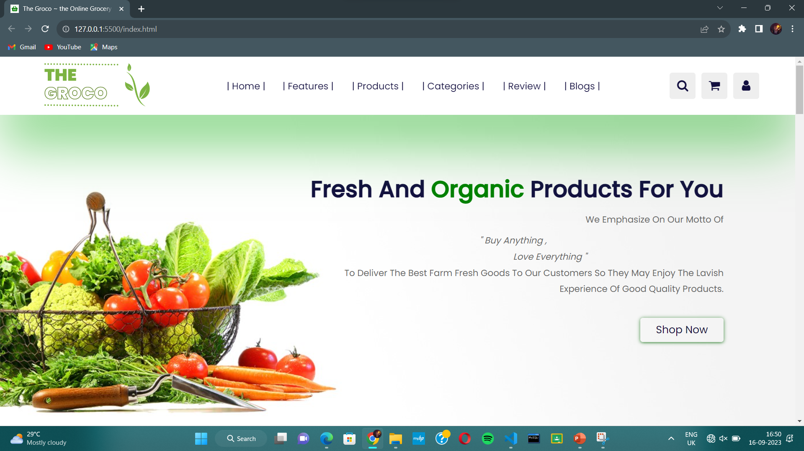
Project Highlights
The Home Page : this is the title page of our project

Slide 8
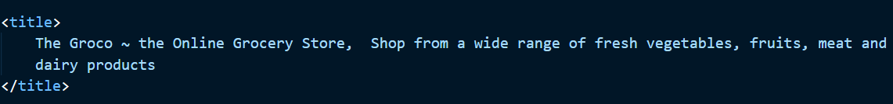
Notice the use of Keywords in description tags , and title

Slide 9
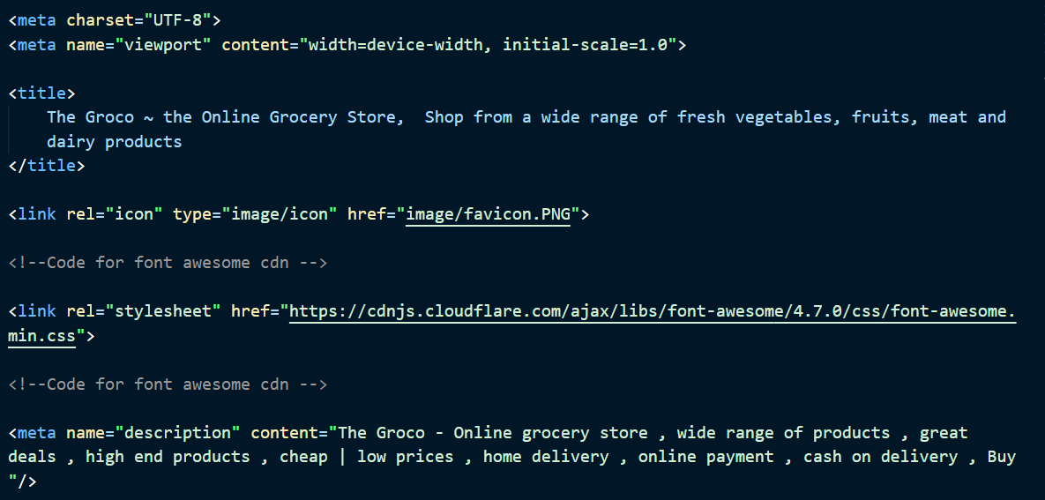
Meta tags : a few meta tags that were used

Slide 10
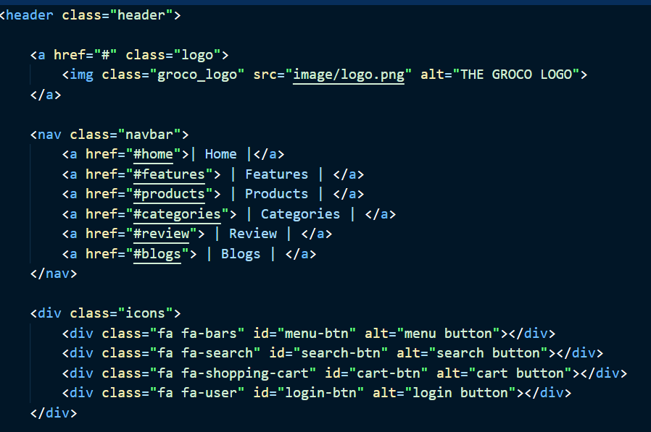
This is the ﻿ part of the home tag html code it symolises the basic structure of the header Notice the use of class , alt and id attributes

Slide 11
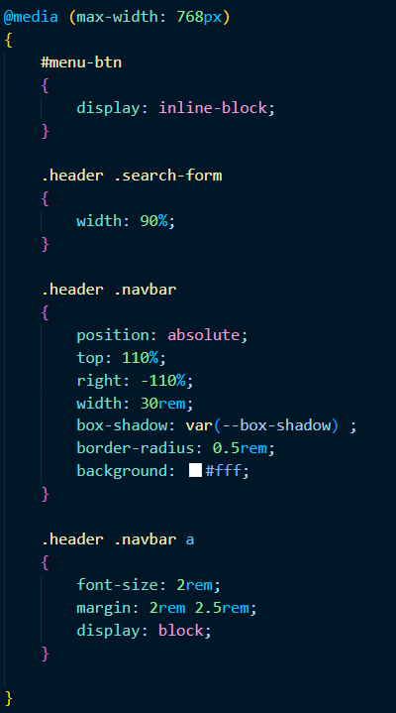
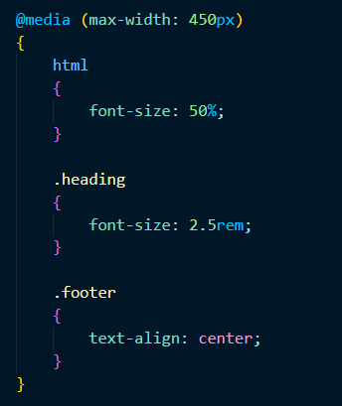
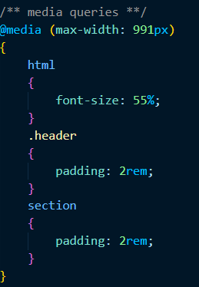
Media queries were used to make the website more mobile friendly and responsive

Slide 12

Bonus Feature(optional)
The project contains all the navigation all on the same page only, which makes the site much more user friendly. Also you may click the header text to navigate as well
Furthermore we have installed a sliding effect in our product and our reviews section which slides after approx. 7.5s
We have added our own icon next to the title

Slide 13
Conclusion
This Project has been an eyeopener to all the respective members about the world of front-end engineering, e-commerce, and teamwork.
The insight illuminated about the struggle experienced by small e-commerce websites and the importance of a fully devoted workforce

Slide 14
References/Links used
https://fonts.google.com/
https://supersimple.dev/
https://swiperjs.com/
https://www.canva.com/create/logos/
https://www.fontawesome.com/

Slide 15


