Slide 1

ARSW Project
Juan Sebastián Frásica
Yeisson Gualdrón
Carlos Gómez

Slide 2
Draw It…
Aca toca poner algo
Aca igual

Slide 3
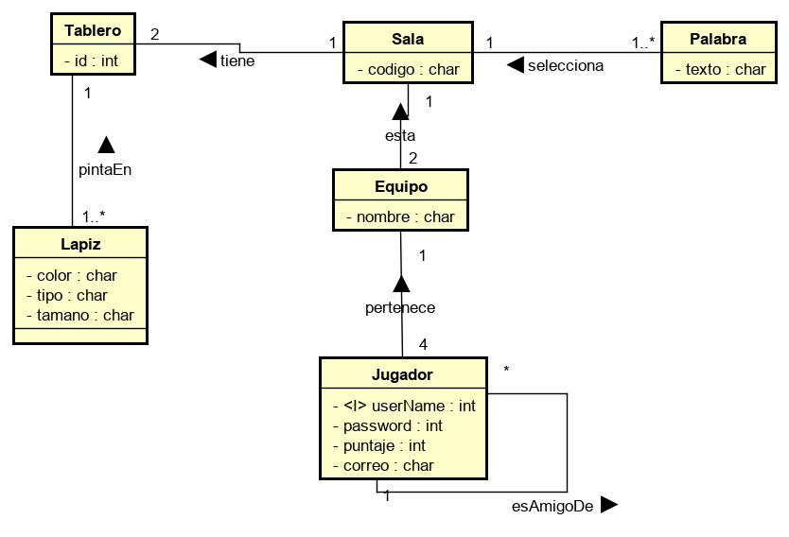
Diagrama E-R

Slide 4
Diagrama de clases

Slide 5
Diagrama de casos de uso

Slide 6
Diagrama de clases
Here you have a list of items
And some text
But remember not to overload your slides with content
Your audience will listen to you or read the content, but won’t do both.

Slide 7
Diagrama de casos de uso
Here you have a list of items
And some text
But remember not to overload your slides with content
Your audience will listen to you or read the content, but won’t do both.

Slide 8


Slide 9
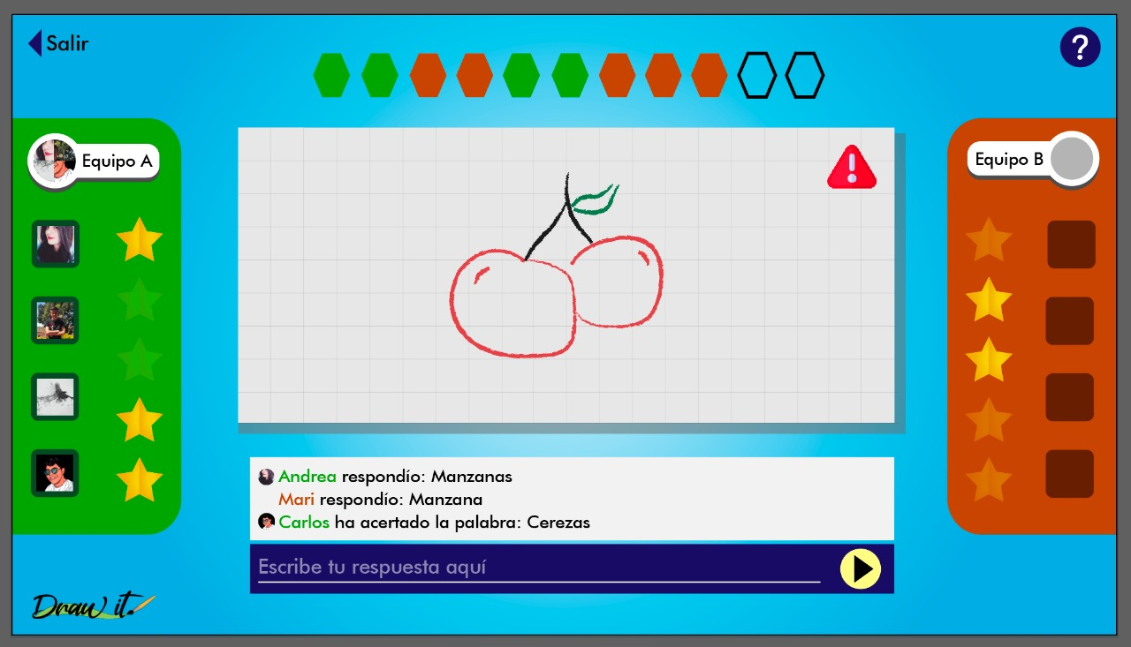

Slide 10
Gracias!

